Slide 1
Design and Implementation of Adhesive Character based CAPTCHA with tiled characters
Jinwoo Lee, Pil Joong Lee
Electronic department, POSTECH

Slide 2
Index
Introduction
Related Work
Main research
Conclusion

Slide 3
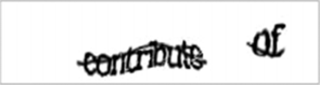
CAPTCHA
CAPTCHA?:
CAPTCHA (Completely Automated Public Turing test to tell Computers and Humans Apart) *
Mainly used to prevent automated software attack to internet websites
Mainly text-based CAPTCHA, which uses hard-to-read characters that human can read but computer cannot read automatically
* Carnegie Mellon University, “The Official CAPTCHA Site,” http://www.captcha.net/

Slide 4
Index
Introduction
Related Work
Main research
Conclusion

Slide 5
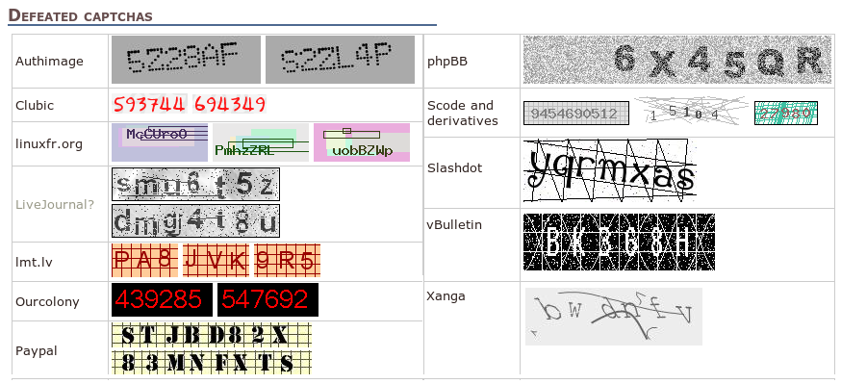
Related Work (1/2)
Improvements on Anti CAPTCHA:
Improvements of OCR technology
CAPTCHA frowning tools:
ex) PWNtcha*
Need to implement new hard CAPTCHA
* S. Hocevar, PWNtcha: Pretend we’re not a Turing computer but a human antagonist, http://sam. zoy. org/wiki/PWNtcha, 2004

Slide 6

Related Work (2/2)
Recent CAPTCHAs are hard to read *:
To prevent attacks:
concave, convex
collision, adhesive
is widely being used
Example of concave, convex:
Example of collision, adhesive:
These are hard to read
Concave, convex texts are hard to read. If the CAPTCHA does not use these, it is more convenient for human users
* Ann Smarty, Impossible CAPTCHA: It Doesn’t Really Matter if You are Human or Not, May, 2009, seosmarty

Slide 7
Index
Introduction
Related Work
Main research
Conclusion

Slide 8
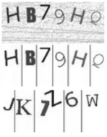
Previous CAPTCHAs and Technologies (1/3)
Early text-based CAPTCHAs:
Yahoo’s Ez-gimpy
Windows’s MSN CAPTCHA
Google’s Gmail CAPTCHA
Vertical projection attack:
Split texts by using vertical lines
Each text is recognized automatically by OCR
Early CAPTCHAs were vulnerable to this attack
This attack is easy to prevent

Slide 9
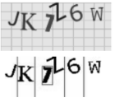
Previous CAPTCHAs and Technologies (2/3)
Connectivity check attack:
Select pixels with same color
Find whether outer line is connected or not
Split found character
By using connectivity check:
Text that cannot be found by vertical projection attack can be found
To prevent this:
To make separation hard
Collision
To make texts hard to read:
Concave, convex

Slide 10
Previous CAPTCHAs and Technologies (3/3)
Collision
By using collision connectivity check attack can be prevented
Connectivity check attack can not separate X from Y
Concave, convex
Basic fonts, basic design’s text can be easily analyzed by OCR
To prevent OCR analysis, characters are usually modified
These modified characters are hard to analyze with OCR
But, hard to read

Slide 11
Development Guides
These guides are modification of
Wang Nan, “Design and Implementation of Character CAPTCHA based on Contraction Mapping” Advanced Materials Research Vols. 341-342, 2012
‘s guidelines.
[a, b, d, e, f, g, h, m, n, q, r, t, u, A, B, D, E, F, G, H, J, M, N, P, R, T, U, Y, 2, 3, 4, 5, 6, 7, 8, 9] are used, and [c, i, j, k, l, o, p, s, v, w, x, y, z, C, I, K, L, O, Q, S, V, W, X, Z, 0, 1] are not used
CAPTCHA text size is from 40 to 60 pixels, selected by random
CAPTCHA texts are collided with fake texts or other CAPTCHA texts
Background tiles are randomly generated. Tiles size are random. Each tile can have several fake characters
Fakes characters are limited to its tile. Its size is from 20 to 40, selected by random
Tiles are displayed in background

Slide 12
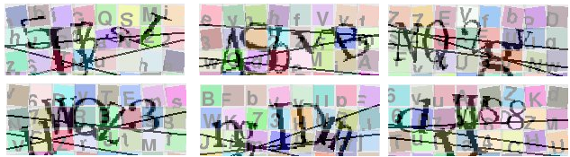






Implemented CAPTCHA examples (ver 1)
Left-up to right-bottom:
5UhsI
ASbVB
NQ2gy
HWQZ3
ngIDm
dnWS8
dSvCA
5C8G4
BSjZQ
6hKQJ
2QXSN
hHCn3

Slide 13
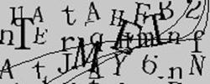
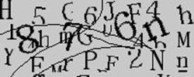
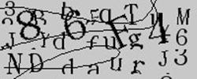
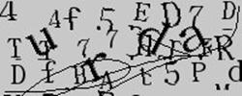
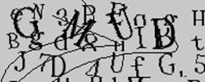
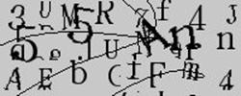
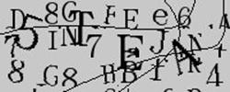
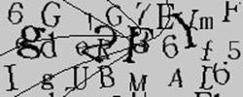
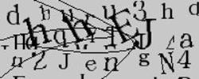
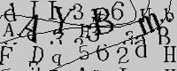
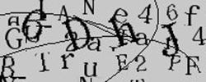
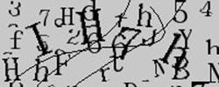
Implemented CAPTCHA examples (ver 2)
Left-up to right-bottom:
TMET
876n
86F4
urda
GMUD
55An
5TEA
g2FY
hhEJ
AYBm
6DhJ
IH7h

Slide 14


Difference between version 1 and 2
We made version 1 CAPTCHA using colored tile
Version 1:
Version 2:
Version 2 is clearer, but it does not have colored tile, so some characters could be confused, whether it is a real CAPTCHA text or not

Slide 15
Attack Tests(1/2)
PWNtcha:
Using automated CAPTCHA attack utility, PWNtcha, we attacked one hundred CAPTCHA images generated by implemeted CAPTCHA
PWNtcha is a utility that can automatically solve Paypal, Authimage, phpBB, and so on
Test environment:
ubuntu 12.04
Compiled PWNtcha
Results:
PWNtcha recognized nothing

Slide 16
Attack Tests (2/2)
GOCR:
GOCR is a widely used utility that outputs texts given pdf, jpeg, png inputs
It is usually used to automatically read texts from scanned image files
Test environment:
ubuntu 12.04
gocr from default ubuntu software center
Results:
test@test-desktop:~/workspace/isCap_ver2$ for f in `seq 100`; do gocr "shot$f.jpeg"; done
shot0.jpeg:0__?0__0_
shot1.jpeg:_ 000
shot2.jpeg:>__ _ _ _ J
shot3.jpeg:_?0
shot4.jpeg:_5? __D_
shot5.jpeg:? n0_, __ ______r,
......

Slide 17
Index
Introduction
Motivation
Main research
Conclusion

Slide 18
Conclusion
By using backgroud tiles with characters, we proposed new CAPTCHA which does not use concave or convex, which make CAPTCHA easy to recognize
Implementation Focuses:
Does not used concave or convex. So it is easy to read each text
Background tiles are easily applied to other existing CAPTCHAs, to make them hard to read
Fonts of CAPTCHA texts and fake texts are same
Fake text’s maximum size is bigger than CAPTCHA text’s minimum size, so it is difficult to detect by using size detection
By using these, known attacks like vertical projection attack and connectivity check attack can be prevented

