Slide 1
Forensic Database
By: Megan Woolschlager

Slide 2
The Business dilemma:
The original proposal stated that there was issues with the way data was organized at the forensics lab.
A list of bodies was to be expected, along with procedures equipment used on the bodies, and what staff member worked on which body, there was also a table designated for workers outside the forensics department of the FBI.
There where 7 tables in my original ER model .
It was discovered that there were many issues with SQL constraints with that amount of tables.

Slide 3

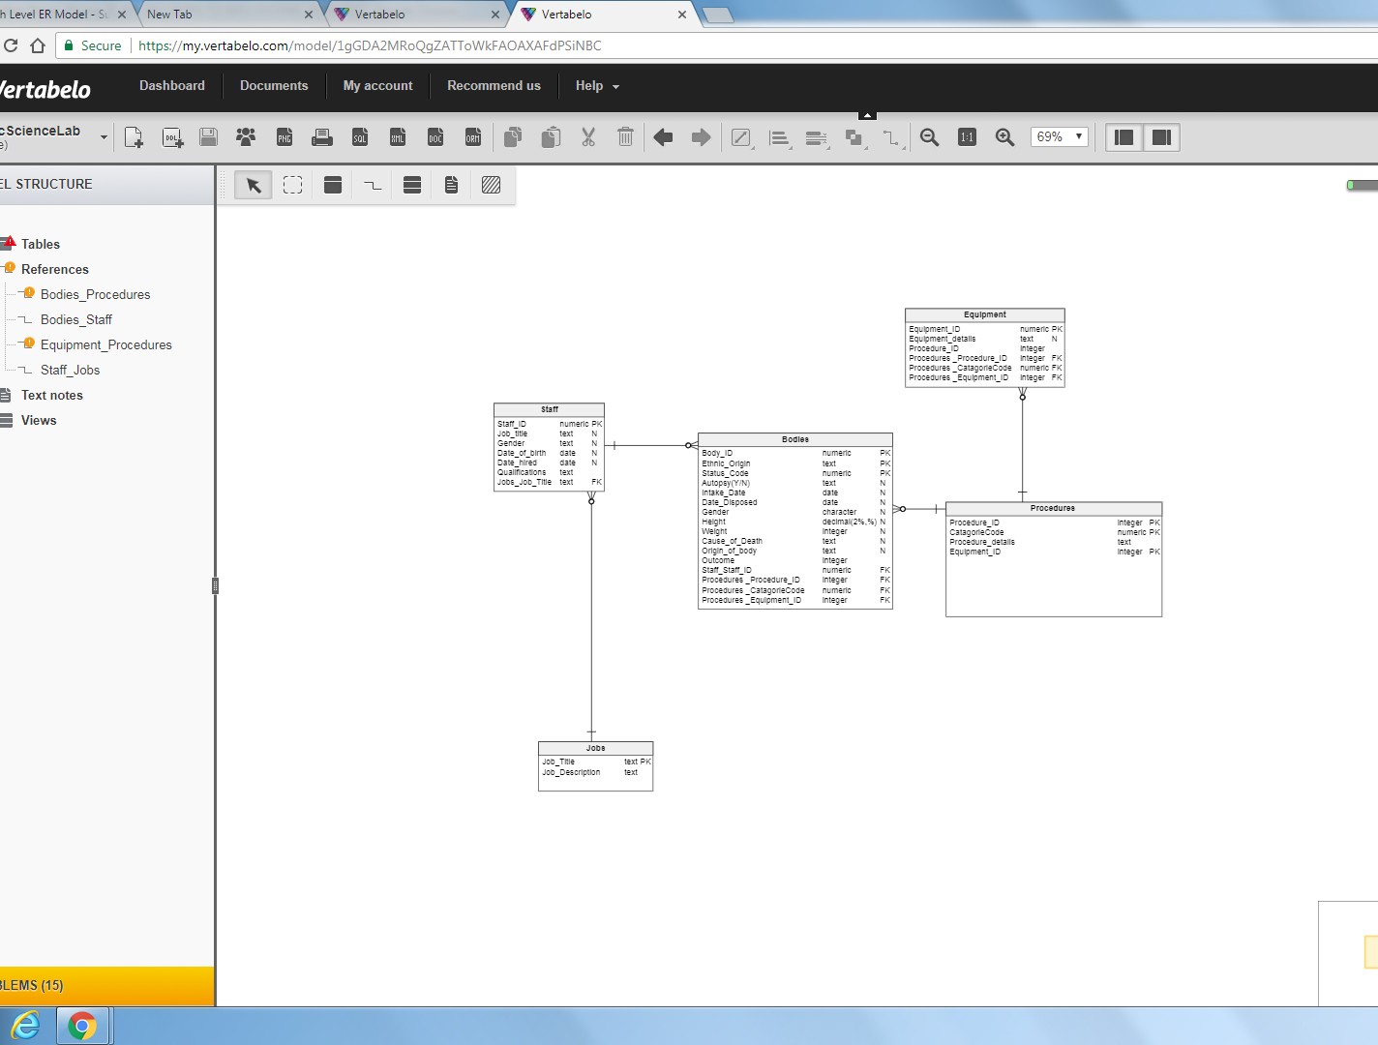
The original ER model made simpler:
This shows the 5 tables that I went with for the final SQLight database.
It worked well as a concept but I had issues with foreign key constraints that were preventing me from entering records in my table

Slide 4
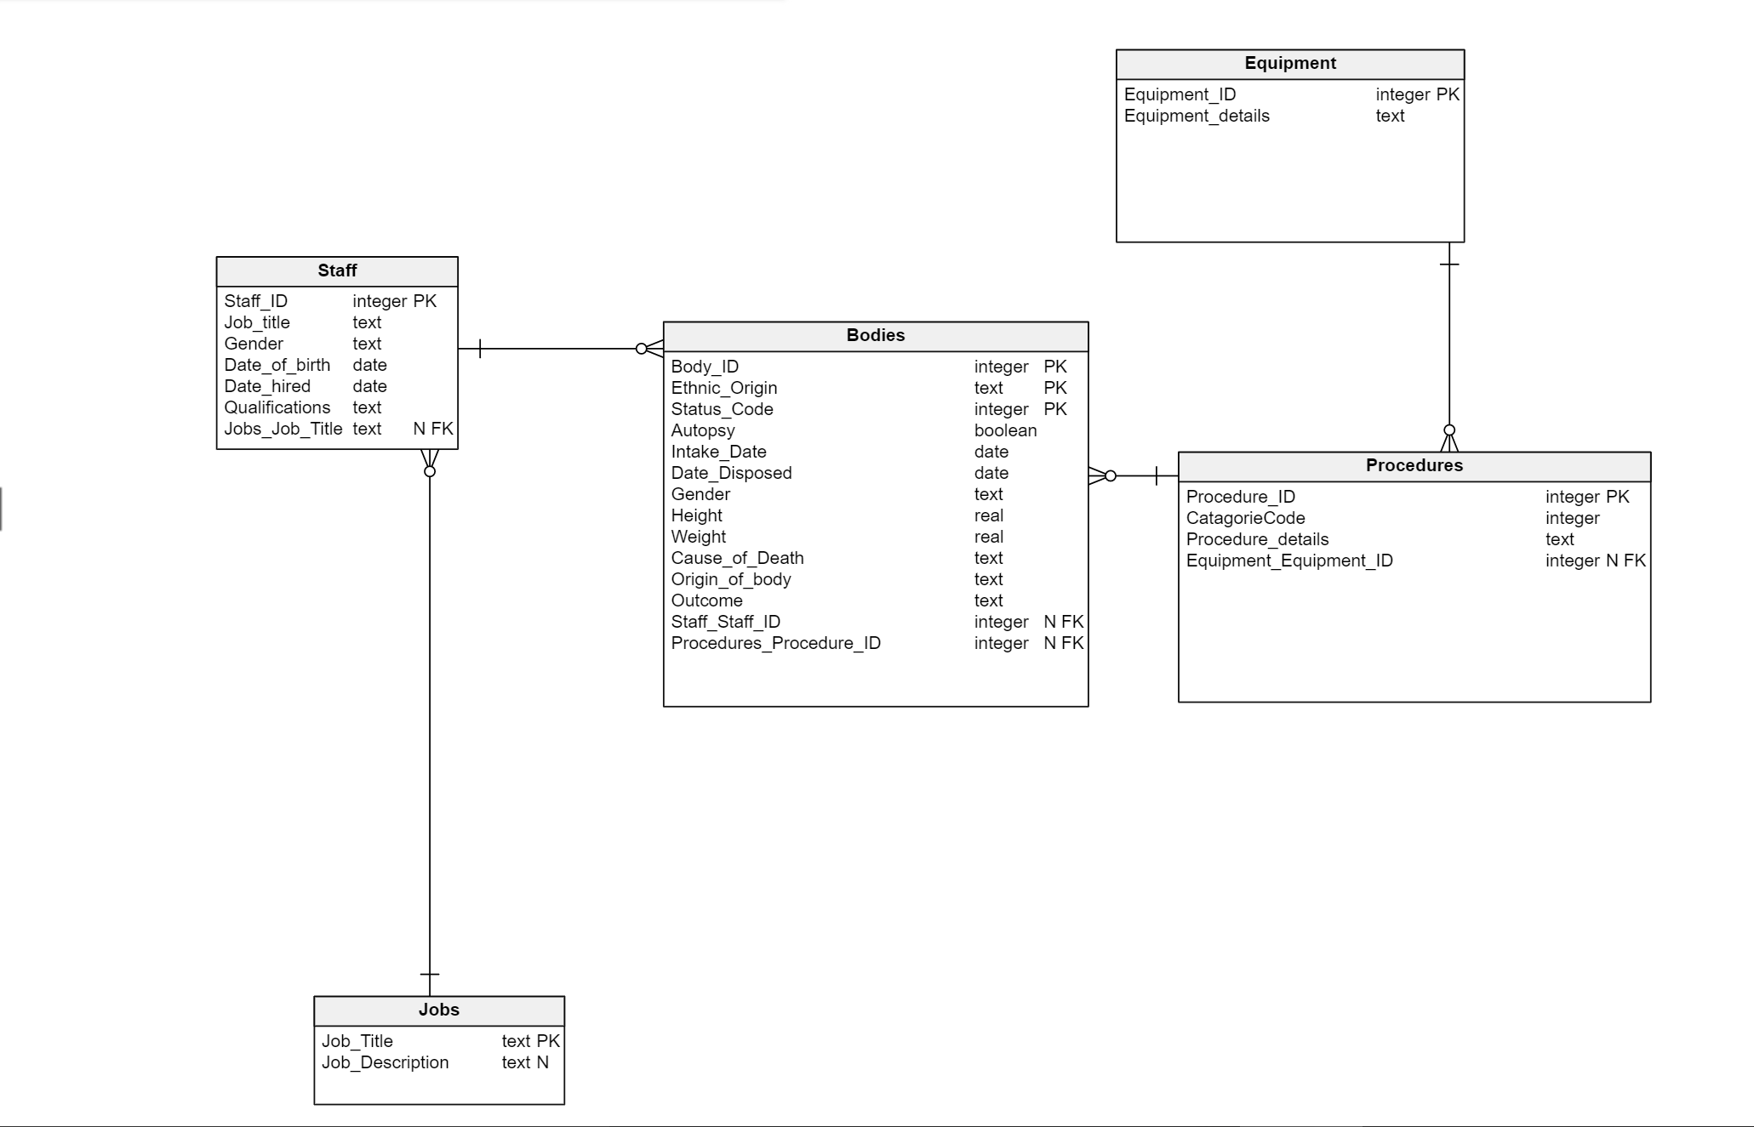
This is the fixed Diagram
Notice the relationships are fixed in order to work in SQLight, production database data that was originally text is defined as an integer.

Slide 5
The problem with converting SQL code from vertabalo to SQLight
There were also additional issues when I tried to run SQL code in SQLight
I ran into problems when I did my Joins’
I would run the code and sometimes it would return 0 records
I made the queries as simple as possible and made sure there was related data in each Table

Slide 6
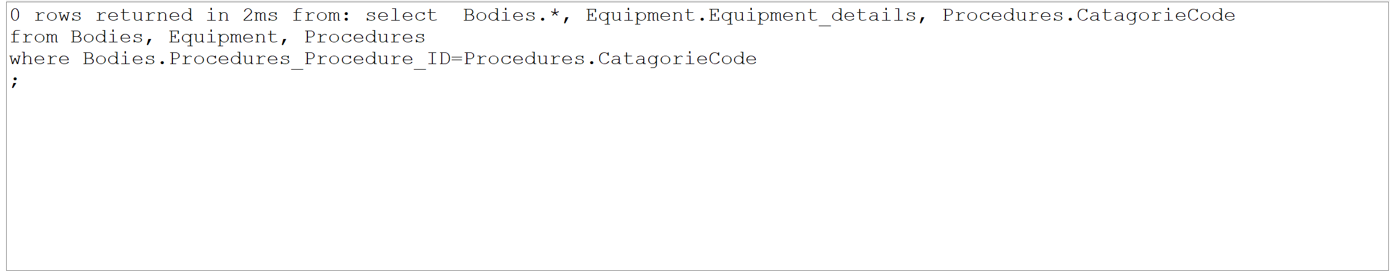

Slide 7
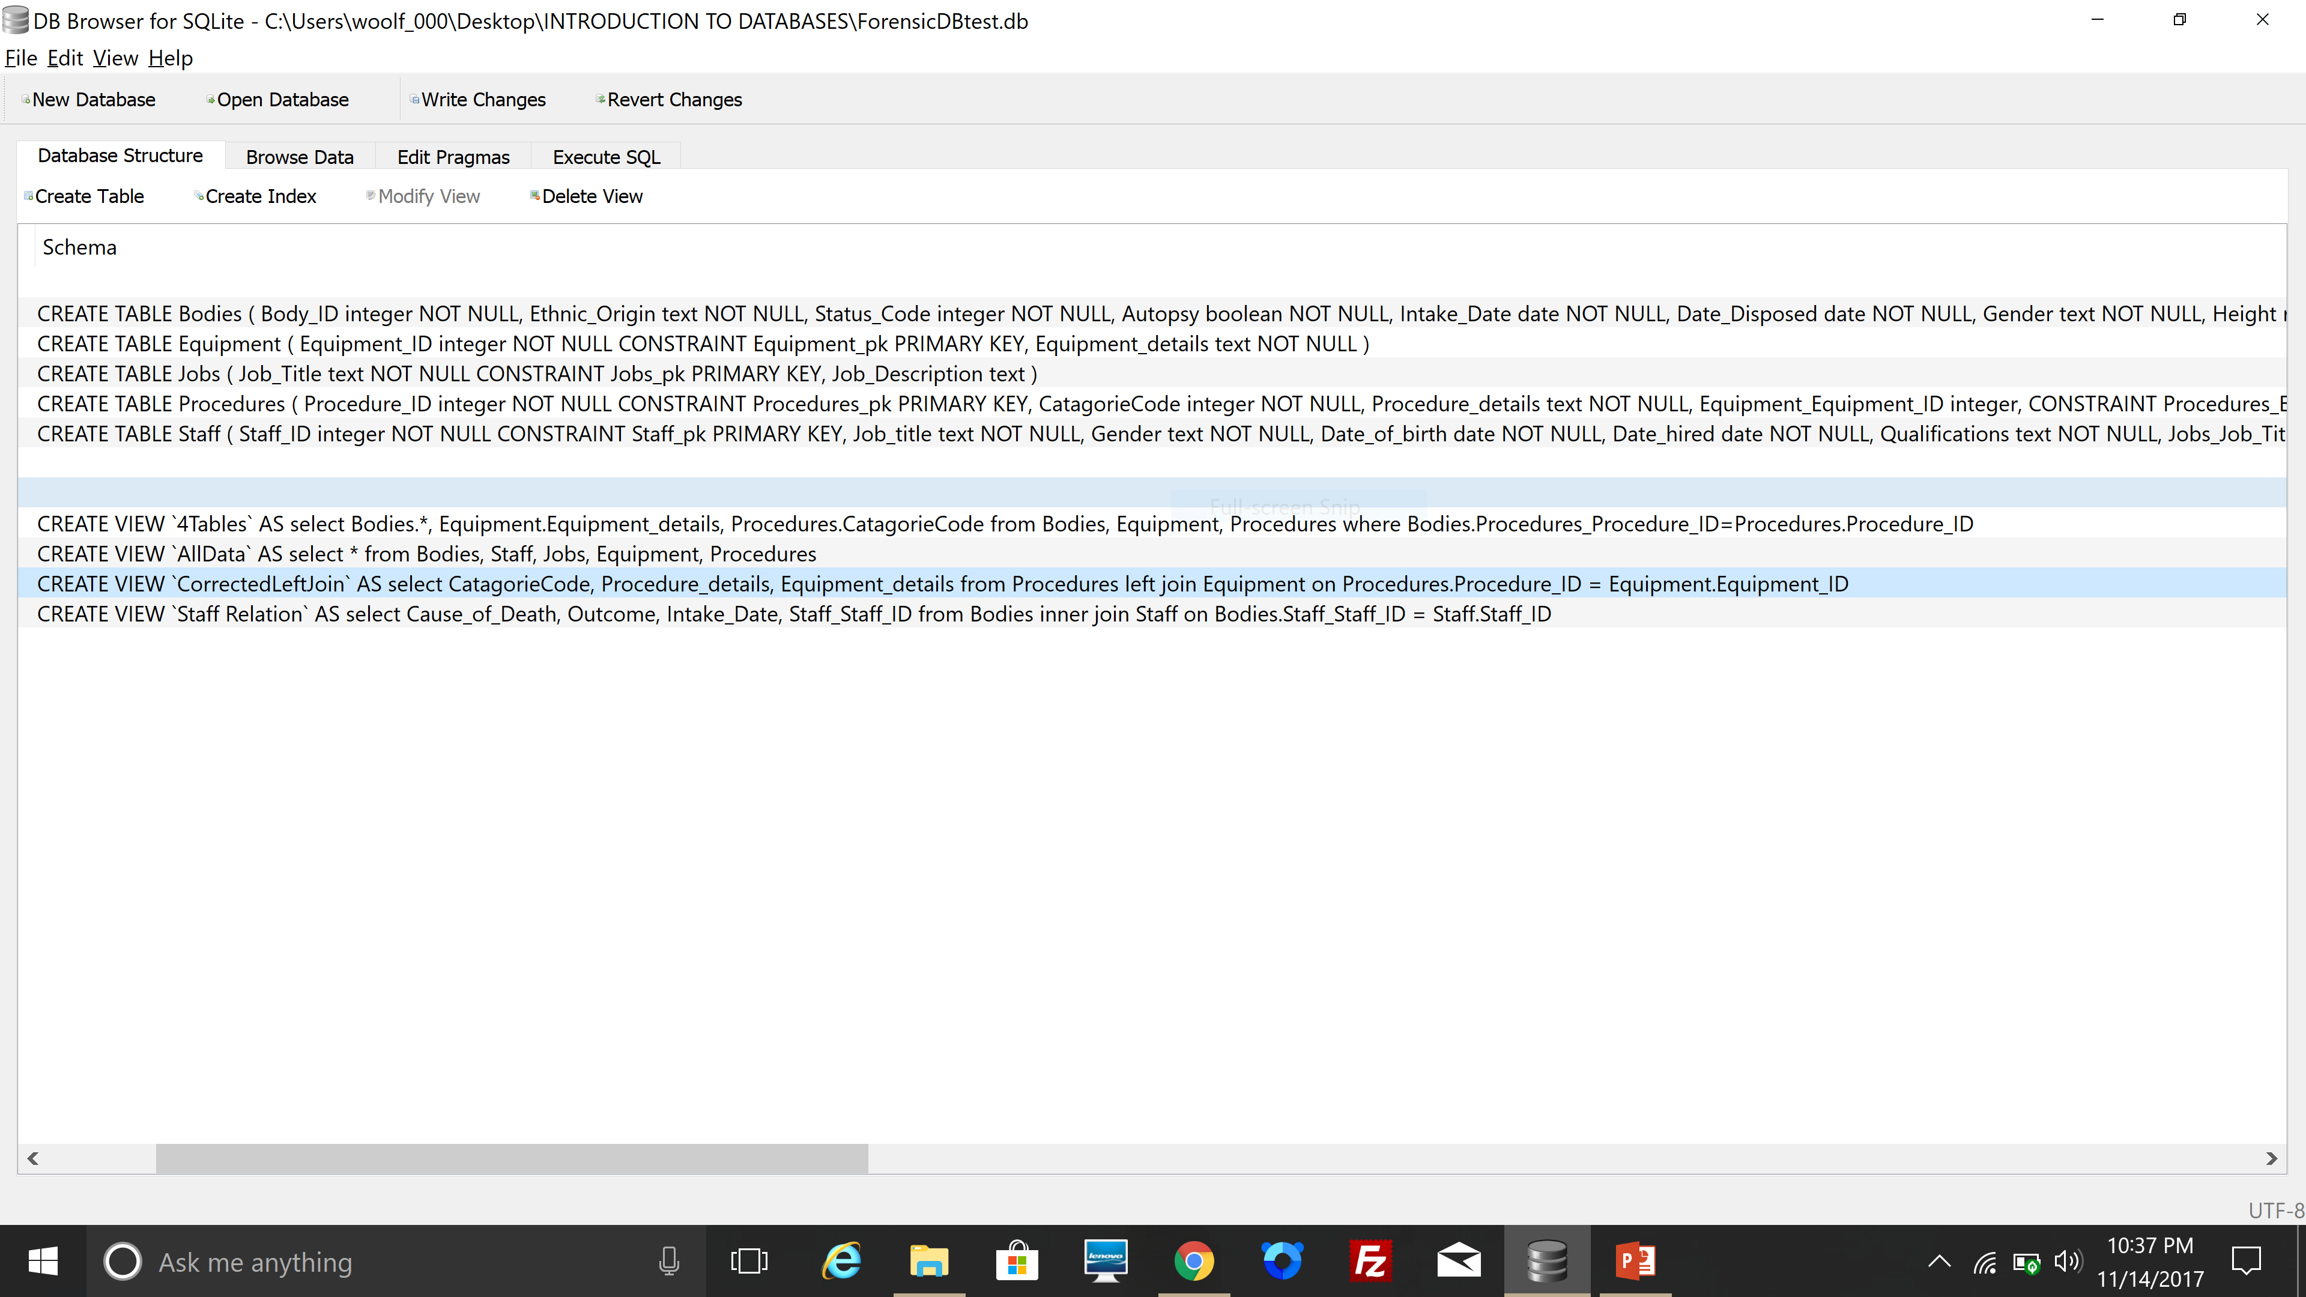

Slide 8
I ended up with 5 tables and 4 queries
I believe I did meet the business requirements of the forensics department
One thing I would change would be some of the foreign key constraints and add, more related data. in the fields I would put autopsy as a field in procedures; because having autopsy in procedures would result in cleaner data output in the queries.

