Slide 1
Hy-Tech Club: C# 102
Abstract Classes

Slide 2
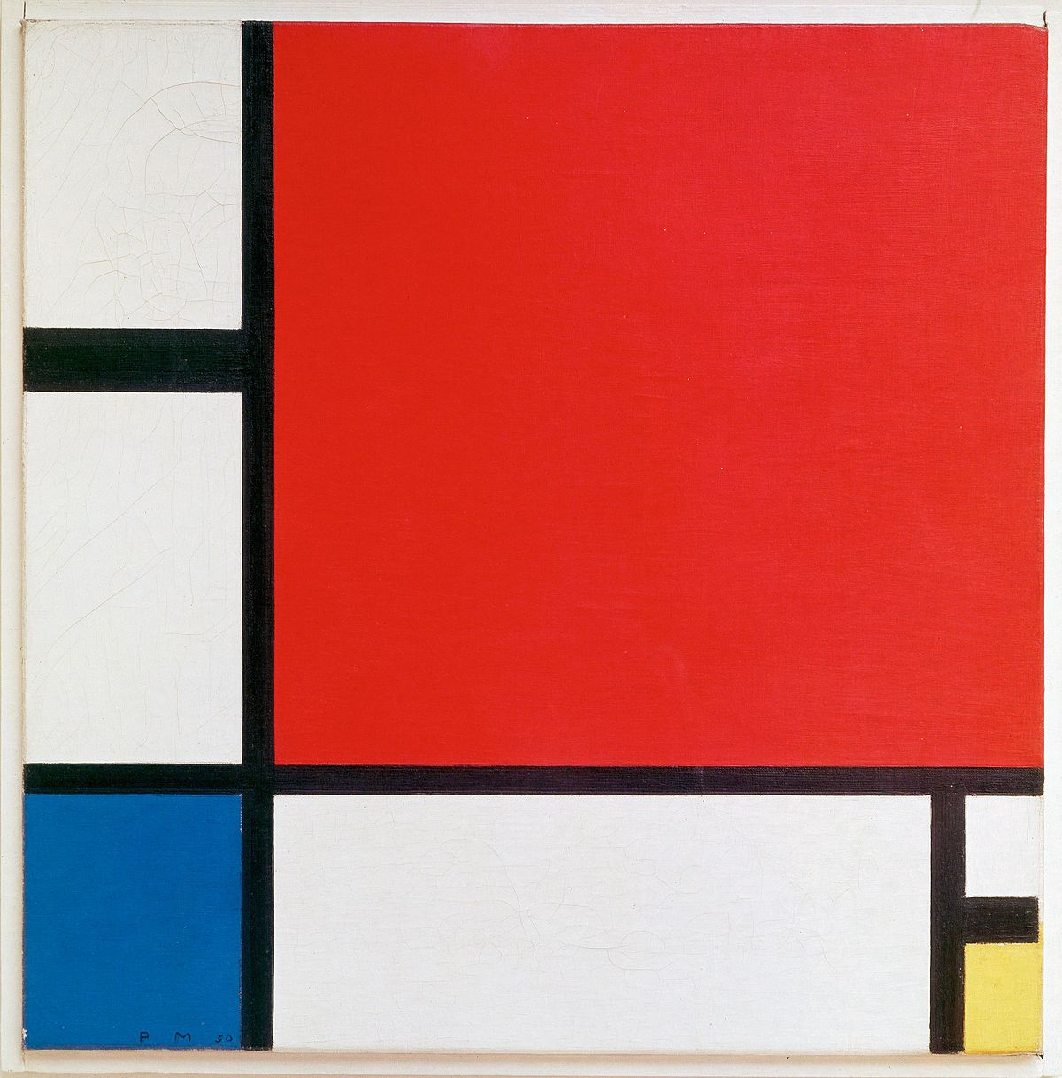
← not this

Slide 3
Abstract Class
An abstract class is a base class that is not completely implemented
They provide a common definition that multiple derived classes can share
They cannot be instantiated
They have methods that are designed to be overridden by derived classes

Slide 4
Abstract Method
An abstract method is the signature of a method (without the implementation)
They are used within abstract classes
They are designed to be overridden by derived classes

Slide 5
Example – Abstract class definition
public abstract class Shape
{
public double XPos { get; set; }
public double YPos { get; set; }
public abstract double GetArea();
}
Notes:
`abstract` keyword
Implementation of a `XPos` and `YPos` property
NO implementation of the `GetArea()` property

Slide 6
Example – Inheriting from an abstract class
public class Rectangle : Shape
{
public double Width { get; set; }
public double Height { get; set; }
public override double GetArea()
{
return Width*Height;
}
public double GetRightEdgePosition()
{
return XPos + Width;
}
}
Notes:
Derives Shape
Overrides/Implements GetArea method
Can access Shape properties (`XPos`)

