Slide 1

Applied Data Science: Machine Learning Capstone Project Time Series forecast of PM2.5 concentration Parthenopi Stergiou, 03.12.2021

Slide 2
Outline
Introduction [2 mins]
The problem statement
The data collection
Exploratory Data Analysis - EDA [10 min]
Stationarity (KPSS, Augmented Dickey-Fuller statistical test)
Cleaning the data [2 mins]
handling missing values (MissForest Imputation), outliers
Machine Learning models [12 mins]
preprocessing pipeline (splitting, encoding, scaling, qunatile transformation)
baseline models (average, first-lag model)
KNRegressor
ElasticNet
Random forest
Convolutional Neural Network (CNN)
Model Evaluation [3 mins]
Evaluation based on two metrics (R², MAE)
Seasonality (heatmaps, boxplots, etc)
time dependency (autocorrelation, partial correlation)
data transformations (quantile transformations, QQ-plots)
feature engineering

Slide 3
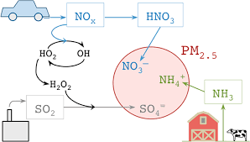
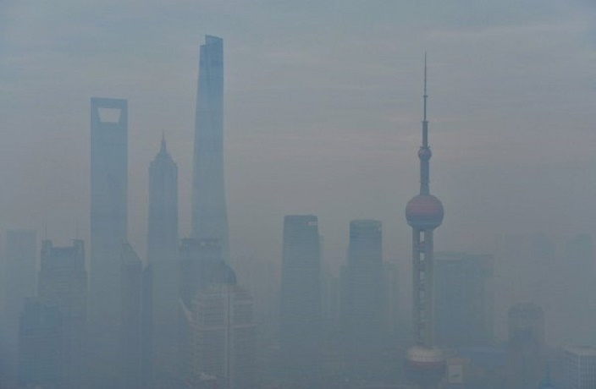
The problem statement
PM2.5 includes a complex mixture of solid and liquid particles with a carbon core (with attached hydrocarbons and metals), hydrocarbons, and secondary particles formed from oxides of sulfur and nitrogen.
High levels of PM2.5 concentration are proven to be dangerous for the health and reduce visibility. The problem is acute in China.

Slide 4
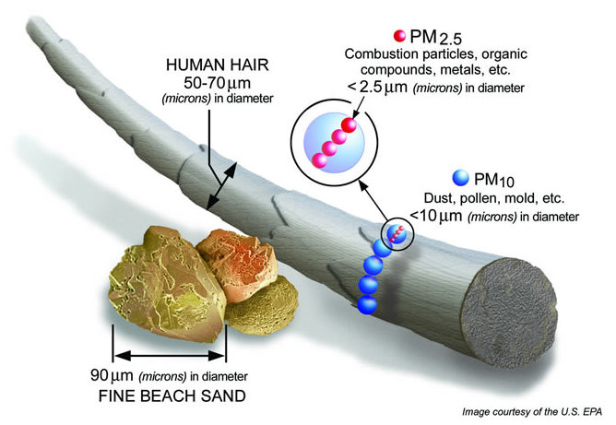
The data
"Bejing Multi-Site Air-Quality Data Set" in UCI ML Repository
Type of data: time series multivariable hourly data
Time (period: 2013-2017):
year: year of data in this row
month: month of data in this row
day: day of data in this row
hour: hour of data in this row
target variable:
PM2.5: PM2.5 concentration (μg/m³)
pollutants:
PM10: PM10 concentration (μg/m³)
SO2: SO2 concentration ((μg/m³)
NO2: NO2 concentration (μg/m³)
CO: CO concentration (μg/m³)
O3: O3 concentration (μg/m³)
weather indicators:
TEMP: temperature (degree Celsius)
PRES: pressure (hPa)
DEWP: dew point temperature (degree Celsius)
RAIN: precipitation (mm)
wd: wind direction
WSPM: wind speed (m/s)
cardinality: 35064
dimentionality: 17
Subset selected for the city of Wanshouxigong, China
Link: https://archive.ics.uci.edu/ml/datasets/Beijing+Multi-Site+Air-Quality+Data.

Slide 5
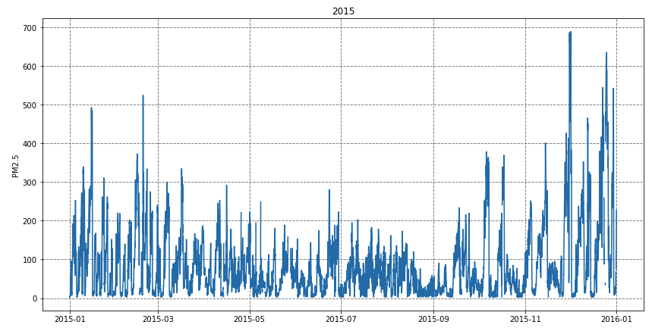
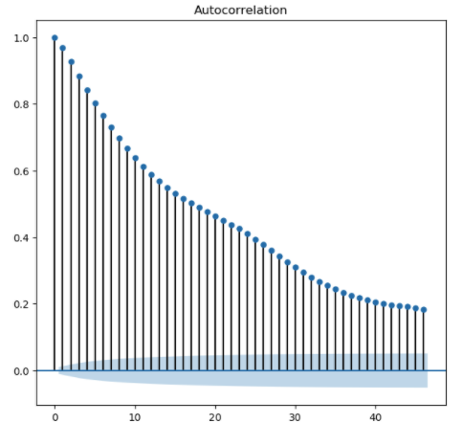
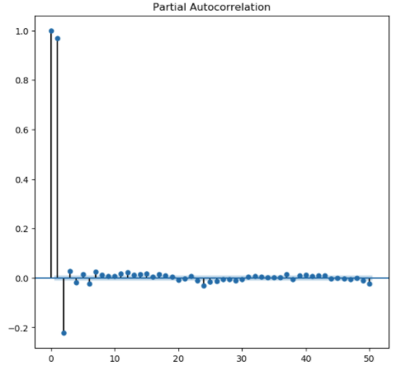
EDA - Lags and Stationarity
Stationary data according to KPSS and Augmented Dickey-Fuller statistical test
ACF
PACT
ACF and PACF of first 50 lags exhibits high correlation, 1st lag could be used as a baseline

Slide 6
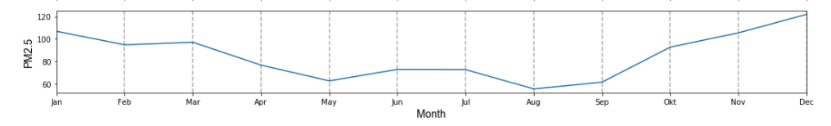
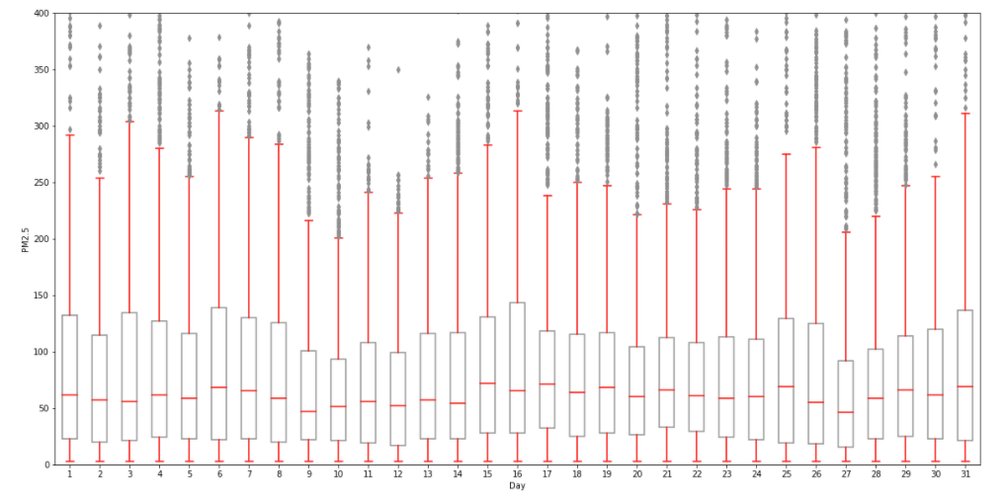
EDA - Seasonality
monthly mean PM2.5 concentration difference across 5 years
summer months to have lower PM2.5 concentration values compared to the winter months
hourly mean PM2.5 concentration fluctuations
weak seasonality component every two weeks

Slide 7
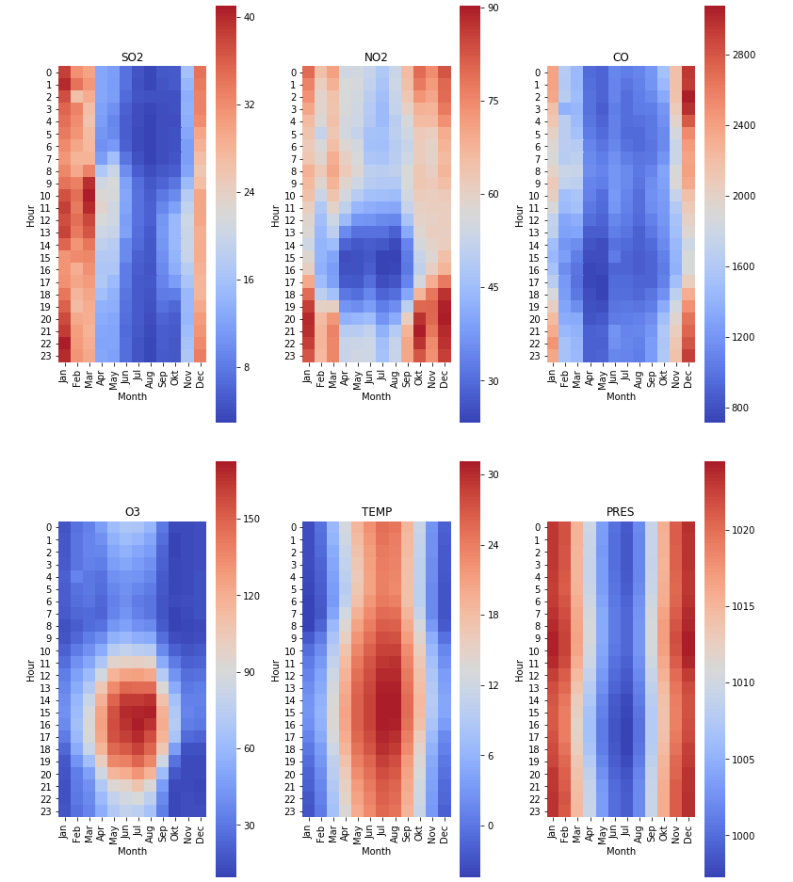
EDA - Seasonality
Visualizing monthly and hourly seasonal patterns at the same time with heatamps
For clarity reasons only a subset of features is shown

Slide 8
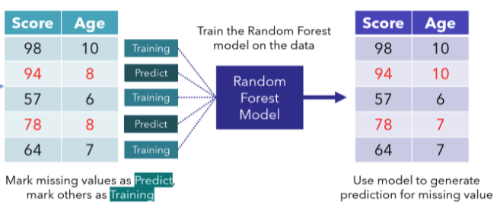
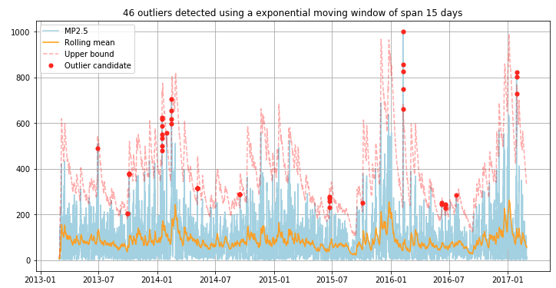
Cleaning the data
Miss forest imputation for categorical data, 3 hours rolling mean for numerical data
Exponential moving average for capping outliers

Slide 9
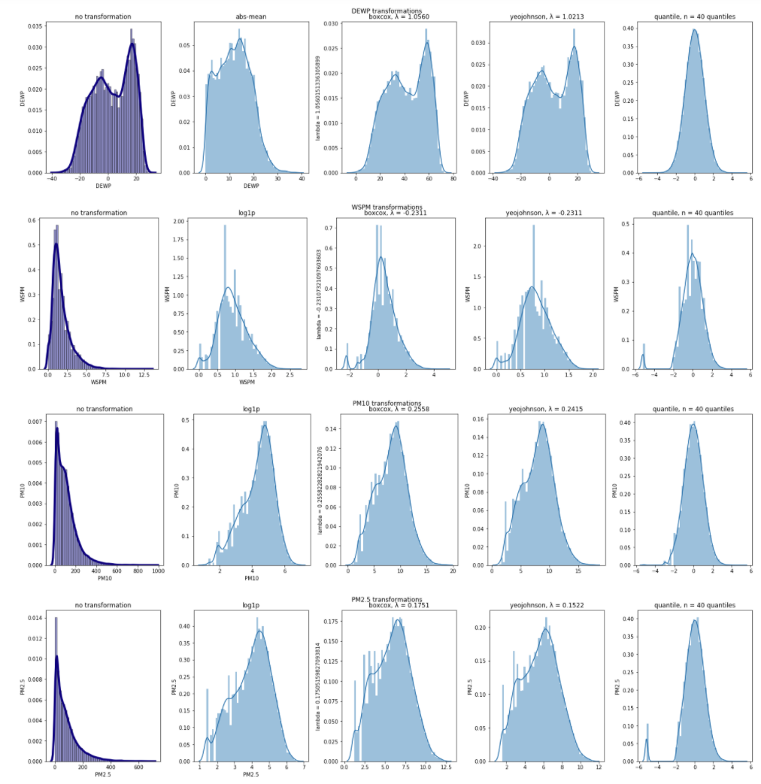
EDA - data transformations
Original data
Abs-mean/Log1p
Boxcox
Yeo-Johnson
Quantile
For clarity reasons only a subset of features is shown

Slide 10
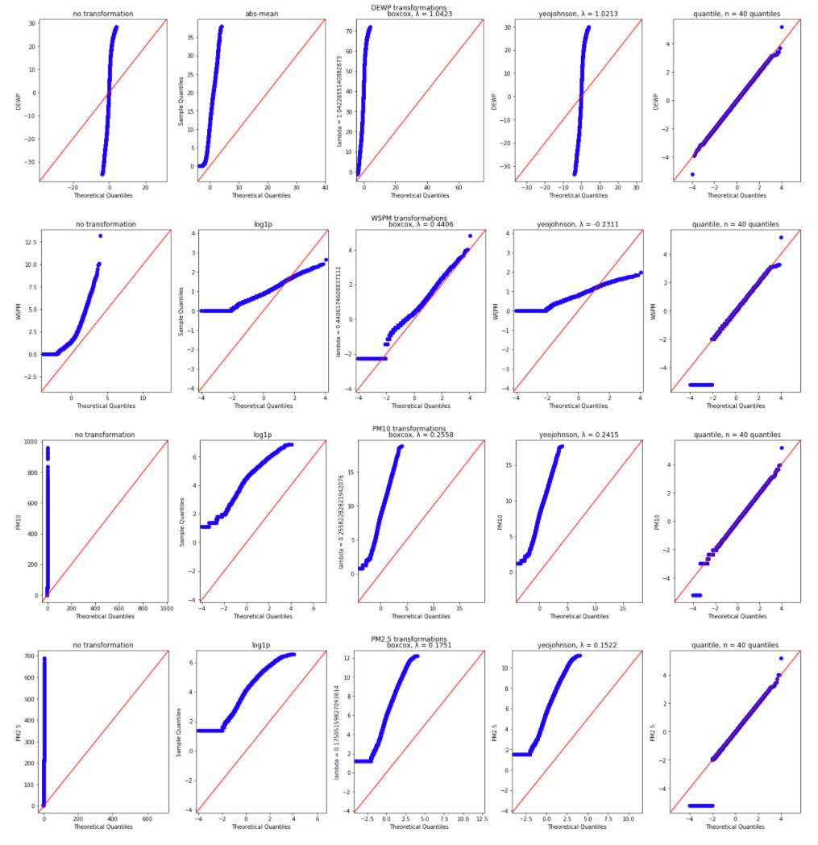
EDA - QQplots
Quantile transformation approaches better normality

Slide 11
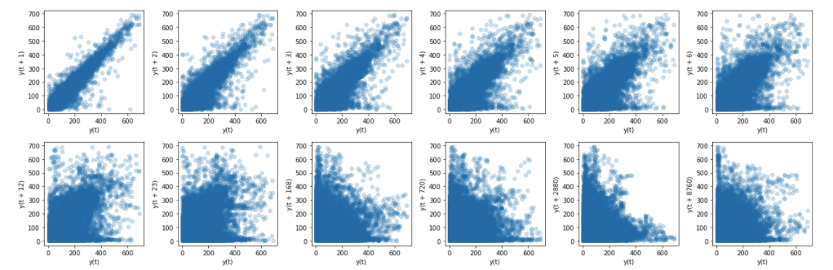
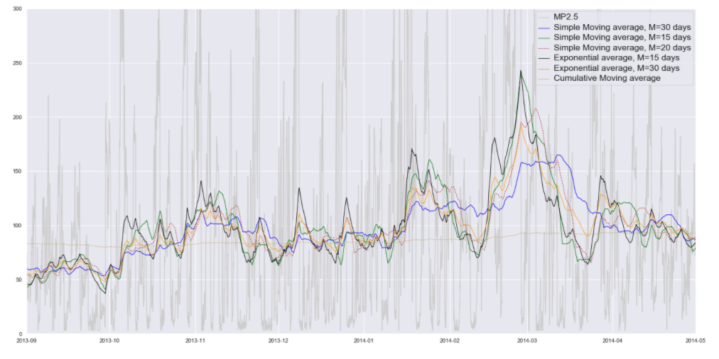
Feature Engineering
The first 8 lags of the target variable were added as features
the EMA of 15 days width along with binary (RAIN) and seasonal features were added

Slide 12
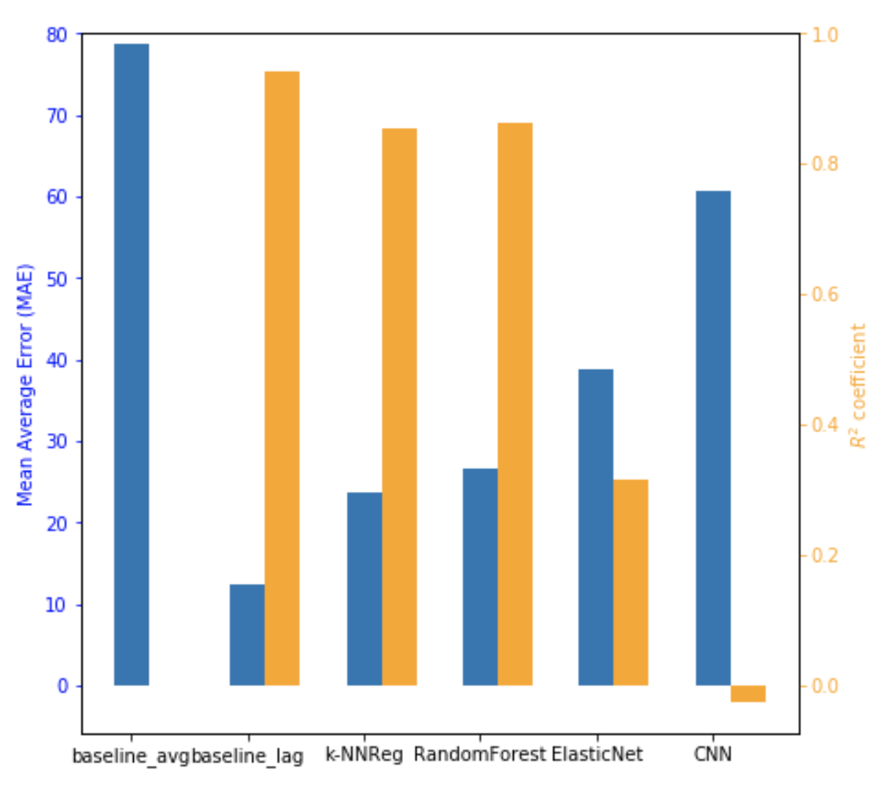
Model Evaluation
the 1st lag baseline wins according to MAE and R² metrics

Slide 13
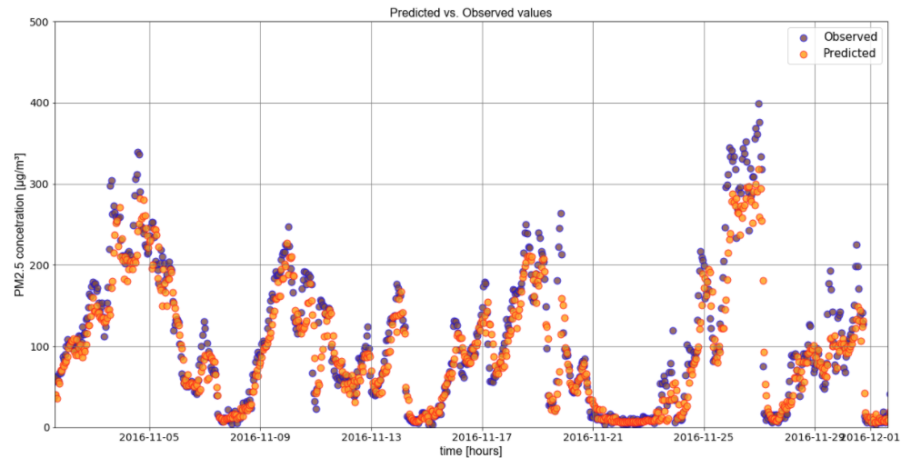

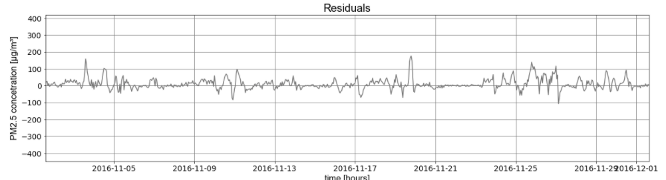
Predictions vs. Reality
Predictions of KNRegressor that performed better among the ML algorithms evaluated

