Slide 1
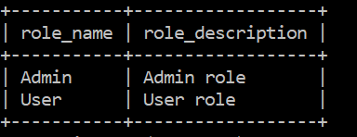
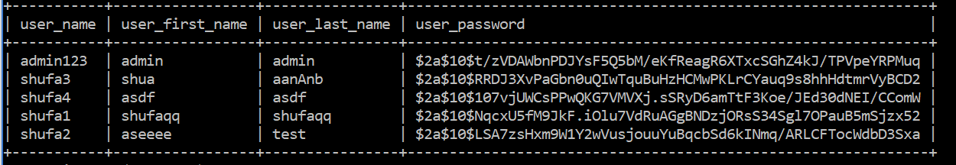
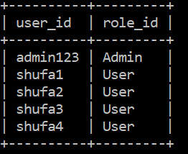

Slide 2
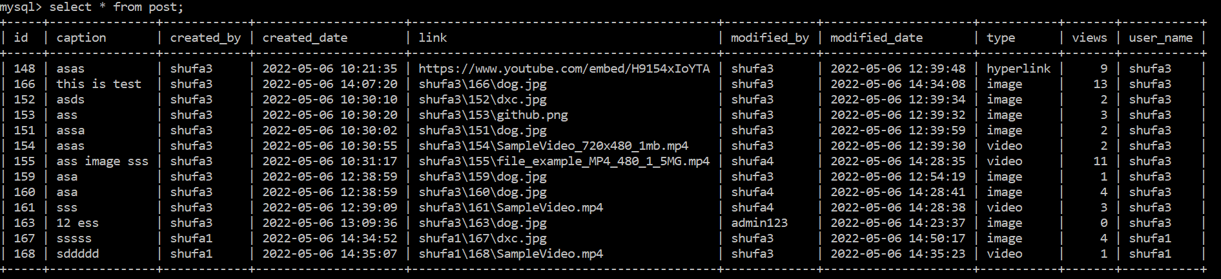
Notes:
Uisng jwt token and spring security for anthentication, jwt token contains information for example, username and role: either admin or user role
Auth guard : decided whether particular path be accessible to user or not. Fetch the token, use token to fetch role, allowRole and actual role are match, then allow. Otherwise we show message to show that path are not allowed to accesss
Intercepter: add header, before request send, intercepter will add no auth header for example signin, signup request
Or adding JWT token to request call other api, automatically add jwt token to the request header

Slide 3
Normal visitor
AuthController.java
API | JWT Token | Frontend Validation | Backend Validation
/api/v0/signin | No | userPassword: required userPassword: required | username: @NotBlank userPassword: @NotBlank
api/v0/signup | No | userName: [a-z0-9]{3,8} userFirstName:[a-zA-Z]{3,8} userLastName“: [a-zA-Z]{3,8} userPassword: At least one digit At least one upper case ASCII letter At least one lower case ASCII letter 5-10 chars no white space | userName: [a-z0-9]{3,8} userFirstName:[a-zA-Z]{3,8} userLastName“: [a-zA-Z]{3,8} userPassword: At least one digit At least one upper case ASCII letter At least one lower case ASCII letter 5-10 chars no white space
Notes:
Normal visitor
No need to have the authorization header for user login (/anthenticate) and user sign up(/registerNewUser)
Do not need to use JWT token, no need to verify jwt token for this two paths

Slide 4
Login as admin
AdminController.java
API | JWT Token | Purpose | Frontend AuthGuard | Backend
/api/v0/forAdmin | Yes | get all users – user management | Admin role | Admin role
/api/v0/getUser/{userName} | Yes | Get any user info for updating | Admin role | Admin role
api/v0/updateUser/{userName} | Yes | update user only | Admin role | Admin role Target user is not admin
api/v0/deleteUser/{userName} | Yes | Delete user only | Admin role | Admin role Target user is not admin
Notes:
Login as admin
AuthGuard is used to protect the routes from unauthorized access in angular.
@PreAuthorize annotation spring security: means that access will only be allowed for users with the role “Admin_Role"
Target user is not admin: update and delete admin request will fail in backend
back
Update user Postman

Slide 5
Login as admin
AdminController.java
API | Frontend Validation | Backend Validation
api/v0/updateUser/{userName} | userName: [a-z0-9]{3,8} userFirstName:[a-zA-Z]{3,8} userLastName“: [a-zA-Z]{3,8} userPassword: optional | userName: [a-z0-9]{3,8} userFirstName:[a-zA-Z]{3,8} userLastName“: [a-zA-Z]{3,8} userPassword: optional 0-8 char
Notes:
Login as admin
AuthGuard is used to protect the routes from unauthorized access in angular.
@PreAuthorize annotation spring security: means that access will only be allowed for users with the role “Admin_Role"
Target user is not admin: update and delete admin request will fail in backend
back
Update user Postman

Slide 6
Login as user
UserController.java
API | JWT Token | Purpose | Frontend AuthGuard | Backend @PreAuthorize
/api/v0/forUser | Yes | get all posts belong to this user – post management | User role | User role
/api/v0/createPostWithFile | Yes | Create a post with media(photo/video) file | User role | User role
api/v0/createPostWithHyperlink | Yes | Create a post with online hyperlink (online picture, online video) | User role | User role
Notes:
Login as user
AuthGuard is used to protect the routes from unauthorized access in angular.
@PreAuthorize annotation spring security: means that access will only be allowed for users with the role “User_Role"

Slide 7
Login as user
UserController.java
API | Frontend Validation | Backend Validation
/api/v0/createPostWithFile | <Type + content + post caption> Image + image_file + caption Video + video_file+ caption button [disabled]
api/v0/createPostWithHyperlink | Hyperlink + link + caption button [disabled]
Notes:
Login as user

Slide 8
Login as user or admin
PostController.java
API | JWT Token | Purpose | Frontend AuthGuard | Backend @PreAuthorize
/api/v0/getAllPosts | Yes | get all posts | User role Admin Role | User role Admin Role
/api/v0/getPostById/{id} | Yes | Get a specific post’s detail Used after updating post/increasing view | User role Admin Role | User role Admin Role
api/v0/updatePost/{id} | Yes | Update hyperlink (Or/and) Update caption | User role Admin Role | User role Admin Role
api/v0/updatePostWithFile/{id} | Yes | Update image/video (Or/and) Update caption | User role Admin Role | User role Admin Role
api/v0/addViewsCount/{id} | Yes | Click to show image/video to increase view count | User role Admin Role | User role Admin Role
api/v0/deletePost/{id} | Yes | Delete a post | User role Admin Role | User role Admin Role
Notes:
Login as user

Slide 9
Login as user
UserController.java
API | Frontend Validation | Backend Validation
api/v0/updatePost/{id} | Update to hyperlink post - [disabled] when !{5, 120} or link.trim().length===0 [disabled] if invaild caption ({5,120}) | Admin or Login user is the same use who created the post
api/v0/updatePostWithFile/{id} | Image/file + media file + caption [disabled] if invaild caption | Admin or Login user is the same use who created the post
Notes:
Login as user

Slide 10
FileController.java
API | JWT Token | Purpose | Frontend AuthGuard | Backend @PreAuthorize
/files/{user}/{postid}/{filename} | No | Get media source and display
Notes:
I have issue to display resource in html file
It is okay to send request, let intercepter to add the jwt token, backend also can successfully send the responseEntity, but I have not figure out how to display the media resource from the response in html.
Auditing for post entity

