Slide 1
About Honeypot
Cuckoo sandbox
[BoB6th][Forensics][Woonseon-Yoo]

Slide 2


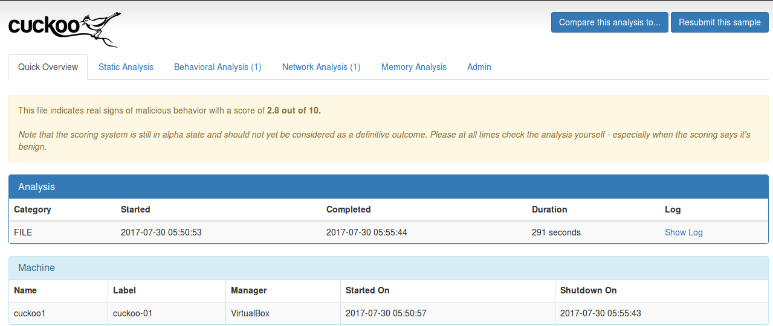
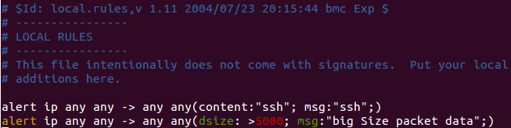
Cuckoo Sandbox
Honeypot
Cuckoo Sandbox is open src.
So, we can easily use this honeypot.
It’s so interesting!!

