Slide 1
What is societal impact?
How can we measure societal impact
for ESG reporting?
Investor relevant
HTA focused
Industry pursued
Investors demand greater awareness and positive impact of companies in their interactions with society
Access hurdles are becoming greater as HTAs include further societal value demonstration requirements
Top pharmaceutical companies are pursuing societal impact calculations ex. Novartis claiming 200B USD Social Impact

Slide 2




Pharmaceutical product contribution to society is underexplored in current ESG sustainability reporting
ENVIRONMENT
PRODUCTS & SOLUTIONS
HEALTH CARE SYSTEM
PEOPLE
CO2 Neutrality
Water Toxification
Loss of Biodiversity
Energy Consumption
Circular economy
Increased life expectancy/ real option value
Work productivity
Caregiver burden & family spillovers
Severity of disease
Reduced disability and reduced health disparities
…
Net costs
System impact (resources, waste, efficiency)
Shifting of location of care/ Reduced complexity
Reduction in follow-up costs and re-hospitalization
Safeguard colleagues & their families
Enhance and adapt workplace policies
Engagement & Lifelong Learning
Talent Management
Underexplored from an ESG sustainability perspective

Slide 3
About the Data
Burden Variables:
About the Data:
Burden (General)
Financial Burden
Emotional Burden
Physical Burden
2014 and 2019 survey data on caregiving in the US.
Survey conducted by the National Alliance for Caregiving (NAC) and the American Association of Retired Persons (AARP).
3352 rows, 307 variables, 38% missing values

Slide 4
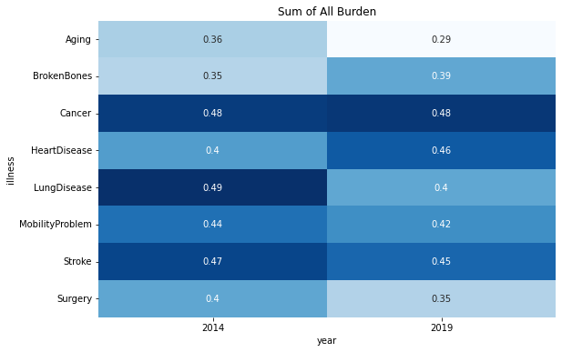
Burden Analysis
Analysis
The heatmap shows the change in the average burden (0-1 scale) of each of the illnesses.
Interpretation
Not much has changed overall. Certain illnesses such as heart disease and broken bones had an increase in burden while others like cancer and lung disease had a decrease in burden.
Hypothesis
Little advancements in the past 5 years in assisting the care and rehabilitation patients.
Notes:
Broken Bones

Slide 5
About the Data
ADLs are basic tasks that are essential to independent living.
IADLs are more complex tasks that are still a necessary part of everyday life.
Activities of Daily Living (ADL):
Instrumental Activities of Daily Living (IADL):
Help with bed
Help with dressed
Help with toilet
Help with bathe
Help with diapers
Help with feeding
Lives with care recipient
Giving medicine
Managing finances
Help with grocery shopping
Help with housework
Help with preparing meals
Help with transportation
Help with outside services

Slide 6
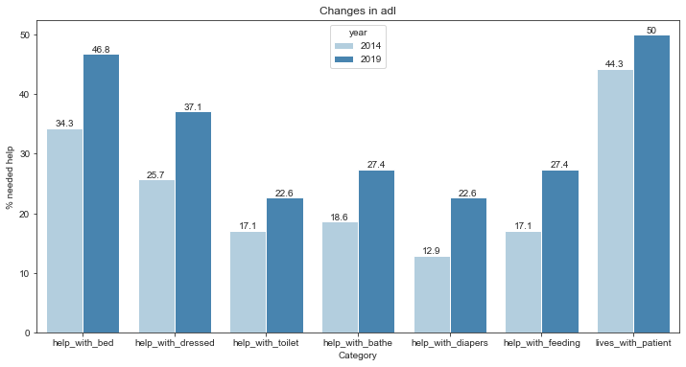
Heart Disease Analysis - ADLs
Analysis
% of patients needing help with ADL categories.
Observation
Significant increase in patients needing assistance in all categories of ADL.
Hypothesis
A lot of these activities involve basic movement. Possibly suggesting an increase in obesity related heart disease.

Slide 7
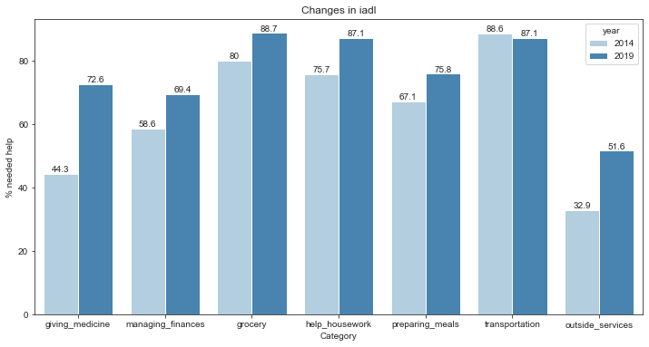
Heart Disease Analysis - IADLs
Observation
Significantly more patients needed assistance in taking their medicine and arranging outside services (nurses, home care aides).
Hypothesis
Development in patient friendly medication and patient friendly method to request outside services may reduce the care-giver burden.

Slide 8
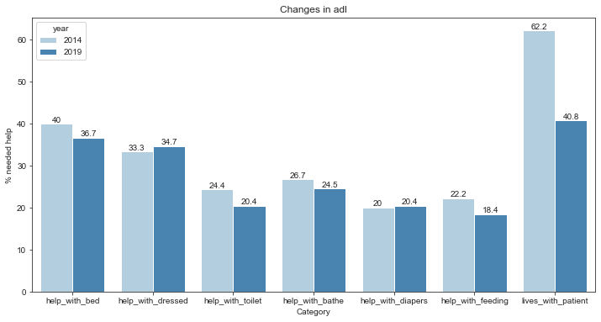
Lung Disease Analysis - ADLs
Observation
There are no significant changes in ADL assistance but there were significantly less caregivers living with the patients.
Hypothesis
24/7 assistance for patients with lung disease has become unneccessary.

Slide 9
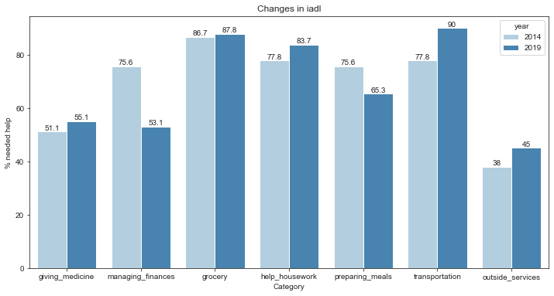
Lung Disease Analysis - IADLs
Observation
The only IADL category that had a significant decrease was managing finances.

Slide 10
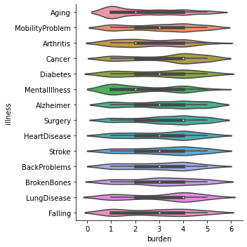
Caregiver Burden Exploration
“Cancer”, “Surgery” and “Lung Disease” were clearly right skewed. This was expected as they are terminal diseases and often lead to life-threatening complications.
Other notable illnesses are “Mobility Problems”, “Diabetes”, “Heart Disease”, and “Back Problems”

Slide 11
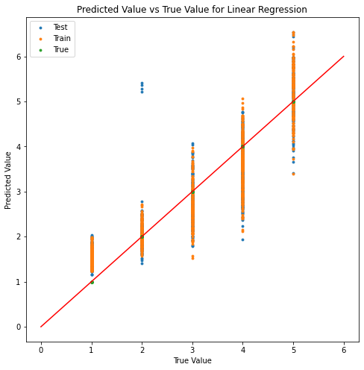
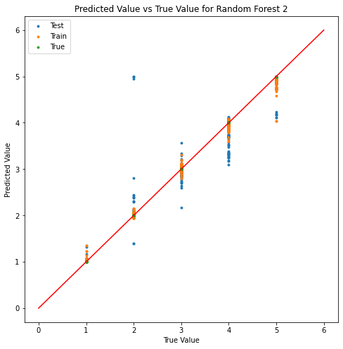
Modeling Caregiver Burden – Using 2014 as train and 2020 as test
test RMSE = 0.6173
10 CV RMSE = 0.5909
Score = 0.8359
test RMSE = 0.2139
10 CV RMSE = 0.1636
score = 0.9869

Slide 12
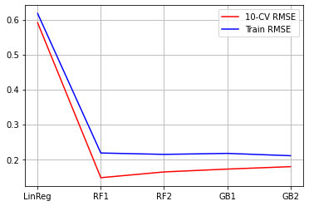
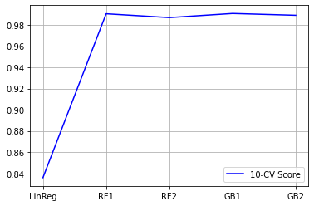
Modeling Caregiver Burden – Using 2014 as train and 2020 as test
Random Forest models had the lowest 10-CV RMSE and the highest 10-CV $R^{2}$-score

Slide 13
Limitations of the Study
The nature of the survey data is subjective and impairs reliability.
Insufficient observations for some illnesses (Ex. 0 observations for liver failure, 8 observations for asthma)
Difficulty in extrapolating Burden-of-Care into fiscal values.

Slide 14

Summary Insights and Further Research
Not much advancement has been made in the past 5 years to assist the patients and relieve the burden-of-care.
A solution that helps the patients be self-sufficient and reducing the need for a care-giver to live with the patient decreases the burden-of-care.
Research Questions
Does improving the assistance in patient mobility reduce the burden-of-care?
Does improving the methods to arrange outside services (such as nurses, home care aides, or meals-on-wheels) reduce the burden-of-care?
Does developing patient friendly medication (flexible with time, less frequent) reduce the burden-of-care?

