Slide 1
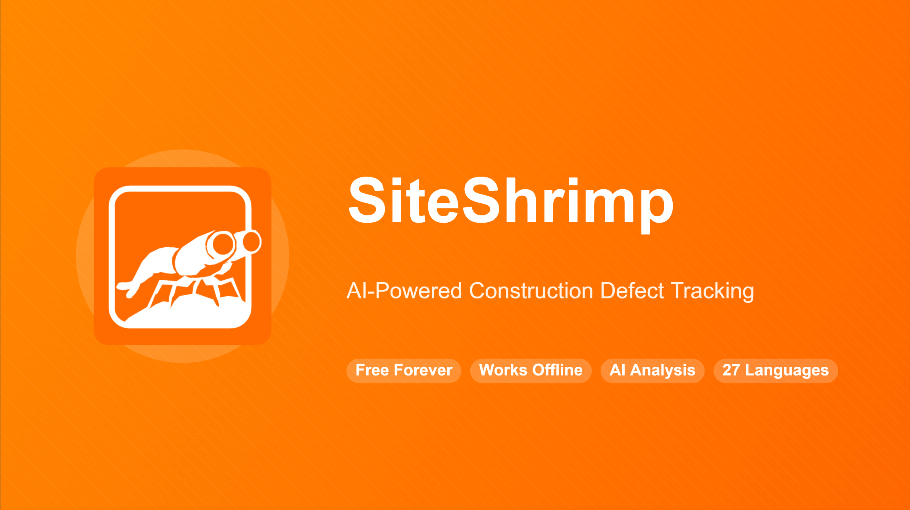


Report and track site issues in real-time
Log Case . Tag Location . Review Input . Report Update
-
Digital Records
AI-Powered
Real Time
User Friendly

Slide 2
