Slide 1
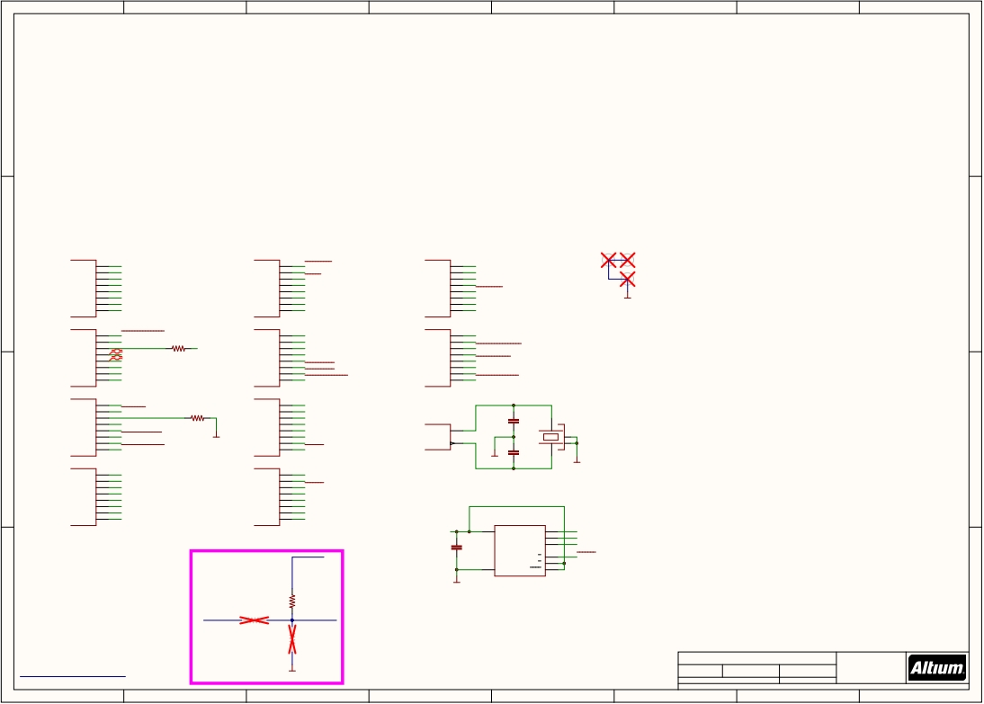
1
2
3
4
5
6
7
8
마이크로 컨트롤러
A
A
STM32F437VIT6 100pin (497-14049-ND)
-최대 180MHz 주파수
-2MB 메모리
-1.7V ~3.6V 공급
STM32F437VIT6
U1001A
STM32F437VIT6
U1001E
STM32F437VIT6
U1001I
B
PA0
PA1
PA2
PA3
PA4
23
24
25
26
29
FMU-UART4_TX
FMU-UART4_RX
BATT_VOLTAGE_SENS
BATT_CURRENT_SENS
VDD_5V_SENS
PC0
PC1
PC2
PC3
PC4
15
16
17
18
33
VBUS_VALID
SPI_INT_MAG_!CS
MPU_CS
FMU_AUX_POWER_ADC1
FMU_AUX_ADC2
PE0
PE1
PE2
PE3
PE4
97
98
1
2
3
FMU-UART8_RX
FMU-UART8_TX
SPI_EXT_SCK
VDD_3V3_SENSORS_EN
MPU_EXT_CS
B
PA5
PA6
PA7
30
31
32
SPI_INT_SCK
SPI_INT_MISO
SPI_INT_MOSI
PC5
PC6
PC7
34
63
64
PRESSURE_SENS
SERIAL_FMU_TO_IO
SERIAL_IO_TO_FMU
PE5
PE6
PE7
4
5
38
SPI_EXT_MISO
SPI_EXT_MOSI
FMU-UART7_RX
GND
STM32F437VIT6
U1001B
STM32F437VIT6
U1001F
STM32F437VIT6
U1001J
PA8
PA9
PA10
PA11
PA12
PA13
PA14
PA15
67
68
69
70
71
72
76
77
VDD_5V_PERIPH_EN
VBUS
OTG_FS_N
OTG_FS_P
FMU-SWDIO
FMU-SWCLK
ALARM
R1001
470R
IO debug console
IO-USART1_TX
PC8
PC9
PC10
PC11
PC12
PC13
PC14
PC15
65
66
78
79
80
7
8
9
SDIO_D0
SDIO_D1
SDIO_D2
SDIO_D3
SDIO_CK
GYRO_EXT_CS
BARO_EXT_CS
ACCEL_MAG_EXT_CS
PE8
PE9
PE10
PE11
PE12
PE13
PE14
PE15
39
40
41
42
43
44
45
46
FMU-UART7_TX
FMU-CH4
VDD_5V_HIPOWER_OC
FMU-CH3
FMU-LED_AMBER
FMU-CH2
FMU-CH1
VDD_5V_PERIPH_OC
STM32F437VIT6
U1001C
STM32F437VIT6
U1001G
STM32F437VIT6
U1001K
PB0
35
EXTERN_DRDY
PD0
81
CAN1_RX
PB1
PB2
PB3
PB4
PB5
PB6
PB7
36
37
89
90
91
92
93
EXTERN_CS
PB2-BOOT1
FMU-SWO
Future Use
VDD_BRICK_VALID
CAN2_TX
VDD_BACKUP_VALID
R1002
10K
PD1
PD2
PD3
PD4
PD5
PD6
PD7
82
83
84
85
86
87
88
CAN1_TX
SDIO_CMD
FMU-USART2_CTS
FMU-USART2_RTS
FMU-USART2_TX
FMU-USART2_RX
BARO_CS
C1002
8p
C1003
X1001
Crystal Oscillator in 3.2x2.5 SMD
C
GND
OSC_IN
OSC_OUT
12
13
결정진동자
-정확한 주파수를 생성하여 여러 부품들의 클락을 단일화
-외부 크리스탈 사용 이유 : 온도에 따른 변화율이 적음
C
STM32F437VIT6
U1001D
STM32F437VIT6
U1001H
GND
8p
GND
PB8
PB9
PB10
PB11
PB12
PB13
PB14
PB15
95
96
47
48
51
52
53
54
FMU-I2C1_SCL
FMU-I2C1_SDA
FMU-I2C2_SCL
FMU-I2C2_SDA
CAN2_RX
FRAM_SCK
FRAM_MISO
FRAM_MOSI
PD8
PD9
PD10
PD11
PD12
PD13
PD14
PD15
55
56
57
58
59
60
61
62
FMU-USART3_TX
FMU-USART3_RX
FRAM_CS
FMU-USART3_CTS
FMU-USART3_RTS
FMU-CH5
FMU-CH6
MPU_DRDY
FMU-VDD_3V3
8
U1002
6
FRAM_SCK
FM25V02A(428-3211-ND)
-128Kbit 비휘발성 플래쉬 메모리
-Fixhawk의 parameter 값을 저장
VDD
C
5
2
FRAM_MOSI
FRAM_MISO
Timer allocation:
PE9: TIM1_CH1: FMU-CH4
Note: MAG/ACCEL/GYRO_DRDY pins chosen
for both timer capture and separate
C1001
D
Q
PE11: TIM1_CH2: FMU-CH3
PE13: TIM1_CH3: FMU-CH2
PE14: TIM1_CH4: FMU-CH1
PA15: TIM2_CH1: ALARM
PB0: TIM3_CH3: GYRO1_DRDY
PB1: TIM3_CH4: GYRO2_DRDY
PB4: TIM3_CH1: ACCEL_DRDY
EXTI operaton.
EXTI0 - TIM3_CH3 - GYRO1
EXTI1 - <free>
EXTI2 - <free>
EXTI3 - <free>
EXTI4 - TIM3_CH1 - ACCEL
Serial Level shifter protection
option 1: R1022 fitted
FMU-VDD_3V3
0u1
S
W
HOLD
1
3
7
FRAM_CS
4
VSS
PB5: TIM3_CH2: MAG_DRDY
PD13: TIM4_CH2: FMU-CH5
EXTI5-9
- TIM3_CH2 - MAG
option 2: R1020 and 1021 fitted
R1022
GND
FM25V02A
PD14: TIM4_CH3: FMU-CH6
PD15: TIM4_CH4: spare
DO NOT USE
D
Future Use
R1020
220R
220R
Level_Shift Enable
D
note:
R1021 10K
note:
Title
FMU FMU3 REV C.SchDoc
*
*
http://creativecommons.org/licenses/by-sa/3.0
GND
Size: A3
Number: *
Revision: *
*
*
PCB is NOT covered by this license, ONLY the Schematic.
The Cube Shape and the use of the DF17 Connector and the screw pattern for holding the cube is patented. DO NOT COPY
Date: 24/05/2018 Time: 2:16:19 PM Sheet 1 of 10
File: E:\Git\The-Cube\FMU\FMU_FMU_REV_1B.SchDoc
*
1
2
3
4
5
6
7
8

Slide 2
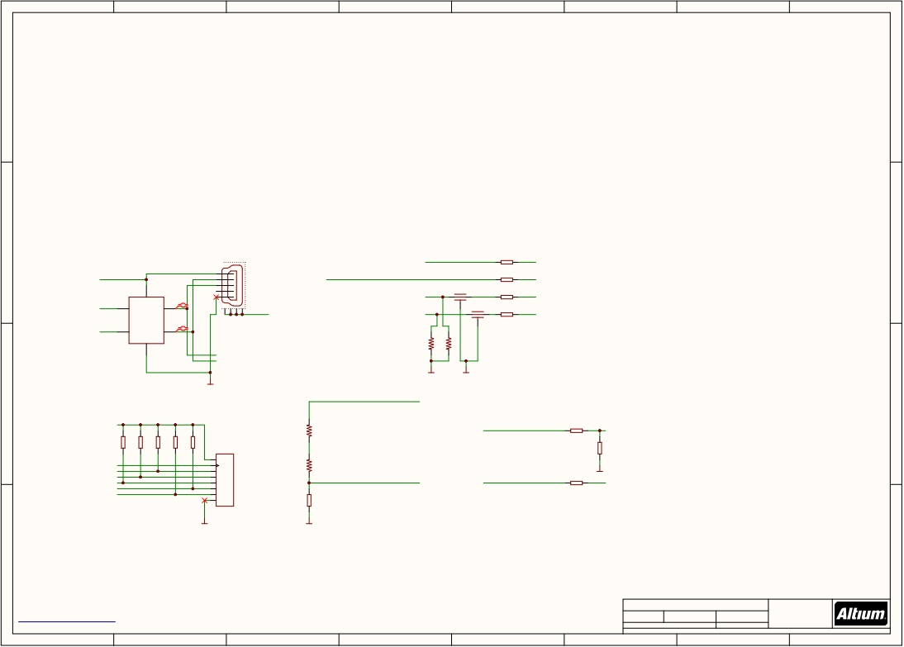
1
2
3
4
5
6
7
8
USB , SD Card 회로 구성 시 사용하는 보편적인 회로도
A
A
B
NUF2042XV6
USB Upstream Terminator
B
J2001
FMU_AUX_ADC2
8
9
AUX_BATT_CURRENT_SENS
VBUS
OTG_FS_P 4
1
FMU_AUX_POWER_ADC1
RN2002H 10K/0.1%
5
2
3
4
5
7 10 AUX_BATT_VOLTAGE_SENS
L2001 RN2002G 10K/0.1%
Kyocera KNH16C104DA5TS EMI filter
BATT_CURRENT_SENS_PROT 1 16 BATT_CURRENT_SENS
L2002 RN2002A 10K/0.1%
Kyocera KNH16C104DA5TS EMI filter
BATT_VOLTAGE_SENS_PROT
2
15
BATT_VOLTAGE_SENS
U2001
D2O
VBUS
NUF2042XV6
3
D2I
DO NOT FIT
USB_GND_SHIELD
OTG_FS_N 6
1
47346-0001
RN2002B 10K/0.1%
D1O
GND
D1I
1M
1M
2
OTG_P
OTG_N
R2003
R2004
To be used with panel-
mount micro USB connectors:
- Amphenol MUSBK15230
GND
GND
GND
C
VDD_SERVO
C
FMU-VDD_3V3
R2001
10K/0.1%
VDD_5V_SENS
16 100K
15 100K
14 100K
13 100K
12 100K
10K/0.1%
20K 저항을 쓰지않은 이유는 단가 절약 때문
VDD_5V_IN314
RN2002C
13
RN2001A
RN2001B
RN2001C
RN2001D
RN2001E
U2002
VCC
CLK
D2
D3
10K/0.1%
1
2
3
4
5
4
5
1
2
RN2002D
SDIO_CK
SDIO_D2
SDIO_D3
10K/0.1%
4
R2002
10K/0.1% GND
SDIO_CMD
3
CMD
VDD_SERVO_SENS
PRESSURE_SENS
5
12
PRESSURE_SENS_IN
SDIO_D0
SDIO_D1
7
8
6
D0
D1
GND
11
SERVO PORT 전원 연결 신호
5V VDD
전원 연결 신호
RN2002E
PRESSURE
2908-05WB-MG(3M5607CT-ND)
Card Connector microSD
RN2002F
10K/0.1%
2908-05WB-MG
microSD
6
GND
GND
D
D
Title
SD USB FMU3 REV C.SchDoc
*
*
http://creativecommons.org/licenses/by-sa/3.0
Size: A3
Number: *
Revision: *
*
*
PCB is NOT covered by this license, ONLY the Schematic.
The Cube Shape and the use of the DF17 Connector and the screw pattern for holding the cube is patented. DO NOT COPY
Date: 24/05/2018 Time: 2:16:20 PM Sheet 2 of 10
File: E:\Git\The-Cube\FMU\SD_USB_FMU_REV_1B.SchDoc
*
1
2
3
4
5
6
7
8

Slide 3
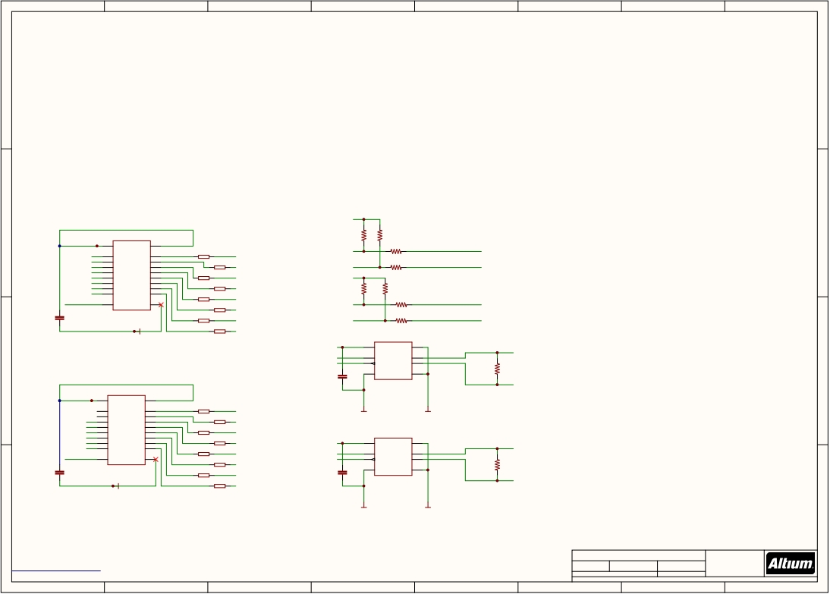
1
2
3
4
5
6
7
8
A
A
TXS0108QFN20(296-24806-1-ND)
-Voltage-Level Translator
-VCCA , VCCB에 같은 값을 넣어주는 이유? : Buffer 로서의 기능 수행, 신호 전달 시 신호 보호용
B
FMU-VDD_3V3
FMU-VDD_3V3
I2C PORT input
신호 보호용 회로
B
U3002
R3001
R3003
2
VCCA
VCCB
19
1K5
1K5
R3005
FMU-USART3_RTS 1
A1
B1
20
1
16
SERIAL2_RTS
FMU-I2C2_SCL
120R
I2C_2_SCL
FMU-USART3_CTS
A2
FMU-USART3_RX 4
A3
FMU-USART3_TX 5
A4
B2
B3
B4
18
17
16
RN3001A 120R
2 15 SERIAL2_CTS
RN3001B 120R
FMU-I2C2_SDA
R3006
120R
I2C_2_SDA
FMU-USART2_RX 6
A5
B5
15
3
14
SERIAL2_RX
FMU-VDD_3V3
FMU-USART2_TX 7
A6
FMU-USART2_RTS 8
A7
B6
B7
14
13
RN3001C 120R
4
13 SERIAL2_TX
R3002
1K5
R3004
1K5
FMU-USART2_CTS 9
A8
B8
12
5 12
RN3001E 120R
RN3001D 120R
SERIAL1_RX
R3007
Level_Shift Enable 10
OE
GND
11
6 11 SERIAL1_TX
RN3001F 120R
10 SERIAL1_RTS
FMU-I2C1_SCL
120R
R3008
I2C_1_SCL
C3002
TXS0108QFN20
7
FMU-I2C1_SDA
I2C1
I2C_1_SDA
0u1
GND
RN3001G 120R
8 9 SERIAL1_CTS
RN3001H 120R
120R
FMU-VDD_3V3
3
U3003
8
CAN2_TX
CAN2_RX
C3003
1
4
2
VCC
RS
7
6
5
CAN_H_2
DIN
DOUT
GND
CANH
CANL
SHDN
120R
R3009
C
FMU-VDD_3V3
0u1
CAN_L_2
C
3.3-V CAN TRANSCEIVER
2
U3001
19
MAX3051EKA+TCT-ND
1
3
VCCA
VCCB
20
18
1 16
RN3002A 120R
PROT_SPARE_1
A1
A2
B1
B2
GND
GND
FMU-UART7_RX 4
A3
B3
17
2
15 PROT_SPARE_2
FMU-UART7_TX 5
A4
B4
16
RN3002B 120R
FMU-UART8_RX 6
A5
FMU-UART8_TX 7
A6
B5
B6
15
14
3 14
RN3002C 120R
SERIAL5_RX
U3004
FMU-UART4_RX 8
A7
B7
13
4
13 SERIAL5_TX
FMU-VDD_3V3
3
VCC
RS
8
FMU-UART4_TX 9
A8
B8
12
5
RN3002D 120R
CAN_H_1
Level_Shift Enable 10
11
12
SERIAL4_RX
CAN1_TX
1
DIN
CANH
7
OE
GND
RN3002E 120R
CAN1_RX
4
DOUT
CANL
6
120R
C3001
6
11 SERIAL4_TX
C3004
2
5
R3010
0u1
TXS0108QFN20
7
RN3002G 120R
RN3002F 120R
10 SERIAL3_RX
0u1
GND
SHDN
CAN_L_1
GND
8 9 SERIAL3_TX
RN3002H 120R
3.3-V CAN TRANSCEIVER
D
GND
GND
D
Title
SERIAL FMU3 REV C.SchDoc
*
*
http://creativecommons.org/licenses/by-sa/3.0
Size: A3
Number: *
Revision: *
*
*
PCB is NOT covered by this license, ONLY the Schematic.
The Cube Shape and the use of the DF17 Connector and the screw pattern for holding the cube is patented. DO NOT COPY
Date: 24/05/2018 Time: 2:16:20 PM Sheet 3 of 10
File: E:\Git\The-Cube\FMU\SERIAL_FMU_REV_1B.SchDoc
*
1
2
3
4
5
6
7
8

Slide 4
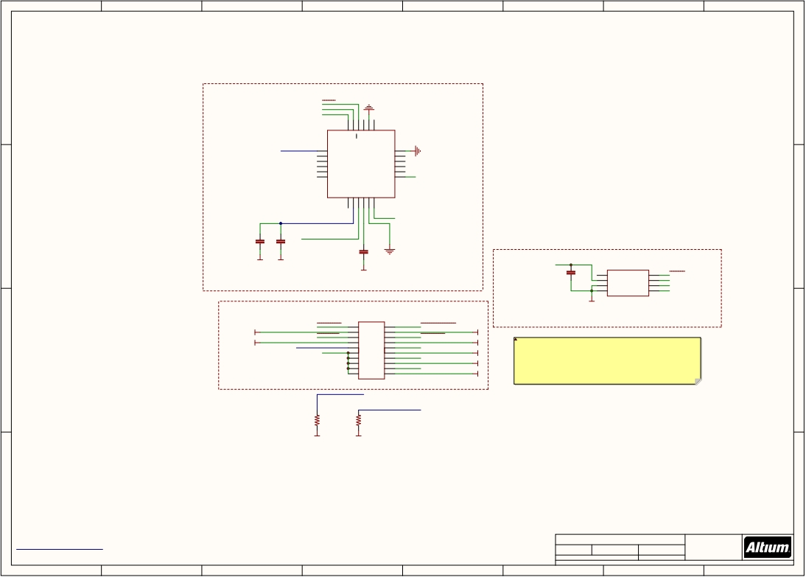
1
2
3
4
5
6
7
8
SENSORS
A
A
MPU_CS
SPI_INT_SCK
SPI_INT_MOSI
Pin 1
GND
24
23
22
21
20
19
CS
RESV
RESV
SDA/SDI
AUX_DA
VDD_3V3_SENSORS
1
2
3
4
5
6
NC
NC
NC
NC
NC
NC
SCL/SCLK
GND
NC
NC
NC
NC
VDD
18
17
16
15
14
13
GND
GND
VDD_3V3_SENSORS
AUX_CL
AD0/SDO
VDDIO
REGOUT
MPU9250
3축 자이로 및 3축 가속도계
FSYNC
INT
7
8
9
10
11
12
B
VDD_3V3_SENSORS
MPU-9250
U405
MPU_DRDY
B
C4002
C4003
SPI_INT_MISO
REGOUT
2u2
0u1
C4001
GND
GND
2u2
GND
VDD_3V3_SENSORS
C4006
U4003
GND
0u1
4
1
2
3
CSB1
VDD
PS
GND
CSB2
SDI/SDA
SDO
SCLK
5
7
6
8
BARO_CS
SPI_INT_MOSI
SPI_INT_MISO
SPI_INT_SCK
GND
MS5611-01BA
MS5611-01BA(824-MS561101BA03-05)
-기압계
GND
BARO_EXT_CS
MPU_EXT_CS
1
3
5
1
3
5
2
4
6
2
4
6
ACCEL_MAG_EXT_CS
GYRO_EXT_CS
GND
GND
7
IMU_TEMPERATURE_CONTROL 9
VDD_3V3_SENSORS 11
13
7
9
11
13
8
10
12
14
8
10
12
14
SPI_EXT_MOSI
SPI_EXT_MISO
GND
GND
duetotheseriallinesbeingabletobackpowerthecpu,TheSDcardcanendupinastatewhere it'sCPUdoesnotshutdowncorrectly,anditgoesintoabrownoutstate. ThiscancausetheSDcardtofailonstartup.ThisischarecterisedbyanSOStonefromthe buzzer,everysecondstartup. ThisresistorcausesthevoltagetoholdbelowthestartthresholdoftheSDcard,andtherfore stopsthecardenteringthebrownoutstate.
H11905CT-ND
-FPC 커넥터 PCB연결용 커넥터
C
15
17
15
17
16
18
16
18
SPI_EXT_SCK
GND
C
19
19
20
20
GND
VDD_3V3_SENSORS
FMU-VDD_3V3
R4001
220R
R4002
220R
GND
GND
D
D
http://creativecommons.org/licenses/by-sa/3.0
PCB is NOT covered by this license, ONLY the Schematic.
Title
SENSORS FMU3 REV C.SchDoc
*
*
The Cube Shape and the use of the DF17 Connector and the screw pattern for holding the cube is patented. DO NOT COPY
Size: A3
Number: *
Revision: *
*
*
Date: 24/05/2018 Time: 2:16:20 PM Sheet 4 of 10
File: E:\Git\The-Cube\FMU\SENSORS_FMU_REV_1B.SchDoc
*
1
2
3
4
5
6
7
8

Slide 5
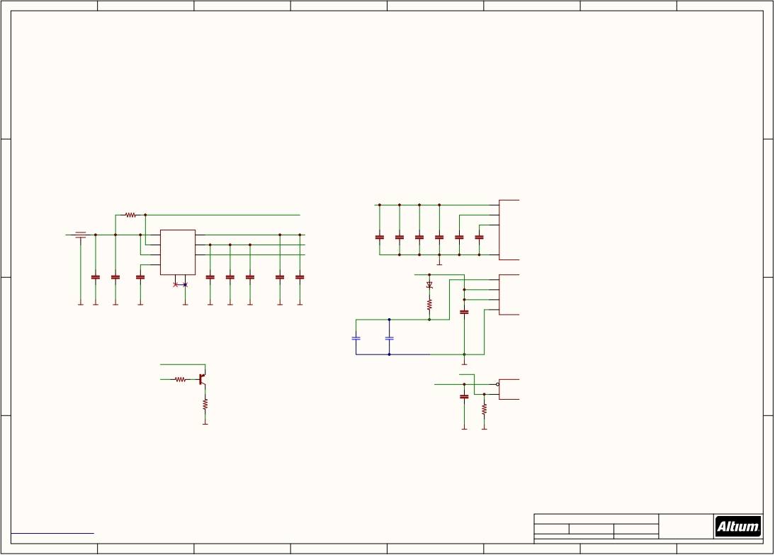
1
2
3
4
5
6
7
8
POWER
A
A
MIC5332(576-4110-1-ND)
Micro-Power High Performance Dual 300mA ULDO
-2.3V ~ 5.5V 입력전압 범위
-LDO당 300mA전류 출력
같은 커패시터가 병렬로 4개인 이유?
-메인 CPU각 면마다 입력전원 안정화를 위한 커패시터
Note: Maximise copper area connected
STM32F437VIT6
B
R5001
to center ground pad.
FMU-VDD_3V3
VDD
11 19 28 50 75 100
B
L5001
Kyocera KNH16C104DA5TS EMI filter
10K
U5001
MIC5332
VDD_3V3_SENSORS_EN
49
VCAP_1
C5009
0u1
C5010
0u1
C5011
0u1
C5012
0u1
C5013
2u2
73
VCAP_2
VDD_5V_IN
FMU-VDD_5V5
1
5
VIN
EN1
VOUT1
VOUT2
8
7
VDD_3V3_SENSORS
FMU-VDD_3V3
C5016 U1001M
2u2
4
EN2
POR2
3
FMU-!RESET
-리셋 슈퍼바이저 :
전원 공급 시 시스템 오류 감지 및 최소화 되도록 하고 시스템이 올바르게 시작되는지 확인
VSS
10 27 74 99
10n
6
CSET
1u
0u1
22u/25V
0u1
22u/25V
GND
FMU-VDD_3V3
STM32F437VIT6
U1001N
GND
2
D5001
6
VBAT
C5001
10u/25V
POR reset
delay 1s / uF
Schottky barrier diode 22
21
VDDA
VREF+
0u1
C5002
C5003
C5004
C5005
C5006
C5007
C5008
GND
GND
GND
GND
GND
GND
GND
GND
GND
GND
R5005
1K
C5014
20
VSSA
VBAT
0u1
VDD_3V3_SENSORS VDD_3V3_SENSORS_EN
C5100
100uF
20%
4V
C0805
C5101
100uF
20%
4V
C0805
C
C
1K8
Q5001
MMBT3906*SMD
GND
FMU-BOOT0
STM32F437VIT6
U1001L
센서 전원 입력 확인 신호
R5002
FMU-!RESET
0u1
14
94
NRST
BOOT0
R5003
10R
Drain resistor for
Sensor Power Rail
C5015
R5006
10K
GND
GND
GND
D
D
Title
FMU Power FMU3 REV C.SchDoc
*
*
http://creativecommons.org/licenses/by-sa/3.0
Size: A3
Number: *
Revision: *
*
*
PCB is NOT covered by this license, ONLY the Schematic.
The Cube Shape and the use of the DF17 Connector and the screw pattern for holding the cube is patented. DO NOT COPY
Date: 24/05/2018 Time: 2:16:20 PM Sheet 5 of 10 *
File: E:\Git\The-Cube\FMU\FMU_Power_FMU_REV_1B.SchDoc
1
2
3
4
5
6
7
8

Slide 6
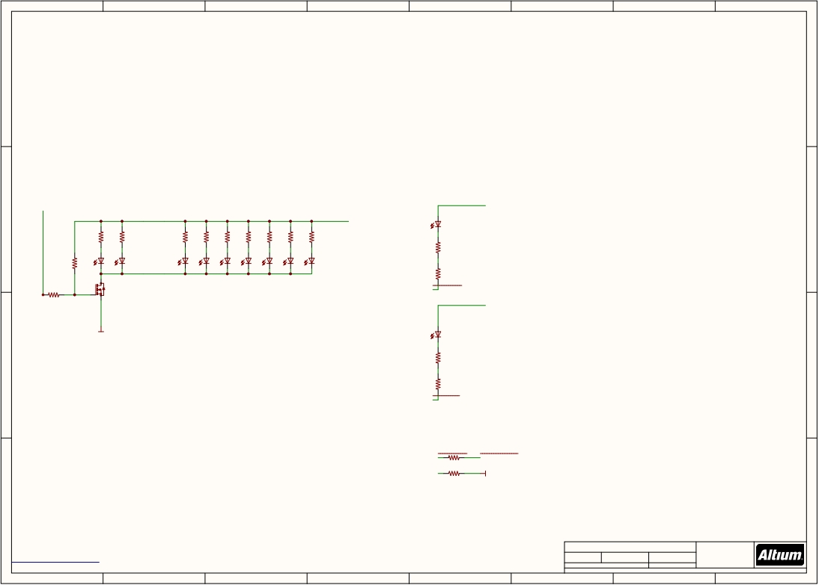
1
2
3
4
5
6
7
8
LED
A
A
I/O_POWER_BREATHING
220R
X 11
VDD_5V_IN
B
IO-VDD_5V5
LED6010
B
AMBER
R6003
R6004
R6007
R6008
R6009
R6010
R6011
R1
220R
R2
220R
R6012
LED6001
220R LED6002
220R LED6005
220R LED6006
220R LED6007
220R LED6008
220R LED6009
220R
R6002
10K
Breath_LED
LED1
LED2
R6013
220R
1K
Q6001
LED0603_Green
X 11
FMU-LED_AMBER
R6001
BSS123
IO-VDD_5V5
GND
LED6011
AMBER
C
R6014
220R
C
R6015
220R
IO-LED_AMBER
IO-LED_SAFETY
1K5
SAFETY
R6017
68R
IO-LED_SAFET_PROT
GND
R6016
D
D
Title
LEDs FMU3 REV C.SchDoc
*
*
http://creativecommons.org/licenses/by-sa/3.0
Size: A3
Number: *
Revision: *
*
*
PCB is NOT covered by this license, ONLY the Schematic.
The Cube Shape and the use of the DF17 Connector and the screw pattern for holding the cube is patented. DO NOT COPY
Date: 24/05/2018 Time: 2:16:21 PM Sheet 6 of 10
File: E:\Git\The-Cube\FMU\LEDs_FMU_REV_1B.SchDoc
*
1
2
3
4
5
6
7
8

Slide 7
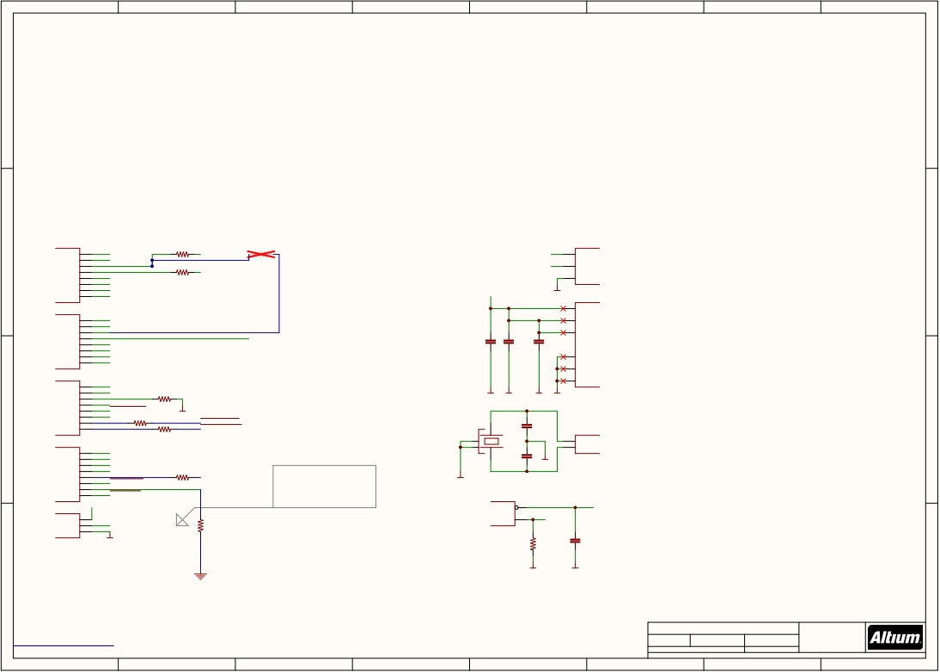
1
2
3
4
5
6
7
8
A
A
ST STM32F101/103 48pin LQFP
PA010 IO-CH1
11 IO-CH2
PA1
U7001A
U7001H
R7003
220R
R7013
220R
1
9
8
B
SERIAL_IO_TO_FMU
VBAT
VBAT VDDA VSSA
B
PA2
PA3
12
13
R7004
SERIAL_FMU_TO_IO
IO-VDD_3V3
PA4
PA5
14
15
VDD_SERVO_SENS
RSSI_IN
220R
16
IO-CH5
PA6
17
IO-CH6
PA7
ST STM32F101/103 48pin LQFP
29
PPM_INPUT
PA8
IO-VDD_3V3
GND
ST STM32F101/103 48pin LQFP
U7001E
VDD_1
VDD_2
U7001B
24
36
PA9
PA10
30
31
IO-USART1_TX Routed to FMU for debug purposes
IO-USART1_RX_SPECTRUM_DSM
C7002
C7003
C7006
48
VDD_3
PA11
32
I/O_POWER_BREATHING
PA12
PA13
PA14
PA15
33
34
37
38
RSSI_IN
IO-SWDIO
IO-SWCLK
IO-!VDD_SERVO_IN_FAULT
0u1
0u1
0u1
23
35
47
VSS_1
ST STM32F101/103 48pin LQFP
18
IO-CH7
PB0
U7001C
VSS_2
VSS_3
PB1
PB2
19
20
IO-CH8
IO-BOOT1
R7002
GND
GND
GND
GND
ST STM32F101/103 48pin LQFP
PB3
39
IO-SWO 10K
C
PB4
PB5
PB6
PB7
40
41
42
43
SBUS_OUTPUT_EN
SAFETY R7010 220R
220R
GND
R7011
VDD_BRICK_VALID
VDD_BACKUP_VALID
C7004
8p
C
X7001
5
6
U7001G
ST STM32F101/103 48pin LQFP
45 IO-CH3
PB8
46
IO-CH4
PB9
21
SBUS_OUTPUT
PB10
U7001D
C7005
8p
PD0/OSC<=
PD1/OSC=>
ST STM32F101/103 48pin LQFP
PB11
22
SBUS_INPUT
GND
PB12
PB13
PB14
PB15
25
26
27
28
IO-LED_SAFETY
IO-LED_AMBER
220R
FMU-VDD_3V3
R7012
IMU_TEMPERATURE_CONTROL
PixHawk 1:PC14 Floating
PC15 Floating
PixHawk 2:PC14 3.3v
PC15 GND
GND
Crystal Oscillator in 3.2x2.5 SMD
ST STM32F101/103 48pin LQFP
U7001I
VDD_3V3_SPEKTRUM_EN
ST STM32F101/103 48pin LQFP
2
HARDWARE BIT 0
PC13
U7001F
NRST
BOOT0
7
44
IO-BOOT0
IO-!RESET
PC14
PC15
3
4
IO-VDD_3V3
GND
R7015 10K
10K
0u1
note:
R7001
C7001
Timer allocation:
PA0: TIM2_CH1: IO-CH1
PA1: TIM2_CH2: IO-CH2
PB8: TIM4_CH3: IO-CH3
GND
GND
D
GND
PB9: TIM4_CH4: IO-CH4
PA6: TIM3_CH1: IO-CH5
PA7: TIM3_CH2: IO-CH6
D
PB0: TIM3_CH3: IO-CH7
PB1: TIM3_CH4: IO-CH8
PA8: TIM1_CH1: PPM_IN
PA11: TIM1_CH4: RSSI_IN
Title
IO FMU3 REV C.SchDoc
*
*
http://creativecommons.org/licenses/by-sa/3.0
Size: A3
Number: *
Revision: *
*
*
PCB is NOT covered by this license, ONLY the Schematic.
The Cube Shape and the use of the DF17 Connector and the screw pattern for holding the cube is patented. DO NOT COPY
Date: 24/05/2018 Time: 2:16:21 PM Sheet 7 of 10
File: E:\Git\The-Cube\FMU\IO_FMU_REV_1B.SchDoc
*
1
2
3
4
5
6
7
8

Slide 8
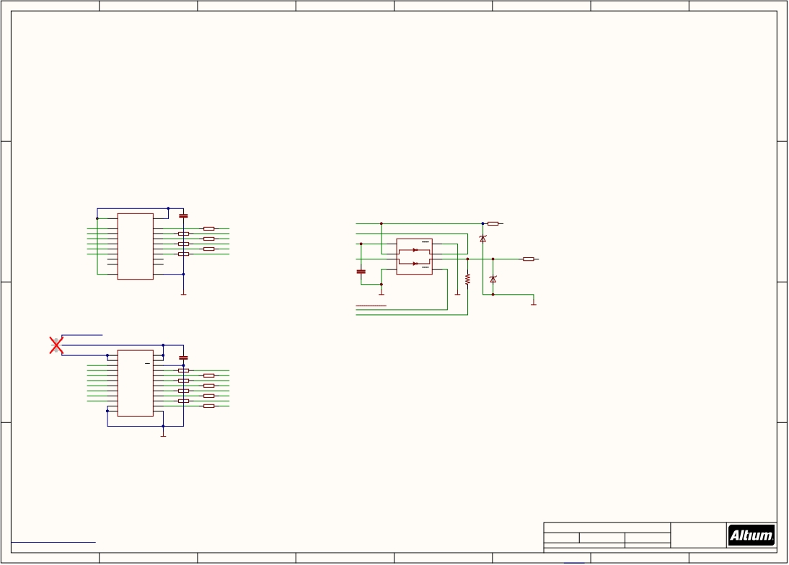
1
2
3
4
5
6
7
8
A
A
TXS0108QFN20(296-24806-1-ND)
-Voltage-Level Translator
-VCCA , VCCB에 같은 값을 넣어주는 이유? : Buffer 로서의 기능 수행, 신호 전달 시 신호 보호용
568-8979-1-ND
Dual inverting buffer/line driver
-transceiver 로 사용
-S.Bus란? : Futaba ,frsky 에서 사용하는 직렬 통신 프로토콜
하나의 신호 케이블로 최대 18개의 채널을 지원
역전된 UART통신이기 때문에 내장된 신호 변환기를 통해 신호를 반전 시켜야 합니다.
B
Servo outputs
FMU-VDD_3V3
U8001
2
VCCA
C8002
0u1
S.Bus in/out
B
FMU-CH1
FMU-CH2
FMU-CH3
1
3
4
VCCB
19
PPM_INPUT
Dual inverter tri-state, 3.3V/5V
7
10 PPM-SBUS-PROT
A1
A2
A3
B1
B2
B3
20
18
17
1
16
2
RN8002B 120R 3 14
FMU-CH1-PROT
FMU-CH2-PROT
FMU-CH3-PROT
RN8002G 120R
D8001
FMU-CH4
FMU-CH5
FMU-CH6
5
6
7
8
16
15
14
13
15 RN8002A
120R
SBUS_INPUT
U8003
4
RN8002D 120R 5 12
6 11 RN8002E 120R
RN8002F 120R
A4
A5
A6
A7
B4
B5
B6
B7
13 RN8002C
120R
FMU-CH4-PROT
FMU-CH5-PROT
FMU-CH6-PROT
IO-VDD_3V3
SBUS_OUTPUT
8
2
5
VCC
1A
2A
1OE
1Y
2Y
1
6
3
DIODE-TVS
SBUS_UNPROTECTED 8
9
A8
B8
12
C8001
4
7
RN8002H 120R
9 S.BUS_OUT
10
OE
GND
11
0u1
GND
2OE
R8001
D8002
TXS0108QFN20
10K
DIODE-TVS
GND
GND
GND
GND
SBUS_OUTPUT_EN
RSSI_IN
J_1-2
3
2
1
IO-VDD_5V5
C
JP1
IO-VDD_3V3
IO-CH8
1
2
3
U8002
24
23
22
C8003
0u1
C
VCCA
DIR
A1
VCCB
VCCB
OE
IO-CH7
4
A2
B1
21
1
16
IO-CH8-PROT
IO-CH6
5
A3
B2
20
RN8001A 120R 15
IO-CH7-PROT
IO-CH5
6
A4
B3
19
3
14 RN8001B 120R
IO-CH6-PROT
IO-CH4
IO-CH3
IO-CH2
IO-CH1
7
8
9
10
11
12
A5
A6
A7
A8
GND
GND
B4
B5
B6
B7
B8
GND
18
17
16
15
14
13
RN8001C 120R 4 13
5 12 RN8001D 120R
6 11
7 10 RN8001F 120R
RN8001G 120R 8 9
RN8001H 120R
IO-CH5-PROT
IO-CH4-PROT
IO-CH3-PROT
IO-CH2-PROT
IO-CH1-PROT
RN8001E
120R
SN74LVC8T245
GND
SN74LVC8T245 => TXS0108QFN20 로 교체
D
D
Title
PWM PPM FMU3 REV C.SchDoc
*
*
http://creativecommons.org/licenses/by-sa/3.0
Size: A3
Number: *
Revision: *
*
*
PCB is NOT covered by this license, ONLY the Schematic.
The Cube Shape and the use of the DF17 Connector and the screw pattern for holding the cube is patented. DO NOT COPY
Date: 24/05/2018 Time: 2:16:21 PM Sheet 8 of 10
File: E:\Git\The-Cube\FMU\PWM_PPM_FMU_REV_1B.SchDoc
*
1
2
3
4
5
6
7
8

Slide 9
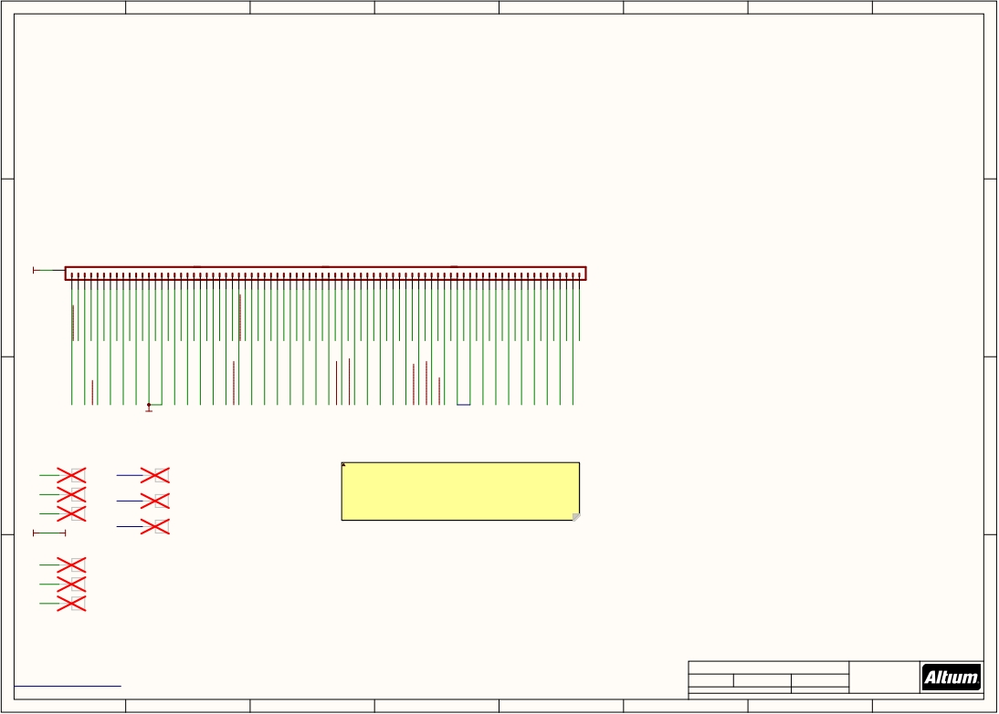
1
2
3
4
5
6
7
8
A
A
GND
CON-DF17-80F
U$9001
B
GND
1
GND
B
2
3
5
7
9
11
13
15
17
19
21
23
24
25
27
29
31
33
35
37
39
41
43
45
47
48
49
51
53
55
57
59
61
63
65
67
69
71
73
75
77
79
4 I2C_2_SDA
IO-USART1_RX_SPECTRUM_DSM
6 I2C_2_SCL
8 CAN_L_3
10 CAN_H_3
12 SERIAL5_RX
14 SERIAL5_TX
16 SERIAL4_RX
18 SERIAL4_TX
20 SERIAL3_RX
22 SERIAL3_TX
26 IO-VDD_3V3
28 IO-LED_SAFET_PROT
30 SERIAL2_RTS
32 SERIAL2_CTS
34 SERIAL2_RX
36 SERIAL2_TX
38 SERIAL1_RX
40 SERIAL1_TX
42 SERIAL1_RTS
44 SERIAL1_CTS
46 IO-USART1_TX
50 FMU-CH1-PROT
52 FMU-CH2-PROT
54 FMU-CH3-PROT
56 FMU-CH4-PROT
58 FMU-CH5-PROT
60 FMU-CH6-PROT
62 PPM-SBUS-PROT
64 S.BUS_OUT
66 IO-CH8-PROT
68 IO-CH7-PROT
70 IO-CH6-PROT
72 IO-CH5-PROT
74 IO-CH4-PROT
76 IO-CH3-PROT
78 IO-CH2-PROT
FMU-LED_AMBER
80 IO-CH1-PROT
ALARM
BATT_VOLTAGE_SENS_PROT
AUX_BATT_VOLTAGE_SENS
BATT_CURRENT_SENS_PROT
VDD_3V3_SPEKTRUM_EN
AUX_BATT_CURRENT_SENS
VDD_5V_HIPOWER_OC
PRESSURE_SENS_IN
VDD_5V_PERIPH_EN
VDD_5V_PERIPH_OC
VDD_BACKUP_VALID
VDD_5V_IN_PROT_1
VDD_5V_IN_PROT_2
VDD_SERVO_IN
SPI_EXT_MOSI
VDD_BRICK_VALID
VDD_5V_IN_PROT_3
FMU-SWDIO
FMU-SWCLK
EXTERN_CS
FMU-!RESET
EXTERN_DRDY
I2C_1_SDA
I2C_1_SCL
VDD_SERVO
VBUS_VALID
SPI_EXT_MISO
SPI_EXT_SCK
CAN_L_2
CAN_H_2
IO-SWDIO
IO-SWCLK
IO-!RESET
SAFETY
VBUS
OTG_P
OTG_N
CAN_L_1
CAN_H_1
GND
VDD_5V_IN
C
C
IO-SWDIO
IO-SWDIO
VDD_5V_IN
5v
Changefrom1A dedicated"Spare"pinsforfutureCAN3 Removedexternal5v5IOandusedpinfor5Vin3(reservedforfutureuse.)
IO-SWCLK
IO-SWCLK
SERIAL5_TX
TX5
IO-VDD_3V3
IO-VDD_3V3
RX5
GND
GND
FMU-SWDIO
SERIAL5_RX
FMU-SWDIO
FMU-SWCLK
FMU-SWCLK
FMU-VDD_3V3
FMU-VDD_3V3
D
D
Title
The Cube TM
*
*
http://creativecommons.org/licenses/by-sa/3.0
Size: A3
Number: *
Revision: *
*
*
PCB is NOT covered by this license, ONLY the Schematic.
The Cube Shape and the use of the DF17 Connector and the screw pattern for holding the cube is patented. DO NOT COPY
Date: 24/05/2018 Time: 2:16:21 PM Sheet 9 of 10
File: E:\Git\The-Cube\FMU\80PIN_FMU_REV_1B.SchDoc
*
1
2
3
4
5
6
7
8

Slide 10
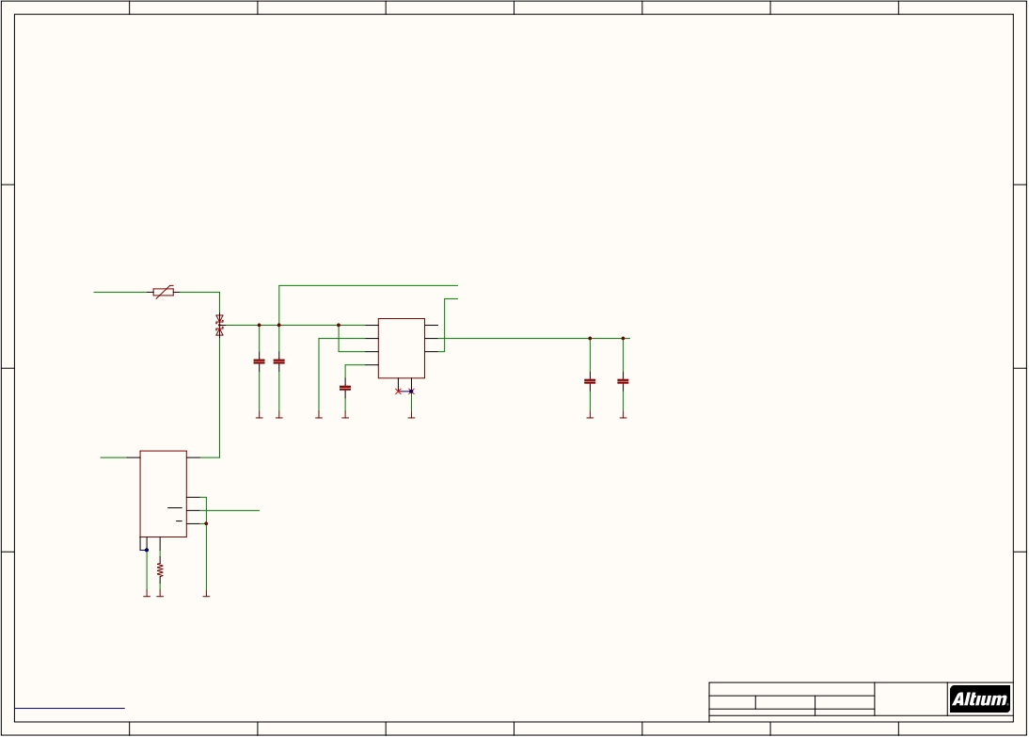
1
2
3
4
5
6
7
8
A
A
0ZCA0035FF2G(507-1479-1-ND)
-PTC 리셋 가능 퓨즈
-열에 따른 저항 변화
-전류 Ih : 350mA It : 750mA
-최대 전압 : 16V
-과전압 방지
MIC5332(576-4110-1-ND)
Micro-Power High Performance Dual 300mA ULDO
-2.3V ~ 5.5V 입력전압 범위
-LDO당 300mA전류 출력
-VOUT 2 만 사용
B
VDD_5V_IN
F10001
IO-VDD_5V5
B
0ZCA0035FF2G
U10002
MIC5332
IO-!RESET
Dual supply from
servo rail and FMU 5V rail
PMEG2005CT
1
VIN
VOUT1
8
D10001
5
EN1
VOUT2
7
IO-VDD_3V3
C10001
10u/25V
C10002
0u1
4
6
EN2
CSET
POR2
3
BQ24313
과전압 및 과전류 보호 IC
LDO전압 조절
최대 10.5V 입력전압
LDO 5.5V 출력전압 제한
C10003
GND
2
C10004
C10005
10n
10u
1u
GND
GND
GND
GND
GND
GND
GND
U10001 BQ24313
Reset output 1s / uF
10n = 10ms delay from power good
C
VDD_SERVO_IN 1
IN
OUT
8
to reset de-asserted.
C
Output voltage limited to 5.5V for
input voltages up to 10.5V; output
switches off at higher input voltages.
6
VBAT
4
IO-!VDD_SERVO_IN_FAULT
Current limit = 25 / Rilim
(current in A, R in kOhms)
100K = 250mA
FAULT
5
VSS
VSS
ILIM
CE
2
GND
7
100K
R10001
GNDGND
GND
D
D
Title
IO PWR FMU3 REV C.SchDoc
*
*
http://creativecommons.org/licenses/by-sa/3.0
Size: A3
Number: *
Revision: *
*
*
PCB is NOT covered by this license, ONLY the Schematic.
The Cube Shape and the use of the DF17 Connector and the screw pattern for holding the cube is patented. DO NOT COPY
Date: 24/05/2018 Time: 2:16:22 PM Sheet 10 of 10
File: E:\Git\The-Cube\FMU\IO_PWR_FMU_REV_1B.SchDoc
*
1
2
3
4
5
6
7
8

Slide 11
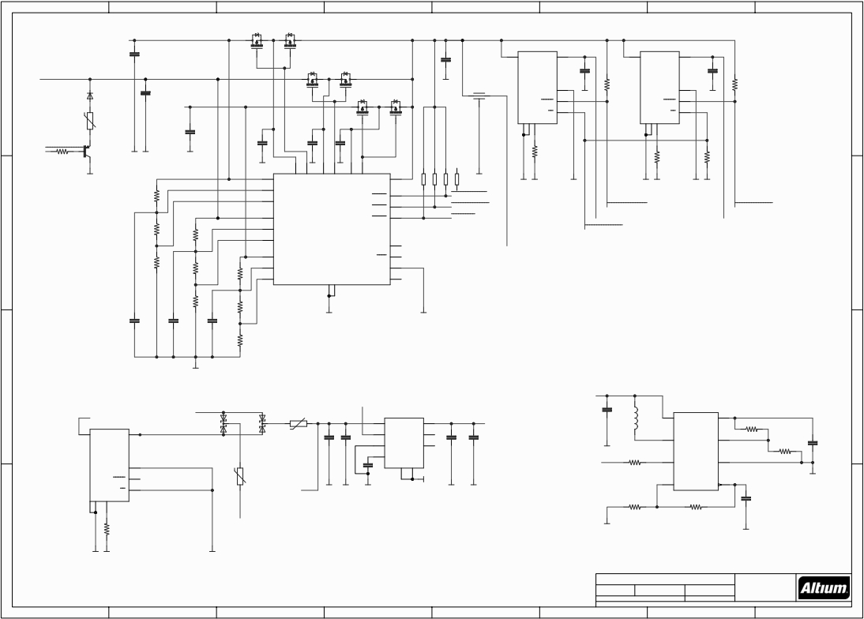
1
2
3
4
5
6
7
8
VDD_5V_BRICK
MOSFET-DUAL-PCHANNEL-CHIPFET
U801A U801B
MOSFET-DUAL-PCHANNEL-CHIPFET
VDD_5V_IN
1
IN
C801
100u
C810
100u
1
U401
IN
BQ24315
8
OUT
U402
BQ24315
8
OUT
MOSFET-DUAL-PCHANNEL-CHIPFET
C401
C402
A
VDD_5V_BACKUP
U802A U802B
MOSFET-DUAL-PCHANNEL-CHIPFET
GND L603
MOSFET-DUAL-PCHANNEL-CHIPFET
MOSFET-DUAL-PCHANNEL-CHIPFET
10u
GND
R402
10u
GND
R405
A
C803
100u
Kyocera KNH16C104DA5TS EMI VBAT 6
1M
1M
D4
filter
FAULT
VBAT
FAULT
6
4
MMSZ5232BT1G
U804A U804B 4
0ZCA0035FF2G
VBUS
VDD_5V_IN
VSS
VSS
ILIM
CE
5
VSS
VSS
ILIM
CE
5
F3
C805
GND
2
7
GND
2
7
1K
Q5001
100u
C807
C808
C809
16K5
R401
VDD_BACKUP_VALID
GND GND
MMBT3906*SMD
GND
0u1 25v
0u1 25v
0u1 25v
25K5
R403
10K
R404
R5002
GND
P$18
P$17
GND
P$16
P$15
GND
P$14
P$13
7
6
5
8
GND
RN801B1M
RN801C1M
RN801D1M
RN801A1M
P$21
P$1
P$2
V1
UV1
OV1
VS1
G1
VS2
G2
VS3
G3
VOUT
VALID1
VALID2
P$12
P$7
P$8
2
3
4
GND
VDD_BRICK_VALID
VDD_BACKUP_VALID
GND GND
GND
Current Limits:
I(limit) = 25000 / R(ilim)
25K = 1A, 16K5 = 1.5A
GNDGND
VDD_5V_HIPOWER_OC
GNDGND
453K
R801
1
P$20
P$9
VBUS_VALID
VDD_5V_HIPOWER
VDD_5V_PERIPH_OC
R802
P$3
V2
LTC4417
VALID3
VDD_5V_PERIPH_EN
VDD_5V_PERIPH
B
56K
453K
R804
P$4
UV2
B
OV2
EN
P$22
VDD_5V_IN_PROT
105K
R803
56K
R805
P$19
P$5
P$6
V3
UV3
OV3
SHDN
HYS
CAS
P$23
P$24
P$11
453K
R807
GND
GND
P10
P25
각 포트에 전원공급
105K
R806
56K
R808
C802
10p/25V
C804
10p/25V
C806
1000p/25V
GND
GND
LTC4417
Prioritized PowerPath Controller
입력전원(VS1, VS2, VS3)의 우선순위에 따른 공통 출력(VOUT)
다수 입력 간 전환
105K
R809
GND
Power source selector
C
LT3469
오디오 증폭기
C
VDD_5V_IN
U2
LT3469
VIN
SW
SERVO_POWER_IN
U10001 BQ24313
8
IN OUT
VDD_5V_IN
0ZCA0020FF2E
VDD_3V3_SPEKTRUM_EN
U1
MIC5332
1
VIN
5
EN1
4
EN2
C7
1u
GND
L1
47uH
D1
D3
VOUT1
VOUT2
POR2
8
7
3
VDD_3V3_SPEKTRUM
3
5
VCC
FB
6
2
R1
453K
1
PMEG2005CT
PMEG2005CT
F4
C2
10u/25V
C5
0u1
C4
10u
C3
1u
C6
0u47
6
C1
10n
9K09
R2
VBAT
6
0ZCA0035FF2G
CSET
ALARM
R5
7
+IN
GND
4
16K5
FAULT
CE
4
5
F1
GND
2
GND
8
-IN
OUT
1
BUZZER_OUT
C8
GND
VSS
VSS
ILIM
NC
GND
GND
GND
GND
GND
Component values taken directly from
the LTC evaluation design.
2
GND
7
Note that the ALARM input should idle
low to minimise power dissipation.
10K
100K
5n6
RX
R4
R3
16K5
R10001
Current Limits:
GND
GND
D
I(limit) = 25000 / R(ilim)
25K = 1A, 16K5 = 1.5A
D
GNDGND
GND
PSM components SchDoc
Title
Size:
*
*
*
*
Number: *
Revision: *
Date: 24/05/2018 Time: 1:05:31 PM Sheet * of *
File: E:\Git\The-Cube\PSM\PSM_components.SchDoc
*
1
2
3
4
5
6
7
8

Slide 12
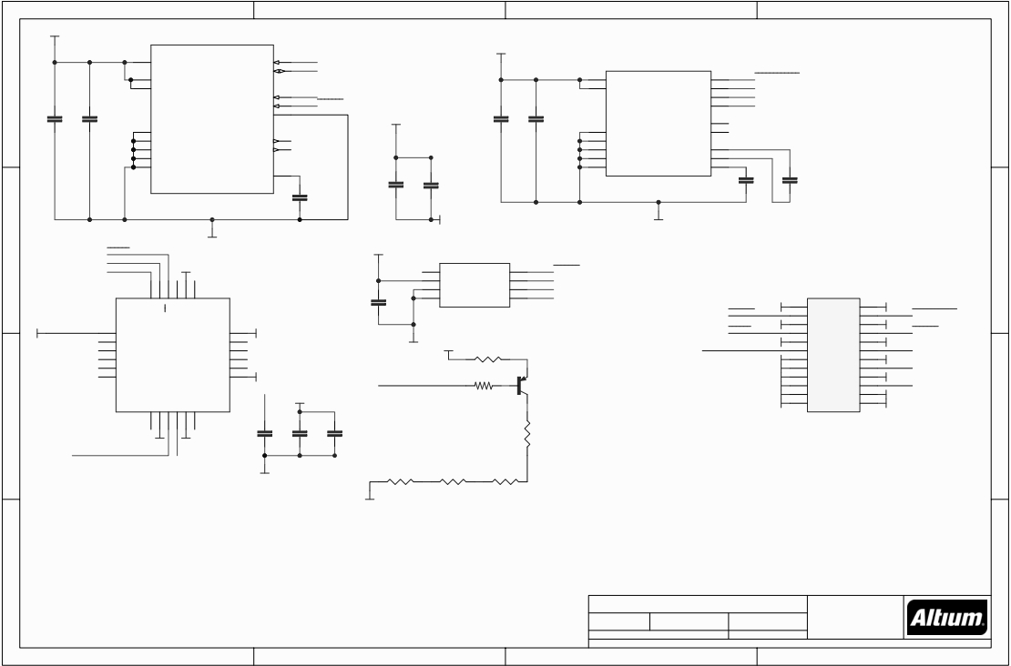
1
2
3
4
+3V3
U1
IMU_SCK
IMU_MOSI
IMU_MISO
GYRO_CS
+3V3
U2
VDD
VDD_IO
RSRV
GND
GND
GND
GND
1
15
16
9
10
11
12
13
VDD_IO
VDD
VDD
GND
GND
GND
GND
GND
SCL/SPC
SDA/SDI/SDO
SDO/SA0
CS
GND
INT1
DRDY/INT2
CAP
2
3
4
5
8
7
6
14
A
14
1
10
5
12
13
16
CS
SCL/SPC
SDA/SDI/SDO
SDO/SA0
INT1
INT2
SETC
SETP
C1
8
4
6
7
11
9
2
3
15
ACCEL_MAG_CS
IMU_SCK
IMU_MOSI
IMU_MISO
C6 C7
A
C1
C2
+3V3
C13
C4
C5
C3
C14
LSM303D
L3GD20
GND
GND
GND
전압출력 DAC
B
MPU_CS
IMU_SCK
IMU_MOSI
+3V3
MS5611
C12
U4
CSB1
VDD
PS
GND
B
GND
4
1
2
3
CSB2
SDI/SDA
SDO
SCLK
5
7
6
8
BARO_CS
IMU_MOSI
IMU_MISO
IMU_SCK
24
23
22
21
20
19
P1
CS
RESV
RESV
MS5611-01BA
MS5611-01BA
기압센서
BARO_CS
GND
GND GND
1 2
GND
ACCEL_MAG_CS
SDA/SDI
AUX_DA
SCL/SCLK
GND
MPU_CS
GND
IMU_TEMPERATURE_CONTROL
+3V3
+3V3
+3V3
+3V3
+3V3
GND
3 4
5 6
7 8
9 10
11 12
13 14
15 16
17 18
19 20
GND GND
GND
GND
GND
GND
GND
GND
+3V3
1
2
3
4
5
6
NC
NC
NC
NC
NC
NC
GND
NC
NC
NC
NC
VDD
18
17
16
15
14
13
GND
+3V3
REGOUT
+3V3
GYRO_CS
IMU_MOSI
IMU_MISO
IMU_SCK
GND +3V3
R5
IMU_TEMPERATURE_CONTROL
Q5001
AUX_CL
AD0/SDO
R5002
VDDIO
REGOUT
FSYNC
INT
MPU9250
R4
DF40C-20DP
C
7
8
9
10
11
12
C8
C9
C10
기판간 FPC커넥터
C
IMU_MISO
+3V3
GND
IMU 온도 컨트롤러
MPU9250
3축자이로 및 3축 가속도계
R1
R2
R3
D
IMU For The CUBE
Proficnc
Black Hill
D
Title
Ballarat
Victoria 3350
Size:
A4
Number: *
Revision: 3
Date: 24/05/2018 Time: 12:12:50 PM Sheet 1 of 1
File: E:\Git\The-Cube\IMU\IMU_REV_1A.SchDoc
Australia
1
2
3
4

Slide 13
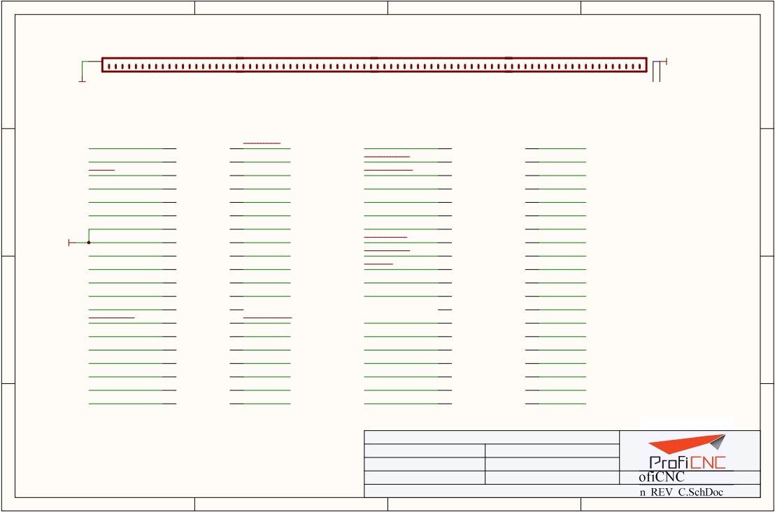
17-80M
1
2
3
4
hole-1
hole-2
A
GND |  | GND
GND
A
hole-1
hole-2
GND
FMU-SWDIO
FMU-SWCLK
EXTERN_CS
FMU-!RESET
VDD_SERVO_IN
EXTERN_DRDY
1
3
5
7
9
11
2
FMU-LED_AMBER
4
I2C_2_SDA
6
I2C_2_SCL
8
CAN_L_3
10 CAN_H_3
12 SERIAL5_RX
CAN_H_2
VDD_5V_PERIPH_OC
VDD_5V_HIPOWER_OC
BATT_VOLTAGE_SENS_PROT
BATT_CURRENT_SENS_PROT
SPI_EXT_MOSI
41
43
45
47
49
51
42 SERIAL1_RTS
44 SERIAL1_CTS
46 IO-USART1_TX
48 IO-USART1_RX_SPECTRUM_DSM
50 FMU-CH1-PROT
52 FMU-CH2-PROT
B
B
13
15
14 SERIAL5_TX
16 SERIAL4_RX
VDD_SERVO
VDD_BRICK_VALID
53
55
54 FMU-CH3-PROT
56 FMU-CH4-PROT
GND
SAFETY
VDD_3V3_SPEKTRUM_EN
PRESSURE_SENS_IN
AUX_BATT_VOLTAGE_SENS
AUX_BATT_CURRENT_SENS
VDD_5V_PERIPH_EN
VBUS
OTG_DP1
OTG_DM1
I2C_1_SDA
I2C_1_SCL
CAN_L_2
17
19
21
23
25
27
29
31
33
35
37
39
18 SERIAL4_TX
20 SERIAL3_RX
22 SERIAL3_TX
24 ALARM
26
28 IO-LED_SAFET_PROT
30 SERIAL2_RTS
32 SERIAL2_CTS
34 SERIAL2_RX
36 SERIAL2_TX
38 SERIAL1_RX
40 SERIAL1_TX
VDD_BACKUP_VALID
VBUS_VALID
VDD_5V_IN_PROT
VDD_5V_IN_PROT
SPI_EXT_MISO
IO-SWDIO
IO-SWCLK
SPI_EXT_SCK
IO-!RESET
CAN_L_1
CAN_H_1
57
59
61
63
65
67
69
71
73
75
77
79
58 FMU-CH5-PROT
60 FMU-CH6-PROT
62 PPM-SBUS-PROT
64 S.BUS_OUT
66 IO-CH8-PROT
68 IO-CH7-PROT
70 IO-CH6-PROT
72 IO-CH5-PROT
74 IO-CH4-PROT
76 IO-CH3-PROT
78 IO-CH2-PROT
80 IO-CH1-PROT
C
C
DF17(1.0H)-80DP-0.5V(57)-ND
Title: FULL_CB_80_Pin_REV_C.SchDoc
Date: 24/05/2018 Time: 12:58:46 PM
Sheet:* of: * Drawn By: Philip Rowse
Approved: * Checked By: * ProfiCNC
D
D
https://creativecommons.org/publicdomain/zero/1.0/
Title: E:\Git\The-Cube\CB_REV_C_Altium\FULL_CB_80_Pin_REV_C.SchDoc
1
2
3
4

Slide 14
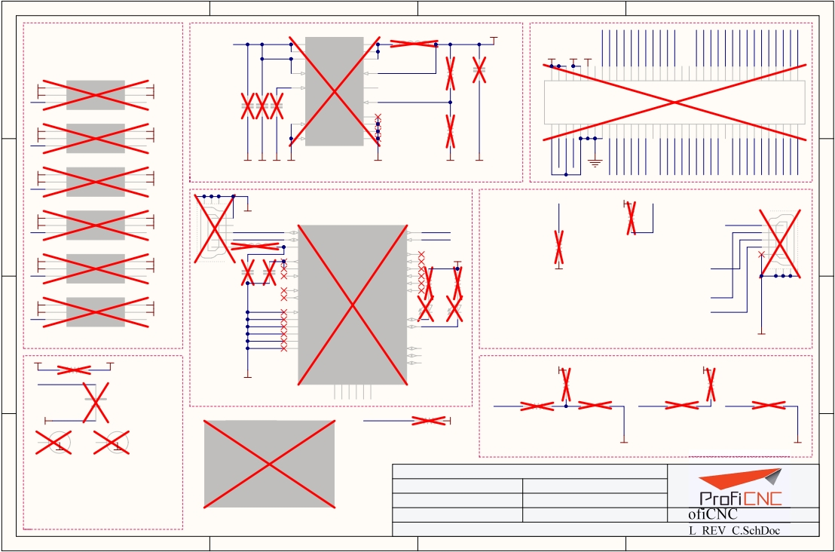
1
2
3
4
U601
L600
4V38
VDD_5V_HIPOWER
11
12
10
PVIN
PVIN
AVIN
SW
SW
SW
1
2
3
994-XFL4020-222MEB C6 R600 |  |  |  | 00
UART_2_RX
RESET_OUT#
SD_0_CLK_FB
UART_1_TX
SD_0_DAT2
SD_0_DAT0
SD_0_DAT3
USB_VBUS
SD_0_CLK
SD_0_DAT1
SD_0_CD#
USB_DP
SD_0_CMD
VSYS
3V3 1V8
USB_DN
GP44
GP45
GP46
GP47
GP48
GP49
GP15
GP14
GP42
GP40
GP41
GP43
A
LV600
VCC_A VCC_B
GND DIR
i/o_A i/o_B
13
9
EN
SS/TR
VOS
PG
FB
14
4
5
47K
1%
490-7611-1-ND
2
4
6
8
10
12
14
16
18
20
22
24
26
28
30
32
34
36
38
40
42
44
46
48
50
52
54
56
58
60
62
64
66
68
70
A
P600
DF40-70_RE
H11908CT-N
1
1V8
2
GND
UART_1_TX 3
6
5
4
3V3
1V8
SERIAL2_RX
490-5523-6-ND
311-1047-1-ND
311-1047-1-ND
0u1 33000pf
C601 10.00UF
SN74LVC1T45
296-20629-1-ND LV601
VCC_A VCC_B
GND DIR
i/o_A i/o_B
C602 C603
8
7
EP
DEF AGND
PGND
FSW PGND
TPS62130RGTT
17
6
15
16
1
1V8
2
GND
UART_1_RX 3
6
5
4
3V3
GND
SERIAL2_TX
R603
10.5K
1
3
5
7
9
11
13
15
29
49
1%
MSIC_SLP_CLK3
17 PWRBTN#
19 FAULT
21 PSW
23 V_VBAT_BKUP
25 GP165
27 UART_2_TX
31 RCVR_MODE
33 GP13_PWM1
35 GP12_PWM0
37 GP182_PWM2
39 GP183_PWM3
41 I2C_1_SCL_ED
43 I2C_1_SDA_ED
45 I2C_6_SCL
47 I2C_6_SDA
51 SPI_2_FS1
53 SPI_2_FS0
55 SPI_2_CLK
57 SPI_2_TXD
59 SPI_2_RXD
61 UART_1_RX
63 UART_1_RTS
65 UART_1_CTS
67 OSC_CLK_OUT_0
SN74LVC1T45
USB_ID
69 FW_RCVR
1V8
GND
1
2
UART_1_CTS 3
LV602 296-20629-1-ND
6
5
4
GNDGNDGNDGND
GND
GND
GND
GND
VCC_A VCC_B
GND DIR
i/o_A i/o_B
3V3
GND
SERIAL2_RTS
SN74LVC1T45
LV603 296-20629-1-ND
VCC_A VCC_B
GND DIR
i/o_A i/o_B
SN74LVC1T45
LV604 296-20629-1-ND
VCC_A VCC_B
GND DIR
i/o_A i/o_B
SN74LVC1T45
LV605 296-20629-1-ND
VCC_A VCC_B
GND DIR
i/o_A i/o_B
SN74LVC1T45
296-20629-1-ND
VSYS
R609
USB600
GND
240-2389-6-ND
0u1 0u1
C605 C604
PSW
R606
10K
GND
1V8
R605
100K
FAULT
USB601
1
2
3
4
5
B
C
1
1V8
2
GND
UART_1_RTS 3
1
1V8
2
GND
UART_2_TX 3
1
1V8
2
GND
UART_2_RX 3
4V38
6
5
4
6
5
4
6
5
4
3V3
1V8
SERIAL2_CTS
3V3
1V8
UART_2_TX_out
3V3
GND
UART_2_RX_out
5
4
3
2
1
U603
USBDP
USBDM
VCC
3V3OUT
VCCIO
RESET
OSCI
OSCO
TEST
AGND
GND
GND
GND
GND
USB_VBUS
USB_DP
USB_DN
USB_ID
B
C
14
15
19
16
1
18
27
28
26
24
4
17
20
33
TXD
RXD
DTR
DSR
RTS
CTS
DCD
RI
CBUS0
CBUS1
CBUS2
CBUS3
CBUS4
30 UART_2_RX_out
2 UART_2_TX_out
31
6 VSYS
32
8 R607 R608
7
3 220R 220R
22
21
10
11
9
MICRO USB B, BOTTOM MOUNT
MICRO USB B, BOTTOM MOUNT
311-1047-1-ND
311-1047-1-ND
L601
754-1546-1-ND
754-1546-1-ND
LED600
LED601
BLUE
BLUE
GND
0R
V_VBAT_BKUP
GND
NC
NC
NC
NC
NC
NC
VSYS
R610
1V8
R611
BATT600
TS621FE-FL11E-ND
29
5
12
13
25
23
R612
220R
10K
S600
Power
220R
S601
FWR_RCVR
S602
RCVR_MODE
FT232RQ-Reel
768-1008-1-ND
R613
PWRBTN#
P16767DKR-ND
FW_RCVR
P16767DKR-ND
RCVR_MODE
P16767DKR-ND
GND
EDISON600
RESET_OUT#
1V8
PEM-SMTSO-M1.6-2-ET
PEM-SMTSO-M1.6-2-ET
10K
0
Nut 601
0
Nut 600
0
GND
0
GND
GND
GND
Title: FULL_CB_INTEL_REV_C.SchDoc
Date: 24/05/2018 Time: 12:58:46 PM
Sheet:* of: * Drawn By: Philip Rowse
D
D
Ed
Approved: * Checked By: * ProfiCNC
https://creativecommons.org/publicdomain/zero/1.0/
Title: E:\Git\The-Cube\CB_REV_C_Altium\FULL_CB_INTEL_REV_C.SchDoc
1
2
3
4

Slide 15
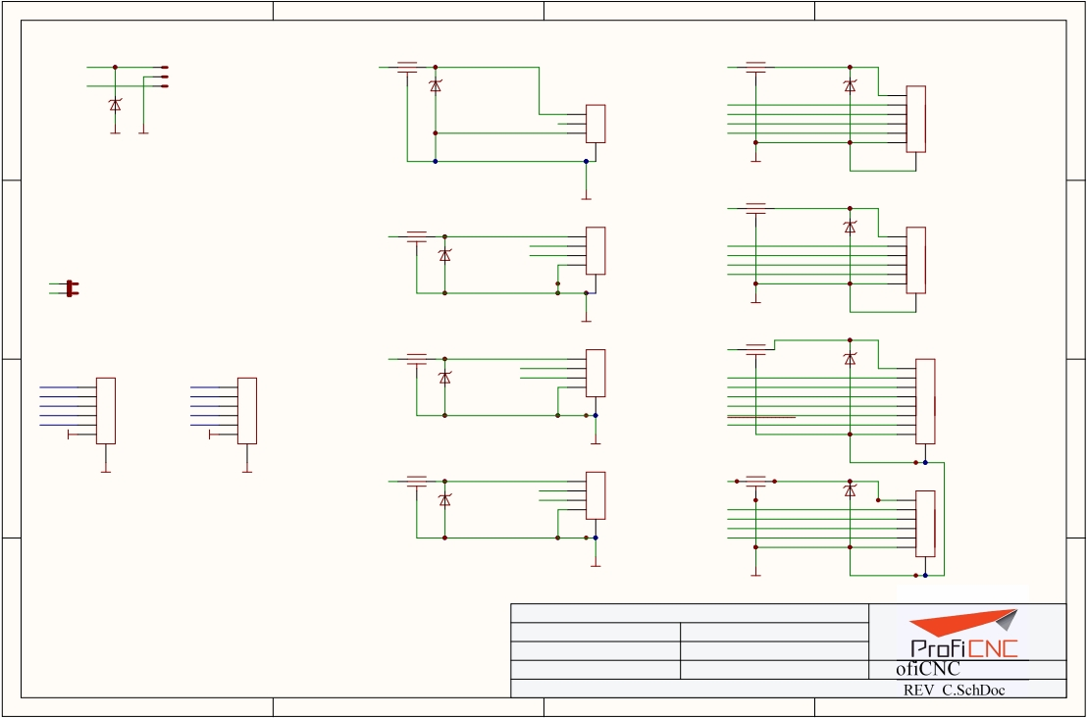
외부포트
1
2
3
4
Spektrum/DSM
L100 ADC connector
Kyocera KNH16C104DA5TS EMI filter
AUX ADC PORTS
L101 Serial_1 (RFD900)
Kyocera KNH16C104DA5TS EMI filter
VDD_3V3_SPEKTRUM
SPKT100A
VDD_5V_PERIPH
5V_PRES
VDD_5V_HIPOWER
SPKT100B
IO-USART1_RX_SPECTRUM_DSM
DIODE-TVS
DIODE-TVS
SERIAL1
SPKT100C
478-6878-1-ND 650-PESD0402-140
478-6878-1-ND
SERIAL1_TX
650-PESD0402-140
A
DIODE-TVS
D100
P101
D101
1
2
A
650-PESD0402-140
GND
GND
1
PRESSURE_SENS_IN 2
3
SERIAL1_RX
SERIAL1_CTS
SERIAL1_RTS
3 P100
4
5
6
D102
JST_GH_V3
GND
GND
GND
JST_GH_V6
455-1579-2-ND
455-1582-2-ND
Serial_2 (TELEM, LOW POWER)
L102
I2C_2
GND
Kyocera KNH16C104DA5TS EMI filter
L103
Kyocera KNH16C104DA5TS EMI filter
VDD_5V_PERIPH
DIODE-TVS
PERIPH_5V
VDD_5V_PERIPH
1 P102
478-6878-1-ND
650-PESD0402-140
SERIAL2
I2C_2_SCL
I2C_2_SDA
2
3
SERIAL2_TX
SERIAL2_RX
D103
1
DIODE-TVS
2
3 P103
HEADER_2MM_RA_S
478-6878-1-ND 650-PESD0402-140
4
SERIAL2_CTS
4
B
D104
JST_GH_V4
SERIAL2_RTS
5
6
B
IO-USART1_RX_SPECTRUM_DSM
GND
SERIAL1_RX 2
JP100
830-10-002-40-001101-ND
455-1580-2-ND
JST_GH_V6
GND
GND
CAN_1
GND
L104
455-1582-2-ND
Debug header
L105
Kyocera KNH16C104DA5TS EMI filter
Kyocera KNH16C104DA5TS EMI filter
VDD_5V_PERIPH
GPS 1
VDD_5V_PERIPH
1 P104
DIODE-TVS
JTAG IO
VDD_5V_PERIPH 1
IO-USART1_TX 2
JTAG FMU
P106
VDD_5V_PERIPH 1
SERIAL5_TX 2
CAN_H_2
CAN_L_2
2
3
4
650-PESD0402-140
SERIAL3
Default
GPS port
P105
DIODE-TVS
SERIAL3_TX
SERIAL3_RX
I2C_1_SCL
D105
1
2
3
4
478-6878-1-ND 650-PESD0402-140
478-6878-1-ND
D106
5 P107
6
7
IO-USART1_RX_SPECTRUM_DSM 3
IO-SWDIO 4
IO-SWCLK 5
SERIAL5_RX 3
FMU-SWDIO 4
FMU-SWCLK 5
JST_GH_V4
455-1580-2-ND
I2C_1_SDA
SAFETY
IO-LED_SAFET_PROT
GND
GND
6
GND
6
8
C
GND
JST_SUR_6
GND
JST_SUR_6
CAN_2
GND
JST_GH_V8
C
L106
L107
GND
SM06B-SURS-TF(LF)(SN)-ND
GND
SM06B-SURS-TF(LF)(SN)-ND
GND
Kyocera KNH16C104DA5TS EMI filter
VDD_5V_PERIPH
1 P108
Kyocera KNH16C104DA5TS EMI filter
VDD_5V_PERIPH
455-1584-2-ND
GPS 2
DIODE-TVS
CAN_H_1
CAN_L_1
2
3
DIODE-TVS
650-PESD0402-140 SERIAL4
478-6878-1-ND 650-PESD0402-140
4
478-6878-1-ND
D107
1
D108
SERIAL4_TX
SERIAL4_RX
2
3 P109
JST_GH_V4
455-1580-2-ND
I2C_2_SCL
I2C_2_SDA
4
5
6
GND
JST_GH_V6
GND
GND
455-1582-2-ND
Title: FULL_CB_Plugs_REV_C.SchDoc
Date: 24/05/2018 Time: 12:58:47 PM
Sheet:* of: * Drawn By: Philip Rowse
Approved: * Checked By: * ProfiCNC
GND
D
D
https://creativecommons.org/publicdomain/zero/1.0/
Title: E:\Git\The-Cube\CB_REV_C_Altium\FULL_CB_Plugs_REV_C.SchDoc
1
2
3
4

Slide 16
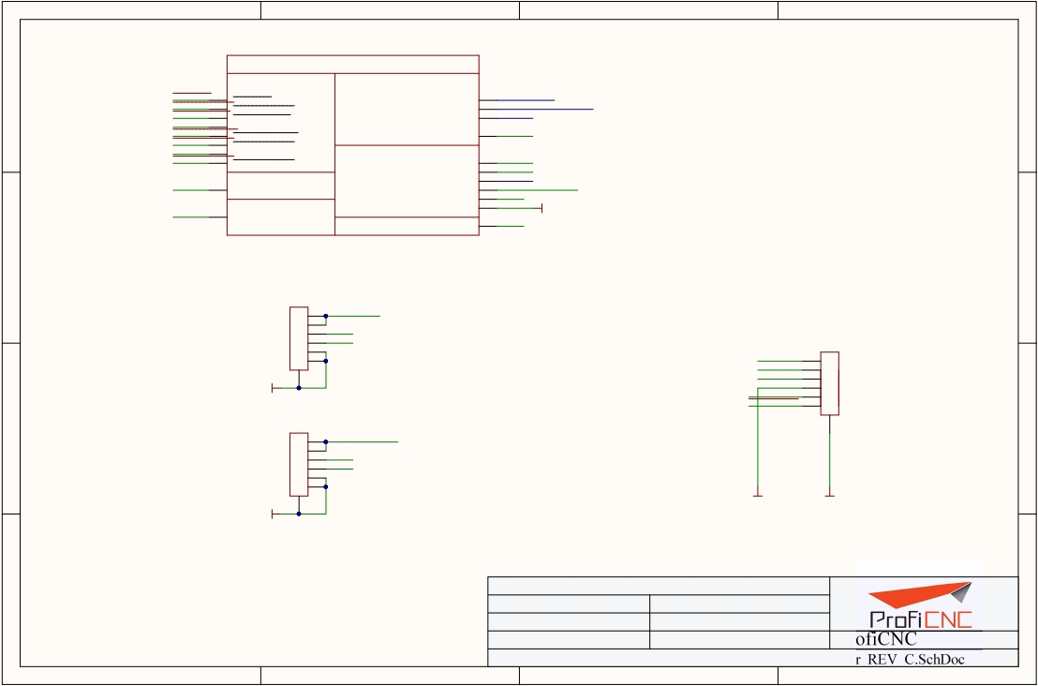
1
2
3
4
A
VBUS_VALID
VBUS_VALID
VDD_BRICK_IN
VDD_5V_BRICK
A
VDD_BACKUP_VALID
VDD_BACKUP_VALID
VDD_5V_BACKUP
VDD_5V_BACKUP
VDD_BRICK_VALID
VBUS
VDD_BRICK_VALID
VBUS_TO_FMU
VDD_VBUS
VBUS
VDD_5V_HIPOWER_OC
VDD_5V_HIPOWER_OC
VDD_5V_PERIPH_OC
VDD_5V_PERIPH_OC
VDD_3V3_SPEKTRUM_EN
VDD_3V3_SPEKTRUM_EN
VDD_5V_PERIPH_EN
VDD_5V_PERIPH_EN
SERVO_IN
NC
VDD_3V3_SPEKTRUM
RX 5V out
VDD_SERVO_IN
VDD_3V3_SPEKTRUM
RX_5V0_OUT
ALARM
VDD_5V_IN_PROT
ALARM
VDD_5V_TO_FMU
VDD_5V_PERIPH
VDD_5V_HIPOWER
GND
BUZZ_OUT
VDD_5V_PERIPH
VDD_5V_HIPOWER
GND
BUZZER_OUT
Power Selection module
B
B
P200
1
VDD_5V_BRICK
2
3
BATT_CURRENT_SENS_PROT
4
BATT_VOLTAGE_SENS_PROT
5
6
CLICKMATE_2_6
WM2279CT-ND
P202
1
VDD_5V_BACKUP
VBUS
OTG_DP1
OTG_DM1
BUZZER_OUT
FMU-LED_AMBER
1
2
3 P201
4
5
6
JST_GH_V6
455-1582-2-ND
GND
GND
C
GND
C
2
3
AUX_BATT_CURRENT_SENS
4
AUX_BATT_VOLTAGE_SENS
5
6
CLICKMATE_2_6
GND
GND
GND
GND
WM2279CT-ND
Title: FULL_CB_Power_REV_C.SchDoc
Date: 24/05/2018 Time: 12:58:47 PM
Sheet:* of: * Drawn By: Philip Rowse
Approved: * Checked By: * ProfiCNC
D
D
https://creativecommons.org/publicdomain/zero/1.0/
Title: E:\Git\The-Cube\CB_REV_C_Altium\FULL_CB_Power_REV_C.SchDoc
1
2
3
4

Slide 17
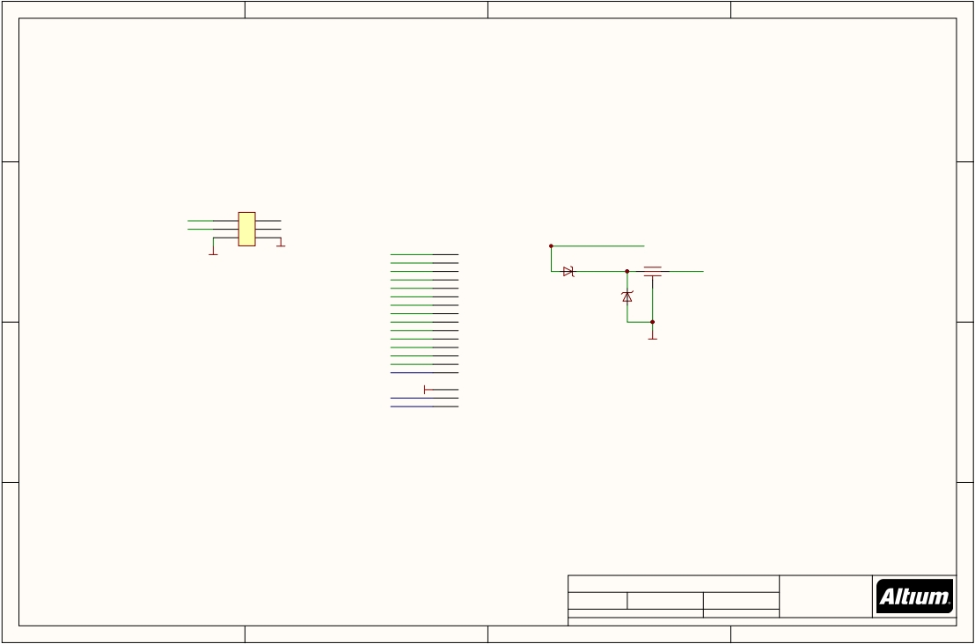
1
2
3
4
A
A
S.BUS_OUT
VDD_SERVO
1
3
5
P301
2
4
6
FR-Sky_telemetry
SERIAL5_TX
SERIAL5_RX
B
GND
con 2x6 GND
79P3920
FMU-CH1-PROT
FMU-CH2-PROT
FMU-CH3-PROT
FMU-CH4-PROT
FMU-CH5-PROT
FMU-CH6-PROT
IO-CH1-PROT
IO-CH2-PROT
IO-CH3-PROT
IO-CH4-PROT
IO-CH5-PROT
IO-CH6-PROT
IO-CH7-PROT
IO-CH8-PROT
PPM-SBUS-PROT
1 P304
FMU-CH6
2
FMU-CH5
3
FMU-CH4
4
FMU-CH3
5
FMU-CH2
6
FMU-CH1
7
IO-CH1
8
IO-CH2
9
IO-CH3
10
IO-CH4
11
IO-CH5
12
IO-CH6
13
IO-CH7
14
IO-CH8
15
PPM In
D300
15R2105
VDD_SERVO
L300
Kyocera KNH16C104DA5TS EMI filter
VDD_SERVO_IN
478-6878-1-ND
650-PESD0402-140
GND
B
DIODE-TVS
D301
GND
GND
VDD_SERVO VCC
RX_5V0_OUT RX 5V
GND
SERVO VCC
RX 5V
PH_2 Servo header
C
C
D
*
*
D
Title
*
Size: A4 Number: * Revision: *
*
*
Date: 24/05/2018 Time: 12:58:47 PM Sheet * of * *
File: E:\Git\The-Cube\CB_REV_C_Altium\FULL_CB_Servo_REV_C.SchDoc
1
2
3
4

Slide 18
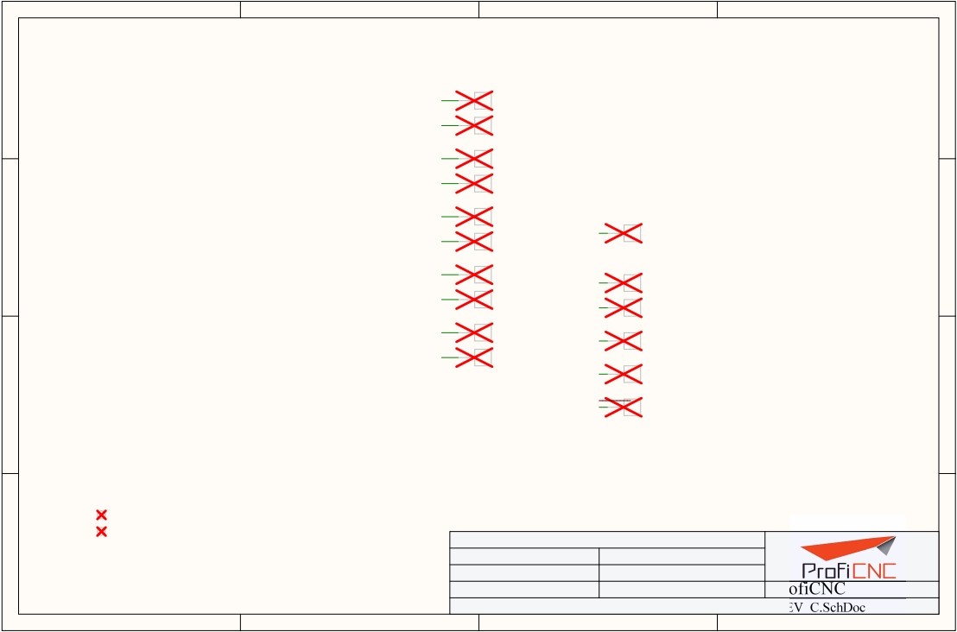
1
2
3
4
A
B
C
S1TX
SERIAL1_TX
S1RX
SERIAL1_RX
PAD.04
S2TX
SERIAL2_TX
S2RX
SERIAL2_RX
PAD.04
S3TX
SERIAL3_TX
S3RX
SERIAL3_RX
PAD.04
S4TX
SERIAL4_TX
S4RX
SERIAL4_RX
PAD.04
S5_TX
SERIAL5_TX
S5_RX
SERIAL5_RX
PAD.04
A
B
C
PAD.04
PAD.04
PAD.04
ADC_PR
PRESSURE_SENS_IN
PAD.04
D_RDY1
EXTERN_DRDY
SPI_SCK1
SPI_EXT_SCK
PAD.04
SPI_MISO1
SPI_EXT_MISO
PAD.04
SPI_MOSI1
SPI_EXT_MOSI
PAD.04
SPI!CS1
PAD.04
PAD.04
PAD.04
PAD.04
EXTERN_CS
Fiducials for machine
vision alignment.
Title: FULL_CB_tp_REV_C.SchDoc
D
Date: 24/05/2018 Time: 12:58:47 PM
Sheet:* of: * Drawn By: Philip Rowse
Approved: * Checked By: * ProfiCNC
D
https://creativecommons.org/publicdomain/zero/1.0/
Title: E:\Git\The-Cube\CB_REV_C_Altium\FULL_CB_tp_REV_C.SchDoc
1
2
3
4

