Slide 1
Neural Networks

Slide 2
Computer Vision
So far we have been dealing with known datasets
MNIST handwritten digit dataset: we know that there are 28x28 pixels image
+ we know that there are 10 output classes
Olivetti Faces dataset: contains 64x64 pixels images
WE KNOW WHAT WE ARE LOOKING FOR
Computer vision: we are after a general solution
If we have a given image → we want to make sure the algorithm is able to
detect and recognize objects (faces, cars or horses)

Slide 3
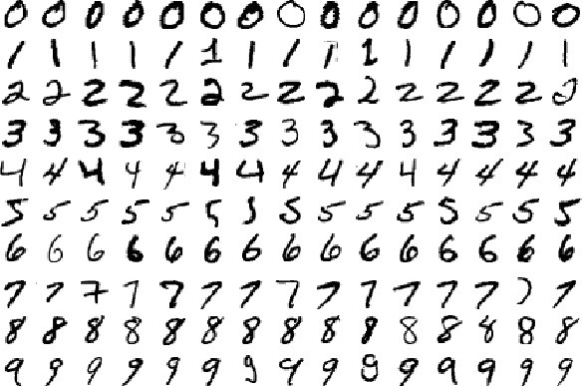
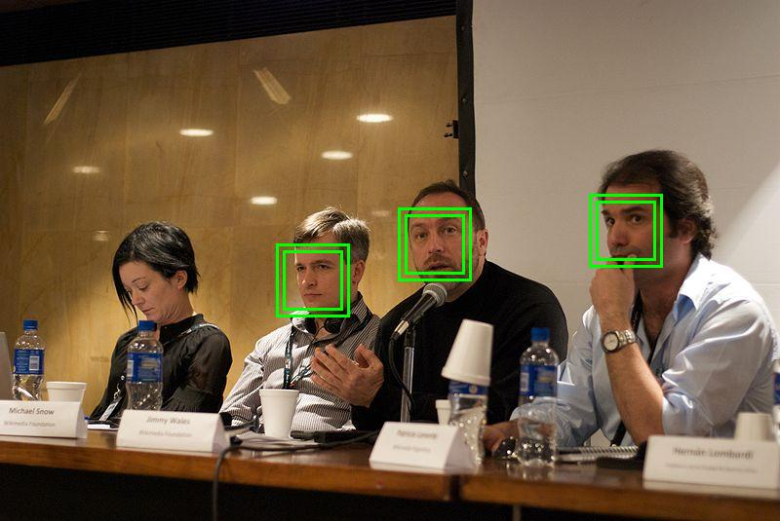
Computer Vision
we can tune the given machine learning
algorithm or neural networks to deal
with this specific task
we have to find the object on the image
and make sure our detection
algorithm is correct

Slide 4
Viola-Jones Algorithm
This algorithm tries to find the most relevant features for a human face
(we are dealing with face detection)
→ what are relevant features for detecting faces?
→ two eyes, nose, lips, forehead ...
→ we can construct an algorithm based on the most relevant features:
if the algorithm does not find one of these
features it comes to the conclusion that there is
no human face on that region of the image
THIS ALGORITHM HANDLES GRAYSCALE IMAGES
~ so the first step is to convert the image into grayscale

Slide 5
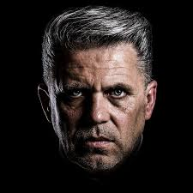
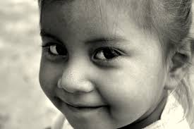
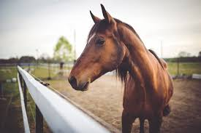
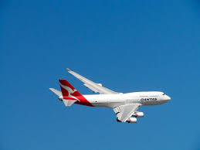
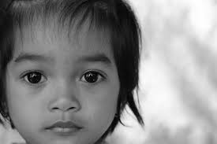

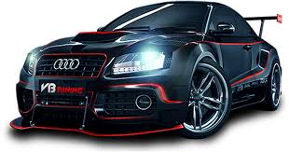
Viola-Jones Algorithm
The algorithm was formulated by Paul Viola and Michael Jones in 2001
→ it is a machine learning algorithm: so it needs training as well
~ training phase + testing (detecting the objects)
→ the algorithm needs positive images (images of faces) and
negative images (images without faces) as well
~ this is how it learns the most relevant feature

Slide 6
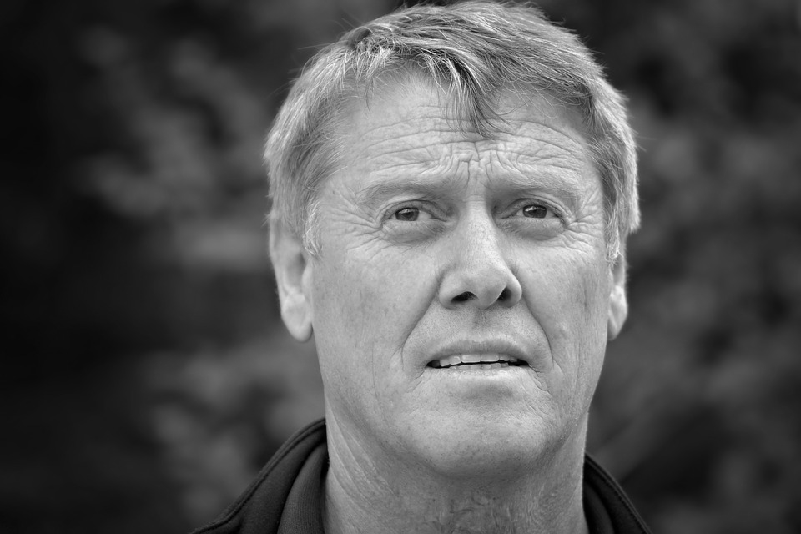
Viola-Jones Algorithm

Slide 7
Viola-Jones Algorithm

Slide 8
Viola-Jones Algorithm

Slide 9
Viola-Jones Algorithm

Slide 10
Viola-Jones Algorithm

Slide 11
Viola-Jones Algorithm

Slide 12
Viola-Jones Algorithm

Slide 13
Viola-Jones Algorithm
We have a huge problem with this approach: size of faces may differ
(window size is too small to include all the relevant features of a face
so the algorithm will not work fine)
~ some faces may be closer to the camera which means they
appear bigger than other faces in the background
scaleFactor: this feature in OpenCV compensates for this issue
The training uses 24x24 pixels images so we have to rescale the input image
~ so we can resize a larger face to a smaller one

Slide 14
Haar-features
Haar-wavelet is a sequence of rescaled square-shaped „functions”
~ very similar to Fourier-analysis
→ it was proposed by Alfréd Haar in 1909
→ they are like convolutional kernels
HAAR FEATURES ARE THE RELEVANT FEATURES FOR FACE DETECTION
edge features can detect edges
quite effectively
line features can detect lines
quite effectively

Slide 15
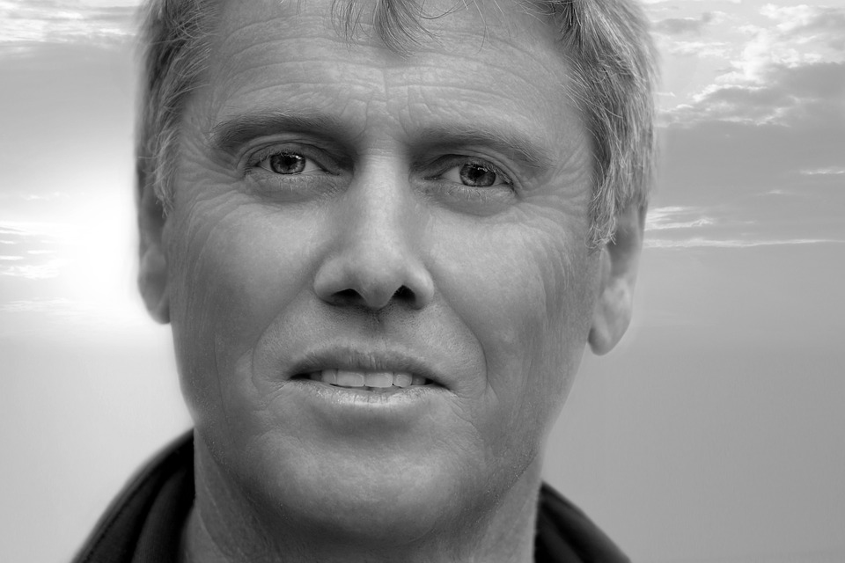
Haar-features
WE CAN REPRESENT THE MOST RELEVANT FEATURES WITH HAAR-FEATURES !!!

Slide 16

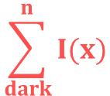

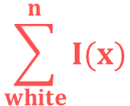
Haar-features
Viola-Jones algorithm will compare
how close the real scenario is to the
ideal case
1.) let’s sum up the white
pixel intensities
2.) calculate the sum of the
black pixel intensities
0
0
1
1
0.1
0.2
0.6
0.8
0
0
1
1
0.2
0.3
0.8
0.6
0
0
1
1
0.2
0.1
0.6
0.8
0
0
1
1
0.2
0.1
0.8
0.9
ideal Haar-feature
pixel intensities
0: white
1: black
these are real values
detected on an image
$$\frac{1}{n}$$
$$\sum_{dark}^{n}{I(x)}$$
$$\frac{1}{n}$$
$$\sum_{white}^{n}{I(x)}$$
Δ = dark – white =
-
Δ for ideal Haar-feature is 1
Δ for the real image: 0.74 – 0.18 = 0.56
The closer the value to 1, the more likely we have found a Haar-feature !!!
(of course we will never get 0 or 1: there are thresholds)

Slide 17
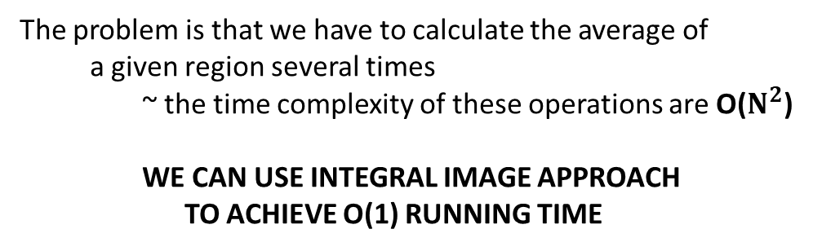
Integral Image
0.1
0.1
0.2
0.1
0.7
0.1
The problem is that we have to calculate the average of
a given region several times
~ the time complexity of these operations are O($N^{2}$)
WE CAN USE INTEGRAL IMAGE APPROACH
TO ACHIEVE O(1) RUNNING TIME
0.2
0.3
0.2
0.7
0.8
0.2
0.1
0.4
0.3
0.3
0.1
0.3
0.1
0.5
0.1
0.1
0.2
0.8
Why are there so many operations?
Because we have to use Haar-features with all
possible sizes and locations
~ 200k features to calculate !!!
→ every time we have to use a quadratic algorithm
~ we have to find a better approach
0.1
0.4
0.8
0.5
0.6
0.5
these are the same
kernels but with
different sizes

Slide 18
Integral Image
0.1
0.1
0.2
0.1
0.7
0.1
0.1
0.2
0.4
0.5
1.2
1.3
0.2
0.3
0.2
0.7
0.8
0.2
0.3
0.7
1.1
1.9
3.4
3.7
0.1
0.4
0.3
0.3
0.1
0.3
0.4
1.2
1.9
3.0
4.6
5.2
0.1
0.5
0.1
0.1
0.2
0.8
0.5
1.7
2.5
3.7
5.3
6.7
0.1
0.4
0.8
0.5
0.6
0.5
0.6
2.3
3.9
5.6
8.0
9.9
original image
integral image

Slide 19
Integral Image
0.1
0.1
0.2
0.1
0.7
0.1
0.1
0.2
0.4
0.5
1.2
1.3
0.2
0.3
0.2
0.7
0.8
0.2
0.3
0.7
1.1
1.9
3.4
3.7
0.1
0.4
0.3
0.3
0.1
0.3
0.4
1.2
1.9
3.0
4.6
5.2
0.1
0.5
0.1
0.1
0.2
0.8
0.5
1.7
2.5
3.7
5.3
6.7
0.1
0.4
0.8
0.5
0.6
0.5
0.6
2.3
3.9
5.6
8.0
9.9
original image
integral image

Slide 20
Integral Image
0.1
0.1
0.2
0.1
0.7
0.1
0.1
0.2
0.4
0.5
1.2
1.3
0.2
0.3
0.2
0.7
0.8
0.2
0.3
0.7
1.1
1.9
3.4
3.7
0.1
0.4
0.3
0.3
0.1
0.3
0.4
1.2
1.9
3.0
4.6
5.2
0.1
0.5
0.1
0.1
0.2
0.8
0.5
1.7
2.5
3.7
5.3
6.7
0.1
0.4
0.8
0.5
0.6
0.5
0.6
2.3
3.9
5.6
8.0
9.9
original image
integral image

Slide 21
Integral Image
0.1
0.1
0.2
0.1
0.7
0.1
0.1
0.2
0.4
0.5
1.2
1.3
0.2
0.3
0.2
0.7
0.8
0.2
0.3
0.7
1.1
1.9
3.4
3.7
0.1
0.4
0.3
0.3
0.1
0.3
0.4
1.2
1.9
3.0
4.6
5.2
0.1
0.5
0.1
0.1
0.2
0.8
0.5
1.7
2.5
3.7
5.3
6.7
0.1
0.4
0.8
0.5
0.6
0.5
0.6
2.3
3.9
5.6
8.0
9.9
original image
integral image
SUM = 3.7

Slide 22
Integral Image
0.1
0.1
0.2
0.1
0.7
0.1
0.1
0.2
0.4
0.5
1.2
1.3
0.2
0.3
0.2
0.7
0.8
0.2
0.3
0.7
1.1
1.9
3.4
3.7
0.1
0.4
0.3
0.3
0.1
0.3
0.4
1.2
1.9
3.0
4.6
5.2
0.1
0.5
0.1
0.1
0.2
0.8
0.5
1.7
2.5
3.7
5.3
6.7
0.1
0.4
0.8
0.5
0.6
0.5
0.6
2.3
3.9
5.6
8.0
9.9
original image
integral image
SUM = 3.7 – 0.5

Slide 23
Integral Image
0.1
0.1
0.2
0.1
0.7
0.1
0.1
0.2
0.4
0.5
1.2
1.3
0.2
0.3
0.2
0.7
0.8
0.2
0.3
0.7
1.1
1.9
3.4
3.7
0.1
0.4
0.3
0.3
0.1
0.3
0.4
1.2
1.9
3.0
4.6
5.2
0.1
0.5
0.1
0.1
0.2
0.8
0.5
1.7
2.5
3.7
5.3
6.7
0.1
0.4
0.8
0.5
0.6
0.5
0.6
2.3
3.9
5.6
8.0
9.9
original image
integral image
SUM = 3.7 – 0.5 + 0.2

Slide 24
Integral Image
0.1
0.1
0.2
0.1
0.7
0.1
0.1
0.2
0.4
0.5
1.2
1.3
0.2
0.3
0.2
0.7
0.8
0.2
0.3
0.7
1.1
1.9
3.4
3.7
0.1
0.4
0.3
0.3
0.1
0.3
0.4
1.2
1.9
3.0
4.6
5.2
0.1
0.5
0.1
0.1
0.2
0.8
0.5
1.7
2.5
3.7
5.3
6.7
0.1
0.4
0.8
0.5
0.6
0.5
0.6
2.3
3.9
5.6
8.0
9.9
original image
integral image
SUM = 3.7 – 0.5 + 0.2 – 1.7 = 1.7
Why is it good? We can achieve O(1) running time for handling Haar-features
~ we assume these features are rectangles

Slide 25
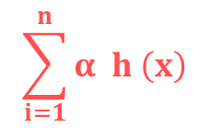
Computer Vision - Boosting
we can boost some part of the algorithm with the help of integral image approach
BUT there are way too many features
~ most of the features are irrelevant and not important at all
HOW TO SELECT THE BEST FEATURES? WITH BOOSTING !!!
we keep combining h(x)
weak learners (weak learner with
a single Haar-feature)
$$\sum_{i=1}^{n}{α h \left(x\right)}$$
H(x) = sign
i
i
final H(x) model which
is a strong classifier
every h(x) week learner
make a prediction
based on a single Haar-feature

Slide 26
Computer Vision - Boosting
At the beginning all the h(x) weak learners have the same weight
~ all of them contribute to the final decision (face is detected or not)
During the training phase Viola-Jones algorithm update
the weights for the h(x) weak learners (the features)
and finally we have the relevant features with higher weights

Slide 27

Computer Vision - Boosting
At the beginning all the h(x) weak learner have the same weight
~ all of them contribute to the final decision (face is detected or not)
During the training phase Viola-Jones algorithm update
the weights for the h(x) weak learners (the features)
and finally we have the relevant features with higher weights

Slide 28
Computer Vision - Boosting
At the beginning all the h(x) weak learner have the same weight
~ all of them contribute to the final decision (face is detected or not)
During the training phase Viola-Jones algorithm update
the weights for the h(x) weak learners (the features)
and finally we have the relevant features with higher weights

Slide 29
Cascading
With boosting we can make the algorithm quite fast ...
But can we do even better?
→ we know that most of the image region is non-face region
→ it is a better idea to have a simple method to check if a window
is not a face region: if it is not, discard it in a single shot
→ do not process unnecessary regions: focus on regions where
there can be a face instead
THIS IS WHY WE USE THE CASCADE CLASSIFIER CONCEPT
Instead of applying all the ~6000 Haar-features: we use the most relevant ones
in the first iteration (first stages contain very less features: 1, 10, 15, 50...)

Slide 30
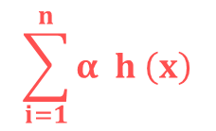
Cascading
How to find the most relevant features?
~ boosting algorithm has already found the best features
we keep combining h(x)
weak learners (weak learner with
a single Haar-feature)
$$\sum_{i=1}^{n}{α h \left(x\right)}$$
H(x) = sign
i
i
final H(x) model which
is a strong classifier
every h(x) week learner
make a prediction
based on a single Haar-feature
THE h(x) CLASSIFIERS WITH HIGHER α VALUES ARE THE RELEVANT FEATURES !!!
→ if the window does not contain the most relevant features we
can consider the next region on the image

Slide 31
Cascading
first feature
second feature
third feature
FACE
NOT A FACE
NOT A FACE
NOT A FACE

