Slide 1
An Image Is Worth 16x16 words: Transformer For Image Recognition At Scale
발표자: 송우석
wssong97@gmail.com

Slide 2
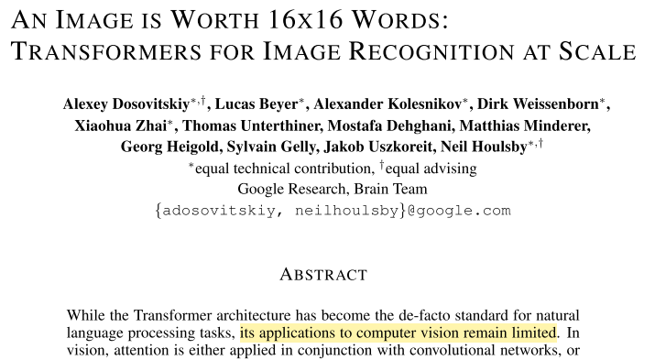
Today’s contents
“We show that reliance on CNNs Is not necessary and a pure transformer applied directly to sequence of image patches can perform very well on image classification task ”
“Pretrained on large amounts of data and transferred , excellent result with fewer computational resource “

Slide 3
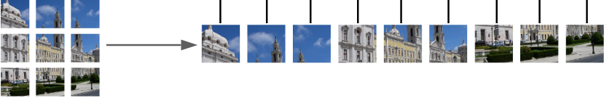
Motivation
“Inspired by The Transformer scaling successes in NLP, try to apply on standard Transformer directly to image”
Transformer

Slide 4
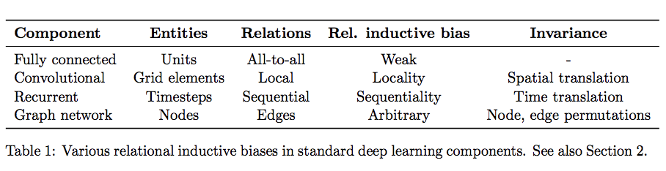
Limitation
Transformer lack some of the Image-specific inductive biases, So do not generalize well when trained on insufficient amount of data.
=>Need to be trained on Large Dataset
Ref) https://stackoverflow.com/questions/35655267/what-is-inductive-bias-in-machine-learning

Slide 5
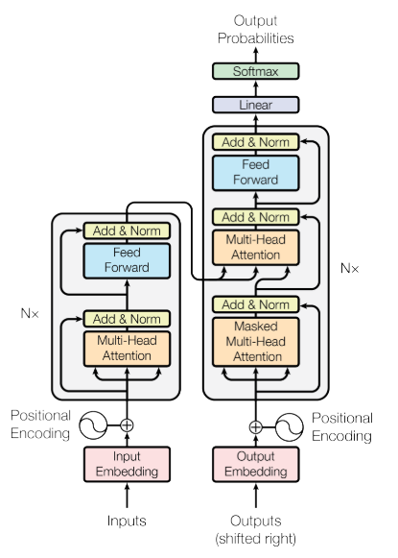
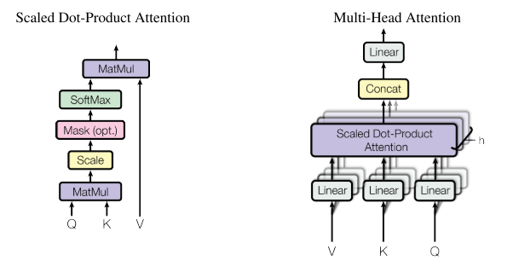
Transformer
잘 설명된 영상 https://www.youtube.com/watch?v=mxGCEWOxfe8

Slide 6
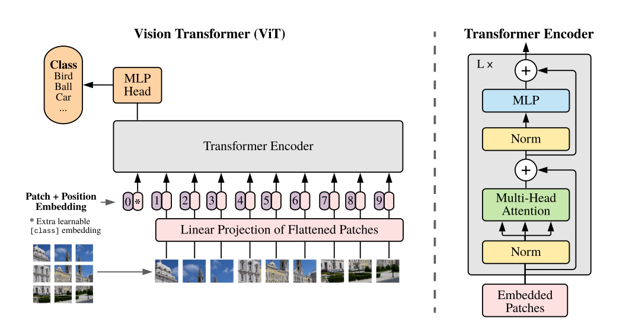
Vision Transformer(ViT)
NLP -> tokenize
Vision -> Just cut image into patches and flatten the patches

Slide 7
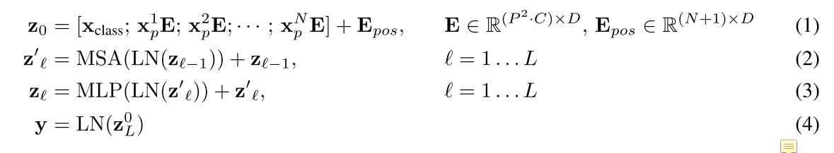
Vision Transformer(ViT)

Slide 8
Vision Transformer(ViT)

Slide 9
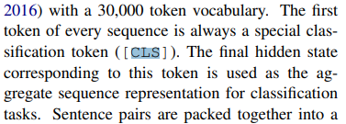
Vision Transformer(ViT)
<From BERT>

Slide 10


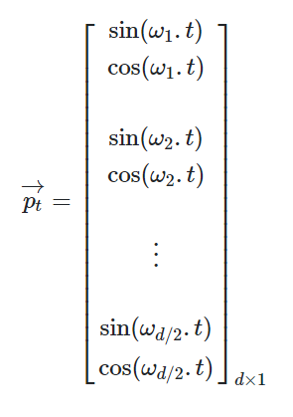
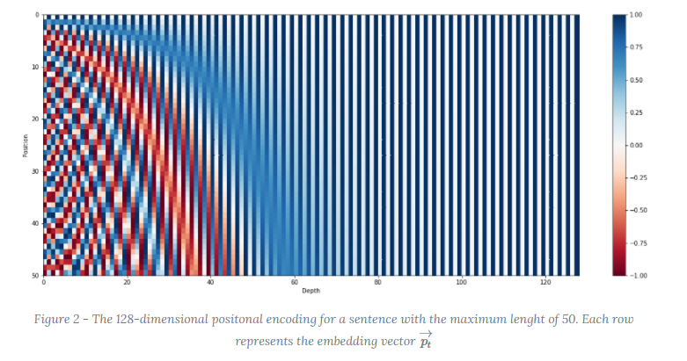
Vision Transformer(ViT)
Fixed case: Why using sinusoid in Position Embedding?
Pt-> d-dim vector about position t
Ref) https://kazemnejad.com/blog/transformer_architecture_positional_encoding/

Slide 11
Vision Transformer(ViT)

Slide 12
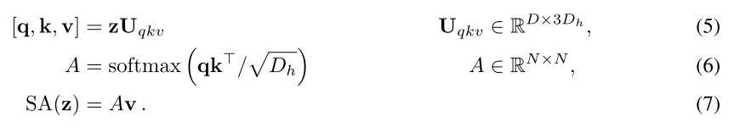
Vision Transformer(ViT)
Multi-head –Self Attention

Slide 13

Vision Transformer(ViT)

Slide 14
Vision Transformer(ViT)

Slide 15
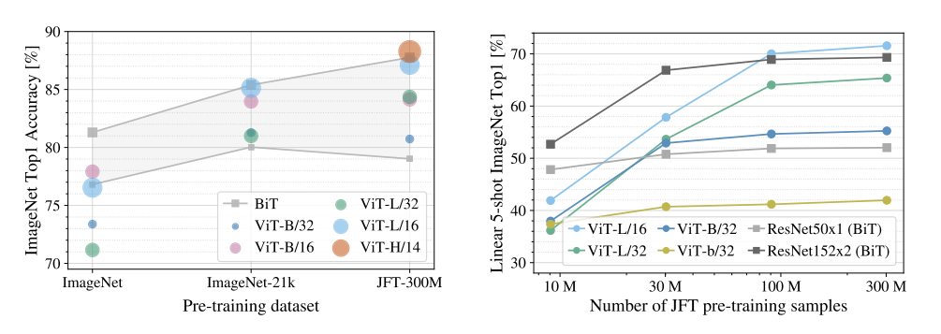
Experiments
How crucial is the dataset size?

Slide 16
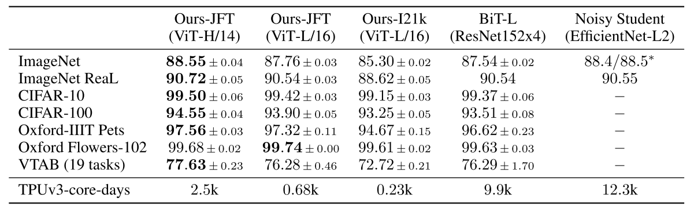
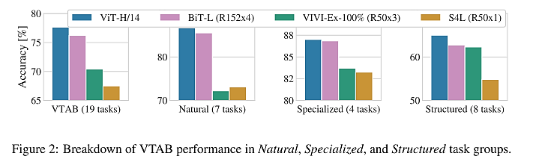
Experiments

Slide 17
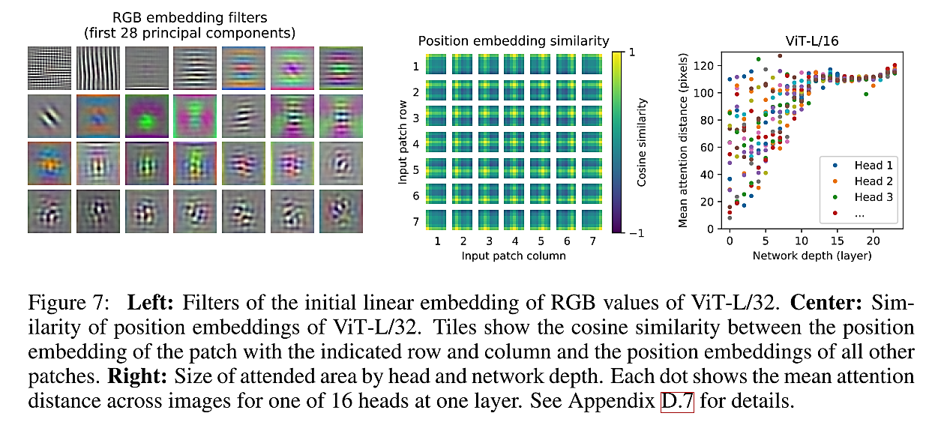
Experiments

Slide 18
Conclusion
So
Prior work: image-specific inductive biases apart from initial patch extraction step
Here: interpret image as a sequence of patches , Standard Transformer Encoder used in NLP.
Break Through
Apply ViT to other Computer Vision tasks
Challenging, self supervised pre-training method, Large gap between self-supervised and large-scale supervised pretraining

Slide 19
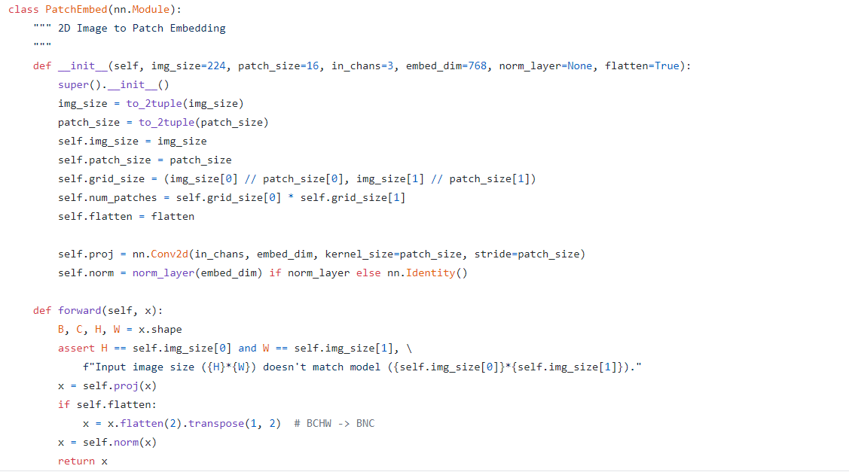
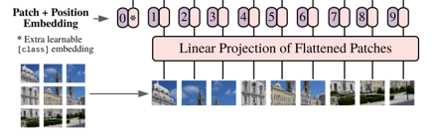
Code[Cut image]
Ref) https://github.com/rwightman/pytorch-image-models

Slide 20
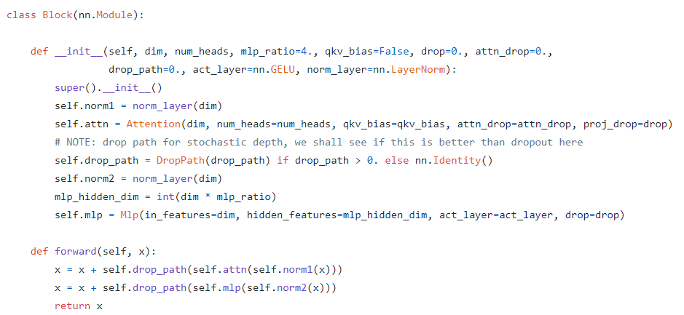
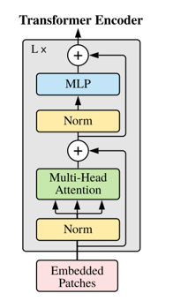
Code[Encoder]
Ref) https://github.com/rwightman/pytorch-image-models

Slide 21
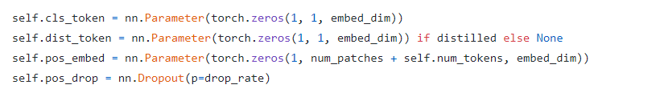
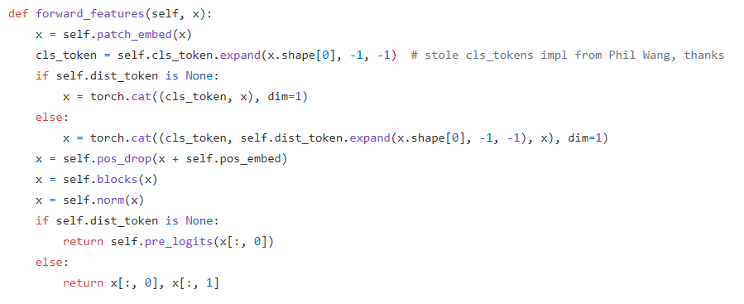
Code[Forward]
Ref) https://github.com/rwightman/pytorch-image-models

Slide 22
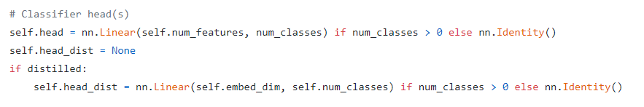
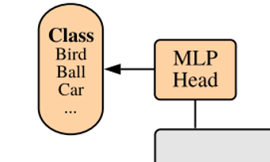
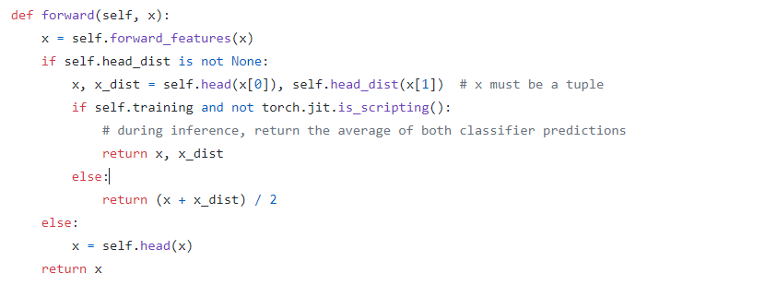
Code[Classifier]
Ref) https://github.com/rwightman/pytorch-image-models

Slide 23
대박 정리 링크입니다.
Ref https://amaarora.github.io/2021/01/18/ViT.html

Slide 24
감사합니다

