Slide 1
ResMLP: Feedforward networks for image classification with data-efficient training
발표자: 송우석
wssong97@gmail.com

Slide 2
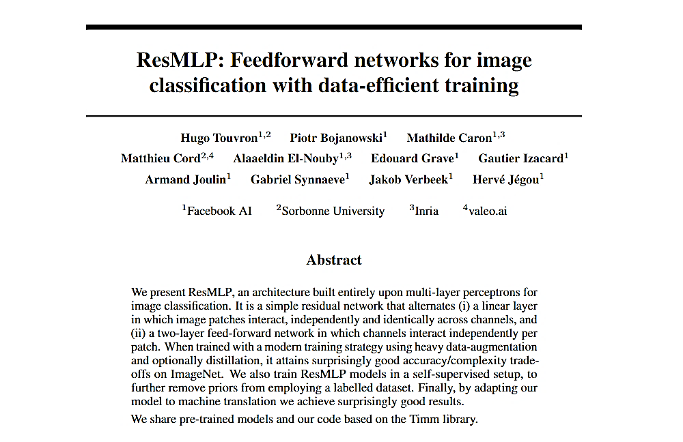
Today’s contents
“Built Entirely upon multi-layer Perceptrons for image classification”

Slide 3
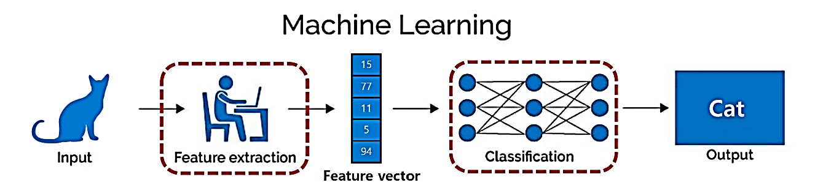
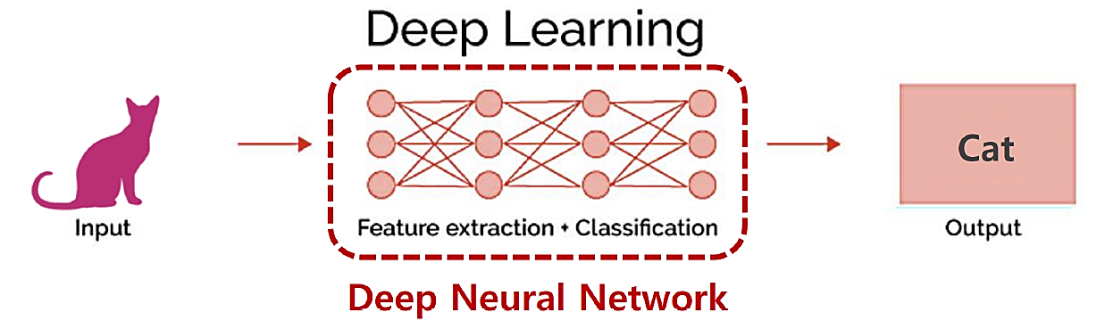
History of visual learning
Ref) AIAS lecture note 2

Slide 4
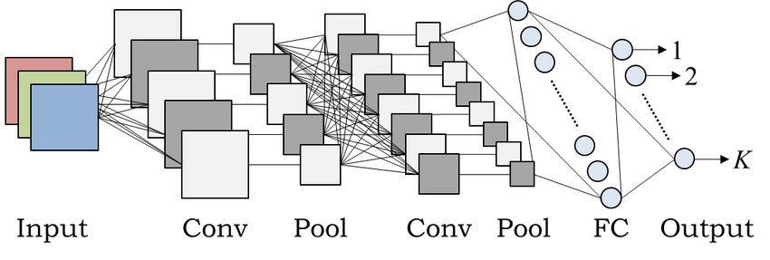
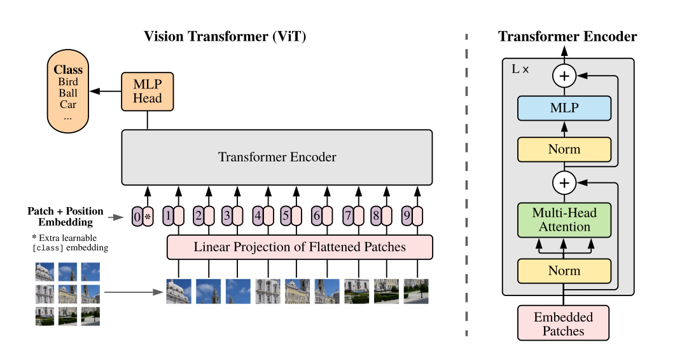
History of visual learning
CNN
Transformer
Ref) https://www.researchgate.net/figure/An-example-of-CNN-architecture_fig1_320748406

Slide 5
History of visual learning
Machine Learning -> MLP -> CNN -> Vision Transformer
By evolution of learning visual features,
Model removes several hard decisions encoded in the model=> Less Hand-crafted

Slide 6
Motivation
“The evolution toward less hard-coded prior in the architecture has been fueled by better training schemes and we push this trend further by showing that a purely multi layer-perceptron based architecture”

Slide 7
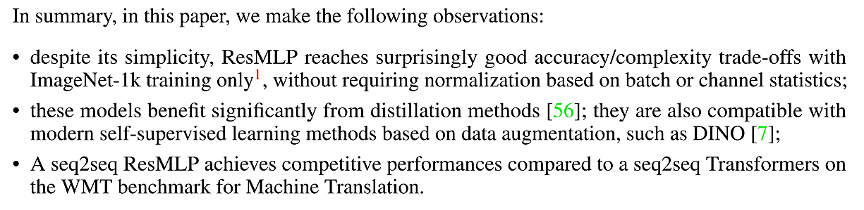
Contribution
Abstract
Good accuracy/complexity trade-off
Benefit significantly from distillation methods
Competitive performances compared to Seq2seq2

Slide 8
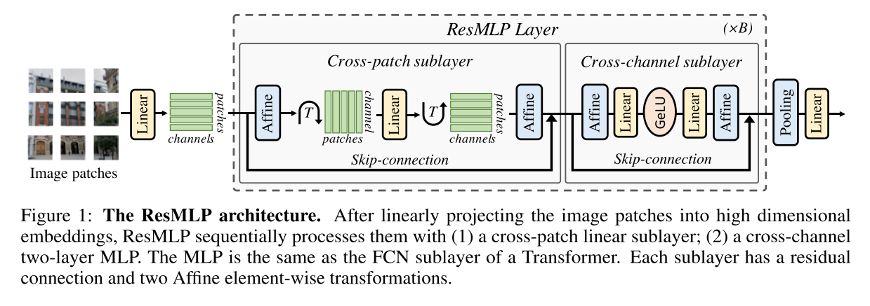
Method

Slide 9

Method
Affine operator
Advantage of using Affine operator
Not like Layer Normalization, it has no cost at inference time
Not like batch Normalization, it has no dependence on batch statistics

Slide 10
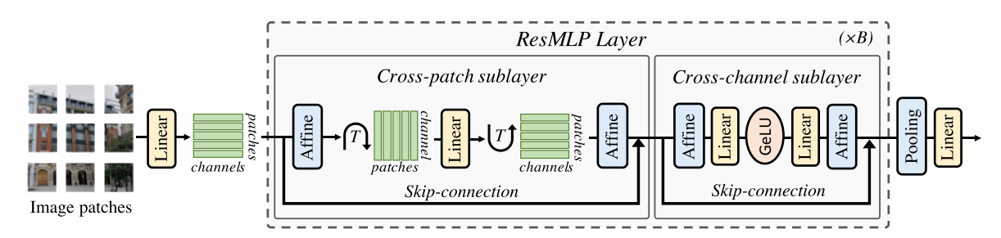
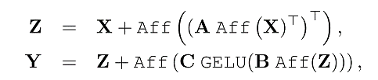
Method
ResMLP Layer

Slide 11
Method
Average Pooling
CLS-MLP: Separate CLS token from patch embedding
Idea From CaiT(Going deeper with Image Transformers)
In ResMLP CLS-MLP is replaced to Average Pooling

Slide 12
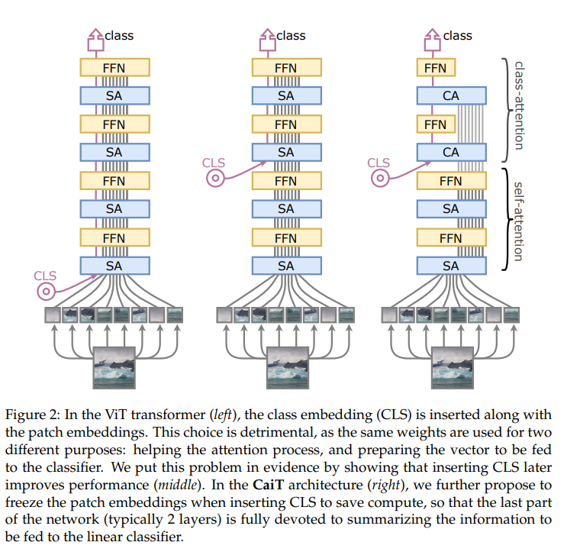
Method
CaiT(class-attention in Transformer)
ViT’s Problem : learned weights are asked to optimize two contradictory objectives
Guiding the self-attention between patches
While summarizing the information useful to the linear classifier
Ref) Going deeper with Image Transformers
https://arxiv.org/pdf/2103.17239.pdf

Slide 13
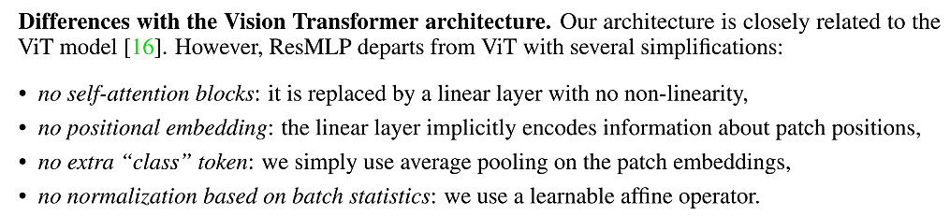
Method
Q. Difference between Self-Attention Block and Linear?
Self-Attention: aggregate information from other patches are data dependent through queries and keys.
Linear : only based on absolute positions of patches(global)
=>Focus on absolute rather than relative positions

Slide 14
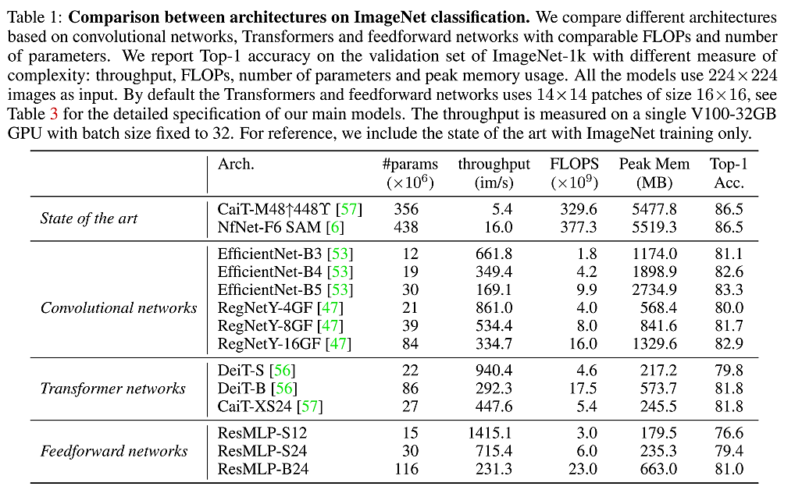
Experiment

Slide 15
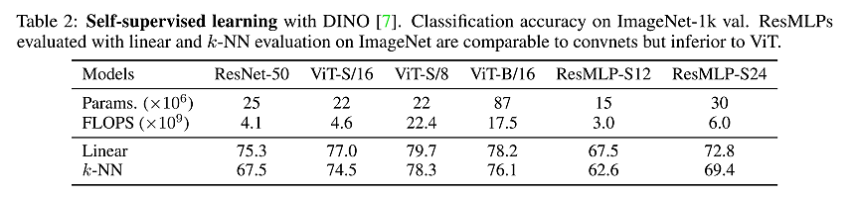
Experiment

Slide 16
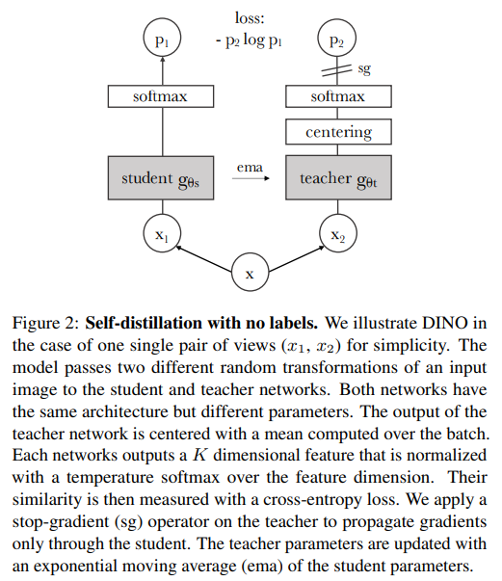

Experiment
DINO
EMA: places greater weight and significance on the most recent data points
Ref) Emerging Properties in Self-Supervised Vision Transformers
https://arxiv.org/pdf/2104.14294.pdf

Slide 17
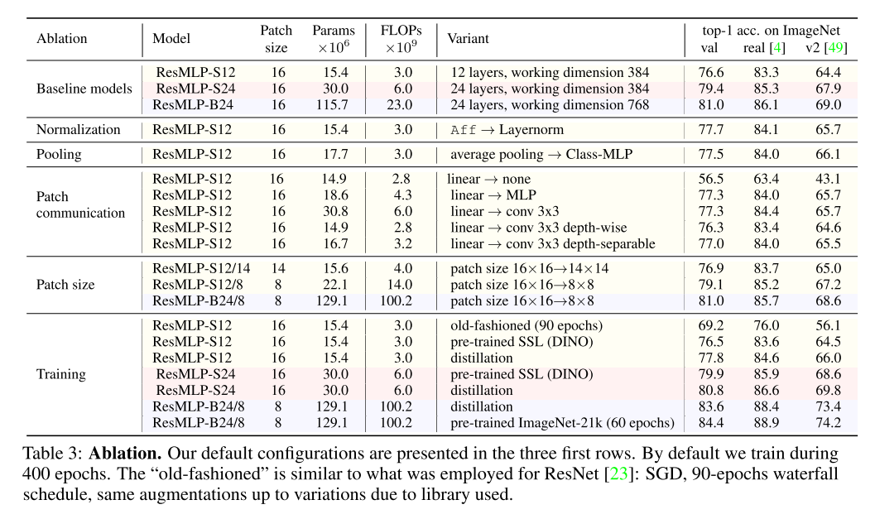
Experiment
Ablation study(remove or replace component into some different thing)

Slide 18
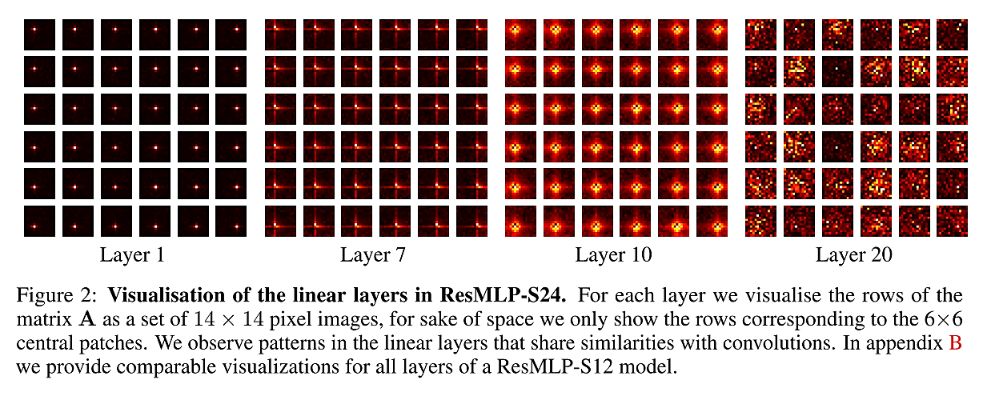
Experiment

Slide 19
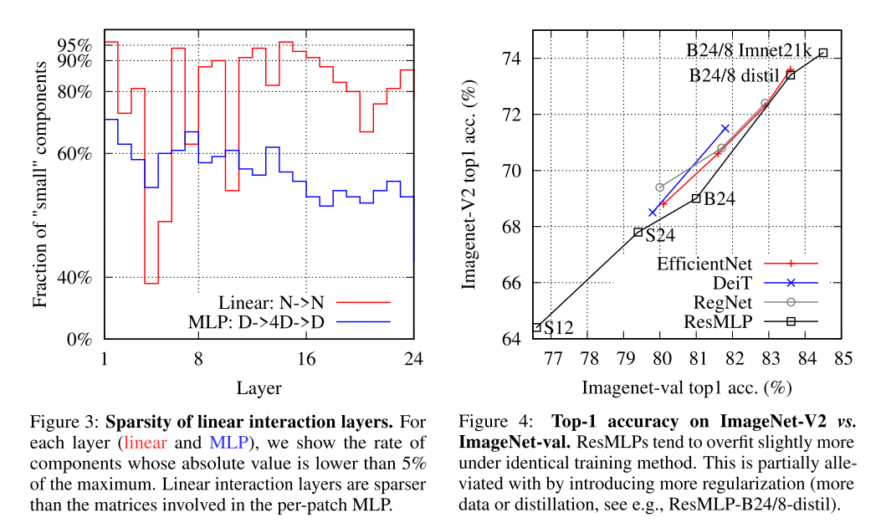
Experiment
Sparse-> they may be compatible with parameter pruning

Slide 20
Conclusion
Simple residual architecture consist of one-hidden layer feed-forward network achieves an unexpectedly high performance on ImageNet classification benchmarks
Adopted a modern training strategy such as those recently introduced for transformer-based architectures.
Linear layers as the main mean of communications between patches , can visualize the filters learned by this simple MLP.
MLP is GOOD!

Slide 21
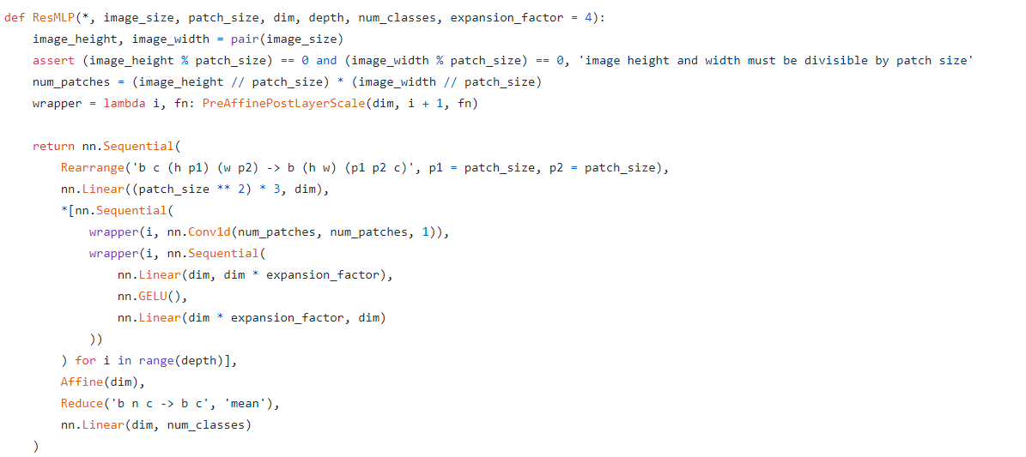
Code
Ref) https://github.com/lucidrains/res-mlp-pytorch/blob/main/res_mlp_pytorch/res_mlp_pytorch.py

Slide 22
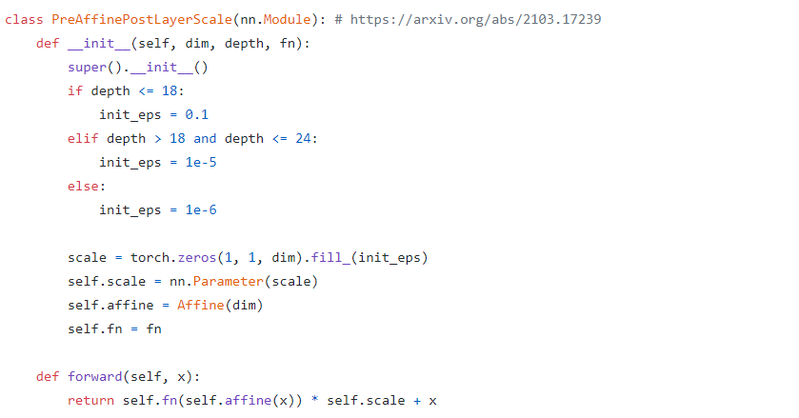
Code
Ref) https://github.com/lucidrains/res-mlp-pytorch/blob/main/res_mlp_pytorch/res_mlp_pytorch.py

Slide 23
Dataset
ImageNet-1k (약 백만장) – 150G
ImageNet-21k(천 사백만장) -
JFT-300M(3억장) 18291 categories

Slide 24
감사합니다

