Slide 1
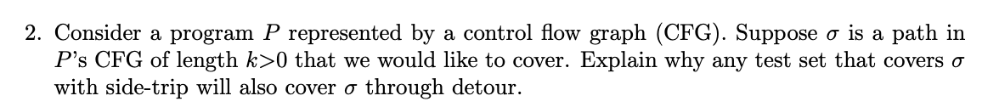
Suppose sigma = [ n1 , n2 , n3 .... , nj ] → sequence of nodes
test-path t that covers sigma by side-triip [ t1, t2, n1, n2, t3,t4 ,n2, n3 ..... ]

Slide 2
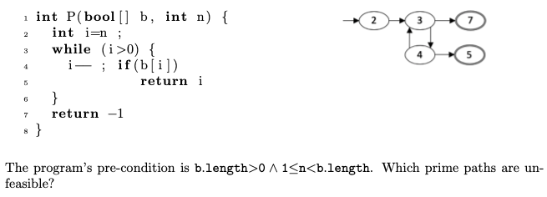

Slide 3
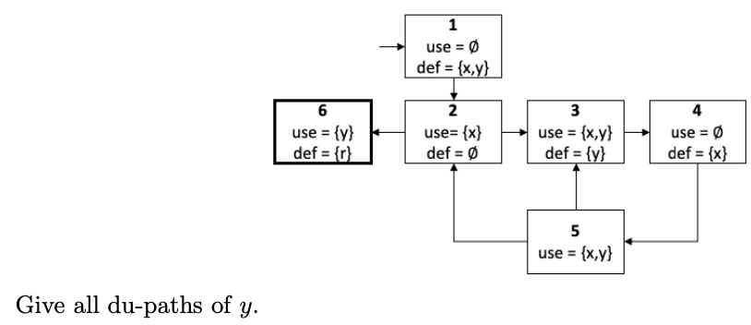

Slide 4
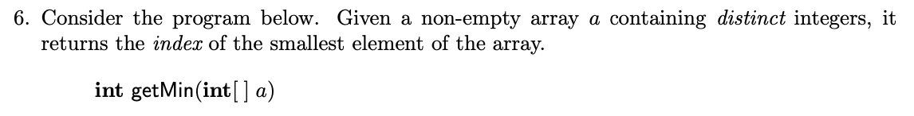
Pre: #a > 0 /\ (forall j : 0<= j < #a : (forall : 0<= k < #a : j!=k ==> a[j] != a[k]))
Pre: #a > 0 /\ forall(a, j => forall(a, k => j!=k ==> a[j] != a[k]))
Post: 0<=retval<#a /\ (forall j : 0<=j<#a : a[retval] <= a[j])

Slide 5
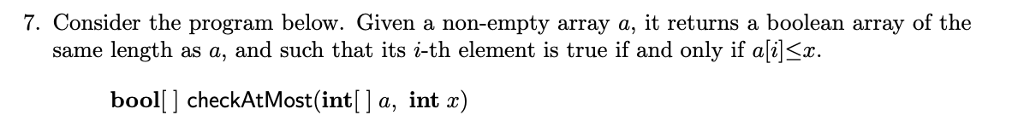
Pre: #a > 0
Post: #retval = #a /\ (forall i : 0<=i<#retval : retval[i] = (a[i] <= x) )
Post: : #retval = #a && forall(retval, i => retval[i] => (a[i] <= x) )

Slide 6
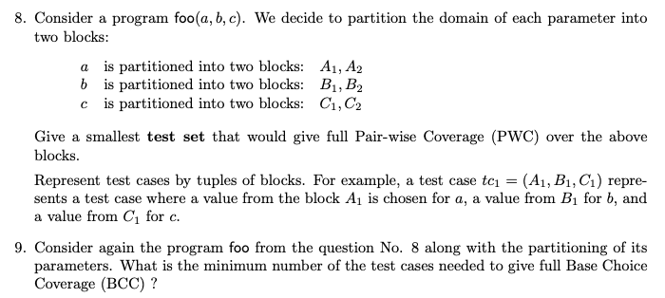
test t1 : (A1 , B1 , C1)

Slide 7
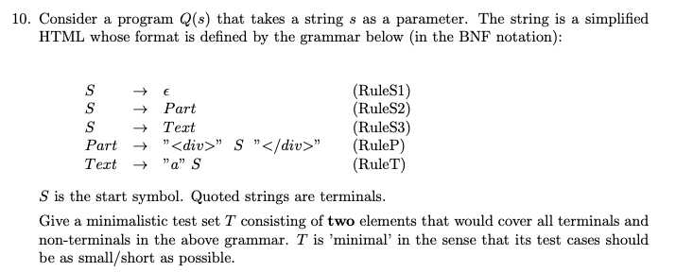

Slide 8
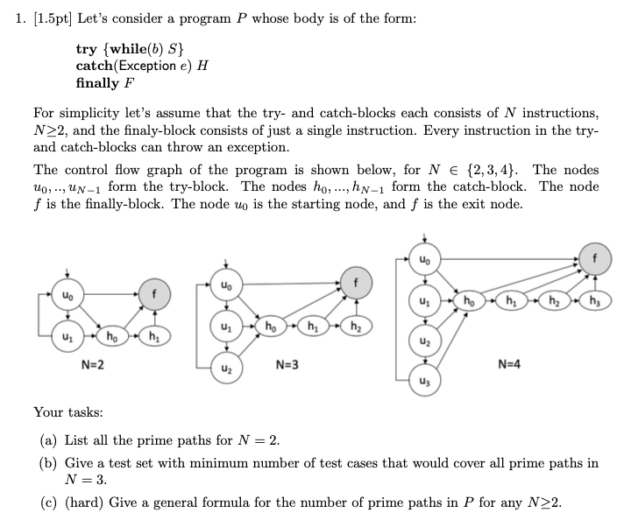




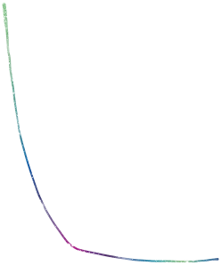




(a)
(b)
(c)

Slide 9
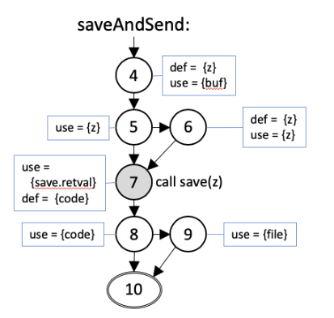
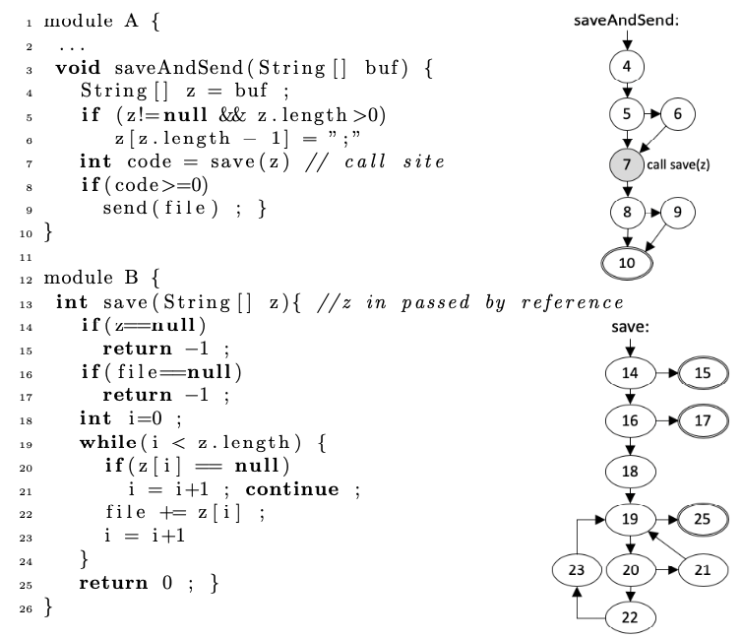
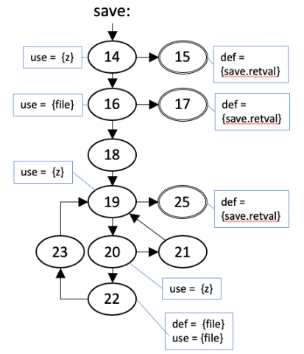
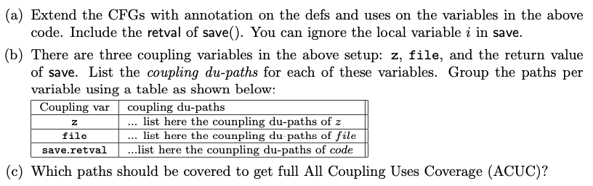

z
z
z : 457-14 , 67-14
file : 22,23,19,25,7,8,9
retval: 15,7 ... 17,7
retv
retv
retv
file

Slide 10
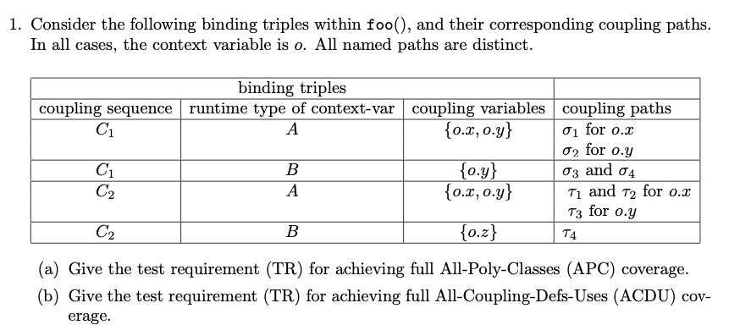


Slide 11
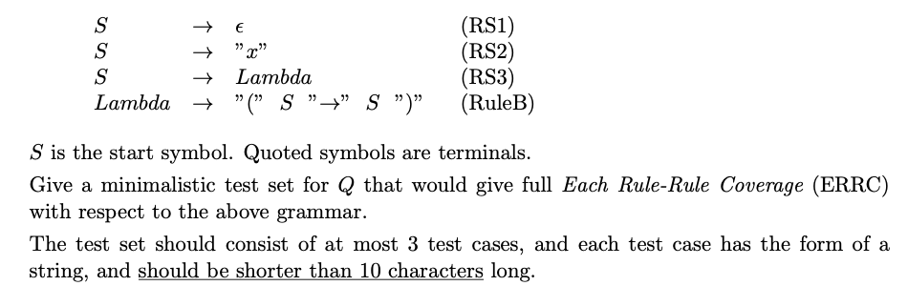
S -> Lambda --*--> ( -> )
S -> Lambda --*--> ( x -> x ) S -> Lambda --*--> ( S -> S ) --*--> ( ( -> ) -> ( -> ) )
S → Lambda ; followed by Lambda → ....
Lambda → ( S ➝ S ) ; followed by S → eps on the S@1 or followed by S → eps on the S@3
Lambda → ( S ➝ S ) ; followed by S → x on the S@1 or followed by S → x on the S@3
Lambda → ( S ➝ S ) ; followed by S → lambda on the S@1 or followed by S → lambda on the S@3

