Slide 1
W1

Slide 3
Overview of the previous lecture
By users/customers (or 3rd party hired to represent them)
Requirement Analysis
Acceptance Test
Architecture Design
System Test
Detailed
Design
Integration Test
Implementation
Unit Test
By developers
Simplified version of AO Fig. 1.2.
(1) In a real-world setup you need to organize your testing effort, e.g. a la V-model

Slide 4
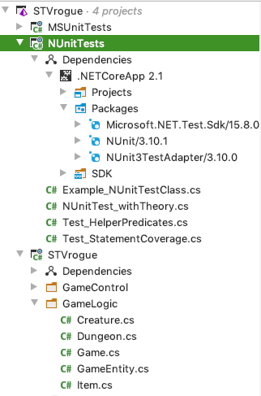
Unit Testing
Test1_Triangle() {
TriangleType ty = TriType(4,4,1) ;
Assert.AreEqual( ty , Isosceles)
}
(2) Script your tests!
(3) Use a (Unit) Testing Framework → NUnit
(4) Organize your development project

Slide 5
W2

Slide 6
Notation
C# in-code style | predicate-logic
retval | retval or return
p && q | p ∧ q
p || q | p ∨ q
x == y | x = y
Exists(a, k ➝ a[k]=0) | (∃ k: 0≤k<#a : a[k]=0) or (exists k: 0≤k<#a : a[k]=0)
Forall(a, k ➝ a[k]=0) | (∀ k: 0≤k<#a : a[k]=0) or (forall k: 0≤k<#a : a[k]=0)

Slide 7
getMIN(int[ ] a)
The program takes a non-null and non-empty integer array a, and returns the smallest element of the array a.
{* a != null /\ #a>0 *}
getMIN(a)
{* (forall k : 0<=k<#a : a[k] > = retval) /\ (exists k : 0<=k<#a : a[k] = retval) *} (exists x : x in a : x = retval)
retval in a

Slide 8
current-goal G -→ REPEAT(SEQ(getNearestFood, G))
Goal: arrivedAt(e).withTactic(T)
tatctic T : FIRSTOf( dealWithMonster, hungryTactic, navigateTo(e) ) tactic hungryTactic(agent) = action(“name”) .do2( state, f -> agent. addBefore(travelTo(f)) ; ABORT() ) .on( state -> .... i am hungry ; let f = id of nearest food ; return f) .lift()

