Slide 1
Hoare Logic LN chapter 5, 6.1, 6.2
Hoare Logic is used to reason about the correctness of programs. In the end, it reduces a program and its specification to a set of verification conditions.

Slide 2
Overview
Hoare logic (Ch 5, 6.1)
Hoare triple
Rules for basic statements // SEQ, IF, ASG
Weakest pre-condition
Example
Weakest pre-condition (LN 6.2)

Slide 3
Hoare logic basics LN Chapter 5, 6.1

Slide 4
Why Hoare logic?
We’ve looked at proofs about purely functional programs
e.g., rev and rv are purely functional
∀ s :: rev s = rv [] s
Purely functional programs only take in an input and return an output; the behavior is not affected by anything else and it does not affect anything else
Thus, we prove properties about it mathematically, as above
Now we reason about stateful/imperative/object oriented programs
These are affected by and affect the state of the memory, etc.

Slide 5
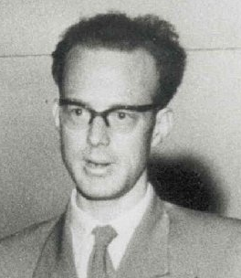
Hoare logic
Invented by Tony Hoare (1934-2026) in 1969
Influenced by Robert Floyd
The Hoare triple expresses the effect the program has on state
The triple says: if we are in a state satisfying P, after the program runs, we are in a state satisfying Q.
{* P *} program {* Q *}
pre-condition
(a logical statement specifying states)
the program being specified
post-condition
(a logical statement specifying states)

Slide 6
Hoare triple
Example:
Meaning: if we are in a state where y≠0, then after running Pr(x,y), we are in a state where return = x/y.
{* y≠0 *} Pr(x,y) {* return = x/y *}
pre-condition
the program being specified
post-condition

Slide 7
Partial and total correctness interpretation
{* P *} Pr(x) {* Q *}
Total correctness interpretation of Hoare triple: if the program is executed on a state satisfying P, it will terminate in a state satisfying Q.
Partial correctness interpretation: if the program is executed on a state satisfying P, and if it terminates, it will terminate in a state satisfying Q.
Partial correctness is of course weaker, but on the other hand easier to prove. Useful in situations where we can afford to postpone concerns about termination.

Slide 8
Limitations of Hoare logic
Not every type of behavioral property can (naturally) be captured with Hoare logic.
Examples:
If we want to reason about the order in which certain things happen when a program is run.
Alternative: CSP (communicating sequential process)
If we want to reason about how often a state is visited.
Alternative: temporal logic
If we want to reason about trusting information.
Alternative: logic of belief.

Slide 9
Hoare Logic
Components
Basic statement is the Hoare triple
{*P*} program {*Q*}
To prove a specific statement, we use inference rules, like the one below
It says that if the statements above the line hold, then we can conclude the statements below the line
{* P *} S {* Q *} {* Q *} T {* R *}
-----------------------------------------------------------------
{* P *} S ; T {* R *}
9

Slide 10
Sequential decomposition
The first rule is the most important
It tells us that if we want to reason about a program consisting of two statements S and T in sequence, then we can do this by reasoning about the programs S and T separately
Thus, we break down a program into its steps and reason one-by-one
{* P *} S {* Q *} {* Q *} T {* R *}
-----------------------------------------------------------------
{* P *} S ; T {* R *}
SEQ
(B.1.6)
10

Slide 11
Skip
Here is another basic rule
If P holds before executing skip, then it still holds afterwards
-----------------------------------------------------------------
{* P *} skip {* P *}
SKP
11

Slide 12


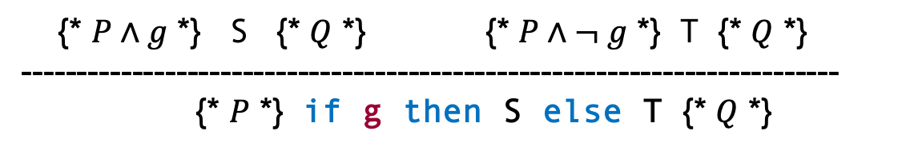



Inference rule for if
{* $P∧g$ *} S {* $Q$ *} {* $P∧¬ g$ *} T {* $Q$ *}
--------------------------------------------------------------------------
{* $P$ *} if g then S else T {* $Q$ *}
IF
(B.1.5)
{* $P∧g$ *} S {* $Q$ *}
S
Mental model:
Sometimes think of $P$ as a logical statement
Sometimes think of $P$ as the set of all states satisfying $P$
$$P$$
g
$$Q$$
¬g
T
{* $P∧¬ g$ *} T {* $Q$ *}
12

Slide 13

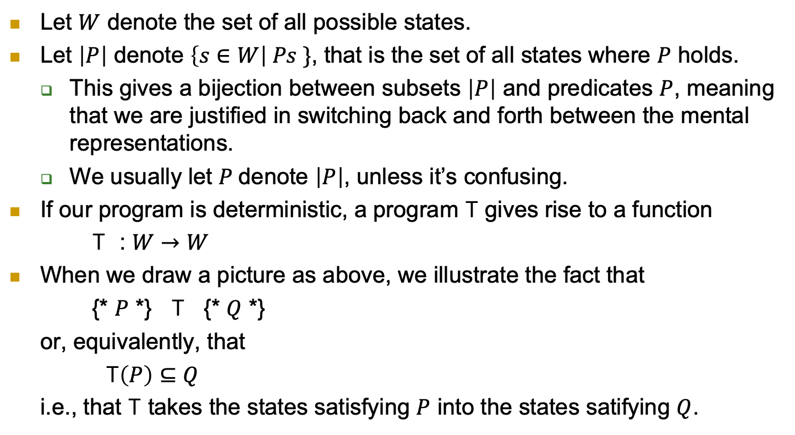

Predicates as subsets
T
$$P$$
$$Q$$
Let $W$ denote the set of all possible states.
Let $\left|P\right|$ denote $\left\{s∈W\right| Ps \}$, that is the set of all states where $P$ holds.
This gives a bijection between subsets $\left|P\right|$ and predicates $P$, meaning that we are justified in switching back and forth between the mental representations.
We usually let $P$denote $\left|P\right|$, unless it’s confusing.
If our program is deterministic, a program T gives rise to a function
T : $W→W$
When we draw a picture as above, we illustrate the fact that
{* $P$ *} T {* $Q$ *}
or, equivalently, that
T$\left(P\right)⊆Q$
i.e., that T takes the states satisfying $P$ into the states satifying $Q$.
13

Slide 14
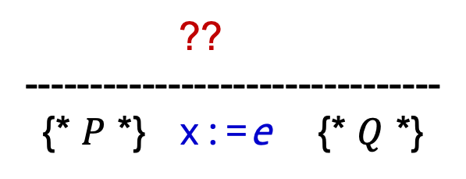
Inference rule for assignment
?? --------------------------------
{* $P$ *} x:=e {* $Q$ *}
Idea: let’s first construct a pre-condition W that holds before the assignment if and only if Q holds after the assignment.
Then we can equivalently prove P ⇒ W
14

Slide 15
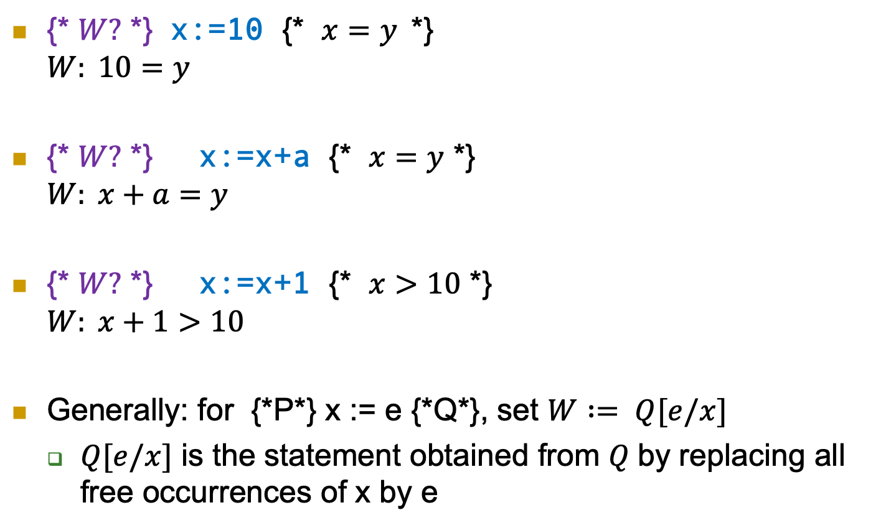
Examples
{* $W?$ *} x:=10 {* $x=y$*} $W: 10=y$
{* $W?$ *} x:=x+a {* $x=y$ *} $W: x+a=y$
{* $W?$ *} x:=x+1 {* $x>10$ *} $W: x+1>10$
Generally: for {*P*} x := e {*Q*}, set $W := Q[e/x]$
$Q[e/x]$ is the statement obtained from $Q$by replacing all free occurrences of x by e
15

Slide 16

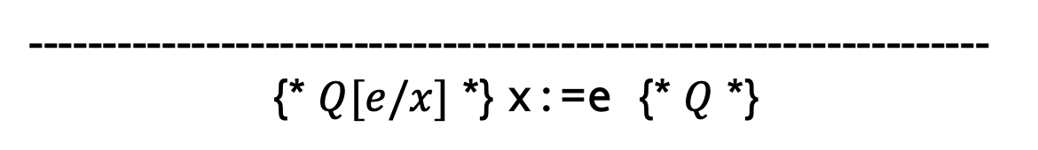
Assignment
Theorem:
$Q$ holds after x:=e
if and only if
$Q[e/x]$ held before x:=e.
-----------------------------------------------------------------
{* $Q[e/x]$ *} x:=e {* $Q$ *}
ASG
16

Slide 17
More basic rules
Pre-condition strengthening:
Post-condition weakening:
⊢ P ⇒ Q , {* Q *} S {* R *}
-------------------------------------------------
{* P *} S {* R *}
PRE
(B.1.2)
{* P *} S {* Q *} , ⊢ Q ⇒ R
-------------------------------------------------
{* P *} S {* R *}
POST
(B.1.1)

Slide 18



Pre-condition strengthening picture
Pre-condition strengthening:
⊢ P ⇒ Q , {* Q *} S {* R *}
-------------------------------------------------
{* P *} S {* R *}
PRE
(B.1.2)
$$Q$$
$$P$$
$$R$$
S

Slide 19


Post-condition weakening picture
Post-condition weakening:
$$R$$
$$P$$
$$Q$$
S
{* P *} S {* Q *} , ⊢ Q ⇒ R
-------------------------------------------------
{* P *} S {* R *}
POST
(B.1.1)

Slide 20
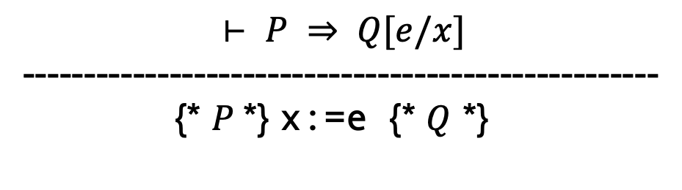
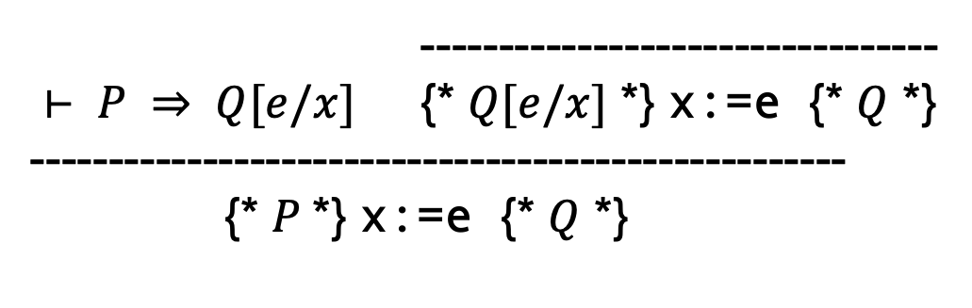
PRE + ASG
---------------------------------
$⊢ P ⇒ Q[e/x]$ {* $Q[e/x]$ *} x:=e {* $Q$ *}
----------------------------------------------------
{* $P$*} x:=e {* $Q$ *}
ASG
PRE
is a proof of
$$⊢ P ⇒ Q[e/x]$$
----------------------------------------------------
{* $P$*} x:=e {* $Q$ *}

Slide 21
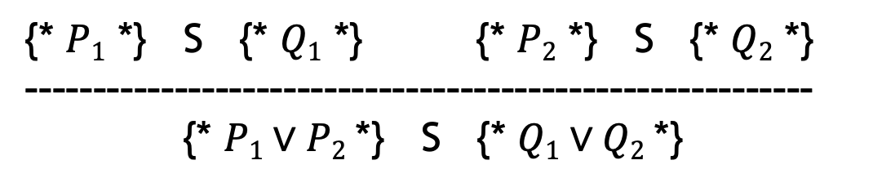
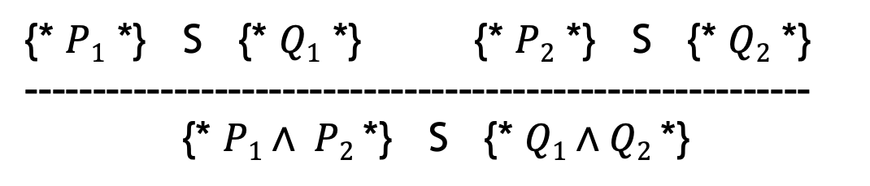
More basic rules
Conjunction of Hoare triples:
Disjunction of Hoare triples
{* $P1$ *} S {* $Q1$ *} {* $P2$ *} S {* $Q2$ *}
----------------------------------------------------------
{* $P1∧ P2$*} S {* $Q1∧Q2$*}
{* $P1$ *} S {* $Q1$ *} {* $P2$ *} S {* $Q2$ *}
----------------------------------------------------------
{* $P1∨P2$*} S {* $Q1∨Q2$*}

Slide 22






Conjunction picture
Conjunction of Hoare triples:
{* $P1$ *} S {* $Q1$ *} {* $P2$ *} S {* $Q2$ *}
----------------------------------------------------------
{* $P1∧ P2$*} S {* $Q1∧Q2$*}
$$P_{1}$$
S
$$Q_{1}$$
S
$$P1∧ P2$$
$$Q1∧ Q2$$
$$P_{2}$$
S
$$Q_{2}$$

Slide 23






Disjunction picture
Disjunction of Hoare triples
$$P1∨ P2$$
$$Q1 ∨Q2$$
$$P_{1}$$
S
$$Q_{1}$$
S
$$P_{2}$$
S
$$Q_{2}$$
{* $P1$ *} S {* $Q1$ *} {* $P2$ *} S {* $Q2$ *}
----------------------------------------------------------
{* $P1∨P2$*} S {* $Q1∨Q2$*}

Slide 24
Weakest pre-condition LN Section 6.2

Slide 25
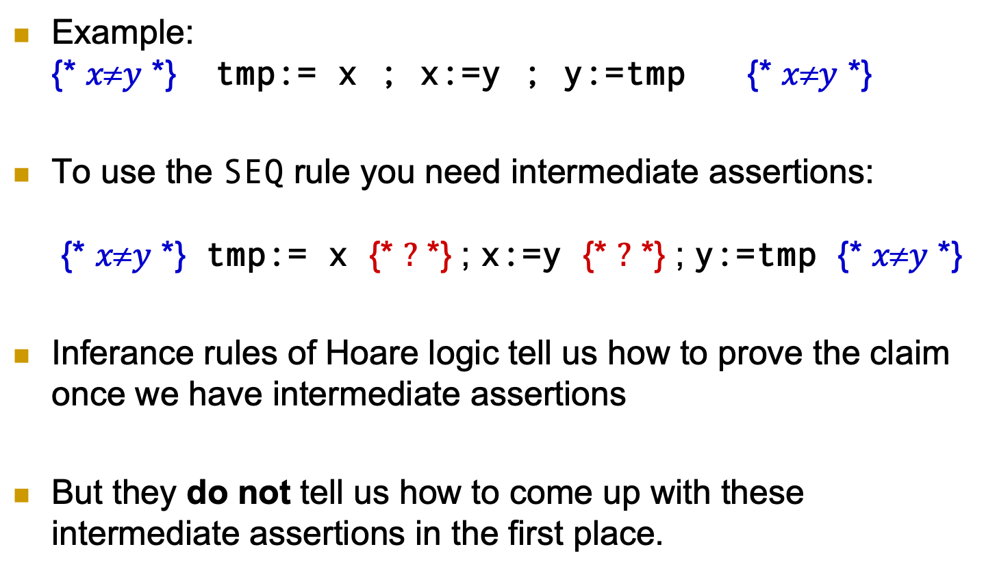
How does a proof proceed now ?
Example: {* $xy$ *} tmp:= x ; x:=y ; y:=tmp {* $xy$ *}
To use the SEQ rule you need intermediate assertions: {* $xy$ *} tmp:= x {* $?$ *} ; x:=y {* $?$ *} ; y:=tmp {* $xy$ *}
Inferance rules of Hoare logic tell us how to prove the claim once we have intermediate assertions
But they do not tell us how to come up with these intermediate assertions in the first place.
25

Slide 26
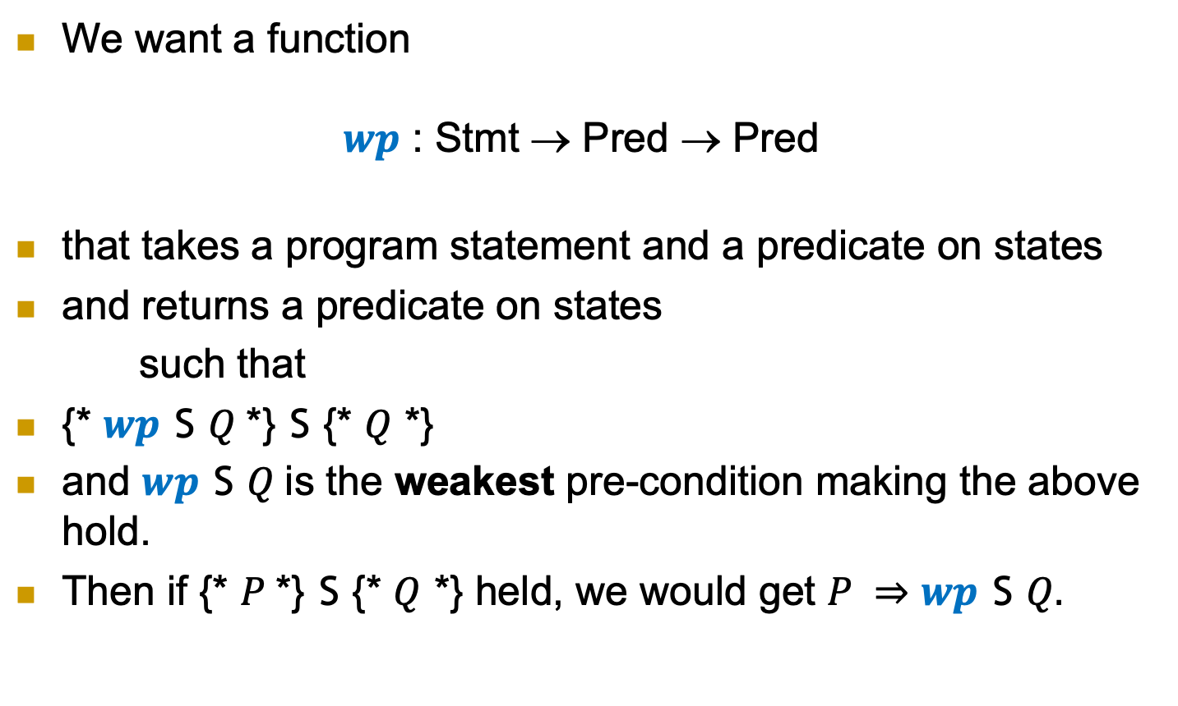
Weakest pre-condition
We want a function $wp$ : Stmt → Pred → Pred
that takes a program statement and a predicate on states
and returns a predicate on states
such that
{* $wp$ S $Q$*} S {* $Q$ *}
and $wp$ S $Q$is the weakest pre-condition making the above hold.
Then if {* $P$*} S {* $Q$ *} held, we would get $P ⇒$ $wp$ S $Q.$
26

Slide 27
Weakest pre-condition
So we characterize wp as follows (Def. 6.2.3): {* P *} S {* Q *} ≡ P ⇒ wp S Q
Corollary-1: Such a wp is a valid pre-condition. That is, you can prove: {* wp S Q *} S {* Q *}
Corollary-2 : wp reduces program verification problems to proving implications, for which we already have a “tool” for (Predicate Logic).
27

Slide 28
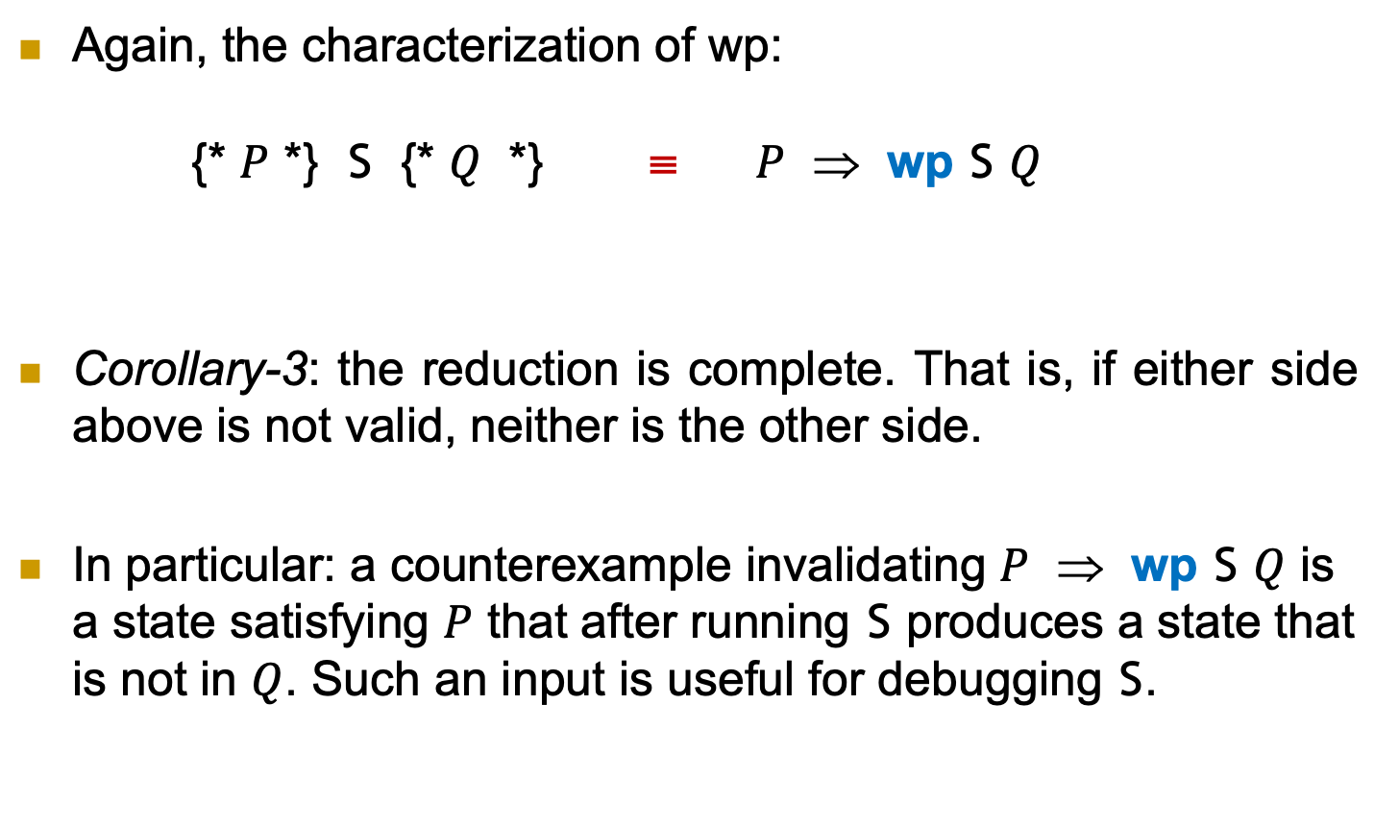
Weakest pre-condition
Again, the characterization of wp: {* $P$ *} S {* $Q$ *} ≡ $P$ ⇒ wp S $Q$
Corollary-3: the reduction is complete. That is, if either side above is not valid, neither is the other side.
In particular: a counterexample invalidating $P$ ⇒ wp S $Q$ is a state satisfying $P$ that after running S produces a state that is not in $Q$. Such an input is useful for debugging S.
28

Slide 29
But...
But this characterization is not constructive: {* P *} S {* Q *} ≡ P ⇒ wp S Q
That is, it does not tell us how to actually calculate wp S Q.
To be actually usable, we need to come up with a constructive definition for wp.
29

Slide 30
Some notes before we attempt to define wp
This is the meta property we want to have: P ⇒ wp S Q ≡ {* P *} S {* Q *}
A definition/implementation of wp should be at least “sound”: P ⇒ wp S Q ⇒ {* P *} S {* Q *}
It should also be “complete”: P ⇒ wp S Q ⇐ {* P *} S {* Q *}
Or, Equivalently:
P ⇒ wp S Q ⇒ {* P *} S {* Q *}
30

Slide 31
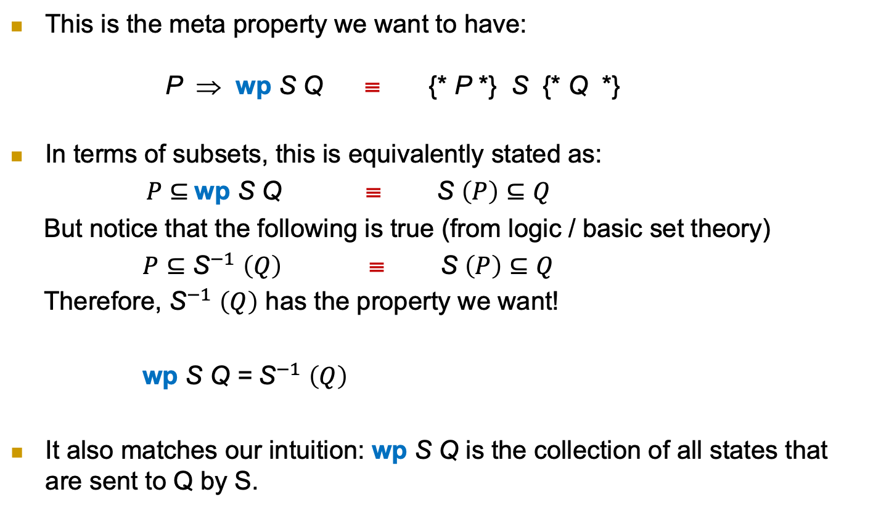
Subset view of wp
This is the meta property we want to have: P ⇒ wp S Q ≡ {* P *} S {* Q *}
In terms of subsets, this is equivalently stated as:
$P⊆$wp S Q ≡ S $\left(P\right)⊆Q$
But notice that the following is true (from logic / basic set theory)
$P⊆{\text{S}}^{−1} \left(Q\right)$ ≡ S $\left(P\right)⊆Q$
Therefore, ${\text{S}}^{−1} \left(Q\right)$ has the property we want!
wp S Q = ${\text{S}}^{−1} \left(Q\right)$
It also matches our intuition: wp S Q is the collection of all states that are sent to Q by S.
31

Slide 32
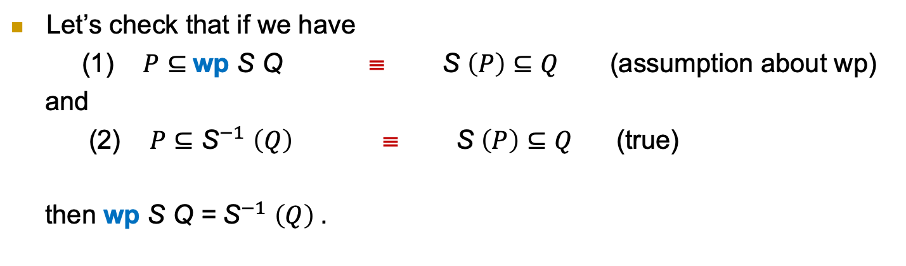
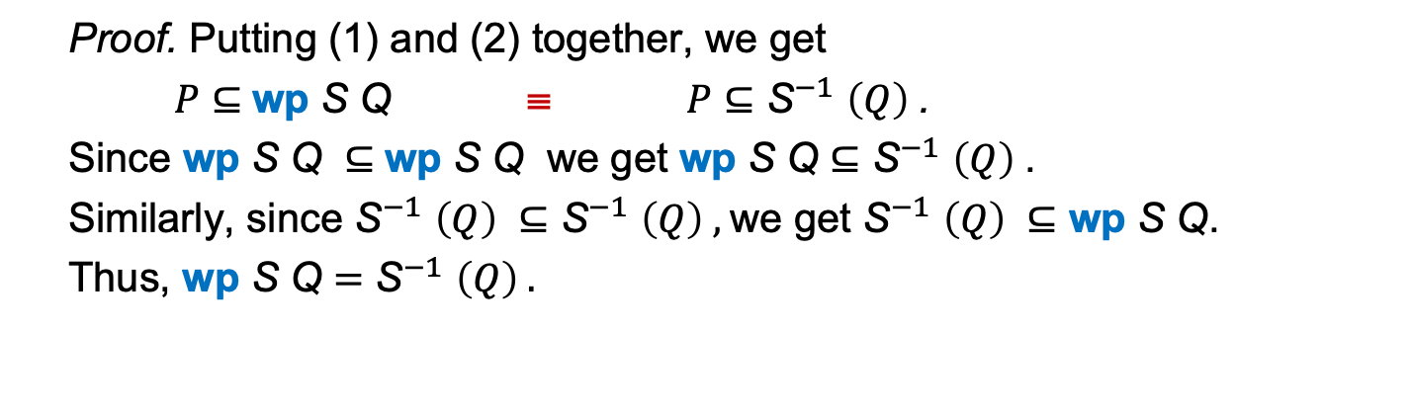
Subset view of wp
Let’s check that if we have
(1) $P⊆$wp S Q ≡ S $\left(P\right)⊆Q$ (assumption about wp)
and
(2) $P⊆{\text{S}}^{−1} \left(Q\right)$ ≡ S $\left(P\right)⊆Q$ (true)
then wp S Q = ${\text{S}}^{−1} \left(Q\right)$.
Proof. Putting (1) and (2) together, we get
$P⊆$wp S Q ≡ $P⊆{\text{S}}^{−1} \left(Q\right)$.
Since wp S Q $⊆$wp S Q we get wp S Q $⊆{\text{S}}^{−1} \left(Q\right)$.
Similarly, since ${\text{S}}^{−1} \left(Q\right) ⊆{\text{S}}^{−1} \left(Q\right) ,$we get ${\text{S}}^{−1} \left(Q\right) ⊆\text{wp} \text{S} \text{Q}$.
Thus, wp S Q $={\text{S}}^{−1} \left(Q\right) .$
32

Slide 33
Deterministic vs. non-deterministic
Remember we are assuming that our programs are deterministic. That is, we model a program P as a function
P: States → States.
Programs can also be nondeterminstic. Then we model a program P as a function
P: States → 𝒫 (States)
Here 𝒫 (States) is the 𝒫owerset of States. That means its elements are subsets of States.
Thus, a nondeterministic program P is one that takes a single state s to a set P s of possible states.
Proofs of our statements are only slightly more complicated for nondeterministic programs. See the lecture notes.
33

Slide 34
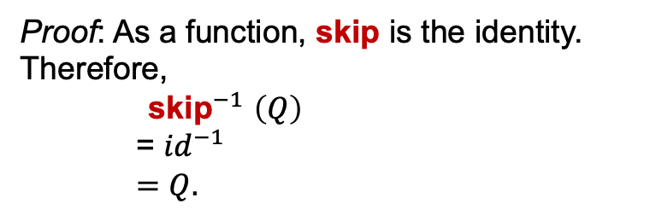
Weakest pre-condition of skip
wp skip Q = Q
Proof: As a function, skip is the identity. Therefore,
${\text{skip}}^{−1} \left(Q\right)$
= ${id}^{−1}$
$=Q.$
34

Slide 35
Inference rule for skip
wp skip Q = Q
From the above, we get the following inference rule (if we didn’t know it before).
-----------------------------------------------------------------
{* Q *} skip {* Q *}
SKP
35

Slide 36
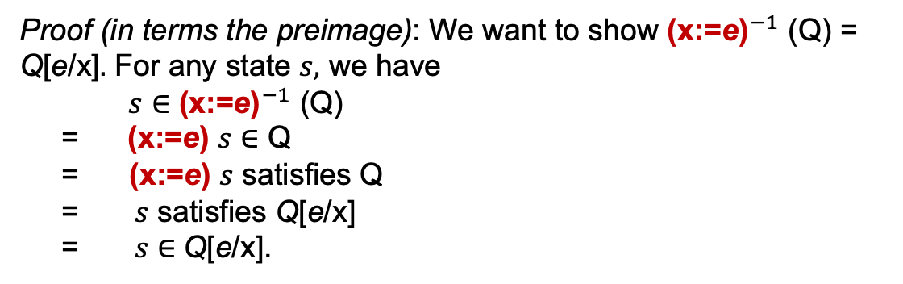
Weakest pre-condition of assignment
wp (x:=e) Q = Q[e/x]
We already showed this! (slide 16)
Proof (in terms the preimage): We want to show ${\text{(}\text{x}\text{:=}\text{e}\text{)}}^{−1}$(Q) = Q[e/x]$.$ For any state $s,$ we have $s∈$ ${\text{(}\text{x}\text{:=}\text{e}\text{)}}^{−1}$(Q)
= $\text{(}\text{x}\text{:=}\text{e}\text{)}$ $s∈$ Q
= $\text{(}\text{x}\text{:=}\text{e}\text{)}$ $s$ satisfies Q
= $s$ satisfies Q[e/x]
= $s∈$Q[e/x].
36

Slide 37

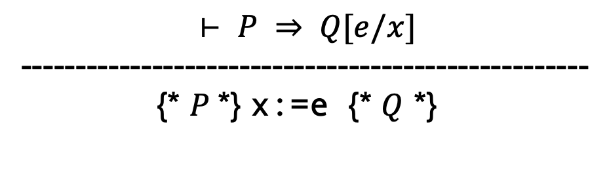
Inference rule for assignment
Now, if we didn’t already know the inference rule for assignment, we would be able to assert
or, equivalently:
-----------------------------------------------------------------
{* $Q[e/x]$ *} x:=e {* $Q$ *}
ASG
$$⊢ P ⇒ Q[e/x]$$
----------------------------------------------------
{* $P$*} x:=e {* $Q$ *}
37

Slide 38
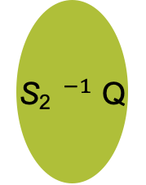
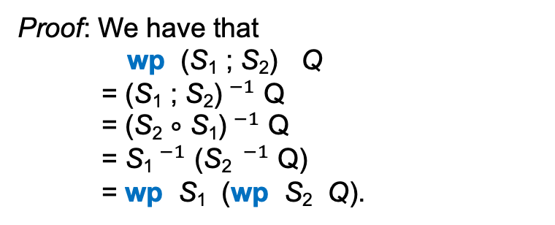
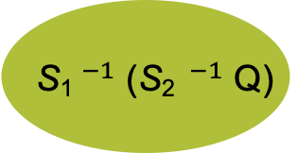
wp of SEQ
wp (S₁ ; S₂) Q = wp S₁ (wp S₂ Q)
Proof: We have that
wp (S₁ ; S₂) Q
= (S₁ ; S₂)$^{−1}$ Q
= (S₂ ∘ S₁)$^{−1}$ Q
= S₁$^{−1}$ (S₂ $^{−1}$ Q)
= wp S₁ (wp S₂ Q).
Q
S₂ $^{−1}$ Q
S₂
S₁$^{−1}$ (S₂ $^{−1}$ Q)
S₁
38

Slide 39
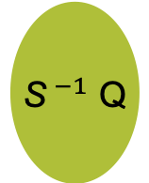
Post condition weakening
(Q ⟹ Q’ ) ⟹ (wp S Q ⟹ wp S Q’)
Proof: We want to show
Q ⊆ Q’ ⟹ wp S Q ⊆ wp S Q’
or equivalently,
Q ⊆ Q’ ⟹ S⁻¹ Q ⊆ S⁻¹ Q’.
Suppose Q ⊆ Q’ . Consider s ∈ S⁻¹ Q with the goal of showing s ∈ S⁻¹ Q’.
s ∈ S⁻¹ Q
= S s ∈ Q
⟹ S s ∈ Q’.
= s ∈ S⁻¹ Q’.
Q
S⁻¹ Q’
S$^{−1}$ Q
Q
Q’
S
39

Slide 40
SEQ and weakening
wp (S₁ ; S₂) R = wp S₁ (wp S₂ R)
(Q ⟹ Q’ ) ⟹ (wp S Q ⟹ wp S Q’)
Recall:
Pretend we don’t already know the inference rule below.
Consider P, S, Q, T, R satisfying its hypotheses.
Then Q ⟹ wp S₂ R so wp S₁ Q ⟹ wp S₁ (wp S₂ R) (by weakening).
But P ⟹ wp S₁ Q ⟹ wp S₁ (wp S₂ R) = wp (S₁ ; S₂) R.
Therefore, if we didn’t already know the inference rule SEQ, we could conclude
{* P *} S {* Q *} {* Q *} T {* R *}
-----------------------------------------------------------------
{* P *} S ; T {* R *}
SEQ
(B.1.6)
40

Slide 41
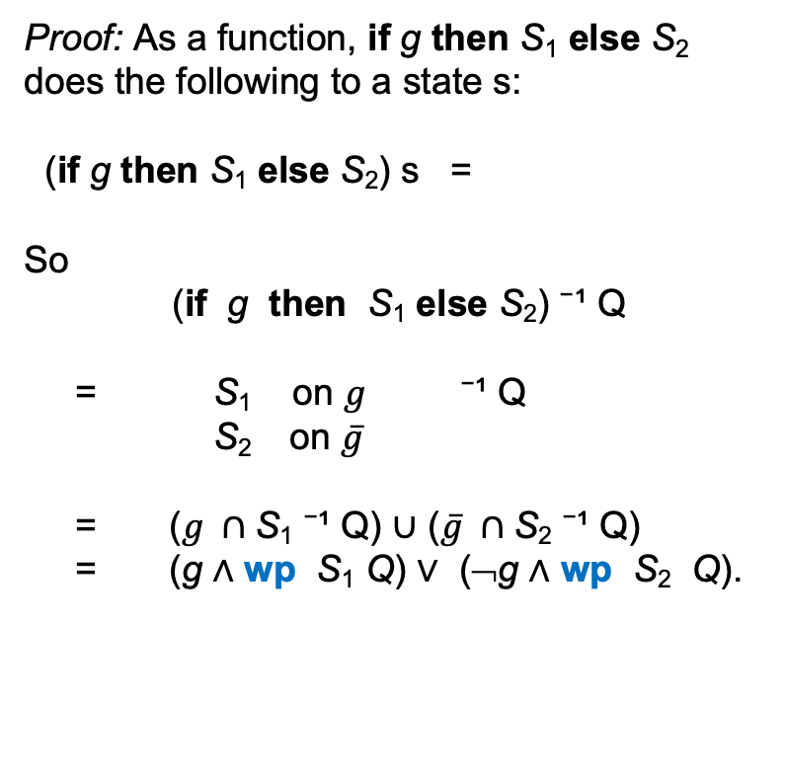
wp of IF
wp (if g then S₁ else S₂) Q = (g ∧ wp S₁ Q) ∨ (¬g ∧ wp S₂ Q)
Proof: As a function, if g then S₁ else S₂ does the following to a state s:
(if g then S₁ else S₂) s =
So
(if g then S₁ else S₂) ⁻¹ Q
= S₁ on $g$ ⁻¹ Q
S₂ on $\overline{g}$
= ($g ∩$S₁ ⁻¹ Q) $∪$ ($\overline{g} ∩$S₂ ⁻¹ Q)
= (g ∧ wp S₁ Q) ∨ (¬g ∧ wp S₂ Q).
S₁(s) if s ∈ g
S₂(s) o/w
S₁
g ∧ wp S₁ Q
Q
g
¬g
¬g ∧ wp S₂ Q
S₂
41

Slide 42
Alternative formulation of wp IF
wp (if g then S₁ else S₂) Q = (g ∧ wp S₁ Q) ∨ (¬g ∧ wp S₂ Q)
=
(g ⇒ wp S₁ Q) ∧ (¬g ⇒ wp S₂ Q)
This formulation for the wp of if-then-else is more convenient for working out proofs. E.g. in a deductive proof its conjunctive form would translate to proving two goals.
42

Slide 43
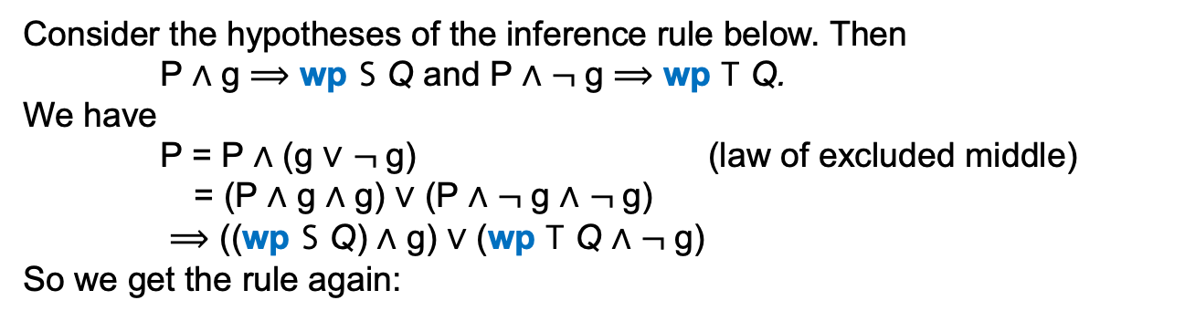
Inference rule for IF
wp (if g then S₁ else S₂) Q = (g ∧ wp S₁ Q) ∨ (¬g ∧ wp S₂ Q)
Consider the hypotheses of the inference rule below. Then
P ∧ g ⟹ wp S Q and P ∧ $¬$g ⟹ wp T Q.
We have
P = P ∧ (g ∨ $¬$g) (law of excluded middle)
= (P ∧ g ∧ g) ∨ (P ∧ $¬$g ∧ $¬$g)
⟹ ((wp S Q) ∧ g) ∨ (wp T Q ∧ $¬$g)
So we get the rule again:
{* $P∧g$ *} S {* $Q$ *} {* $P∧¬ g$ *} T {* $Q$ *}
--------------------------------------------------------------------------
{* $P$ *} if g then S else T {* $Q$ *}
IF
(B.1.5)
43

Slide 44
How does a proof proceed now ?
{* x≠y *} tmp:= x ; x:=y ; y:=tmp {* x≠y *}
Calculate: W = wp (tmp:= x ; x:=y ; y:=tmp) x≠y
Then prove: x≠y ⇒ W
We calculate the intermediate assertions, rather than manually figuring them out!
44

Slide 45
Example 1
{* x > 0 *}
y := -1 - x;
z := x * y
{* z < 0 *}
x * (-1 – x) < 0
x * y < 0
wp (x:=e) Q = Q[e/x]

Slide 46
Example 1
Thm. x > 0 implies x * (-1 – x) < 0.
Proof. x > 0
⟹ 1 + x > 0
⟹ -(1 + x) < 0
⟹ -1 - x < 0.
Since x > 0 and -1 - x < 0, the product x * (-1 – x) < 0.

Slide 47
Example 1
PROOF top
[A:] x > 0
[G:] wp (y := −1−x; z := x∗y) (z < 0)
BEGIN--------------------------------------------------------------
1. { sub } (wp (y := −1−x; z := x∗y) (z < 0)) = (x ∗ (−1 − x) < 0)
EQUATIONAL PROOF sub -----------------------------------------
wp (y := −1−x; z := x∗y) (z < 0)
= {wp formula for sequence}
wp (y := −1−x) (wp (z := x∗y) (z < 0))
= {wp formula for assignment}
wp (y := −1−x) (x*y < 0)
= {wp formula for assignment}
x * (−1 − x) < 0
END ----------------------------------------------------------
2. {follows from A } 1 + x > 0
3. {follows from 2 } -(1 + x) < 0
4. {follows from 3 } -1 - x < 0
6. {follows from A,3 } x ∗ (−1 − x) < 0
7. {rewrite 6 with 1 } wp (y := −1−x; z := x∗y) (z < 0))
END----------------------------------------------------------------

Slide 48
Example 2
{* 0≤i /\ ¬found /\ (found = (∃k : 0≤k<i : a[k]=x)) *}
found := a[i]=x ;
i:=i+1
{* found = (∃k : 0≤k<i : a[k]=x) *}
⇒
(a[i]=x) = (∃k : 0≤k<i+1 : a[k]=x)
found = (∃k : 0≤k<i+1 : a[k]=x)
wp (x:=e) Q = Q[e/x]

Slide 49
Example 2
Thm. Suppose 0≤i ∧ ¬found ∧ (found = (∃k : 0≤k<i : a[k]=x)). Then (a[i]=x) = (∃k : 0≤k<i+1 : a[k]=x).
Proof. We have
(∃k : 0≤k<i+1 : a[k]=x) = (∃k : 0≤k<i : a[k]=x) ∨ a[i]=x (A.4.11.2)
= found ∨ a[i]=x
= false ∨ a[i]=x
= a[i]=x.

Slide 50
Example 2
PROOF top
[A:] 0 ≤ i ∧ ¬found ∧ (found = (∃k : 0 ≤ k < i : a[k]=x))
[G:] wp (found := a[i]=x ; i:=i+1) (found = (∃k : 0≤k<i : a[k]=x))
BEGIN-----------------------------------------------------------------------------------------------
1. {sub1} wp (found:=a[i]=x ; i:=i+1) (found = (∃k:0≤k<i:a[k]=x)) = ((a[i]=x) = (∃k:0≤k<i+1: a[k]=x))
EQUATIONAL PROOF sub1 -------------------------------------------------------------------------
wp (found := a[i]=x ; i:=i+1) (found = (∃k : 0≤k<i : a[k]=x))
= {wp formula for sequence}
wp (found := a[i]=x) (wp (i:=i+1) (found = (∃k : 0≤k<i : a[k]=x)))
= {wp formula for assignment}
wp (found := a[i]=x) (found = (∃k : 0≤k<i+1 : a[k]=x))
= {wp formula for assignment}
(a[i]=x) = (∃k : 0≤k<i+1 : a[k]=x)
END -------------------------------------------------------------------------------------------
2. {∧ elimination from A } ¬found
3. {∧ elimination from A } found = (∃k : 0 ≤ k < i : a[k]=x))
4. {rewriting 3 in 2} ¬(∃k : 0 ≤ k < i : a[k]=x)
5. {∨ introduction } (a[i]=x) ⟹ (∃k : 0≤k<i : a[k]=x) ∨ (a[i]=x)
6. {∨ elimination from 4 } (∃k : 0≤k<i : a[k]=x) ∨ (a[i]=x) ⟹ (a[i]=x)
7. {def of = from 5,6} (a[i]=x) = (∃k : 0≤k<i : a[k]=x) ∨ (a[i]=x)
8. {sub2} (a[i]=x) = (∃k : 0≤k<i+1 : a[k]=x)
EQUATIONAL PROOF sub2 --------------------------------------------------------------------------
a[i]=x
= {7}
(∃k : 0≤k<i : a[k]=x) ∨ (a[i]=x)
= {singleton domain}
(∃k : 0≤k<i : a[k]=x) ∨ (∃k : i≤k<i : a[k]=x)
= {domain split}
(∃k : 0≤k<i+1 : a[k]=x)
END---------------------------------------------------------------------------------------------
10. {rewrite 1 in 8} wp (found := a[i]=x ; i:=i+1) (found = (∃k : 0≤k<i : a[k]=x))
END--------------------------------------------------------------------------------------------------

Slide 51
Example 3
{* odd x ∧ odd y *}
y := y+1;
if x>y then x:=x-y else skip
{* odd (x+y) *}
⇒
((x > y+1) ∧ odd x) ∨ ((x ≤ y+1) ∧ odd (x+y+1))
((x > y) ∧ odd x) ∨ ((x ≤ y) ∧ odd (x+y))
odd (x+y)
odd ((x – y) + y)) = odd x
wp (x:=e) Q = Q[e/x]
wp (if g then S else T) Q = (g /\ wp S Q) \/ (¬g /\ wp T Q)

Slide 52
Example 3
Let’s check that
odd x ∧ odd y ⟹ ((x > y+1) ∧ odd x) ∨ ((x ≤ y+1) ∧ odd (x+y+1)).
We have
odd x ∧ odd y
= {law of excluded middle}
((x > y+1) ∧ (odd x ∧ odd y)) ∨ ((x ≤ y+1) v (odd x ∧ odd y))
⟹ {since odd x ∧ odd y implies odd x and odd (x+y+1)}
((x > y+1) ∧ (odd x)) ∨ ((x ≤ y+1) ∧ (odd (x+y+1)).

Slide 53
Example 3
PROOF top
[A:] odd x ∧ odd y
[G:] wp (y := y + 1; if x>y then x:=x-y else skip) (odd (x+y))
BEGIN------------------------------------------------------------------------------------------------------------------
1. {sub1} wp (y := y + 1; if x>y then x:=x-y else skip) (odd (x+y)) = ((x > y+1) ∧ odd x) ∨ ((x ≤ y+1) ∧ odd (x+y+1)).
EQUATIONAL PROOF sub1 --------------------------------------------------------------------------------------------
wp (y := y + 1; if x>y then x:=x-y else skip) (odd (x+y))
= {wp formula for sequence}
wp (y := y + 1) (wp (if x>y then x:=x-y else skip) (odd (x+y))
= {wp formula for if-then-else}
wp (y := y + 1) (x > y ∧ wp (x:=x-y) (odd (x+y)) ∨ (x ≤ y ∧ wp (skip) (odd (x+y))))
= {wp formula for assignment}
wp (y := y + 1) (x > y ∧ odd (x-y+y)) ∨ (¬(x > y) ∧ wp (skip) (odd (x+y))))
= {wp formula for skip}
wp (y := y + 1) (x > y ∧ odd (x-y+y)) ∨ (¬(x > y) ∧ odd (x+y)))
= {wp formula for assignment}
x > y+1 ∧ odd (x-(y+1)+(y+1)) ∨ ¬(x > (y+1)) ∧ odd (x+(y+1))
= {trivial}
(x > y+1 ∧ odd x) ∨ (x ≤ y+1) ∧ odd (x+y+1))
END --------------------------------------------------------------------------------------------------------------
{law of excluded middle} (x > y+1) ∨ (x ≤ y+1)
{∧ elimination from A} odd x
{∧ elimination from A} odd y
{trivial from 3,4} odd (x + y + 1)
{sub2} (x > y+1) ⟹ (x > y+1 ∧ odd x) ∨ (x ≤ y+1) ∧ odd (x+y+1))
PROOF sub2 -------------------------------------------------------------------------------------------------------
[A:] x > y+1
[G:] (x > y+1 ∧ odd x) ∨ (x ≤ y+1 ∧ odd (x+y+1))
BEGIN-------------------------------------------------------------------------------------------------------------
1. {∧ introduction from A,3} x > y+1 ∧ odd x
2. {∨ introduction from 1} (x > y+1 ∧ odd x) ∨ (x ≤ y+1 ∧ odd (x+y+1))
END---------------------------------------------------------------------------------------------------------------
7. {sub3} (x ≤ y+1) ⟹ (x > y+1 ∧ odd x) ∨ (x ≤ y+1) ∧ odd (x+y+1))
PROOF sub3
[A:] x ≤ y+1
[G:] (x > y+1 ∧ odd x) ∨ (x ≤ y+1 ∧ odd (x+y+1))
BEGIN-------------------------------------------------------------------------------------------------------------
1. {∧ introduction from A,5} (x ≤ y+1) ∧ odd (x+y+1))
2. {∨ introduction from 1} (x > y+1 ∧ odd x) ∨ (x ≤ y+1) ∧ odd (x+y+1))
END---------------------------------------------------------------------------------------------------------------
8. {case split on 2,6,7} (x > y+1 ∧ odd x) ∨ (x ≤ y+1) ∧ odd (x+y+1))
9. {rewriting 1 in 8} wp (y := y + 1; if x>y then x:=x-y else skip) (odd (x+y))
END--------------------------------------------------------------------------------------------------------------------

Slide 54
Some notes about the verification approach
In our training, we prove P ⇒ W by hand.
In practice, to some degree this can be automatically checked using e.g. a SAT solver. With a SAT solver we instead check if: ¬(P ⇒ W) is satisfiable If it is, then P ⇒ W is not valid. Otherwise P ⇒ W is valid.
If the definition of wp is also “complete” (in addition to being “sound”), the witness of the satisfiability of ¬(P ⇒ W) is essentially an input that will expose a bug in the program → useful for debugging.

Slide 55
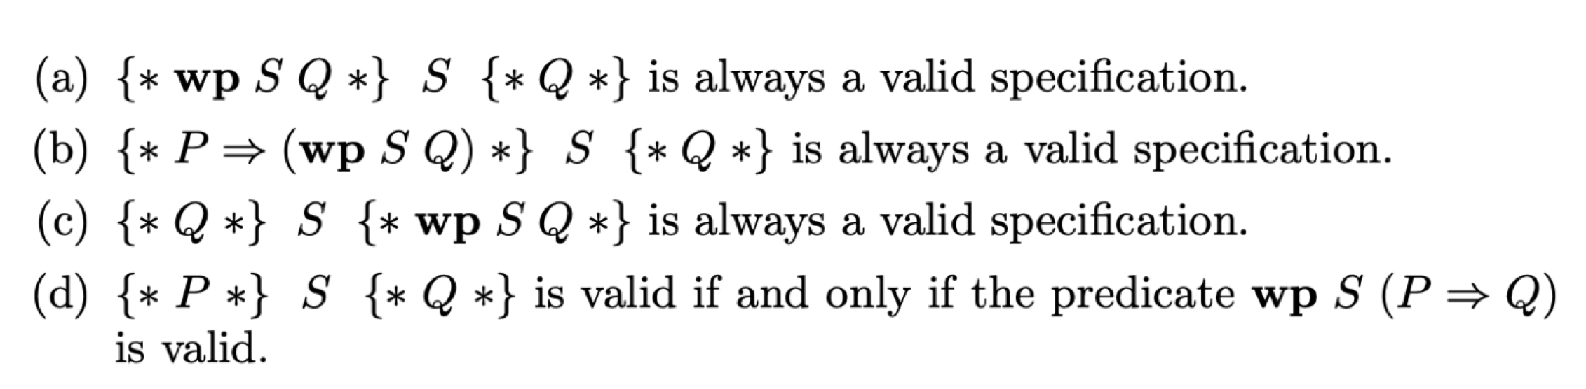
Questions

Slide 56
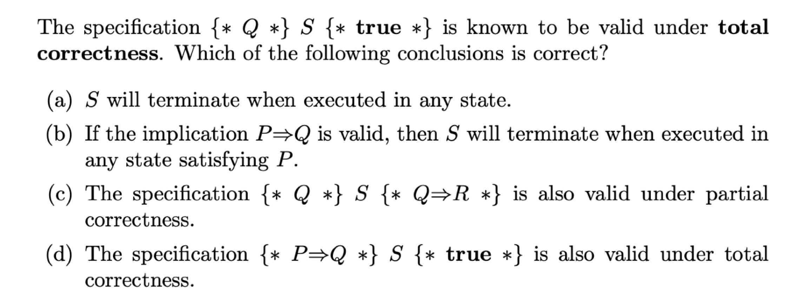
Questions

