Slide 1
Unit Testing
Course Software Testing & Verification
2025/26
Wishnu Prasetya & Paige North

Slide 2
Plan
What is unit testing, and why we do it?
Some essentials on unit testing:
Unit testing in C#
Specifying (and testing) with pre- and post-conditions
Other types of specifications: classinv, ADT, FSM.
Mocking
Note: The subject of unit testing is only glossed over in A&O. Since unit testing plays an important role in software engineering nowadays, in this lecture we will spend a bit more time to discuss it.

Slide 3
What is “testing” ?
Testing a program: verifying the correctness (or other qualities) of the program by inspecting a finite number of executions.
As such, testing is a pragmatic approach of verification (and we have to accept that it is inherently incomplete).
Note: we will discuss a more complete approach in the 2nd half of the course.

Slide 4
Example: determining triangle type
Equilateral
Scalene
Isosceles
TriangleType TriType(Float a, Float b, Float c) { ... }
If a, b, c represent the sides of a triangle, this methods determines the type of the triangle.

Slide 5
An example of a test
invoke program under test
inputs
Test1() {
TriangleType ty = TriType(4,4,1) ;
Assert.AreEqual(Isosceles , ty)
}
asserting expectation on the program output or state
also called “test oracle”

Slide 6
What is a “test” ?
Test1() { ty = TriType(4,4,1) ; Assert.AreEqual(Isosceles,ty) }
A “test” (also called test-case) for a program P(x) specifies an input for P(x) and the output it expects.
The definition fits nicely for a function/method-like P.
What if P is an interactive program e.g. a web application?
What if P is a continuously running system, e.g. a car control system?

Slide 7
A more general definition
A test for P(x) specifies a sequence of interactions along with the needed parameters on P, and the expected responses P should produce.
Compare this with AO Def. 1.17 (both definitions try to say the same thing).

Slide 8
Multi-level testing
By users/customers (or 3rd party hired to represent them)
Requirement Analysis
Acceptance Test
Architecture Design
System Test
Detailed
Design
Integration Test
Implementation
Unit Test
By developers
Simplified version of AO Fig. 1.2.
The diagram above is often called the V-model of muti-level testing. In practice people do testing in multi level.
Notes:
Acceptance test: to test if the resulting system is indeed what the customer wants. In principle the customer has to do this himself. In practice this is often done with the help of a 3rd party hired to help the customer set up the test.
System test is to test if the system meets its specification.
Integration test might be defined as to test if a subsystem meets its specifiations; however this is not how AO defines it. Instead, it is to test that “modules” connect properly. The modules are assumed to be correct individually; we focus on their connections.
Module test is to test that a module behaves correctly.
Arch, design: e.g. that a system follows a client-server architecture.
Detailed design could be class diagrams of the client-side and server-side.

Slide 9
Unit Testing
Make sure that your units are correct!
Invest in unit testing! Debugging an error at the system-test level is much more costly than at the unit level.
Note: so-called “unit testing tool” can often also be used to facilitate integration and system testing.

Slide 10
What is a “unit” ?
Program “units” should not be too large, that you can still easily comprehend of its logic.
Possibilities: functions, methods , or classes as units.

Slide 11
What is a “unit” ?
However, different types of units may have different types of interactions and complexity, thus requiring different approaches to test them:
a function’s behavior depends only on its parameters; does not have any side effect.
A procedure depends-on its parameters, but may additionally have side effect on its parameters.
A method may additionally depend on and affect instance variables, or even class (static) variables.
A class: is a collection of potentially interacting methods.

Slide 12
Unit testing in C#
Unit Testing Framework: MSUnit, NUnit, xUnit. We will be using NUnit.
Coverage tool: both Rider and VS Enterprise have it.
Check related tutorials/docs:
NUnit Quick Start (older version, but will do for a tutorial): https://nunit.org/docs/2.5.9/quickStart.html
NUnit doc: https://github.com/nunit/docs/wiki/NUnit-Documentation
Testing from your IDE (Rider):
https://www.jetbrains.com/help/rider/Introduction.html, check the entry on “Get Started with Unit Testing”.
Obtaining test coverage information: https://www.jetbrains.com/help/dotcover/Getting_Started_with_dotCover.html
In this lecture we focus on the underlying concepts.

Slide 13

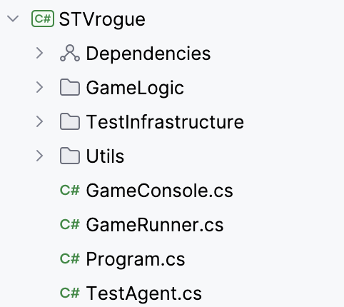
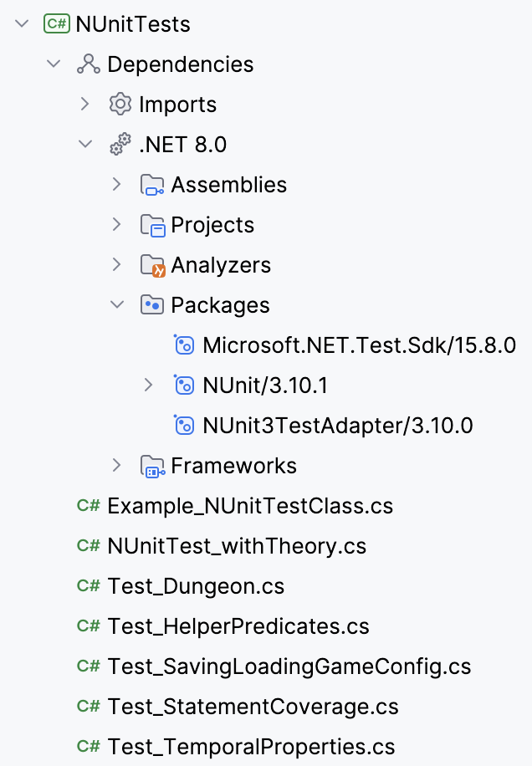
The structure of a solution with “test projects”
the project that we want to test
A test project is a just a project in your solution that contains your test-classes.
dependencies

Slide 14
The structure of a “test project”
A solution may contain multiple projects; including multiple test projects.
A test project is used to group related test classes. You decide what “related” means; e.g. you may decide to put all test-cases for package/namespace in its own test project.
A test class is used to group related test methods.
A test method does the actual testing work, it usually encodes a single test-case.

Slide 15
Test Class and Test Method (NUnit)
[TestFixture]
public class TriangleTest {
[ SetUp]
public void Init() ...
//[TearDown]
//public void Cleanup() ...
[Test]
public void Test1_Triangle() ...
[Test]
public void Test2_Triangle() ....
}
Test1_Triangle() {
var ty = TriType(4,4,1) ;
Assert.AreEqual(Isosceles, ty)
}
Notes:
Example of properties in TestContext: TestName, TestRunDirectory, TestResultDirectory
Notation [TestClass()] is used to assign a meta-attribute, which can be inspected at the runtime.
ClassCleanUp() is called after all test methods in the class have been run.

Slide 16
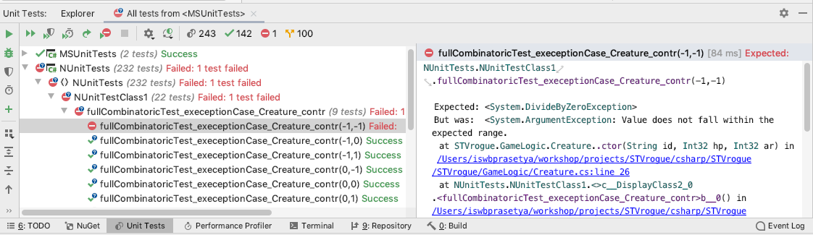
Inspecting Test Result (Rider)

Slide 17
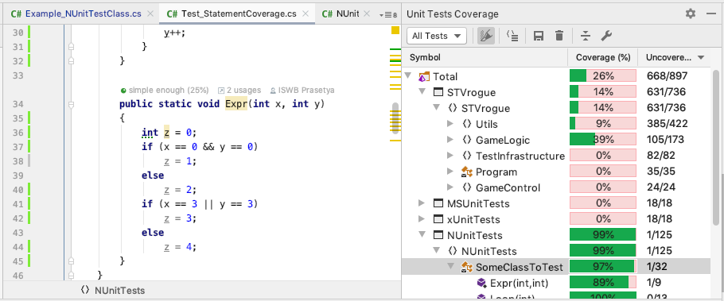
Inspecting Coverage (Rider)

Slide 18
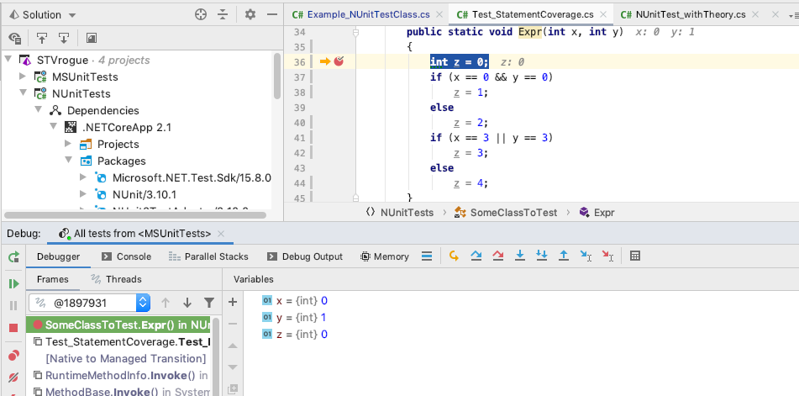
Finding the source of an error: use a debugger!
Add break points; execution is stopped at every BP.
You can inspect the values of every variable
You can proceed to the next BP, or execute one step at a time: step-into, step-over, step-out.

Slide 19
Test Oracle
Test1_Triangle() {
var ty = TriType(4,4,1) ;
Assert.AreEqual(Isosceles, ty)
}
An oracle specifies your expectation on the program’s responses.
Check NUnit doc on Assertions: https://github.com/nunit/docs/wiki/Assertions
Classic way: Assert.IsTrue(x == 0) or Assert.AreEqual(0,x)
Constraint model: Assert.That(x, Is.EqualTo(0))

Slide 20
A test needs oracles
Test1_Triangle() {
var ty = TriType(4,4,1) ;
Assert.AreEqual(Isosceles, ty)
}
How do we determine what the expected responses of the program under test?
Ideally, there exists a specification (or you have to elicit that, somehow).

Slide 21
Informal or formal specification?
TriType(Float a, Float b, Float c) { ... }
Informal: “If a, b , c represent the sides of a triangle, this methods determines the type of the triangle.”

Slide 22
Formal specification, pros and cons
Pros:
Precise
Can be turned to “executable” specifications.
When the program is changed, only its specification needs to be adapted; we don’t have to re-program the test cases.
Allow you to “generate” the test sequences/inputs rather than writing them manually.
Cons:
Capturing the intended specification is not always easy.
Additional work.

Slide 23
Example
Formalize the specification of TriType(a,b,c).
Informal: “If a, b , c represent the sides of a triangle, this methods determines the type of the triangle.”
Notes:
To be a triangle: 1) a,b,c should all be positive 2) the sum of any two sides should be greater than the third side
To be an equilateral all sides must be the same. To be scalene all sides must be different. To be Equilateral two sides must be the same, and the third different.
To be an isoleces: two sides should be equal, and the third side should be different.

Slide 24
Formalizing specification with a pre- and post-conditions (in Pred. Logic)
Pre-condition
{ a>0 ∧ b>0 ∧ c>0 ∧ a+b>c ∧ a+c>b ∧ b+c>a }
TriType(a,b,c)
{ (a=b ∧ b=c ∧ a=c) ⟺ retval=Equilateral ∧ (a≠b ∧ b≠c ∧ a≠c) ⟺ retval=Scalene
∧ ... ⟺ retval=Isosceles }
Post-condition
Formal, but not yet “executable”. We can’t invoke it from our test cases.
“…” above means “information not shown” (it does not mean “else”)
Notes:
(a=b /\ a!=c) \/ (a=c /\ a!=b) \/ (b=c /\ b!=a) <==> retval=isosceles

Slide 25
Turning it to an in-code specification (here, encoded as a parameterized NUnit-test)
void MethodSpec(x) {
if (...pre-cond...) {
var retval = Method(x)
Assert.IsTrue( ...post cond... )
} else Assert.Throws<expected exception>(() => Method(x));
}
Pre-condition
Post-condition
Check that the method throws the right exception when the pre-cond is violated.
In-code specifications are specifications expressed in a programming language. It is less clean, but it is executable, so you can invoke them from your tests.

Slide 26
In-code Spec of TriType (encoded as a parameterized NUnit-test)
bool TriTypeSpec(float a, float b, float c) {
if (a>0 && b>0 && c>0 && ...) {
var retval = TriType(a,b,c)
Assert.True((retval == Equilateral) == (a==b && b==c && a==c)) Assert.True((retval == Scalene) == (a!=b && b!=c && a!=c))
Assert.True((retval == Isosceles) == ...)
}
else Assert.Throws<ArgumentException>(() => TriType(a,b,c)) }
Pre-condition
Post-condition

Slide 27
In-code Spec v2 of TriType (encoded as a parameterized NUnit-test)
bool TriTypeSpec(float a, float b, float c) {
Assume(a>0 && b>0 && c>0 && ...) ;
var retval = TriType(a,b,c)
Assert.True((retval == Equilateral) == (a==b && b==c && a==c)) Assert.True((retval == Scalene) == (a!=b && b!=c && a!=c))
Assert.True((retval == Isosceles) == ...)
}
Pre-condition
Post-condition
v1 (previous slide) : if the method under test commits to checking the pre-cond and is expected to throw a specific exception when the pre-cond is violated.
v2 : if the method under test does check the pre-cond (shifting the resposibility to the caller). The Assume-construct of Nunit serves for filtering the test-input to let through only those that satisfy the assumed condition.

Slide 28
Now you can write your tests like this (NUnit, parameterized test)
[TestCase(4,4,1)]
[TestCase(4,4,4)]
[TestCase(1,2,4)]
[TestCase(0,4,1)]
[TestCase(0,0,0)]
...
bool TriTypeSpec(float a, float b, float c) { ... }
Important observation: this approach also opens a way for you to “generate” the tests, e.g. using a QuickCheck-like tool.
Note: “TestCase” Nunit attribute can only handle simple types. See also the doc. for ‘TestCaseSource” Nunit attribute.

Slide 29
Example2: specification for a method on array/collection
int GetIndex(x, int[ ] a) { ... }
Informal: given a non-empty integer array a, and assume x occurs in a, the method returns an index k in a of an x.

Slide 30
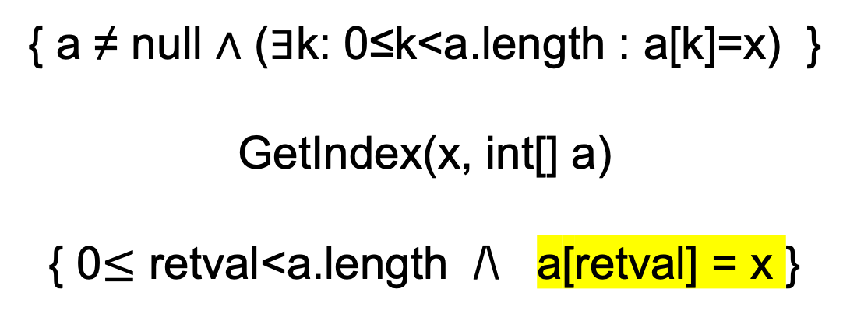
Formal spec: now we also need “quantifiers”
Informal: given a non-empty integer array a, and assume x occurs in a, the method returns an index k in a of an x.
{ a ≠ null ∧ (∃k: 0≤k<a.length : a[k]=x) } GetIndex(x, int[] a) { 0$≤$ retval<a.length /\ a[retval] = x }

Slide 31
Providing quantifiers as in-code
Define (static):
Exists(a,P) = there exists a valid index i of a, such that P(i) is true.
Similarly you can define Forall(a,P).
Similarly you can define quantifiers for collections.
Already provided in STVRogue project.
Exists<T> ( T [ ] a, Predicate<int> P) { for (int k=0; k<a.Length; k++) if (P(k)) return true ; return false ; }

Slide 32
Specifying properties of arrays (and similarly collections)
Now we can write in-code properties, e.g. : the array a contains only positive integers:
Or, the array a has at least one positive integers:
Alternatively using built-in a.Any(..) and a.All(..)
Forall(a, k => a[k] > 0 )
Exists(a, k => a[k] > 0 )

Slide 33
Example: in-code spec of GetIndex
Informal: given a non-empty integer array a, and assume x occurs in a, the method returns an index k in a of an x.
GetIndexSpec(int x, params int[] a) {
if (a!=null && Exists(a, k => a[k]==x)) { var retval = GetIndex(x,a) Assert.IsTrue(a[retval]) == x) }
else Assert.Throws<ArgumentException>(() => GetIndex(x,a))
}
Pre-condition
Post-condition

Slide 34
Using GetIndexSpec for parameterized test
[TestCase(0)]
[TestCase(0,1)]
[TestCase(0,0,0)]
[TestCase(0,1,1,1,0)]
...
GetIndexSpec(int x, params int[] a) { ... }

Slide 35
Specifying a “class”
Many classes have methods that interact with each other (e.g. as in Stack). How to specify (and test) these interactions?
Option-1: specify every method with pre- and post-conditions (we discussed this).
This is expressive enough, tough pre- and post-conditions may not, arguably, naturally capture inter-method interactions.
May need to access private fields. Also, directly testing private methods via their pre-/post is an issue.

Slide 36
Specifying a “class”
Other options, which can be user either as alternatives or in conjunction with pre/post-conditions:
class invariant
Abstract Data Type (ADT)

Slide 37
Specifying with class invariant
class Thermometer { double temperature // in Celcius Value() Incr(t) Decr(t) }
A class invariant of a class C specifies valid states of instances of C. When an instance is created, it must have a valid state. All operations/methods of C are expected to restore the state of their target instance to a valid state.
Example: class inv for Thermometer: temperature ≥ -273.15

Slide 38
Specifying a class as an ADT
An Abstract Data Type (ADT) is a model of a (stateful) data structure. The data structure is modeled abstractly by only describing a set of operations (without exposing underlying data structure implementing the state).
The semantic is described in terms of “logical properties” (also called the ADT’s axioms) over those operations.

Slide 39
ADT specification for Thermometer
class Thermometer { double temperature // in Celcius Value() Incr(t) Decr(t) }
Axioms:
For any t₀ and t>0: after Incr(t), Value() should be t₀+t, if t₀ was Value() before.
For any t₀ and t>0: after Decr(t), Value() should be max(t₀-t, -273.15), if t₀ was Value() before.
Notice that the ADT axioms never refer to the class state variables.

Slide 40
Testing ADT
Testing an ADT amounts to verifying each of its axioms, each can be formulated as a parameterized test.
For example, to test Thermometer’s Axiom-1:
We can imagine e.g. these test cases :
s such that s.temperature is -273.15 and s such that s.temperature > -273.15
very small t and normally large t
Axiom1(Thermometer s, double t) { assumeThat(t > 0) ;
t₀=s.Value() ; s. Incr(t) ; assertEqual(t₀+t, s.Value()) ; }

Slide 41
Example-2 : specifying my ItemStore
class ItemStore<T> {
Put(T x)
T Get() int Size() }
Do these look familiar?
Axioms :
The Size of a new ItemStore is 0.
After Put(x), Size is 1 + the Size before.
If Size>0, after Get(), Size is the Size before - 1.
After Put(x), followed by n-times Put(.) and Get(), such that k-th Get is preceeded by at least k-times Put, Get() gives x.

Slide 42
Testing ADT
For example, to test Ax-4:
We can imagine e.g. these test cases :
empty s
a non-empty s that does not contain x
an s that already contains x
Axiom4(ItemStore s, T x, T y) { s.Put(x) ; s.Put(y) ; s.Get() ; assertEqual(x, s.Get()) ; }
Notes:
In the literature, testing a program by exploiting relations of multiple methods/operations like in the example above is also called “metamorphic testing”

Slide 43
Mock
Consider testing a class C that uses a class D.
In a larger project, it is possible that D is developed by a separate team, and by the time you want to test C, D is not ready/stable yet. Solution: we ”mock” D.
A mock of a program P:
has the same interface as P
may only implement a very small subset of P’s behavior
fully under your control
You would want a way to conveniently create mocks.
Mentioned in Ch. 6.2.1 A&O (12.2.1 2nd Ed).

Slide 44
Example: Heater
class Heater
double limit
bool active
Thermometer thermometer
public AutoOff() {
// if thermometer.value()
// exceeds the limit,
// deactivate the heater }
class Thermometer double Value()
…
test1() {
thermometer = .... // get some thermometer
Heater heater = new Heater(thermometer) Assume.That(thermometer.Value() >= heater.limit+0.001)
heater.AutoOff()
Assert.IsFalse(heater.active)
}
Notice that for this test you need a working Thermometer class.

Slide 45
You need to restructure a bit
class Heater
double limit
bool active
IThermometer thermometer
Heater(Ithermometer t) // contr
autoOff() {
// if thermometer.value()
// exceeds the limit,
// deactivate the haeter
}
interface IThermometer double Value()
…
class Thermometer
To facilitate mocking usually you need to replace your dependency so that your class of interest depends on interfaces instead.
Notes:
There are other mock framework for .NET, e.g. Moq, rhino, easymock, etc.

Slide 46
Creating mocks dynamically using NSubstitute
Create an instance of an Interface, by calling the method “For” from the class ” NSubstitute.Substitute” : thermometer = Substitute.For<IThermometer>()
You can program the behavior of the interface’s methods on-demand. General form: mock.<method>(x1,x2,...).Returns(y), e.g.: thermometer.Value ().Returns(100) Now whenever you do thermometer.Value() this will return 100.
Notes:
Note:
The method “For<I>()” creates an instance of I.
The method “Returns” is probably more magical, especially for Java programmer. E.g. in the above example the method “value(x)” of IThremometer returns a “double”. Now, in C# primitives like double are also objects.
Furthermore C# allows a class, including primitives, to be “method-extended”. Normal class can be sub-classed. But primitives and sealed classes cannot be sub-classed. However, C# allows a syntactic sugar called “extension method”. Example with extending string:
static class Extensions
{
public static string UpperFirst(this String str)
{
if (String.IsNullOrEmpty(str))
return String.Empty;
return str.Substring(0, 1).ToUpper() + str.Substring(1, str.Length-1).ToLower();
}
}
Having this in the scope, we can now write: String z = “hello” z = z.UpperFirst() So what NSubstutute does is likely to extend return types of mocked methods with the method “Returns”.

Slide 47
Test with a mock
class Heater
double limit
bool active
IThermometer thermometer Heater(Ithermometer t)
autoOff()
interface IThermometer double Value()
…
Now we can write test1() like this:
test1() {
thermometer = Substitute.For<IThermometer>()
Heater H = new Heater(thermometer)
thermometer.Value().Returns(heater.limit + 0.001)
H.autoOff()
Assert.IsFalse(H.active)
}
Creating a mock thermometer and programming its behavior.
Notes:
There are other mock framework for .NET, e.g. Moq, rhino, easymock, etc.

