Slide 1
STV Project, PART 1
Course Software Testing & Verification
2025/26

Slide 2
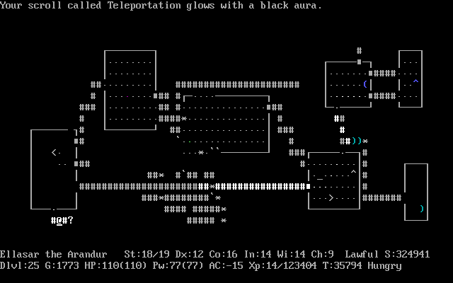
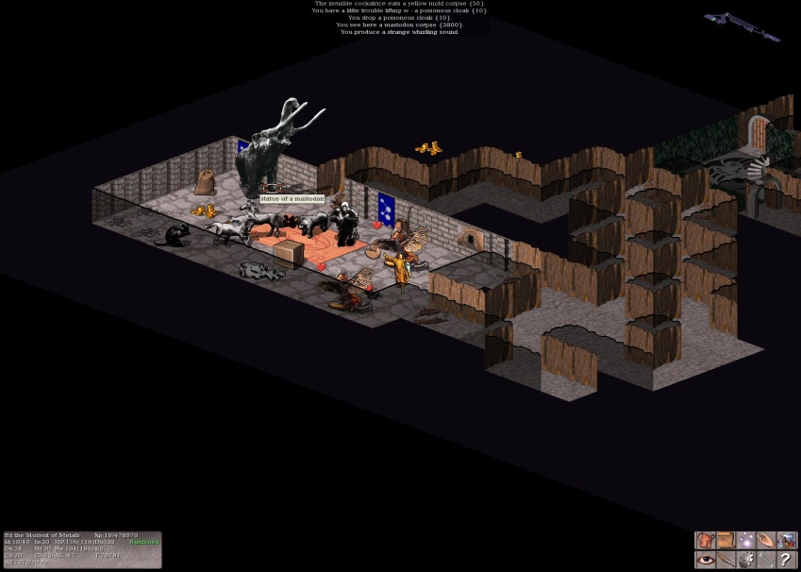
Rogue / Nethack

Slide 3
STV Rogue
Single player
Turn-based (so... not real time)
Command-line-based application
_______ _________ _______ _______ _______ _______
( ____ \\__ __/|\ /| ( ____ )( ___ )( ____ \|\ /|( ____ \
| ( \/ ) ( | ) ( | | ( )|| ( ) || ( \/| ) ( || ( \/
| (_____ | | | | | | | (____)|| | | || | | | | || (__
(_____ ) | | ( ( ) ) | __)| | | || | ____ | | | || __)
) | | | \ \_/ / | (\ ( | | | || | \_ )| | | || (
/\____) | | | \ / | ) \ \__| (___) || (___) || (___) || (____/\
\_______) )_( \_/ |/ \__/(_______)(_______)(_______)(_______/
Welcome stranger...
You are in the room R0. It is dark, and it feels dangerous...
There are corridors leading to rooms R1 and R2.
Your action: Move(m) | Pick-item(p) | Do-nothing(SPACE) | Quit(q)
Attack(a) | Flee(f) | Use-item(u)

Slide 4

STV Rogue: played on a dungeon
START
EXIT
linear dungeon
START
EXIT
tree-shaped dungeon
grid dungeon
EXIT
START

Slide 5
Architecture
Program
configuration file
GameRunner
(game-loop)
GameConsole
(user interaction)
player
TestAgent for automated system-testing
Game
(game state)
_______ _________ _______ _______ _______ _______
( ____ \\__ __/|\ /| ( ____ )( ___ )( ____ \|\ /|( ____ \
| ( \/ ) ( | ) ( | | ( )|| ( ) || ( \/| ) ( || ( \/
| (_____ | | | | | | | (____)|| | | || | | | | || (__
(_____ ) | | ( ( ) ) | __)| | | || | ____ | | | || __)
) | | | \ \_/ / | (\ ( | | | || | \_ )| | | || (
/\____) | | | \ / | ) \ \__| (___) || (___) || (___) || (____/\
\_______) )_( \_/ |/ \__/(_______)(_______)(_______)(_______/
Welcome stranger...
You are in a room. It is dark, and it feels dangerous...
Your action: Move(m) | Pick-item(p) | Do-nothing(SPACE) | Quit(q)
Attack(a) | Flee(f) | Use-item(u)
Dungeon
Player
Item *
Monster *
(Entities : no I/O)

Slide 6
Goals
Development of the game logic and unit testing.
Deliver a working game.
System-level testing.
Stick with simple user interface!
Deliverables:
Implementation + unit testing + basic system-testing + report (9 pt)
Optional: stronger system-testing (1pt)

Slide 7
Other things
Team size 3
Team registration in MSTeam: General > Files > “TEAMS registration.xlsx” Do it today. If you don’t have a team, put your name in the “looking for team” column; we will put you in a team.

