Slide 1
THE Theorem Prover HOL overview
Wishnu Prasetya
www.cs.uu.nl/docs/vakken/pv

Slide 2
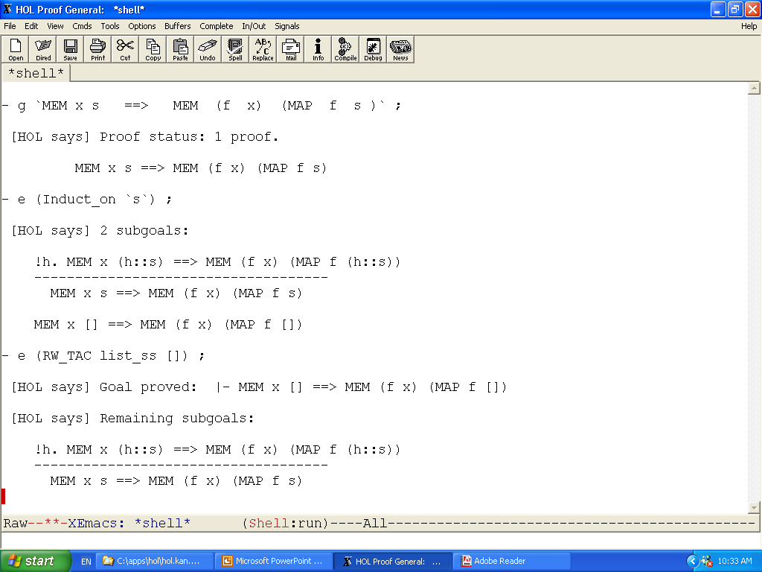
setting up a proof
applying a proof step
the 2-nd subgoal
the 1-st subgoal
solving the first subgoal

Slide 3
Features
“higher order”, as opposed to a first order prover as Z3 → highly expressive! You can model lots of things in HOL.
A huge collection of theories and proof utilities. Well documented.
Safe
computer-checked proofs.
Simple underlying logic, you can trust it.
Unless you hack it, you cannot infer falsity.

Slide 4

HOL is a DSL embedded in ML
HOL
ML
ML is a mature functional programming language.
You can access both HOL and ML
It gives you powerful meta programming of HOL! E.g. for:
scripting your proofs
manipulating your terms
translating back and forth to other representations
Interesting options to embed your own DSL/logic

Slide 5
Non-features
The name “theorem prover” is a bit misleading. Higher order logic is undecidable.
Don’t expect HOL to do all the work for you!
It doesn’t have a good incremental learning material. But once you know your way… it’s really a powerful thing.

Slide 6
ML → programming level
E.g. these functions in ML:
These are ordinary programs, you can execute them. E.g. evaluating identity zero will produce 0.
Unfortunately, there is no direct way to prove properties of these ML functions. E.g. that identity . identity = identity
val zero = 0 ;
fun identity x = x ;

Slide 7
HOL level
We can model them in HOL as follows:
The property we want to prove:
val zero_def = Define `zero = 0` ;
val identity_def = Define `identity x = x` ;
--`identity o identity = identity`--

Slide 8
The proof (scripted) in HOL
val my_first_theorem = prove (
--`identity o identity = identity`--,
CONV_TAC FUN_EQ_CONV
THEN REWRITE_TAC [o_DEF]
THEN BETA_TAC
THEN REWRITE_TAC [identity_def]
) ;
But usually you prefer to prove your formula first interactively, and later on collect your proof steps to make a neat proof script as above.

Slide 9
Model and the real thing
Keep in mind that what we have proven is a theorem about the models !
E.g. in the real “identity” in ML : identity (3/0) = 3/0 → exception!
We didn’t capture this behavior in HOL.
HOL will say it is true (aside from the fact that x/0 is undefined in HOL).
There is no built-in notion of exception in HOL, though we can model it if we choose so.

Slide 10
Core syntax of HOL
Core syntax is that of simply typed λ-calculus:
Terms are typed.
We usually interact on its extended syntax, but all extensions are actually built on this core syntax.
term ::= var | const | term term | \ var. term
| term : type

Slide 11
Types
Primitive: bool, num, int, etc.
Product, e.g.: (1,2) is a term of type num#num
List, e.g.: [1;2;3] is a term of type num list
Function, e.g.: (\x. x+1) is a term of type num->num
Type variables, e.g.: (\x. x) is a term of type ‘a -> ‘a
You can define new types.

Slide 12
Extended syntax
Boolean operators: ~p , p /\ q , p \/ q , p ==> q
Quantifications: // ! = ∀, ? = ∃ (!x. f x = x) , (?x. f x = x)
Conditional: if ... then ... else ... // alternatively g -> e1 | e2
Tuples and lists → you have seen.
Sets, e.g. {1,2,3} → encoded as int->bool.
You can define your own constants, operators, quantifiers etc.

Slide 13
Examples of modeling in HOL
Define `double x = x + x` ;
Define `(sum [ ] = 0) /\ (sum (x::s) = x + sum s)` ;
Define `(map f [ ] = [ ]) /\ (map f (x::s) = f x :: map f s)` ;

Slide 14
Modeling programs
Deep embedding: using data type + denotational semantic.
Shallow embedding: we represent statement constructs with function names. We model what they do in terms of their denotational semantics. For example:
Define `skip state = state` ;
Define `SEQ S₁ S₂ state = S₂ (S₁ state)` ;
Notice the use of higher order functions
So, how do we define GCL’s box ?

Slide 15
Modeling properties
Suppose that you want to prove that skip is “reflexive”, and “;” is “transitive”. First you need to define what such concepts mean. For example:
Define `isReflexive R = (!x. R x x)` ; (so what is the type of isReflexive?)
Define `isTransitive R = (!x y z. R x y /\ R y z ==> R x y)` ;
How to define the reflexive and transitive closure of R ?
Notes:
(S contains R) = !x y. R x y ==> S x y
RTclosure R x y = !S. S contains R /\ isRelfexive S /\ isTransitive S ==> S x y
Always have a solution if the domains of x,y are not empty.

Slide 16
Theorems and proofs

Slide 17
Theorem
HOL terms: --`0`-- --`x = x`--
Theorem : a bool-typed HOL term wrapped in a special type called “thm”, meant to represent a valid fact.
The type thm is a protected data type, in such a way that you can only produce an instance of it via a set of ML functions encoding HOL axioms and primitive inference rules (HOL primitive logic).
So, if this primitive logic is sound, there is no way a user can produce an invalid theorem.
This primitive logic is very simple; so you can easily convince yourself of its soundness.
|- x = x

Slide 18
Theorem in HOL
More precisely, a theorem is internally a pair (term list * term), which is pretty printed e.g. like: Intended to mean that a₁ /\ a₂ /\ ... implies c.
Terminology: assumptions, conclusion.
|- c abbreviates [ ] |- c.
[a₁, a₂, ...] |- c

Slide 19
Inference rule
An (inference) rule is essentially a function that produces a theorem. E.g. this (primitive) inf. rule : is implemented by a rule called MP : thm→thm→thm
Rules can be composed:
A |- t₁ ⇒ t₂ , B |- t₁ ----------------------------------- Modus Ponens A @ B |- t₂
fun myMP t₁ t₂ = GEN_ALL (MP t₁ t₂)

Slide 20
Backward proving
Since a “rule” is a function of type (essentially) thm→thm, it implies that to get a theorem you have to “compose” theorems. → forward proof; you have to work from axioms
For human it is usually easier to work a proof backwardly.
HOL has support for backward proving. Concepts :
Goal → terms representing what you want to prove
Tactic → a function that reduce a goal to new goals

Slide 21
Goal
type goal = term list * term Pretty printed: Represent our intention to prove [ a₁ , a₂ , ... ] |- h
Terminology : assumptions, hypothesis
type tactic = goal → goal list * proof_func
[ a₁, a₂ , ... ] ?- h

Slide 22
Proof Function
type tactic = goal → goal list * proof_func
So, suppose you have this definition of tac : // so, just 1 new subgoal Then the ϕ has to be such that : ϕ [ A’ |- h’ ] = A |- h
So, ϕ is technically an inference rule, and tac is essentially the reverse of this rule.
tac (A ?- h) = ( [ A’ ?- h’ ] , ϕ )

Slide 23
Proof Tree
A proof constructed by applying tactics has in principle a tree structure, where at every node we also keep the proof function to ‘rebuild’ the node from its children.
g₁
If all leaves are ‘closed’ (proven) we build the root-theorem by applying the proof functions in the bottom-up way.
tac1
g₂
g₃
In interactive-proof-mode, such a ‘proof tree’ is actually implemented as a ‘proof stack’ (show example).
tac2
tac3
(proven)
g₄
tac4
(proven)

Slide 24
Interactive backward proof (Desc 5.2)
HOL maintains a global state variable of type proofs :
proofs : set of active/unfinished goalstacks
goalstack : implementation of proof tree as a stack
A set of basic functions to work on these structures.
Setting up a new goalstack : g : term quotation → proofs set_goal : goal → proofs
Applying a tactic to the current goal in the current goalstack: e (expand) : tactic → goalstack

Slide 25
For working on proofs/goalstack...
Switching focus r (rotate) : int → goalstack
Undo b : unit → goalstack restart : unit → goalstack drop : unit → proofs

Slide 26
Some basic rules and tactics Shifting from/to asm... (Old Desc 10.3)
A |- v
------------------------ DISCH u
A \ {u} |- u ==> v
A ?- u ==> v
-----------------------DISCH_TAC
A + u ?- v
A |- u ==> v
---------------------- UNDISCH
A + u |- v
A ?- v
------------------------ UNDISCH_TAC u
A / {u} ?- u ==> v

Slide 27
Some basic rules and tactics Modus Ponens (Old Desc 10.3)
A₁ |- t ⇒ u
A₂ |- t
----------------------- MP
A₁ ∪ A₂ |- u
A ?- u
A‘ |- t -------------------- MP_TAC
A ?- t ⇒ u
A’ should be a subset of A
A₁ |- !x. t_{x} ⇒ u_{x} A₂ |- t_{o}
--------------------------- MATCH_MP
A₁ ∪ A₂ |- u_{o}
A ?- u_{o}
A’ |- !x. t_{x} ⇒ u_{x} --------------------------- MATCH_MP_TAC
A ?- t_{o}
A’ should be a subset of A

Slide 28
Some basic rules and tactics Stripping and introducing ∀ (Old Desc 10.3)
A |- !x. P
---------------- SPEC u A |- P[u/x]
A ?- P ---------------------- SPEC_TAC(u,x) A ?- !x. P[x/u]
A |- P
---------------- GEN x A |- !x. P
A ?- !x. P x ---------------------- GEN_TAC A ?- P[x’/x]
provided x is does not appear as a free variable in A
x’ is chosen so that it does not appear as a free variable in A

Slide 29
Some basic rules and tactics Intro/striping ∃ (Old Desc 10.3)
A |- P
---------------------- EXISTS (?x. P[x/u], u)
A |- ?x. P[x/u]
A ?- ?x. P
--------------------------- EXISTS_TAC u
A ?- P[u/x]

Slide 30
Rewriting (Old Desc 10.3)
A ?- t
------------------- SUBST_TAC [A’ |- u=v]
A ?- t[v/u]
provides A’ ⊆ A
you can supply more equalities...
A ?- t
------------------- REWRITE_TAC [A’ |- u=v]
A ?- t[v/u]
also performs matching e.g. |- f x = x will also match “... f (x+1)”
recursive
may not terminate!

Slide 31
Tactics Combinators (Tacticals) (Old Desc 10.4)
The unit and zero ☺
ALL_TAC // a ‘skip’ ☺
NO_TAC // always fail
Sequencing :
t1 THEN t2 → apply t1, then t2 on all subgoals generated by t1
t THENL [t1,t2,…] → apply t, then t_{i} on i-th subgoal generated by t
REPEAT t → repeatedly apply t until it fails (!)

Slide 32
Examples
DISCH_TAC ORELSE GEN_TAC
REPEAT DISCH_TAC THEN EXISTS_TAC “foo” THEN ASM_REWRITE_TAC [ ]
fun UD1 (asms,h) = ( if null asms then NO_TAC else UNDISCH_TAC (hd asms) ) (asms,h) ;

Slide 33
Practical thing: quoting HOL terms (Desc 5.1.3)
Remember that HOL is embedded in ML, so you have to quote HOL terms; else ML thinks it is a plain ML expression.
‘Quotation’ in Moscow ML is essentially just a string: `x y z` → is just “x y z”
But it is represented a bit differently to support antiquotation:
Notice the backquotes!
val aap = 101
` a b c ^aap d e f `
→ [QUOTE “a b c", ANTIQUOTE 101, QUOTE “d e f"] : int frag list

Slide 34
Quoting HOL terms
The ML functions Term and Type parse a quotation to ML “term” and “hol_type”; these are ML datatypes representing HOL term and HOL type.
Term `identity (x:int)` → returns a term Type `:num->num` → returns a hol_type
Actually, we often just use this alternate notation, which has the same effect:
--`identity (x:int)`--

Slide 35
A bit inconsistent styles
Some functions in HOL expect a term, e.g. : prove : term -> tactic -> thm
And some others expect a frag list / quotation ☹ g : term frag list -> proofs Define : term frag list -> thm

Slide 36
Some common proof techniques (Desc 5.3 – 5)
Power tactics
Induction
Proof by case split
Proof by contradiction
In-line lemma

Slide 37
Power Tactics: Simplifier
Power rewriter, usually to simplify goal : SIMP_TAC: simpset→ thm list → tactic standard simpsets: std_ss, int_ss, list_ss
Does not fail. May not terminate.
Being a complex magic box, it is harder to predict what you get.

Slide 38
Examples
Simplify goal with standard simpset: SIMP_TAC std_ss [ ] (what happens if we use list_ss instead?)
And if you also want to use some definitions to simplify: SIMP_TAC std_ss [ foo_def, fi_def , … ] (what’s the type of foo_def ? )

Slide 39
Other variations of SIMP_TAC
ASM_SIMP_TAC
FULL_SIMP_TAC
RW_TAC is like SIMP_TAC but does a bit more :
case split on any if-then-else in the hypothesis
Reducing e.g. “SUC x = SUC y” to “x=y”
reduce let-terms in hypothesis
Notes:
FULL_SIMP_TAC → simplifies concl as well as amsl

Slide 40
Power Tactics: Automated Provers
1-st order prover: PROVE_TAC : thm list -> tactic
Integer arithmetic prover: ARITH_TAC, COOPER_TAC (from intLib)
Natural numbers arith. prover: ARITH_CONV (from numLib)
Undecidable.
They may fail.
Magic box.

Slide 41
Examples
Simplify then use automated prover : RW_TAC std_ss [ foo_def ] THEN PROVE_TAC [ ]
In which situations do you want to do these? RW_TAC std_ss [ foo_def ] THEN TRY (PROVE_TAC [ ]) RW_TAC std_ss [ foo_def ] THEN ( PROVE_TAC [ ] ORELSE ARITH_TAC )

Slide 42
Induction
Induction over recursive data types: Induct/Induct_on
Other types of induction:
Prove/get the corresponding induction theorem
Then apply MP
?- ok s
---------------------------------- Induct_on `s`
?- ok [ ]
ok t ?- ok (x::t)

Slide 43
Case split
Cases_on, examples:
A ?- u
--------------------------------------- Cases_on `p`
A[T/p] ?- u[T/p]
A[F/p] ?- u[F/p]
assuming p is a bool
?- ok s
---------------------------------- Cases_on `s`
?- ok [ ]
?- ok (x::t)
assuming s is a list

Slide 44
Adding “lemma”
by : (quotation * tactic) → tactic // infix
A ?- t --------------------------------- lemma by tac lemma + A ?- t
If tac proves the lemma from A
A ?- t --------------------------------- lemma by tac (1) lemma + A ?- t (2) A ?- z
If tac only reduces lemma to z

Slide 45
Adding lemma
But when you use it in an interactive proof perhaps you want to use it like this: `foo x > 0` by ALL_TAC What does this do ?

Slide 46
Proof by contradiction
SPOSE_NOT_THEN : (thm→tactic)→tactic SPOSE_NOT_THEN f
assumes ¬hyp |- ¬hyp.
now you must prove False.
f (¬hyp |- ¬hyp) produces a tactic, this is then applied.
Example:
A ?- f x = x
----------------------------- SPOSE_NOT_THEN ASSUME_TAC
~(f x = x) + A ?- F

