Slide 1
Probabilistic Model Checking
Wishnu Prasetya
wishnu@cs.uu.nl
www.cs.uu.nl/docs/vakken/pv

Slide 2
additional slides DTMC

Slide 3
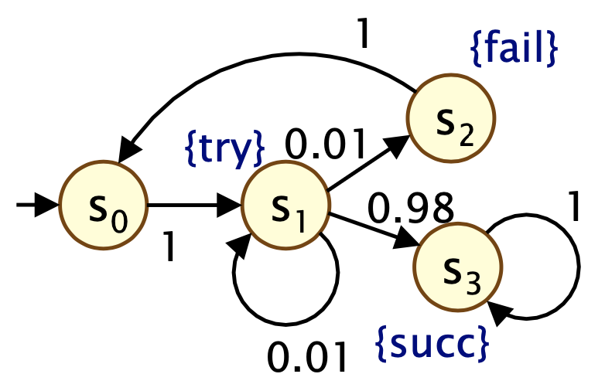
Probability of taking a path or a set of paths
A “DTMC” :
Consider a path 𝜔 e.g. s₀,s₁,s₂,s_{0.} The probability that the system follows this path when executed with the starting state s₀ is denoted by P_{s0}(𝜔). Or simply P(𝜔 ) if it is clear which s₀ is meant. It is the product of the probability of each transition in 𝜔. Example: for the above 𝜔, P(𝜔) = 1 * 0.01 * 1 = 0.01
For a set of of paths U (starting from s0), the probability that the system’s execution follows one of the paths in U, denoted by P(U), is ∑_{𝜔∊U} P(𝜔).

Slide 4
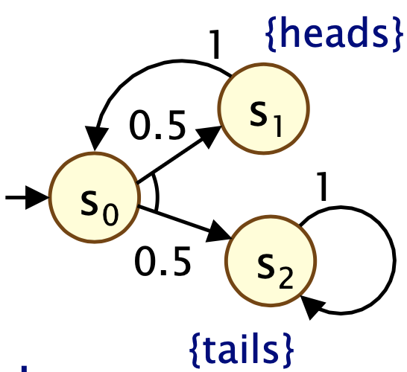
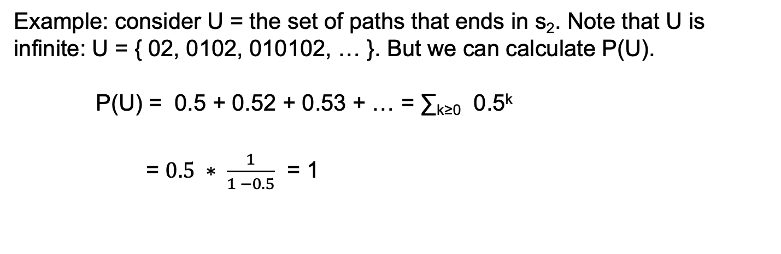
Probability of taking a path or a set of paths
Example: consider U = the set of paths that ends in s₂. Note that U is infinite: U = { 02, 0102, 010102, … }. But we can calculate P(U). P(U) = 0.5 + 0.52 + 0.53 + … = ∑_{k≥0} 0.5^{k}
= $0.5 ∗ \frac{1}{1 −0.5}$ = 1

Slide 5
Probability Matrix Representation
 | s0 | s1 | s2 | s3
s0 | 0 | 1 | 0 | 0
s1 | 0 | 0.01 | 0.01 | 0.98
s2 | 1 | 0 | 0 | 0
s3 | 0 | 0 | 0 | 1
P:
P_{i,k} = the value at the i-th row and k-th column. It specifies the probability of taking the transition s_{i} → s_{k}, if we are now at s_{i}. For example the circle red value above is P_{1,2}, specifying the probability of taking the transition from s₁ to s₂ (check the picture), which is 0.01.

Slide 6
Basic Operations on Probability Matrix
Multiplying P with itself: P^{n}
Multiplying a vector with P: u × P
Multiplying P with a vector: P × v

Slide 7
P^{n}
P⁰ = I (identity matrix) P^{n+1} = P × P^{n}
P^{n}_{i,k} is the probability of ending up in state s_{k} in n-steps, given we start in the state s_{i}.
For example, wirth the previous P, let’s look at P²: P²_{0,2} = (P×P)_{0,2} = P_{0,0}* P_{0,2} + P_{0,1}* P_{1,2} + P_{0,2}* P_{2,2} + P_{0,3}* P_{3,2}
0 | 1 | 0 | 0
0 | 0.01 | 0.01 | 0.98
1 | 0 | 0 | 0
0 | 0 | 0 | 1
0 | 1 | 0 | 0
0 | 0.01 | 0.01 | 0.98
1 | 0 | 0 | 0
0 | 0 | 0 | 1
? | ? | 0.01 | ?
? | ? | ? | ?
? | ? | ? | ?
? | ? | ? | ?
×

Slide 8
Probabity distribution of the next state, given the current distribution
A probability distribution of the current state is the probability of currently being in various states. It can be given by a vector of size K, if K is the number of possible states. E.g. if u = [ 0 , 0.5 , 0.5, 0 ] is the probability distribution of the current state, it says e.g. that there is 0.5 probability that currently we are in the state s₁, but 0 probability that we are in the state s₀.
The product u × P (we often simply write it as uP) gives a new vector u’ of size K, that gives us the probability distribution of the next state.
e.g. u’₁ = u • the green collumn (dot product) = u₀* P_{0,1} + u₁* P_{1,1} + u₂* P_{2,1} + u₃* P_{3,1}
u
0 | 1 | 0 | 0
0 | 0.01 | 0.01 | 0.98
1 | 0 | 0 | 0
0 | 0 | 0 | 1
u’
0 | 0.5 | 0.5 | 0
×
0.5 | 0.005 | 0.005 | 0.49

Slide 9
^{Probabilty vector}
Sometimes we also want to know what the probability to end up in state, say, s₁ or s₂ as the next state, if we start in the state s1.
We can represent “end up in either s₁ or s₂” with a vector v = [0,1,1,0].
Let v^{t} is the transpose of v. The product P × v^{t} gives a w such that w is a (transposed) vector, where w_{i} is the probabilty to end up in one of the states specified in v, if we start in s_{i}.
e.g. w₁ = the green row • v^{t} (dot product) = P_{1,0}* v₀ + P_{1,1}* v₁ + P_{1,2}* v₂ + P_{1,3}* v₃
0 | 1 | 0 | 0
0 | 0.01 | 0.01 | 0.98
1 | 0 | 0 | 0
0 | 0 | 0 | 1
0
1
1
0
1
0.02
0
0
×
v^{t}
w

Slide 10
Probability vector
Prob(𝜑) (notice the underscore) is a probility vector e.g. w = such that the i-th element tells us what the probability that the system would behave as 𝜑 if executed in state s_{i}.
Example: the above w (blue) happens to be equal to Prob(X(try ∨ fail)).
This notation Prob will be used later when we discuss model checking of probabilistic-CTL.
1
0.02
0
0

Slide 11
The construction of P’ for bounded Until
0 | 1 | 0 | 0
0 | 0.01 | 0.01 | 0.98
1 | 0 | 0 | 0
0 | 0 | 0 | 1
The probability matric P of the DTMC on the left.
Consider as an example to check whether the DTMC satisfies P_{>0.99}[ try ∨ ¬fail U^{≤2} succ].
Calculate first the probability vector Prob[ try ∨ ¬fail U^{≤2} succ].
From there you can calculate the set Sat(P_{>0.99}[ try ∨ ¬fail U^{≤2} succ]).
If the initial state s₀ is in the blue Sat-set then the property P_{>0.99}[ try ∨ ¬fail U^{≤2} succ holds on the DTMC.

Slide 12
The construction of P’ for bounded Until
0 | 1 | 0 | 0
0 | 0.01 | 0.01 | 0.98
1 | 0 | 0 | 0
0 | 0 | 0 | 1
The probability matric P of the DTMC on the left.
To calculate the probability vector Prob[ try ∨ ¬fail U^{≤2} succ], we would like to use the matrix P above, however it will also ”contain” transitions that cause you to break the green-property. So the idea is to use a “modified” matrix P’.
We pre-calculate first the S^{yes} = Sat(succ) = {s3}. On all states in S^{yes}, you have the green property immediately (in 0 step).
We pre-calculate S^{no}, we take S^{no} = Sat(¬ (try ∨ ¬fail) ∧ ¬ succ) = { s2 }. Executions starting from S^{no} won’t satisfy your green-property above,

Slide 13
The construction of P’ for bounded Until
S^{no}
0 | 1 | 0 | 0
0 | 0.01 | 0.01 | 0.98
1 | 0 | 0 | 0
0 | 0 | 0 | 1
S^{yes}
P :
X
0 | 1 | 0 | 0
0 | 0.01 | 0.01 | 0.98
0 | 0 | 0 | 0
0 | 0 | 0 | 1
P’ :
We remove outgoing arrows from the states in S^{no} and S^{yes}.
We keep all arrows that go out from states which are not in S^{no} nor S^{yes}.
We add a self-loop s → s with probability 1 for any state s in S^{yes}.

Slide 14
Using P’ for bounded Until
X
0 | 1 | 0 | 0
0 | 0.01 | 0.01 | 0.98
0 | 0 | 0 | 0
0 | 0 | 0 | 1
P’ :
We now use P’ to iteratively calcualte Prob[ try ∨ ¬fail U^{≤2} succ]
From S^{yes} you know that Prob[ try ∨ ¬fail U^{≤0} succ] =
Prob[ try ∨ ¬fail U^{≤1} succ] = P’ × =
Prob[ try ∨ ¬fail U^{≤2} succ] = P’ × =
0
0
0
1
0
0
0
1
0
0.98
0
1
0
0.98
0
1
0.98
0.9898
0
1

Slide 15
So, does the property hold?
We have calculated Prob[ try ∨ ¬fail U^{≤2} succ] = [0.98, 0.9898, 0, 1]
So, the set Sat(P_{>0.99}[ try ∨ ¬fail U^{≤2} succ]) = {s₃}
So we conclude that the DTMC does not satisfy the claimed property P_{>0.99}[ try ∨ ¬fail U^{≤2} succ].

Slide 16
Buchi vs Rabin
Consider the LTL property ♢◻︎a. This can be described by this Buchi automaton, wirth {1} as the accepting state: Notice that this Buchi is non-deterministic. As such, we can use it for model checking on a probabilistic model such as DTMC.
We can however represent the property with a deterministic Rabin automaton, with the pair ({0}, {1}) as its accepting condition.
a
¬a, a
0
1
a
a
0
1
¬a
a
¬a

Slide 17
additional slides MDP

Slide 18
Calculating pmin(s, 𝜑₁ U 𝜑₂)
pmin(s, 𝜑) = the minimum probability for having executions starting from 2 satisfying 𝜑, regardless the adversary.
To calculate pmin(s, 𝜑₁ U 𝜑₂) :
Calculate first the sets S^{yes} and S^{no}.
S^{yes} = { s | P(s, 𝜑₁ U 𝜑₂) ≥ 1, for all adversaries } → with algorithm Prob1A.
S^{no} = { s | P(s, 𝜑₁ U 𝜑₂) ≤ 0, for some adversary } → with algorithm Prob0E.
For any state s in S^{yes}, we then know that pmin(s, 𝜑₁ U 𝜑₂) ≥ 1.
For any state s in S^{no} we have pmin(s, 𝜑₁ U 𝜑₂) ≤ 0.
We then proceed with calculating the pmin for the remaining states (which are not in S^{yes} nor S^{no}).

Slide 19
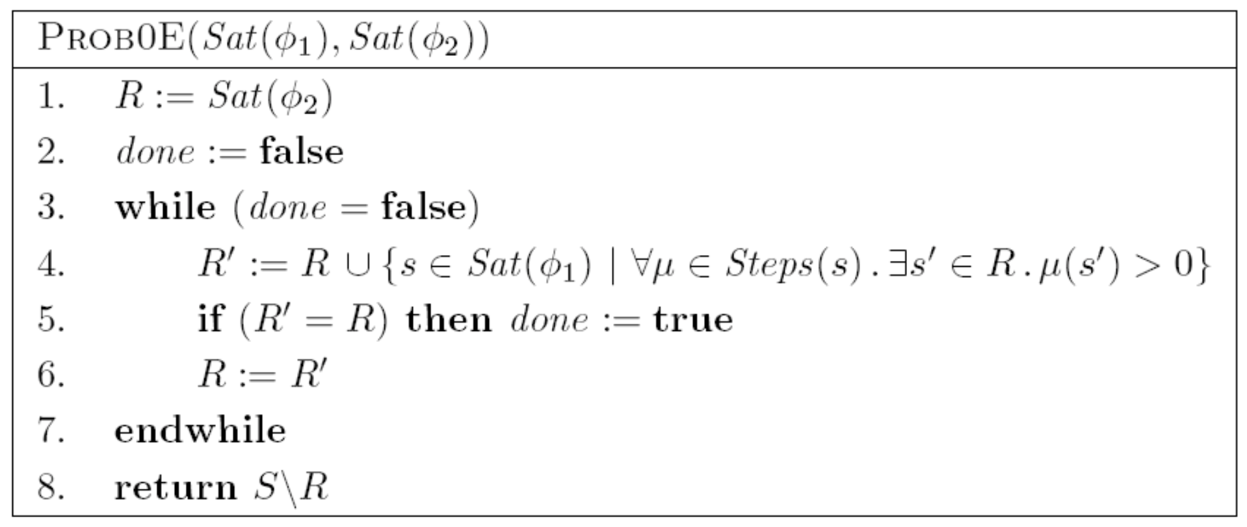
Algorithm Prob0E
The algorithm below first calculates the set R of all states s satisfying E[s, 𝜑₁ U 𝜑₂], regardless the adversary. So, for any state in R, and for any adversary Prob(s, 𝜑₁ U 𝜑₂) > 0.
S^{no} is just complement S/R.
Sat(𝜑₁) and Sat(𝜑₂) in the paremeters are the set of states on which 𝜑₁ and 𝜑₂ respectively hold.

Slide 20
Prob1A
Calculate first the set F of states from where we have a path passing exclusively through states satisfying 𝜑₁ ∧ ¬𝜑₂ and ends in S^{no}, under some adversary. By definition this F also includes S^{no}.
So any state s in F has Prob(s, 𝜑₁ U 𝜑₂) < 1, for some adversary. In other words pmin(s, 𝜑₁ U 𝜑₂) < 1.
P^{yes} in the the complement S/F.
Note: for the calculation of pmin(s, 𝜑₁ U 𝜑₂), we can also just take S^{yes} = Sat(𝜑₂). The calculation would still works, though it would take more steps to get its final results.

Slide 21
Calculating pmax(s, 𝜑₁ U 𝜑₂)
pmax(s, 𝜑) = the maximum probability for having executions starting from 2 satisfying 𝜑, regardless the adversary.
To calculate pmax(s, 𝜑₁ U 𝜑₂) :
Calculate first the sets S^{yes} and S^{no}.
S^{yes} = { s | P(s, 𝜑₁ U 𝜑₂) ≥ 1, for some adversaries } → with algorithm prob1E.
S^{no} = { s | P(s, 𝜑₁ U 𝜑₂) ≤ 0, for all adversary } → with algorithm prob0A.
For any state s in S^{yes}, we then know that pmax(s, 𝜑₁ U 𝜑₂) ≥ 1.
For any state s in S^{no} we have pmax(s, 𝜑₁ U 𝜑₂) ≤ 0.
We then proceed with calculating the pmin for the remaining states (which are not in S^{yes} nor S^{no}).

Slide 22
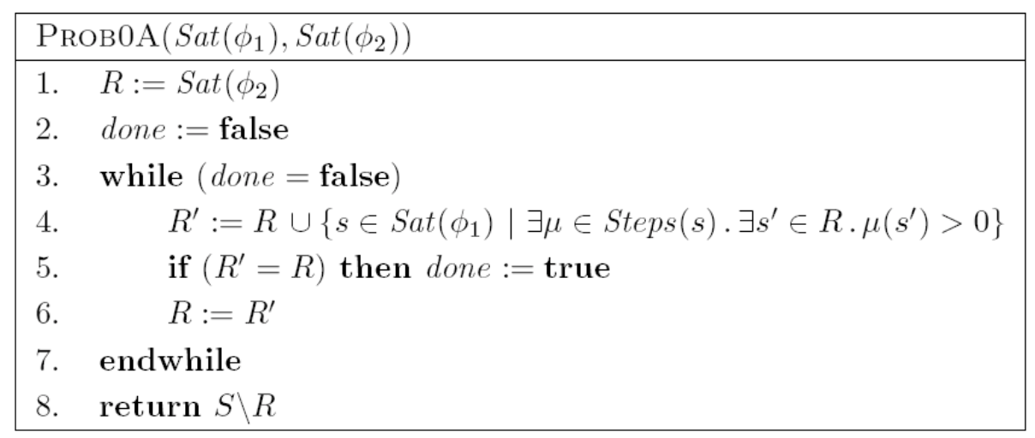
Algorithm Prob0A
The algorithm below first calculates the set R of all states s satisfying E[s, 𝜑₁ U 𝜑₂], for some adversary. So, for any state in R, there is an adversary such that Prob(s, 𝜑₁ U 𝜑₂) > 0.
S^{no} is just complement S/R.
Sat(𝜑₁) and Sat(𝜑₂) in the paremeters are the set of states on which 𝜑₁ and 𝜑₂ respectively hold.

Slide 23
Prob1E
More complicated. See Dave’s slides on MDP.

Slide 24
Prob1E

