Slide 1
Model Checking with SPIN Modeling and Verification with Promela
Wishnu Prasetya
wishnu@cs.uu.nl
www.cs.uu.nl/docs/vakken/pv

Slide 2
Overview
Promela modeling language
Architecture of SPIN
Examples of Promela models
Acknowledgement: some slides are taken and adapted from Theo Ruys’s SPIN Tutorials.

Slide 3
Spin and Promela
Promela = Process Meta Language
Is a modelling language! (not a language to build an application)
Strong features :
Powerful constructs to synchronize concurrent processes
Powerful model checking
Simulation to support analysis (of the models)
SPIN = Simple Promela Interpreter

Slide 4
System, process, and action.
A system in Promela consists of a set of concurrent (and interacting) processes.
Each process in Promela is sequential, but possibly non-deterministic.
Each process is built from atomic actions (transition).
Concurrent execution of multiple processes is modeled by interleaving the processes atomic actions.
Fairness can be imposed.
Notes:
Atomic action = its execution cannot be interrupted.

Slide 5
Example
byte x = 1 ;
active proctype P() { x++ ; assert (x==2) ; }
active proctype Q() { x-- ; }
(using a global variable to interact)

Slide 6
Interleaving model of concurrency
Consider (with pseudo notation), where each arrow is atomic:
Concurrent execution of P||Q has the same effect as interleaving execution :
x++
P :
x--
Q :

Slide 7
Interleaving model of concurrency
Another example. Again each arrow is atomic.
An execution of P||Q abstractly proceeds as one of these paths :
x++
x++
P :
print x
Q :

Slide 8
Degree of atomicity
Whether it is reasonable to model a statement as ‘atomic’, depends on your situation.
x++ usually no problem
x>0 → y:=x ok, if we can lock both x and y
0∈S → found:=true ....?

Slide 9
Promela’s data types
Bit 0,1
Bool true, false
Byte 0..255
Short -2¹⁵ .. 2¹⁵-1
Int -2³¹ .. 2³¹-1
Pid 0..255
Mtype 0..255 // user-def. enumeration
Chan 0..255
One dimensional array
Record

Slide 10
What you don’t have…
No sophisticated data types
No methods ; you have macros
There are only 2 levels of scope:
global var (visible in the entire sys)
local var (visible only to the process that contains the declaration)
there is no inner blocks

Slide 11
(Enabledness) Expression
active proctype P { x++ ; (y==0) ; x-- }
This process has 3 atomic actions.
The action “y==0”
only enabled in a state where the expression is true
it can only be executed when it is enabled; the effect is skip
so, as long as it is disabled, the process will block
if it is not enabled in the current state, a transition in another process may make it enabled in the next state.
even if it is enabled in the current state, there is no guarantee the action will be selected for execution; but there is a way in SPIN to impose fairness.

Slide 12
Example
Use it to synchronize between processes :
// both will terminate, but forcing Q to finish last
byte x=0 , y=0 active proctype P { x++ ; (y>0) ; x-- } active proctype Q { (x>0) ; y++ ; (x==0) ; y-- }

Slide 13
Concurrent programming is tricky….
E.g. one or more processes can become stuck (deadlocked) :
(6 potential executions…)
byte x=0 , y=0 active proctype P { x++ ; (y>0) ; x-- ; (y==0) } active proctype Q { y++ ; (x>0) ; (x==0) ; y-- }
Notes:
Dead lock scenario: y++ ; x++; (y>0) ; x-- → locked now.

Slide 14
Processes can also synchronize with channels
chan c = [3] of {byte} ;
active proctype producer() {
do
:: c ! 0
od
}
active proctype consumer() {
do
:: c ? x
od
}

Slide 15
Channels
mtype = { DATA, ack }
chan c = [0] of {bit};
chan d = [2] of {mtype, bit, byte};
chan e[2] = [1] of {bit};
for exchanging messages between processes
finite sized and asynchronously, unless you set it to size 0 → synchronous channel
Syntax : c ! 0 sending over channel c; blocking if c is full c ? x receives from c, transfer it to x; blocking if c is empty d ? DATA, b, y match and receives
There are some more exotic channel operations : checking empty/full, testing head-value, copying instead of receiving, sorted send, random receive ... → check out the Manual

Slide 16
Conditional
if
:: stmt₁ :: …
:: stmt_{n}
fi
if
:: stmt₁ :: …
:: else -> …
fi
The alternatives do not have to be atomic!
The first action in an alternative acts as its “guard”, which determines if the alternative is enabled on a given state.
Non-deterministically choose one enabled alternatives.
If there is none, the entire IF blocks.
“else” is a special expression that is enabled if all other alternatives block.

Slide 17
Non-determinism can be useful for modeling
proctype consumer() { if :: c ? x ; :: c ? x ; x=corrupt ; // to model occasional corrupted data
fi do something with x }

Slide 18
loop : do-statement
do
:: stmt₁ :: …
:: stmt_{n}
od
Non-deterministic, as in IF
If no alternative is enabled, the entire loop blocks.
Loop on forever, as long as there are enabled alternatives when the block cycle back.
To exit you have explicitly do a break.

Slide 19
Examples
do :: { (i>0) ; i-- } :: { (i==0) ; break } do
do :: (i>0) → i-- :: (i==0) → break do
do :: { (i>0) ; i-- } :: break do

Slide 20
Label and jump
active proctype P() {
(x==0) ;
L0:
if :: … goto L0 ; :: … fi }
Labels can also be useful in specification, e.g. <> P@L0
Referring to labels as above goes actually via a mechanism called “remote reference”, which can also be used to inspect the value of local variables for the purpose of specification.

Slide 21
Exception/Escape
S unless E
Statement! Not to be confused with LTL “unless”.
If E ever becomes enabled during the execution of S, then S is aborted and the execution continues with E. More precisely… check manual.
Notes:
E.g. the handler E distributes over “atomic” in S, but not over dstep

Slide 22
Predefined variables in Promela
_pid (local var) current process’ instantiation number
_nr_pr the number of active processes
np_ true when the model is not in a “progress state”
_last the pid of process that executed last
else true if no statement in the current process is executable
timeout true if no statement in the system is executable
…

Slide 23
Timeout
do
:: c ? x → ...
:: timeout → break
od
timeout
useful as a mechanism to avoid deadlock
beware of statements that are always executable.

Slide 24
Expressing correctness with assertions
active proctype P … active proctype Q { …; assert (x==0 && y==0) }
(here it implies that when Q terminates, x and y should be 0)

Slide 25
We can also express system invariant
Thanks to built-in non-determinism in the interleaving semantics, we can also use assertion to specify a system/global invariant ! // implying that at any time during the run x is either 0 or 1
byte x=0 , y=0 active proctype P { x++ ; (y>0) ; x-- ; (y==0) } active proctype Q { y++ ; (x>0) ; (x==0) ; y-- }
active proctype Monitor { assert ((x==0 || x==1)) }

Slide 26
“System stuck” checking
When a system comes to a state where it has no enabled transition, but one of its processes is not in its terminal (end) state:
“Invalid end state” will be reported by SPIN
But sometimes you want to model that this is ok → suppress it via the invalid-endstate option.
The terminal state of a process P is by default just P’s textual end of code.
You can specify additional terminal states by using end-label:
Of the form “end_1” , “end_blabla” etc
This does not check “local” deadlock!

Slide 27
Expressing progress requirement
We can mark some states as progress states
Using “progress*” labels
Any infinite execution must pass through at least one progress label infinitely many often; else violation.
We can ask SPIN (with an option) to verify no such violation exists ( non-progress cycles option).

Slide 28
(i)SPIN Architecture
•deadlocks
•safety properties
•liveness properties
spin command line tool
random
guided
interactive
ϕ
LTL
Translater
Simulator
Promela
model M
ispin
spin
Verifier
Generator
editing window
simulation options
verification options
MSC simulation window
C program
pan.*
counter
example
false
checker
pan.exe

Slide 29
Command line mode
#define N 4
byte x[N] ;
proctype P(byte i) {
do
:: x[i-1] != x[i] -> x[i] = x[i-1] ;
od
}
init { run P(1) ; run P(2)}
ltl p0 { <>(x[0]=x[2]) }
Simulate: spin model.pml
Intersect: spin –a model.pml
Compile: cc pan.c
Verify: a.exe
With fairness: a.exe -f
Debug: spin –t –c model.pml
Various options: see http://spinroot.com/spin/Man/Pan.html

Slide 30
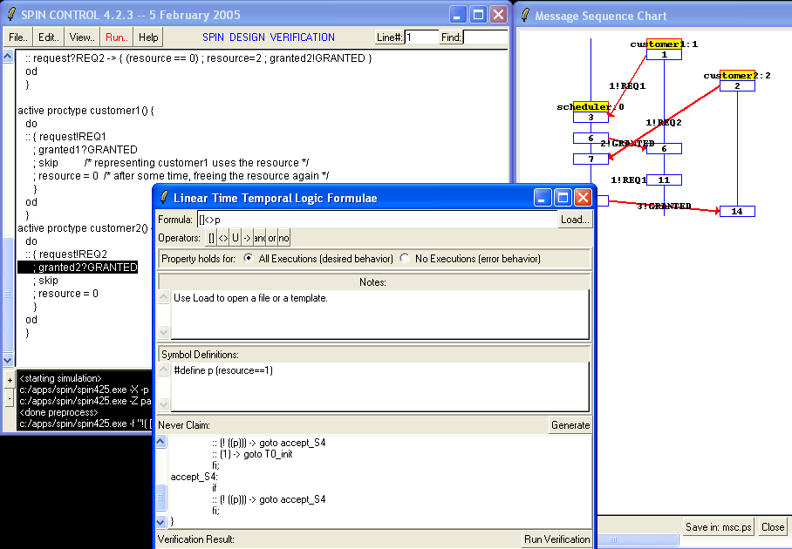
Frontend XSpin

Slide 31
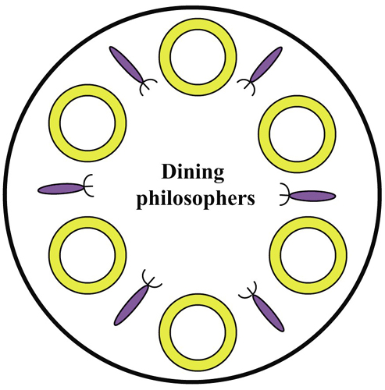
Dining philosophers
N “philosopher”-processes
Each process:
acquire left and right forks (not atomic)
eat...
release forks
think................ then go back to 1

Slide 32
Modelling a solution in Promela
#define N 4
byte fork[N] ;
bool eating[N] ;
proctype P(byte i) {
do
:: atomic{ (fork[i] == N && fork[(i + 1) % N] == N) ;
fork[i] = i
fork[(i + 1) % N] = i } ;
eating[i] = 1 ;// eat ...
eating[i] = 0 ;
fork[i] = N ;
fork [(i + 1) % N]= N
od
}
this atomicity may be unrealistic
Deadlock free, but not starvation free (e.g. 1 and 3 can alternatingly keep getting forks, thus starve 0)
Notes:
Philosopher-i uses fork[i] and [i+1]
It sets them to i, when it gets them
fork[k]= N means it is free
The first statement of the sequence is called its guard , because it determines when the sequence can be started.
If any statement within the atomic sequence blocks, atomicity is lost, and other processes are then allowed to start executing statements. When the blocked statement becomes executable again, the execution of the atomic sequence can be resumed at any time, but not necessarily immediately. Before the process can resume the atomic execution of the remainder of the sequence, the process must first compete with all other active processes in the system to regain control, that is, it must first be scheduled for execution.

Slide 33
Creating processes and init { … }
init {
byte i ;
... // initialize forks
i = 0 ;
do
:: i<N -> { run P(i) ; i++ ; }
:: i>=N -> break ;
od
}
Put this in atomic { … } ;
Be aware of what it means!

Slide 34
How to express the specification?
proctype P(byte i) {
do
:: { atomic {(fork[i] == N && fork[(i + 1) % N] == N) ;
fork[i] = i ;
fork[(i + 1) % N] = i } ;
eating[i] = 1 ;
eating[i] = 0 ;
fork[i] = N ;
fork [(i + 1) % N]= N
}
od
}
Does not exclude the situation that after the check P(i) lost a fork!
assert (fork[i] == i &&
fork[(i+1)%N]== i)
Better option, with ltl: [](eating[0] -> fork[0] == 0 && fork[1]== 0)
... similarly for other processes

Slide 35
Using a “monitor” process
active proctype monitor() {
assert(
(!eating[0] || (fork[0]==0 && fork[1%N]==0)) &&(!eating[1] || (fork[1]==1 && fork[2%N]==1)) && …
) ;
}
But we still can’t express that if a process is “hungry”, it will eventually eat. Using progress labels does not seem sufficient either. For more general temporal specification, use of LTL formulas.

Slide 36
Example: Alternating bit protocol
sender
receiver
imperfect “connections”, but corrupted data can be detected (e.g. with checksum etc).
Possible solution: send data, wait for a positive acknowledgement before sending the next one. Just 1 bit is needed for the ack, hence the “bit” in the name.

Slide 37
You can think of several ways to work it out...
A note on reliable full-duplex transmission over half-duplex links, K. A. Bartlett, R. A. Scantlebury, P. T. Wilkinson, Communications of the ACM, Vol 12, 1969.
NPL Protocol
M<2 Protocol (we’ll discuss this one)
For more, check out: http://spinroot.com/spin/Man/Exercises.html e.g. Go-Back-N Sliding Window Protocol

Slide 38
M<2 Protocol, Sender part
Fetch a new data.
1
?1
!1,data
!0,data // Sender wants to resend
2
4
? error
!1,data
? 0 // Receiver wants Sender to resend
3
State 1 is the starting state, and its accepting state in the sense when the sender is in this state, it assumes the last data package it sent has been successfully received by the receiver, and so it fetches a new data package to send.

Slide 39
M<2 Protocol, Receiver part
1
!0 // request Sender to resend
? error
!1
2
4
?0,rd
// Sender wants Receiver to resend
!1
?1,rd
3

Slide 40
Scenario: 1x error, corrected
1
Fetch a new data.
? error
!0 // request Sender to resend
1
!1
?1
!1,data
2
4
!0,data
// Sender wants to resend
?0,rd
// Sender wants
R to resend
2
4
!1
?1,rd
? error
!1,data
?0
// Receiver wants S to resend
3
3
Though each automaton is simple, the combined (and concrete) behavior is quite complex; ≈ 100 states in my (abstract) SPIN model (there are more explicit states, if we take the “data” into account).

Slide 41
Modeling in Promela
chan S2R = [BufSize] of { bit, byte } ;
chan R2S = [BufSize] of { bit } ;
proctype Sender (chan in, out) { … } proctype Receiver(chan in, out) { … }
init {
run Sender(R2S, S2R) ;
run Receiver(S2R, R2S)
}

Slide 42
Modelling in Promela
proctype Receiver(chan in, out) {
show byte rd ; /* received data */
show bit cbit ; /* control bit */
show byte accepted ;
do
:: in ? cbit, rd ;
if
:: (cbit == 1) -> accepted=rd ; out!1
:: (cbit == 0) -> out!1
:: printf("MSC: ERROR\n") ; out!0
fi
od
}
So, how big the channels should be? Is 0 good enough ?
sender
receiver
1!1,0
2!0
Error
Using visualization in iSpin:
1!1,0

Slide 43
A different style, with “goto”
proctype Sender(chan in, out) {
show byte data ; /* message data */
show bit cbit ; /* received control bit */
S1: data = (data+1) % MAX ; out!1,data ; goto S2;
S2: in ? cbit ;
if
:: (cbit == 1) -> goto S1
:: (cbit == 0) -> goto S3
:: printf("MSC: ERROR\n") -> goto S4
fi ;
S3: out!1,data ; goto S2 ;
S4: out!0,data ; goto S2 ;
}

Slide 44
Specifications
The protocol does not deadlock.
With LTL
□<>Sender@S2 /\ □<>Receiver@S2

Slide 45
Specifications
Each data package, if accepted by the receiver, is accepted exactly once!
LTL:
□(Receiver@S3 → (Receiver:accepted == Sender:data))
□(Sender@S1 → (Receiver:accepted == Sender:data))

Slide 46
2x successive errors
1
Fetch a new data.
? error
!0 // request Sender to resend
1
!1
?1
!1,data
2
4
!0,data
// Sender wants to resend
?0,rd
// Sender wants
R to resend
2
4
!1
?1,rd
? error
!1,data
?0
// Receiver wants S to resend
3
3
Ouch…

Slide 47
Ok... but suppose we still want to verify these:
But, if error does not occur twice successively then: every pck sent, if accepted, is accepted exactly once.
If no error occur, every data sent will eventually be accepted.
Rather than writing a constrained model, just extend the model to allow you to count sucessive errors. Use LTL of the form 𝛗→𝛟 to allow you quantify over executions of certain properties.

