Slide 1
Model Checking with SPIN A Bit More about SPIN
Wishnu Prasetya
wishnu@cs.uu.nl
www.cs.uu.nl/docs/vakken/pv

Slide 2
Content
SPIN internal data structures
SPIN result report
Writing LTL formulas
Containing state explosion
Example
Acknowledgement: some slides are taken and adapted from Theo Ruys’s SPIN Tutorials.

Slide 3
Data structures involved in SPIN DFS
Representation of a state.
Stack for the DFS
To remember where to backtrack in DFS
It corresponds to the current “execution prefix” that is being inspected → used for reporting.
Something to hold the set of visited states = “state space”.

Slide 4
State
Each (global) state of a system is a tuple of the states of its processes.
E.g. Suppose we have:
One global var byte x
Process P with byte y
Process Q with byte z
A system state should describe:
all these variables and their values
Program counter of each process
Other SPIN predefined vars
Such a global state can be quite big.

Slide 5
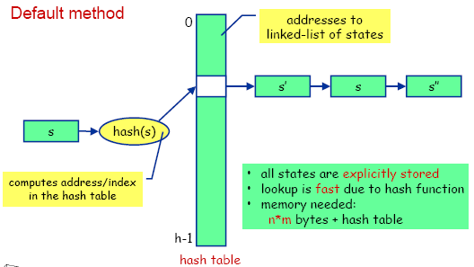
State-space is stored with a hash table
The list of “visited states” is maintained by a Hash-table. So matching if a state occurring in the table is fast!
Optimization: bit state hashing ☺

Slide 6
Verifier’s output
assertion violated !((crit[0]&&crit[1])) (at depth 5) // computation depth
...
Warning: Search not completed
Full statespace search for:
...
never-claim - (not selected)
assertion violations +
invalid endstates +
State-vector 20 byte, depth reached 7, errors: 1 // max. stack depth
24 states, stored // states stored in hash table
17 states, matched // states found re-revisited
41 transitions (= stored+matched)
hash conflicts: 0 (resolved)
(max size 2^19 states)
2.542 memory usage (Mbyte)

Slide 7
Watch out for state explosion!
int x,y,z ;
P { do :: x++ od } Q { do :: y++ od } R { do :: x/=y → z++ od }
Size of each state: > 12 bytes
Number of possible states ≈ (2³²) ³ = 2⁹⁶
Using byte (instead of int) brings this down to 50 MB
Focus on the critical aspect of your model (e.g. its concurrency); abstract from data when possible.

Slide 8
Another source of explosion : concurrency imposing a coarser grain atomicity
atomic { guard → stmt_1; ... ; stmt_n }
active proctype P { int x ; (y>0) ; y-- ; x=y }
put in atomic ?
more abstract, less error prone, but less parallelism
executable if the guard statement is executable
none of stmt-i should be blocking; or rather : if any of then blocks, atomicity is lost

Slide 9
d_step sequences
d_step { guard → stmt_1; ... ; stmt_n }
d_step { /* reset array elements to 0 */
i = 0;
do
:: i < N -> x[i] = 0; i++
:: else -> break
od;
i = 0
}
like an atomic, but must be deterministic and may not block anywhere
atomic and d_step sequences are often used as a model reduction method, to lower complexity of large models (improving tractability)
No jump into the middle of a d_step

Slide 10
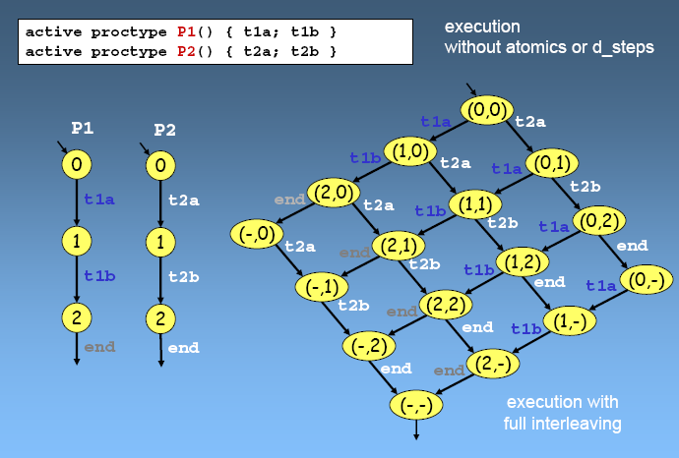
execution without atomics or d_steps

Slide 11
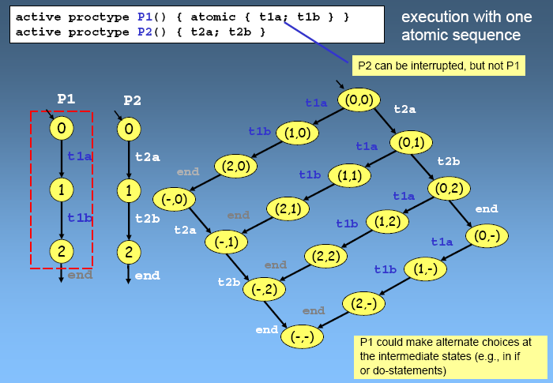
execution with one atomic sequence

Slide 12
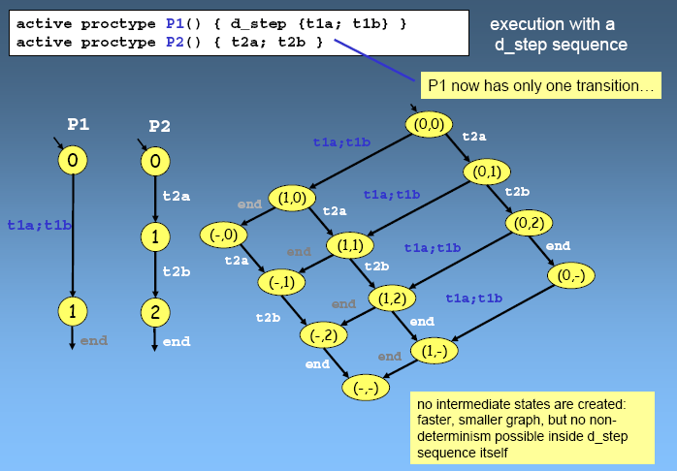
execution with a d_step sequence

Slide 13
atomic vs d_step
d_step:
executed as one block
deterministic
blocking or non-termination would hang you ☺
atomic:
translated to a series of actions
executed step-by-step, but without interleaving
it can make non-deterministic choices

Slide 14
Partial Order Reduction
The validity of a property ϕ is often insensitive to the order in which ‘independent’ actions are interleaved. e.g. stutter invariant ϕ (does not contain X) that only refers to global variables, is insensitive to the relative order of actions that only access local variables.
Idea: if in some global state, a process P can execute only actions updating local variables, always do these actions first (so they will not be interleaved!)
We can also do the same with receive/send actions :
c ? x where x is local, and this process is the only receiver of c
d ! y where this process is the only sender to d
assuming ϕ does not refer to channels
Notes:
Example:
var x=10
process P var y=0 do: y++ ; y++ ; x=y
process Q x--
Note: PO with channel actions → only when the spec does not refer to the channel contents! Note that c!e and c?x will then not interfere with each other; so PO is safe.

Slide 15
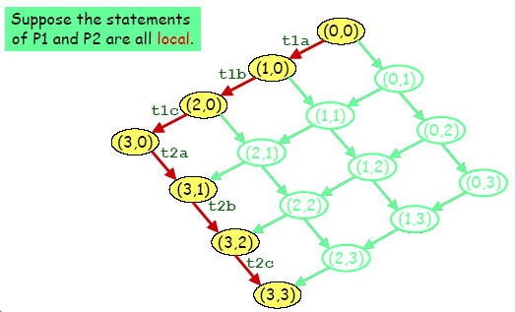
Reduction Algorithms
Partial Order Reduction

Slide 16
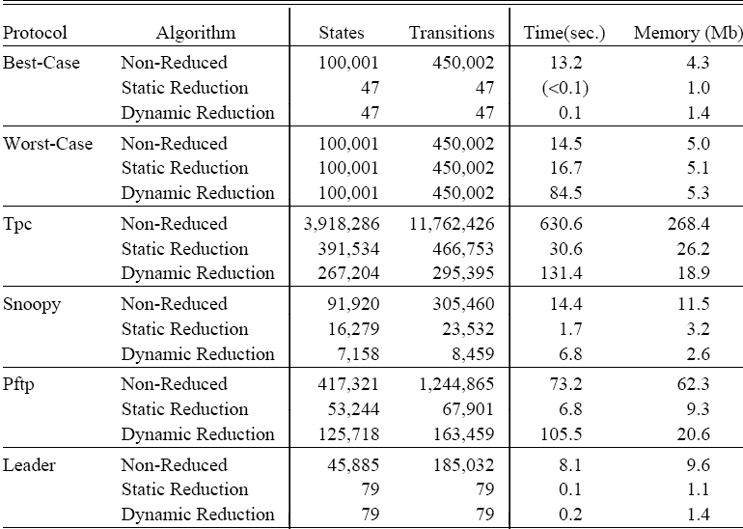
Results on Partial Order Reduction
This result is from Holzmann & Peled in 1994, on a Sparc-10 workstation with 128Mbyte of RAM. (about 40 mhz; so 1 mips??)

Slide 17
Specifying LTL properties
(Check out the Manual)
SPIN then generates the Buchi automaton for this LTL formula; called “Never Claim” in SPIN.
#define PinCritical crit[1]
#define QinCritical crit[2]
ltl name { []!(PinCritical && QinCritical) }

Slide 18
Example of a Never Claim
To verify: <>[] p
SPIN generates this never-claim / Buchi of []<>¬p
never {
init:
if
:: ¬p → goto accept
:: else → goto init
fi;
accept:
skip; goto init ;
}

Slide 19
Neverclaim
From SPIN perspective, a neverclaim (NC) is just another process, but it is executed in “lock-step”. See manual; essentially it means :
Each time the system takes a step, the NC also takes a step (but only an enabled step).
If one of them cannot make a step, the lock-step execution stops.
You can use it to “match” an execution
To match an infinite execution, as in Buchi automaton
The NC reaches its final state (its final “}”) → match! → used to match against finite executions.
We used it to find a counter example, but you can use it as a way to query your state space.
Notes:
Note: literally from SPIN manual: When a never claim is present, the system and the claim execute in lockstep. That is, we can think of system execution as always consisting of a pair of transitions: one in the claim and one in the system, with the second transition coming from any one of the active processes. The claim automaton always executes first. If the claim automaton does not have any executable transitions, no further move is possible, and the search along this path stops. The search will then backtrack so that other executions can be explored.

Slide 20
You can also manually write a custom NC to query the set of possible executions of your model
never {
do
:: (b) ; (!b) ; break :: skip
od accept: skip ; goto accept ;
}
Will match with an execution where at some point b holds, then at the next step it does not hold.
never { accept : do :: (x==0) ; (x==1) od
}
Match with an execution where (x==0)(x==1) holds alternatingly,

Slide 21
Example: distributed sorting
Idea:
Spec:
[0] 193
[1] 31
Let P(i) swap values with P(i+1), if they are in the wrong order.
Network
[2] 333
[3] 31
Eventually the values will be sorted.

Slide 22
SPIN model
init {
byte i ;
do
:: i<N ->
if
:: a[i]=0
:: a[i]=1
...
fi ; i++
:: else -> break ;
od ;
i=0 ;
do
:: i< N - 1 -> run P(i) ; i++
:: else -> run detect() ; break
od
}
#define N 5
byte a[N] ;
proctype P(byte i) {
byte tmp = 0 ;
do
:: d_step{ a[i]>a[i+1] ->
tmp=a[i] ;
a[i]=a[i+1] ;
a[i+1]=tmp ;
tmp=0 }
od ;
}
(let’s just assume locking a[i] and a[i+1] atomically is reasonable.)
Swap values, set tmp back to 0 to save state.

Slide 23
Expressing the spec
Eventually the values will be sorted.
With LTL:
<>[] (∀i : 0 ≤ i < N-1 : a[i] ≤ a[i +1])
Note: SPIN does not however support quantification in its Expr! You can still manually write a neverclaim, where you implement the quantification (note that the quantification is meant to be evaluated atomically).

Slide 24
Detecting “termination”
New spec: we want the processes themselves to know, or to be informed, that the goal (to sort values) has been acomplished.
proctype detect() {
byte i ;
timeout ->
do
:: i<N-1 -> assert (a[i]<=a[i+1])
:: else -> break
od
}
(Central server solution; not a distributed solution)
done = true
Extend P(i), such that when it sees “done” is true, it will terminate.
Unfortunately, not good enough. The above solution uses “timeout” which in SPIN is actually implemented as a mechanism to detect non-progress; in the actual system we now assume not to have this mechanism in the first place, and hence have to implement it ourselves.

Slide 25
Detecting “termination”
Idea: let “detect” keep scanning the array to check if it is sorted.
Unfortunately, this doesn’t work perfectly. Consider this sequence of steps:
[ 4, 5, 1 ]
detect 0,1 → ok
swap 1,2
[ 4, 1, 5 ]
detect 1,2 → ok
now “detect” concludes termination!
Can you find a solution for this??
proctype detect() {
byte i ;
i=0 ;
do
:: i<N-1 -> if
:: a[i]>a[i+1] -> i=0
:: else -> i++
fi
:: else -> done=true ; break
od
}
(Central server solution; not a distributed solution)

