Slide 1
Course on Program Semantics & Verification 2025/2026
URL: www.cs.uu.nl/docs/vakken/pv
by Wishnu Prasetya (s.w.b.Prasetya@uu.nl)
Notes:
§

Slide 2
Program correctness
We do not want to deliver buggy software, not to mention that errors might have severe consequences.
Yet thorough testing is very time consuming (expensive)
So, we are looking for techniques to do software verification automatically.
Is this possible?

Slide 3
Automated program verification
In general undecidable ☹
We need to look for sub-cases that are: (1) decidable, and (2) have practical values. Example:
Type checking
Random testing with QuickCheck
More?
To manage your expectation: it may take years or decades for theories to turn into a mature technology.

Slide 4
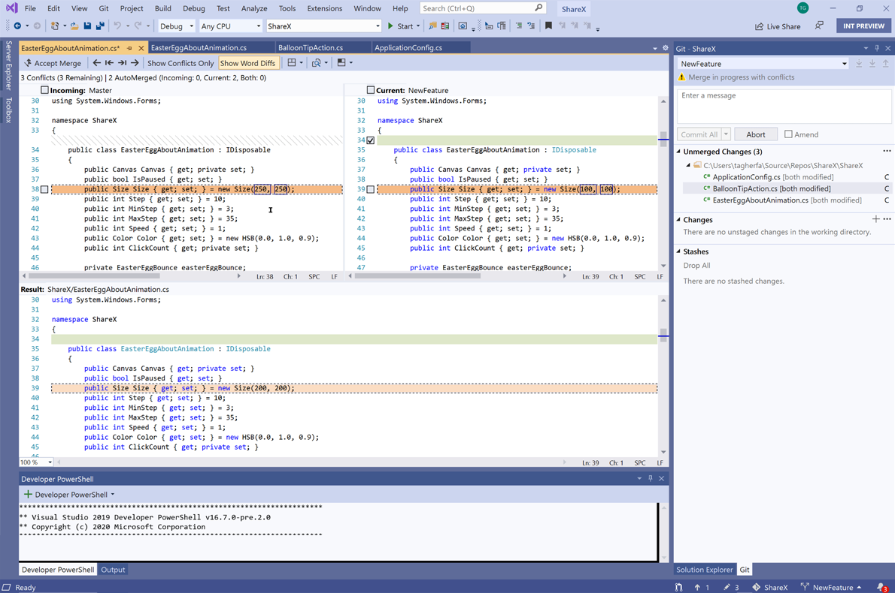
How long does it take?
IDE 2022

Slide 5
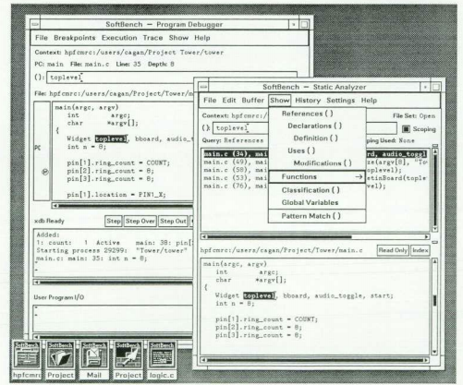
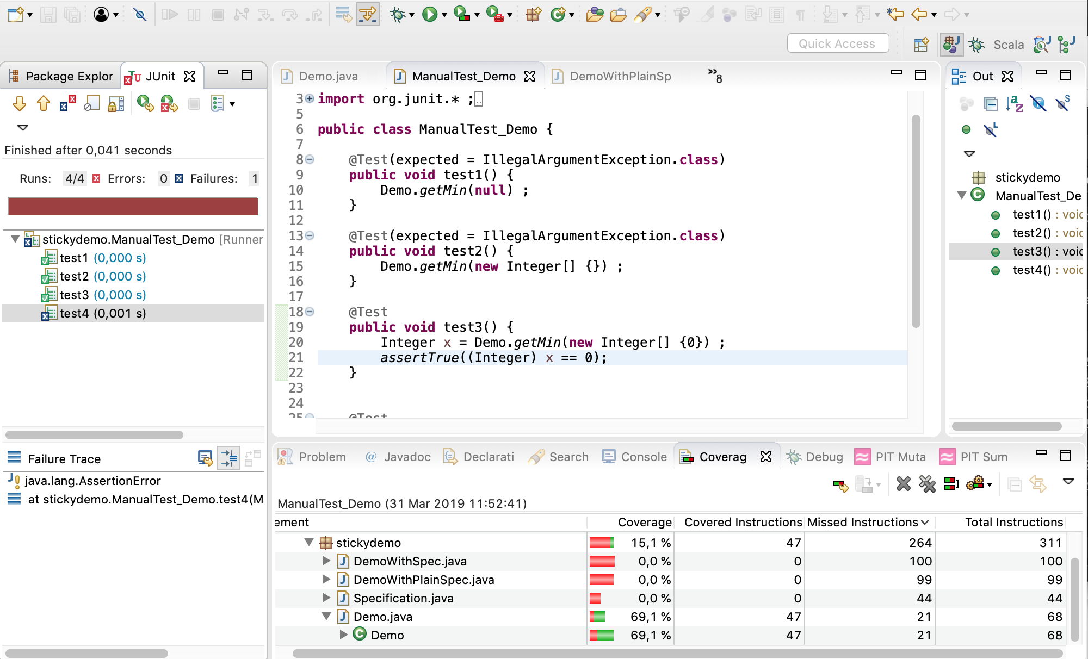
How long does it take?
70’s
90’s
10’s
IDE

Slide 6
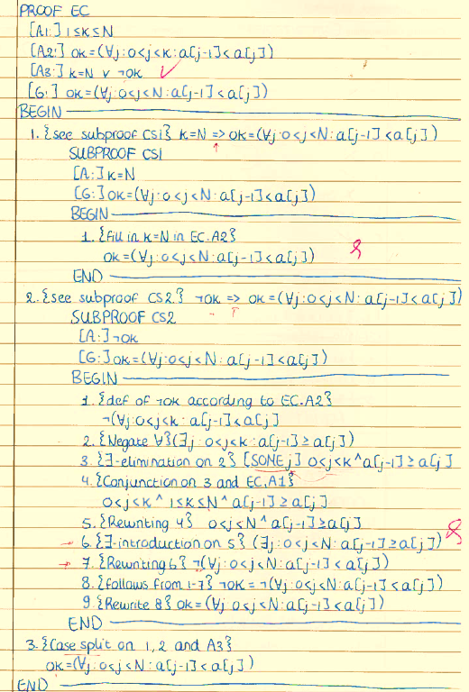
How long does it take?
val HOARE_ifthenelse_thm = prove
(``HOARE S1 (AND g p) q /\ HOARE S2 (AND (NOT g) p) q ==> HOARE (IFTHENELSE g S1 S2) p q``,
REWRITE_TAC [HOARE_def]
THEN REWRITE_TAC [exec_def, AND_def, NOT_def]
THEN BETA_TAC
THEN PROVE_TAC[]
) ;
in 2000’s
proving correctness in 80’s

Slide 7
proving correctness nowadays
Though in terms of user-friendliness, performance, documentation, user support etc, the technologies are not maturing yet. Also: scalability remains a challenge.
(hopefully, you can contribute to this as well)

Slide 8
Learning goals
Become familiar with, and acquire insight on the underlying concepts of:
formalisms to express the correctness of programs: a Hoare-style formalism, LTL, CTL.
automated verification techniques: predicate transformer, symbolic verification, model checking LTL/CTL, probabilistic model checking.
program semantics: operational, denotational, axiomatic (this is covered in MCPD).

Slide 9
Learning goals
Acquire hands-on experience (towards your future research) with :
implementing a verification technique (one of previously mentioned).
using a verification tool to model a problem and conduct a verification of its solution.

Slide 10
setup
Lectures : in the morning 9:00 – 11:00 every monday and wednesday.
Discussing exercises, doing tutorial, doing/discussing/presenting project: 11:00 – 12:45, every monday and wednesday after lectures. We may use some of the exercise-hours for lectures if we get a bit short in time.
2 exams + 1 project that also involves writing a paper presenting your results.
Several other activities e.g. doing exercises together, running a tutorial.

Slide 11
Evaluation
Project + tutorial + assignment
All are mandatory
You can work in a team, up to size 3.
Exams : 2x
Grading:
A SPIN tutorial & assignments : 7.5%
S Probabilistic Model Checking tutorial : 7.5%
E Exams: 20% E1 + 25% E2, average should be ≧ 5.0
P Project: 40%
Your grade = P+E+A+S rounded to the closest 0.1 pt, however if 5.0 ≤ P+E+A+S < 6.0 your grade is rounded to the closest integer.

Slide 12
Evaluation
Supplementary exam,
Note the Faculty’s regulation concerning this.

Slide 13
Coverage
 | A | P | E1 | E2
Pred. transformer |  | ✔ | ✔
LTL + model checking | ✔ |  | ✔
CTL + model checking |  |  |  | ✔
Symbolic model checking |  | ✔ |  | ✔
Probabilistic model checking | ✔ |  |  | ✔
Experience with verification tool | ✔ | ✔
Can implement a verification technique |  | ✔
(may change if the actual progress during the course requires us to adapt)

Slide 14
Course materials
Lecture Notes PV, free. Get it at the course website.
Chapter 10 on probabilistic model checking of Principles of Model Checking, by Baier, Katoen, et. al. MIT Press, 2008.
Slides.

Slide 15
Software
You need your own laptop/machine.
Needed software:
Haskell (a functional programming language)
Z theorem prover and its Haskell-binding, Install them ASAP!!
Spin. Install them ASAP!! Model checker SPIN, also requires
C compiler + its standard libraries.
On Windows you probably also need Cygwin or Msys+Mingw to get the C compiler.
Tk/Tcl for its GUI
Dot for drawing state automata
PRISM probabilistic symbolic model checker, https://www.prismmodelchecker.org/
Links to Spin can be found in PV website. Consult their install instructions.

Slide 16
Other notes
www.cs.uu.nl/docs/vakken/pv
Slides, course plan, etc.
Most communications through MS-Team

