Slide 1











마이크로컨트롤러용 소프트웨어 구조
Framework
Functional
Library
Function
[1]
Function
[2]
Function
[N]
Physical Layer
C
Library
OS Abstraction Layer
Hardware Abstraction Layer
Operating Sys
Microcontroller Hardware

Slide 2
하드웨어 추상 계층
#define PORTA * (uint8_t volatile *) (0x0000)
…
uint8_t u8GetModeSwitchRaw(void)
{
uint8_t mode_switch_raw;
if((PORTA & 0x04) != 0)
{
mode_switch_raw = TRUE;
}
else
{
mode_switch_raw = FALSE;
}
return(mode_switch_raw);
}
Standard Interface to
Physical Layer
Adaptation to
Platform
uint8_t u8GetModeSwitchRaw(void)
{
uint8_t mode_switch_raw;
…
mode_switch_raw = _getbit(P2,14);
return(mode_switch_raw);
}
Adaptation to
Implementation

Slide 3
OS 추상 계층
void vStartEventTask(uint16 u16Event)
{
switch(u16Event)
{
case ERROR:
TaskStart(0);
break;
case POWER_DOWN:
TaskStart(1);
break;
…
}
}
Adaptation to
Framework
Adaptation to
Operating System

Slide 4






물리계층의 역할과 물리량
Sensor
Function
8.0 V ~ 16.0 V
12.0 V
1200
800 ~ 1600 [0.01V]
Electrical Interface
Physical Layer
2.0 V ~ 4.0 V
4.0 V
614
409 ~ 818
Microcontroller Hardware
Hardware Abstraction Layer

Slide 5
물리계층
uint16_t u16GetSwitchState(void)
{
static uint16_t FirstState, SecondState, ThirdState;
uint16_t switch_state_raw, switch_state;
switch_state_raw = u16GetSwitchStateRaw(void);
FirstState = SecondState;
SecondState = ThirdState;
ThirdState = SwitchStateRaw;
if((ThirdState==SecondState)&&(SecondState==FirstState))
{
switch_state = switch_state_raw;
}
return(switch_state);
}
Interface to
Application
Interface to
HW Abstraction Layer

Slide 6
프래임워크
void vTask10ms(void)
{
uint16_t u16_switch, u16_analog_value,
u16_switch = u16GetSwitchState();
if(u16_switch == ON)
{
u16_analog_value = u16GetAnalogValue();
vPerformCurrentControl(u16_analog_value);
}
else
{
vPerformCurrentControl(DEFAULT_CURRENT);
}
}
Interface to
OS or OS Abstraction Layer
Interface to
HW Abstraction Layer

Slide 7
기능라이브러리와 인스턴스
void vInitSensor(uint8_t u8_channel)
{
…
}
uint8_t u8CheckSensor(uint8_t u8_channel)
{
…
}

Slide 8
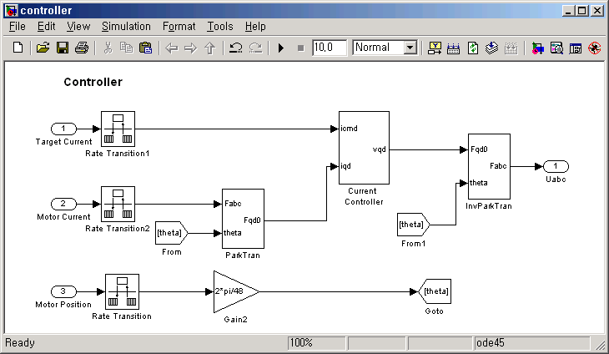








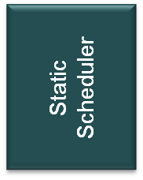



uint8_t u8GetModeSwitchRaw(void)
{
uint8_t mode_switch_raw;
…
mode_switch_raw = _getbit(P2,14);
return(mode_switch_raw);
}
Automatic
Generated Code
Legacy Code
Sensor
SW
Comp.
Control
Comp.
Diagnosis
Comp.
Actuator
SW
Comp.
Run-Time Environment
Hardware Abstraction Layer
Microcontroller Hardware

