Slide 1
Adc_GetData
Measure
SupplyVoltage
CheckError
DriveMotor
Pwm_SetData
Dio_SetData
Can_GetData
Receive
Command
ControlState
TransmitState
Can_SetData
Adc_GetData
Measure
BeltTension
자료흐름도의 예

Slide 2
10ms
10ms
10ms
Adc_GetData
Measure
SupplyVoltage
CheckError
DriveMotor
Pwm_SetData
5ms
Dio_SetData
Can_GetData
Receive
Command
10ms
5ms
ControlState
TransmitState
Can_SetData
1ms
Adc_GetData
Measure
BeltTension
자료전달 방법과 수행주기

Slide 3
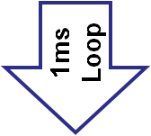
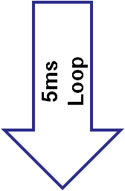

Adc_GetData
Measure
BeltTension
s16
BeltTension
Actual
Receive
Command
enu
Command
Actual
Can_GetData
TransmitState
Can_SetData
Measure
SupplyVoltage
s16
SupplyVoltageActual
Adc_GetData
CheckError
u8
ErrorCode
ControlState
enu
State
Pwm_SetData
DriveMotor
s16
BeltTension
Ref
Dio_SetData
절차지향형 소프트웨어

Slide 4
10ms
10ms
10ms
Adc
_GetData
Measure
Supply
Voltage
s16
SupplyVoltageActual
CheckError
u8
ErrorCode
DriveMotor
Pwm
_SetData
5ms
s16
BeltTension
Ref
Dio
_SetData
Can
_GetData
Receive
Command
enu
Command
Actual
10ms
5ms
ControlState
enu
State
Transmit
State
Can
_SetData
1ms
Adc
_GetData
Measure
BeltTension
s16
BeltTension
Actual
자료흐름도

Slide 5
Sensor Object
Application Object
Actuator Object
10ms
10ms
10ms
Measure
Supply
Voltage
s16
SupplyVoltageActual
DriveMotor
CheckError
u8
ErrorCode
5ms
Receive
Command
enu
Command
Actual
s16
BeltTension
Ref
10ms
5ms
1ms
ControlState
enu
State
Transmit
State
Measure
BeltTension
s16
BeltTension
Actual
Hardware Abstraction Object
Adc
_GetData
Adc
_GetData
Can
_GetData
Can
_SetData
Dio
_SetData
Pwm
_SetData
객체 만들기

Slide 6



Application Object
s16
BeltTension
Ref
10ms
10ms
ControlState
enu
State
CheckError
u8
ErrorCode
Sensor Object
Actuator Object
10ms
5ms
1ms
10ms
5ms
Measure
Supply
Voltage
Receive
Command
Measure
BeltTension
DriveMotor
Transmit
State
s16
SupplyVoltageActual
enu
Command
Actual
s16
BeltTension
Actual
Hardware Abstraction Object
Adc
_GetData
Adc
_GetData
Can
_GetData
Can
_SetData
Dio
_SetData
Pwm
_SetData
객체와 계층구조

Slide 7
Adc_GetData
s16
Adc_SupplyVoltage
Measure
SupplyVoltage
u16
Pwm_Duty
Pwm_SetData
DriveMotor
Can_GetData
u8
Can_Data
Receive
Command
u8
Dio_Direction
Dio_SetData
TransmitState
u8
Can_State
Can_SetData
Adc_GetData
s16
Adc_BeltTension
Measure
BeltTension
자료흐름도의 예[입력부 영역]
자료흐름도의 예[출력부 영역]

Slide 8
Adc_GetData
Measure
SupplyVoltage
CheckError
DriveMotor
Pwm_SetData
Dio_SetData
Can_GetData
Receive
Command
ControlState
TransmitState
Can_SetData
Adc_GetData
Measure
BeltTension
자료흐름도의 예

Slide 9
Main
9
1
8
2
10
Adc_GetData
Measure
SupplyVoltage
CheckError
DriveMotor
Pwm_SetData
3
11
4
Dio_SetData
Can_GetData
Receive
Command
7
12
13
5
ControlState
TransmitState
Can_SetData
6
Adc_GetData
Measure
BeltTension
절차지향 프로그래밍의 복잡한 제어흐름도

Slide 10

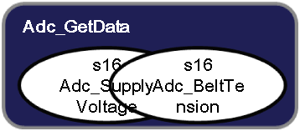
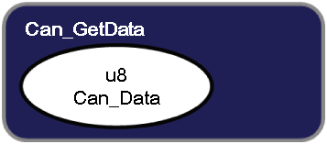
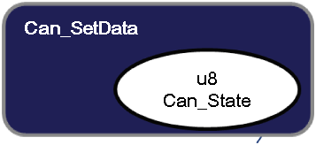
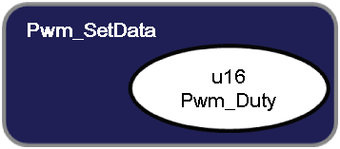

Slide 11



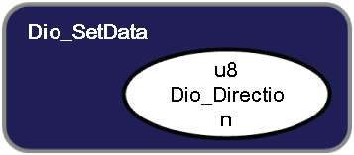


CheckError
ControlState
u8
ErrorCode
enu
State
s16
BeltTension
Ref
Measure
SupplyVoltage
s16
SupplyVoltageActual
Measure
BeltTension
Receive
Command
TransmitState
DriveMotor
s16
BeltTension
Actual
enu
Command
Actual

