Slide 1
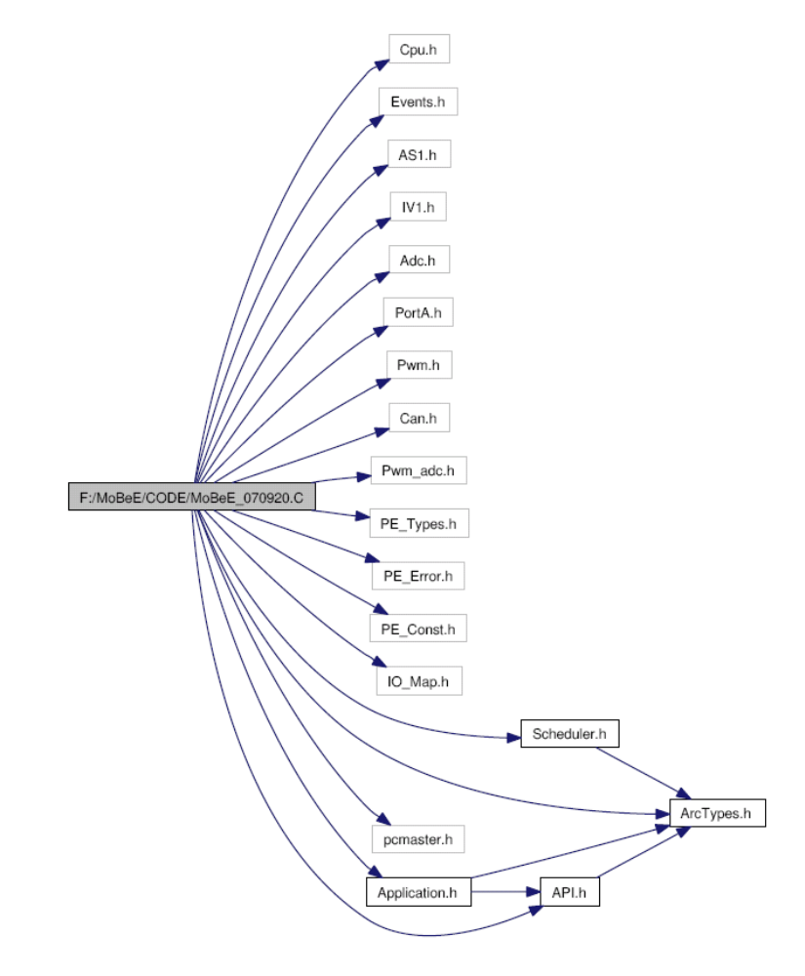
헤더파일 인클루드 구조의 예

Slide 2
바람직한 인클루드 구조
Common1.H
Common2.H
Module.C
Module.H
Project1.H
Project2.H
Other
Module1.H
Other
Module2.H

Slide 3
모듈 헤더파일 인클루드 내용
/* Module.h */
/* Global Include */
#include "GLB_DataTypes.h" /**< Include Global Data types*/
#include "GLB_Macro.h" /**< Include Global Macro*/
#include "GLB_FuncLib.h" /**< Include Function Library*/
#include "GLB_CLib.h" /**< Include C Library*/
/* Project Specific Include */
#include "XXX_DataTypes.h"
#include "XXX_Macro.h" */

Slide 4
공통 자료형 선언
/* GLB_DataTypes.h */
/**** C type extensions ****/
#define void_t void
typedef unsigned char bool_t;
typedef signed char char8_t;
typedef unsigned char uint8_t;
typedef char int8_t;
typedef signed char sint8_t;
typedef unsigned int uint16_t;
typedef int int16_t;
typedef signed int sint16_t;
typedef unsigned long uint32_t;
typedef long int32_t;
typedef signed long sint32_t;
typedef float float32_t;
typedef double float64_t;
/**** C pointer extensions ****/
typedef void* ptr_t;
typedef unsigned char* str_t;

Slide 5
공통 매크로 선언
/* GLB_Macros.h */
#ifndef TRUE
#define TRUE 1
#endif
#define FALSE 0
#define NULL 0
#define SET |=
#define RESET &=~
#define TEST &
/*Bit Position Mask definition */
#define BYTE_BIT0 0x01
…
#define BYTE_BIT7 0x80
#define WORD_BIT0 0x0001
…
#define WORD_BIT15 0x8000

Slide 6
변수의 선언
/* GLB_FuncLib.h */
uint8_t GLB_u8GetAbs(sint8_t s8_value);
uint16_t GLB_u16GetAbs(sint16_t s16_value);
uint32_t GLB_u32GetAbs(sint32_t s32_value);
sint16_t GLB_s16SignedShiftRight(sint16_t s16_value, uint8_t u8_shift);
sint32_t GLB_s32SignedShiftRight(sint32_t s16_value, uint8_t u8_shift);
sint16_t GLB_s16SignedShiftLeft(sint16_t s16_value, uint8_t u8_shift);
sint32_t GLB_s32SignedShiftLeft(sint32_t s16_value, uint8_t u8_shift);
…

