Slide 1
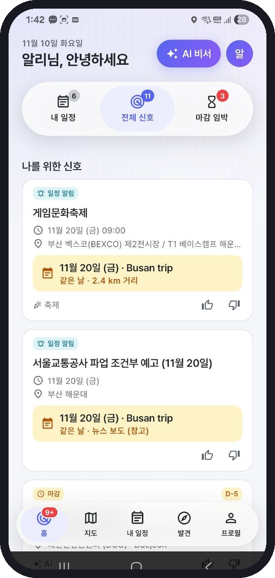
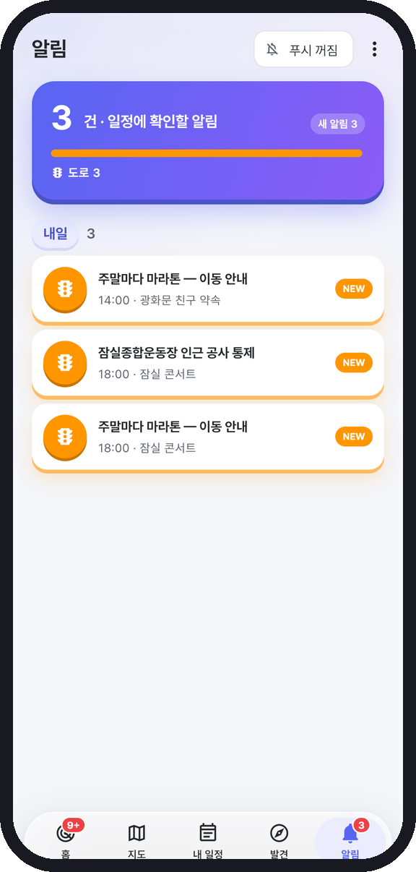
LifeRadar
The AI coworker that watches your schedule
— so you never miss what matters to you.
Finds first
Explains why
You decide
2026 AI Woowangthon · Team 27 DALAB · Abbos Aliboev · Jeon Yeongwoo
Notes:
Hello, we are Team 27, DALAB. Our project is LifeRadar — an AI coworker that watches your schedule.
Today's theme asks: can AI be a coworker? A good coworker doesn't wait to be asked. They notice what affects your day, tell you why, and then let you make the call.
That's exactly what LifeRadar does: it finds first, explains why, and you decide.

Slide 2



“Can AI be a coworker?”
Finds first
Scans your calendar against real events, official traffic notices, news and weather.
Shows why
Yes — if it finds things before you ask, shows its reasons and sources, and never decides for you.
Every card says which plan it touches, how far, and where the fact came from.
You decide
Add to calendar, apply, ignore — nothing happens until you tap.
Notes:
Our answer to the theme is yes — with three conditions.
First, it finds things before you ask. Second, it shows its reasons and sources, so you can trust it. Third, it never acts on its own: you decide.
Keep these three in mind — every feature we show follows them.

Slide 3





It started with an event we found too late
Scattered and Korean-only
Events, grants, traffic notices and strike news live on separate sites, mostly in Korean.
“I only found the event after the application deadline had passed.”
Not linked to my plans
A festival 2 km from my hotel on my trip day? I would have to check three apps to notice.
Our teammate, an international student in Korea. The notice was in Korean, on one of dozens of agency sites — and nothing connected it to his calendar.
You must know what to ask
Search, maps and chatbots answer questions — they never tell you first.
Notes:
This project started from a real problem on our team. Our teammate, an international student, found an event he wanted — after the deadline.
The information existed. The problem is that it is scattered across dozens of sites, mostly in Korean, and nothing connects it to your own plans.
And every tool we use — search, maps, AI chat — only answers when you already know what to ask.

Slide 4




What matters lives where time, place and information meet
The useful part is the overlap
≠
≠
Time
Place
Information
…and nobody computes it for you.
Calendar apps know when you are busy
Map apps know where things are
Event sites, news and traffic notices know what is happening
Example: a Busan trip on Nov 20
Rail unions announce a strike for that date · a big festival runs 2.4 km from the hotel · a seminar sits right next to the KTX route — three facts, three different sites, one plan.
Notes:
Existing tools each own one dimension. Calendars own time, maps own place, and event sites and news own information.
The things that actually change your day sit in the overlap — for example a strike announced for the day of your trip, or a festival next to your hotel.
No product computes that overlap for you. That is the gap LifeRadar fills.

Slide 5
Today, every tool waits for you to ask
 | Calendar app | Map app | Event platforms | AI chatbot | LifeRadar
Tells you before you ask | ◐ | — | ◐ | — | ●
Links your plans × events × traffic | — | — | — | ◐ | ●
Opportunities along your route (+km, +min) | — | ◐ | — | — | ●
Tracks application deadlines | — | — | ● | — | ●
Reason + source + confidence | — | — | — | ◐ | ●
Blocks made-up facts | — | — | — | ◐ | ●
● strong ◐ partial — none Team comparison of typical products; features change over time.
Notes:
Here is the honest comparison. Calendar apps remind you of your own events. Event platforms track deadlines. Chatbots can answer — if you ask, and they may make things up.
None of them tells you first, links your plans to outside events and traffic, or blocks invented facts. That last row matters most for an AI coworker: trust.

Slide 6










LifeRadar crosses them for you — and tells you why
Your plans
Rule engine
Google Calendar + your own
Decides what to show: same day? within 1 km? on your route? deadline soon?
Your interests
chosen, or suggested by AI
You decide
873 real events
Gemini
4 public agencies, daily
→
→
Writes the “why it matters to you” sentence from those facts only
Add to calendar
Apply before the deadline
Leave earlier / change route
Like / dislike — it learns your taste
Official traffic
Seoul TOPIS · national ITS
Strike news
Code check
read by AI, quote-checked
Rejects any number, id or quote that is not in the input
Weather
10-day forecast per place
Notes:
This is the whole system on one slide.
On the left, six inputs: your plans and interests, 873 real events refreshed daily, official traffic notices, strike news and weather.
In the middle, the AI pipeline. A deterministic rule engine decides what is relevant. Gemini only writes the explanation. Then code checks it — any number, id or quote not in the input is rejected.
On the right: you decide. The AI never adds anything by itself.

Slide 7




One trip, four signals you didn’t ask for
Rail strike announced
Seminar on your KTX route
News read by AI, shown with the article quote and link — marked as news, not official.
+7.1 km · +17 min detour. By car it is not suggested — the highway is too far.
Festival 2.4 km from your hotel
Startup grant closes in 2 days
Real TourAPI event on your trip day. Traffic impact not confirmed — and we say so.
Matches your interests → apply link, or add the deadline to your calendar.
Calendar: “Busan trip · Nov 20–22”
Notes:
Let's make it concrete. Your calendar has a Busan trip on November 20th. You ask nothing.
LifeRadar shows four signals. A rail strike announced in the news — with the exact quote and link, and labelled as news. A festival 2.4 km from your hotel — real public data, and we openly say the traffic impact is not confirmed. A seminar right next to your KTX route, only 17 extra minutes. And a startup grant that closes in two days.
Note: the Daejeon seminar is sample data, shown with a 'sample' badge in the app — IT conferences have no public API.

Slide 8

Live demo
Real phone · real data · nothing pre-recorded as “fake results”.
[Insert demo video here — YouTube link or MP4, ≤ 5 min]
1 Onboarding: tell the AI about yourself
2 Alerts tab: the Busan trip signals
3 Plans: “+ Add route” between two plans
4 AI assistant: [Add] one, [Cancel] one
5 Add a 2-month exhibition → pick one day
Notes:
(Play the demo video here — about 3 minutes in the 10-minute slot.)
Narrate over it: onboarding with the AI, the alerts tab for the Busan trip, adding a route between two plans, the assistant proposing actions where I accept one and cancel one, and adding a long exhibition where I pick just one day.

Slide 9
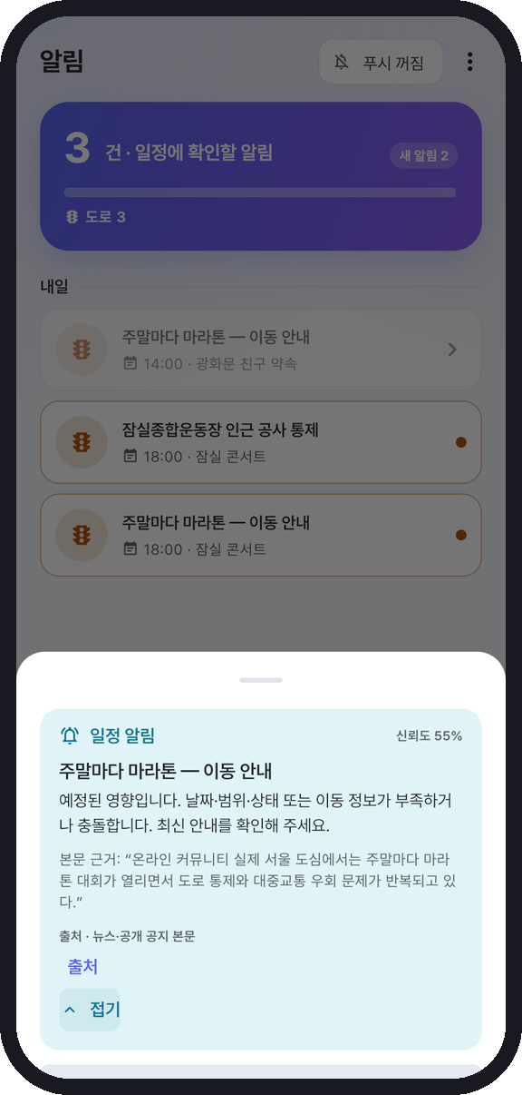




Alerts that only talk about your plans
Road
Official closures within 1 km, in your travel window
Transit
Strikes on the line you actually take
Weather
Rain on the day of an outdoor plan
Crowds
Big events next to your plan — “reference”, not a claim
Two lines first · “Read more” for evidence and source · one tap for push
Notes:
Warnings about your plans get their own tab, separate from event discovery, so they are never lost among recommendations.
Four kinds: road closures, transit strikes, rain and crowds. Each line says which plan it touches. The reason is two lines; tap 'read more' for the exact evidence and source.
Crowd cards are labelled as reference — a big event nearby does not prove traffic impact, and we do not pretend it does.

Slide 10
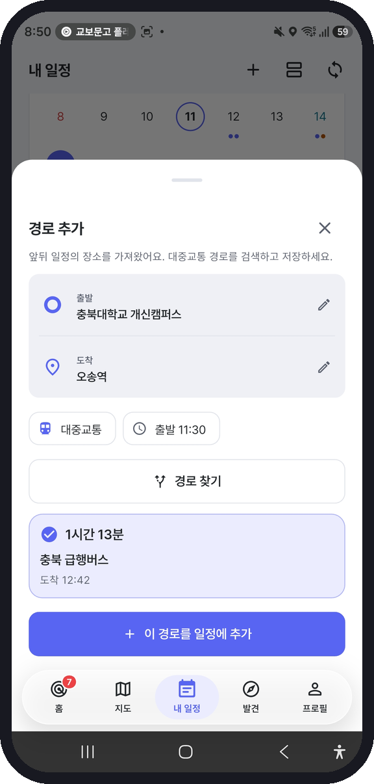
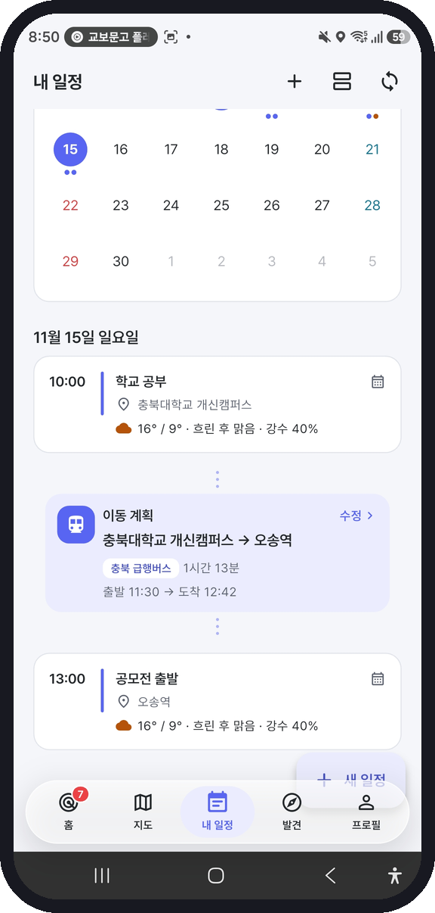
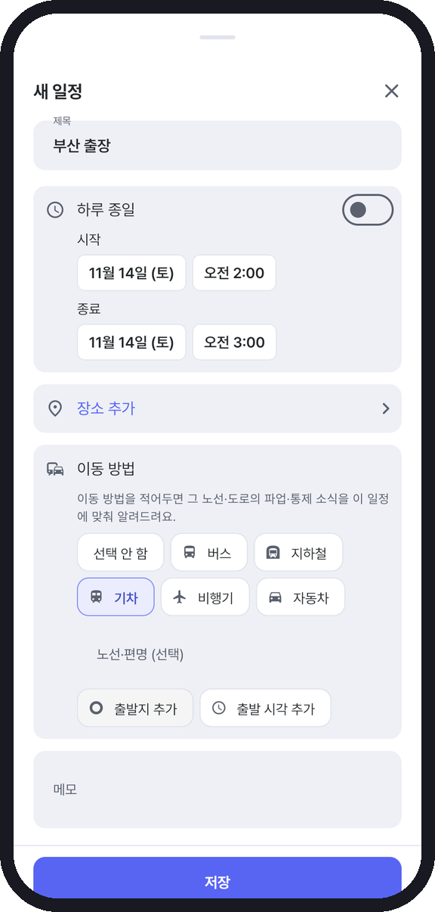



Tell it how you travel — it watches that line
Between two plans
“+ Add route” → transit search → a travel-plan card with departure and arrival.
For any single plan
Bus · subway · train · plane · car, plus line, origin and departure time.
Then it watches
A strike on your line or a closure on your road becomes an alert for that plan.
Notes:
To warn you about your trip, the app has to know how you travel.
Between two plans on the same day, tap 'add route': it pulls both places, searches transit and saves a travel-plan card. For a single plan, just pick bus, subway, train, plane or car and the line.
From then on, a strike on that line or a closure on that road becomes an alert for that plan. Flights are recorded but not used for alerts yet — we don't have flight data.
This feature was designed and built by Jeon Yeongwoo, together with the traffic rules behind it.

Slide 11
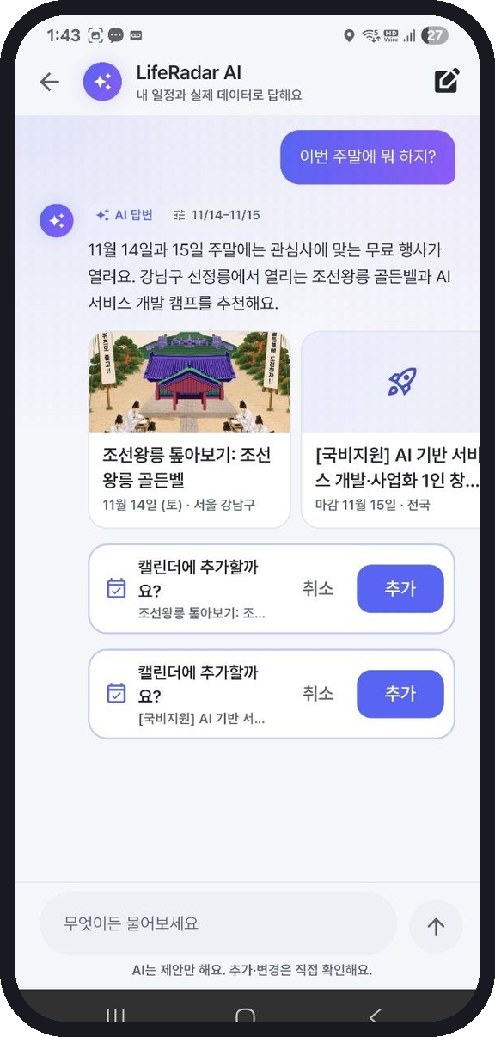
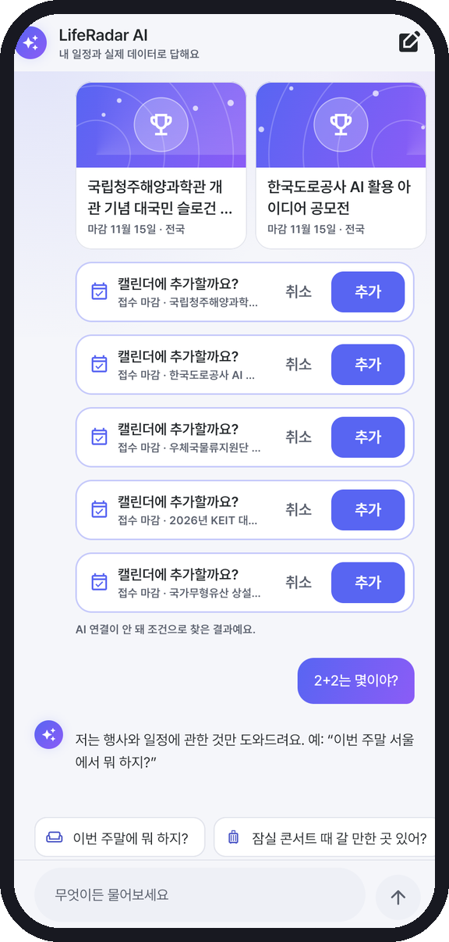
Ask in your own words — answers come from real data only
1
Code reads the question
date · city · category · free · deadline · which plan
2
Code picks real candidates
up to 24 events from today’s data — the AI sees nothing else
3
Gemini answers inside them
any id or number outside the candidates is dropped
4
It proposes, you confirm
[Add] / [Cancel] — and off-topic questions are politely declined
Notes:
You can also just ask: 'What can I do this weekend?' or 'Anything for my Busan trip?'.
Code first reads the conditions from your question and picks real candidate events. Gemini answers only inside those candidates — anything outside is dropped by code. It proposes actions, and you confirm each one.
It also stays on topic: ask it 2 plus 2 and it says it only helps with events and plans. Measured on real Gemini: 7 of 7 answers grounded, zero events outside the candidates.

Slide 12


A coworker, not an oracle: AI writes, code checks
Facts
Judgement
Language
Decision
Public APIs
Rule engine
Gemini
You
Dates, places, prices and links stay exactly as published.
Which plan meets which event, distance, time window, score — deterministic and tested.
Explains, translates, reads news, understands your self-intro and questions.
Nothing is added, applied or saved until you tap.
Guardrails in code: every number in an AI sentence must exist in the input · ids must be real candidates · news quotes must appear in the article · self-intro evidence is cut from your own words by word index
Notes:
This is how we make AI a trustworthy coworker. We split the roles.
Facts come from public APIs untouched. Judgement is a deterministic rule engine with tests. Language is Gemini — explaining, translating, reading news, understanding you. Decisions are yours.
And the guardrails are code, not prompts: numbers must exist in the input, ids must be real candidates, quotes must be in the article.

Slide 13
We measured where AI fails — then changed the design
6 / 6
Card sentences passed the number check
6 / 150
News articles blocked
Found: the model added an unverified “may affect your route” → crowd and traffic cards no longer use AI text.
Strike reader: quote not found in the article → dropped instead of shown.
0
Invented evidence in self-intro
7 / 7
Assistant answers grounded
First design: 20–30% broken Korean quotes. Now the model points to word numbers and code cuts the text.
Zero events outside the candidates; off-topic questions declined.
Real Gemini API, team-built test sets (6 cards · 150 + 25 articles · 7 intros × 3 runs · 7 questions). Small-scale, not a labelled benchmark.
Notes:
We didn't just trust the AI — we measured it with the real Gemini API, and each test changed the design.
Card sentences all passed the number check, but we caught the model adding an unverified traffic claim, so those cards no longer use AI text. The news reader dropped 6 of 150 articles whose quote was not real. Our first self-intro design produced 20 to 30 percent broken Korean quotes — we switched to word indexes and now it is zero. And the assistant was grounded 7 out of 7.
To be honest: these are small team-built test sets, not a large labelled benchmark.

Slide 14



Three repositories, one pipeline
BE · data pipeline
AI · liferadar_core
FE · Flutter app
GitHub Actions
Dart package
Android + Web
4 public event APIs + NAVER news
Normalize, validate, de-duplicate
Gemini: translate, tag, read strikes
Publish events · news · traffic JSON
Daily 06:00, traffic every 3 h
InsightEngine · RouteMatcher
TrafficMatcher · Taste
InsightWriter · Assistant
ProfileExtractor (+ validators)
105 tests, shared by FE and BE
Cache-first feeds, works offline
Google Calendar · Routes · Weather
Kakao Maps · Local · Mobility
National ITS queried on device
Optimistic UI, ko / en, dark mode
→
→
Why ITS on the device? It blocks overseas IPs such as GitHub Actions — so the app asks it directly.
Notes:
Technically we have three repositories. The backend is a scheduled GitHub Actions pipeline: it collects four public event APIs and news, cleans them, uses Gemini to translate and read strike news, and publishes JSON every day.
The AI repository is a shared Dart package with the rule engine and every AI module with its validators — used by both the app and the pipeline.
The Flutter app is cache-first, works offline, and calls Google and Kakao directly. One detail: the national traffic API blocks overseas servers, so the phone queries it itself.

Slide 15
Real data, refreshed automatically
873
real events from 4 public agencies
292 → 11
news articles → transit strikes (AI-read, quote-checked)
26
official traffic notices merged (TOPIS, ITS, news)
Weekly
contest collection from 3 public portals
Notes:
Everything you saw runs on real public data. Today's feed has 873 events from four agencies: Seoul culture, KOPIS concerts, K-Startup notices and TourAPI festivals.
The news reader went through 292 articles and kept 11 real transit strikes. 26 official traffic notices are merged from Seoul TOPIS, national ITS and news. Contests are collected weekly from three public portals.
All public data is under the Korea Open Government License, and every card shows its source.

Slide 16
Built to feel fast and stay up on a real phone
301
0.4 s
20 s
0 ms
automated tests
batching window
network time limit
wait to see your tap
FE 121 · AI 105 · BE 75 — CI on every pull request in all 3 repos
Weather and traffic results are batched — the app no longer froze for seconds after a plan change
No endless spinners; friendly error toasts instead
Like, add, save and delete update the screen first; failures roll back with an error toast
Korean / English everywhere, event titles translated
Light & dark themes, contrast ≥ 4.5 : 1, reduced-motion support
Offline-first: last feed cached on the phone
Real-device feedback → fixed (alerts tab, toasts, duplicate adds, freezes)
Notes:
Completion matters, so we tested on a real phone every day and fixed what we found.
301 automated tests run in CI across three repositories. When the app froze after a plan change, we measured it, found the rule engine was re-running for every weather result, and batched it. Every network call has a time limit, and taps update the screen instantly — if the server fails, it rolls back and tells you.

Slide 17






What is not done yet — stated openly
Sample data
Push while closed
API keys in the app
IT conferences & hackathons have no public API → sample cards, marked “Sample”.
Alerts work while the app runs; server push (FCM) is designed, not built.
For the demo; next: a server proxy and restricted keys.
City-level closures
Flights
Evaluation size
Police UTIC key issued, waiting for server IP registration.
Recorded in plans, not used for alerts — no flight-status data yet.
Small team-built test sets, not a labelled benchmark.
Next: server push · API proxy · UTIC city closures · flight status · university & international-student office pilots
Notes:
We want to be clear about what is not finished. Conference data is sample and labelled as such. Alerts arrive while the app is running — server push is designed but not built. API keys are in the app for the demo; the next step is a server proxy. City-level police closures are waiting for IP registration, and flights are recorded but not watched. Our evaluations are small.
Next we want to pilot with universities and international student offices — the people who had this problem first.

Slide 18




AI finds.
You decide.
Install (APK)
[Insert Google Drive link + QR]
Demo video
[Insert YouTube link + QR]
LifeRadar — a coworker that watches your plans, explains its reasons, and leaves the choice to you.
Code
github.com/woowangthon — WOOWANGTHON_TEAM_27_FE · BE · AI
Notion
[Insert public Notion page link]
Team 27 DALAB · Abbos Aliboev · Jeon Yeongwoo
Notes:
So, can AI be a coworker? We think yes — when AI finds, and you decide.
LifeRadar watches your plans, explains its reasons with sources, and leaves every choice to you. The APK, demo video, code and Notion page are linked here. Thank you — we're happy to take questions.

Slide 19
Questions we expect
Why not just use ChatGPT?
What if Gemini is down or out of quota?
It waits for a question and can invent events. LifeRadar starts from your calendar, uses only today’s real data, and code rejects unverified facts.
Everything still works: rule sentences, filter search and alerts. AI text is marked “AI”; rule results are marked “filter search”.
How do you stop hallucinations?
What about privacy?
Code retrieves facts first; numbers, ids and quotes must exist in the input or the sentence is replaced.
Interests, own plans and feedback stay on the phone; the calendar token stays in memory; chats are not stored.
Is a crowd warning reliable?
How would this grow?
We never claim traffic impact from an event alone — it is a “reference” card until an official notice exists.
API proxy + server push, then pilots with universities and international-student offices; data is national already.
Notes:
Backup slide for Q&A. Keep answers short and point to the measured numbers on the trust slide.

Slide 20
Sources, what we built, and who built it
Data / external tech | Used for
Seoul Open Data · KOPIS · TourAPI · K-Startup | Events, concerts, festivals, startup notices
Seoul TOPIS · national ITS · (Police UTIC pending) | Official road closures
NAVER News API → Gemini | Transit strike reading
Google Calendar · Routes · Weather · Gemini · Sign-In | Plans, transit routes, forecast, AI text
Kakao Maps · Local · Mobility | Map, place search, driving routes
Flutter, Riverpod, go_router (open source) | App framework
Built by us
All app UI and state, the rule engine, AI prompts and validators, collectors and schedules, design system, tests. An AI coding assistant (Claude) was used and is credited in commits.
Team 27 DALAB
Abbos Aliboev
Planning, architecture, design; app, pipeline, engine & AI
Jeon Yeongwoo
Traffic research & impact rules; plan routes, traffic v2, contest collection
Public data under the Korea Open Government License (KOGL); sources are shown on every card.
Notes:
Appendix: data sources, external technologies, what we built ourselves, and who built what — as required by the competition rules.

