Slide 1
Cel-Shading
Makes Awesome Game Worlds
Gary Steelman
University of Texas at Dallas
2012

Slide 2
The Idea
Convert a smooth-shaded, Phong-illuminated model into a cel-shaded model.
This effect has been used in many highly profitable and critically acclaimed games.
  The Legend of Zelda: Skyward Sword
  Tales of Vesperia
  Borderlands
  No More Heroes
Why? I think the style looks cool.
Notes:
The idea of this project was to create a cel-shader. That is, a shader that achieves cartoon-esque style.
Why? This style is used in many popular games, and many games I have played have used it. And it created a very compelling, wonderful game world. Learning how to use this style will aid me in creating video games in the future.

Slide 3
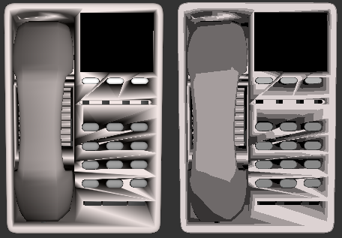
Visual Comparison
Notes:
On the left is the smooth shaded model and on the right is the cel shaded model.

Slide 4
Live Demo
Notes:
Swap over to a live demonstration of the shader in action.

Slide 5
Questions?

