Slide 1
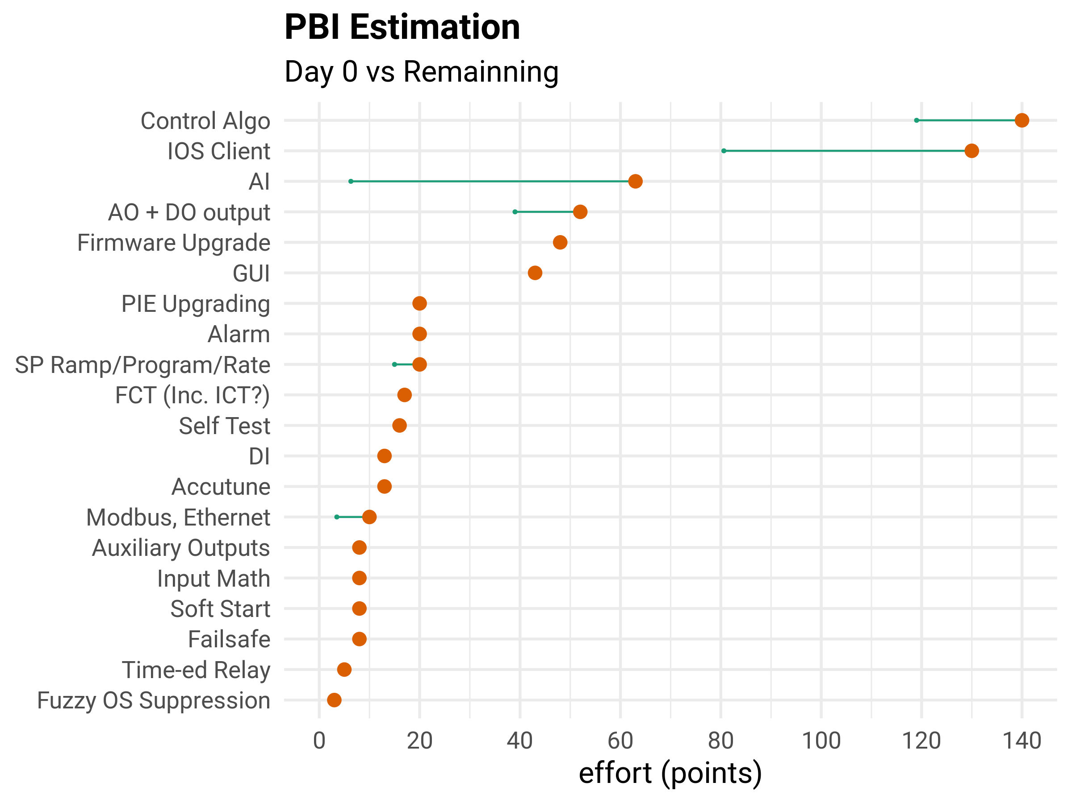
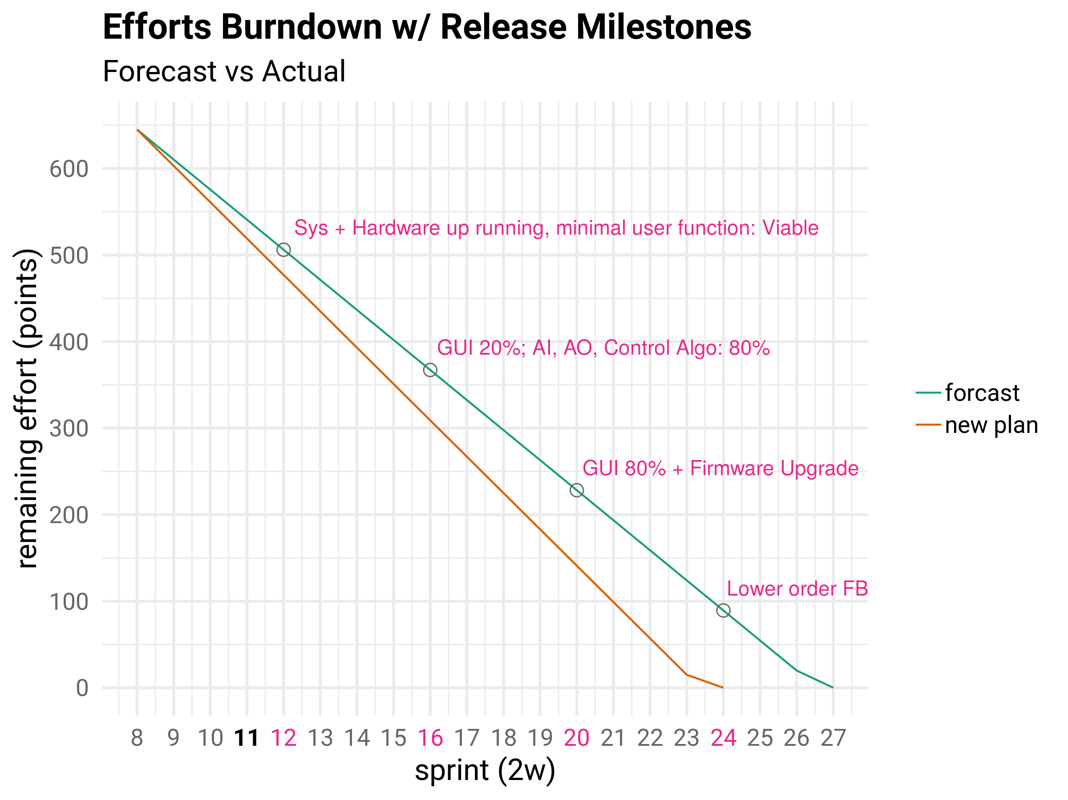
Software: Est., Plan, Status -- Baseline
Efforts are in story points
Estimation from a few earlier sprints

Slide 2
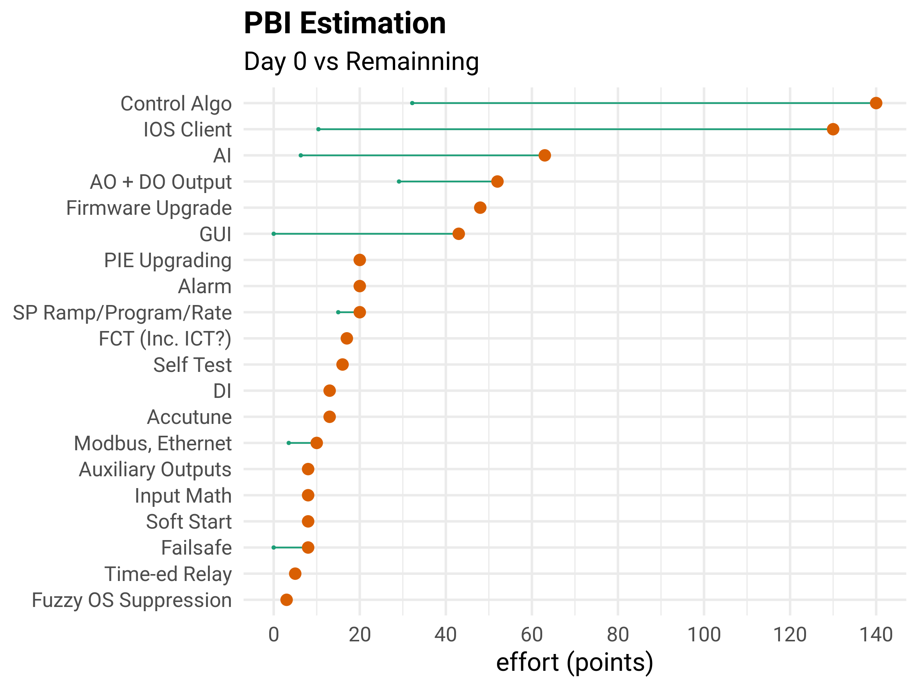
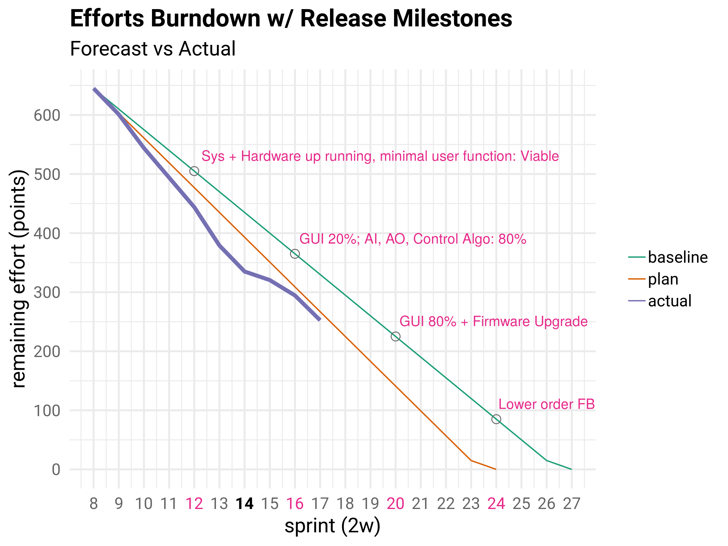
Software: Est., Plan, Status – Nov. 18
Efforts are in story points
Estimation from a few earlier sprints

