Slide 1
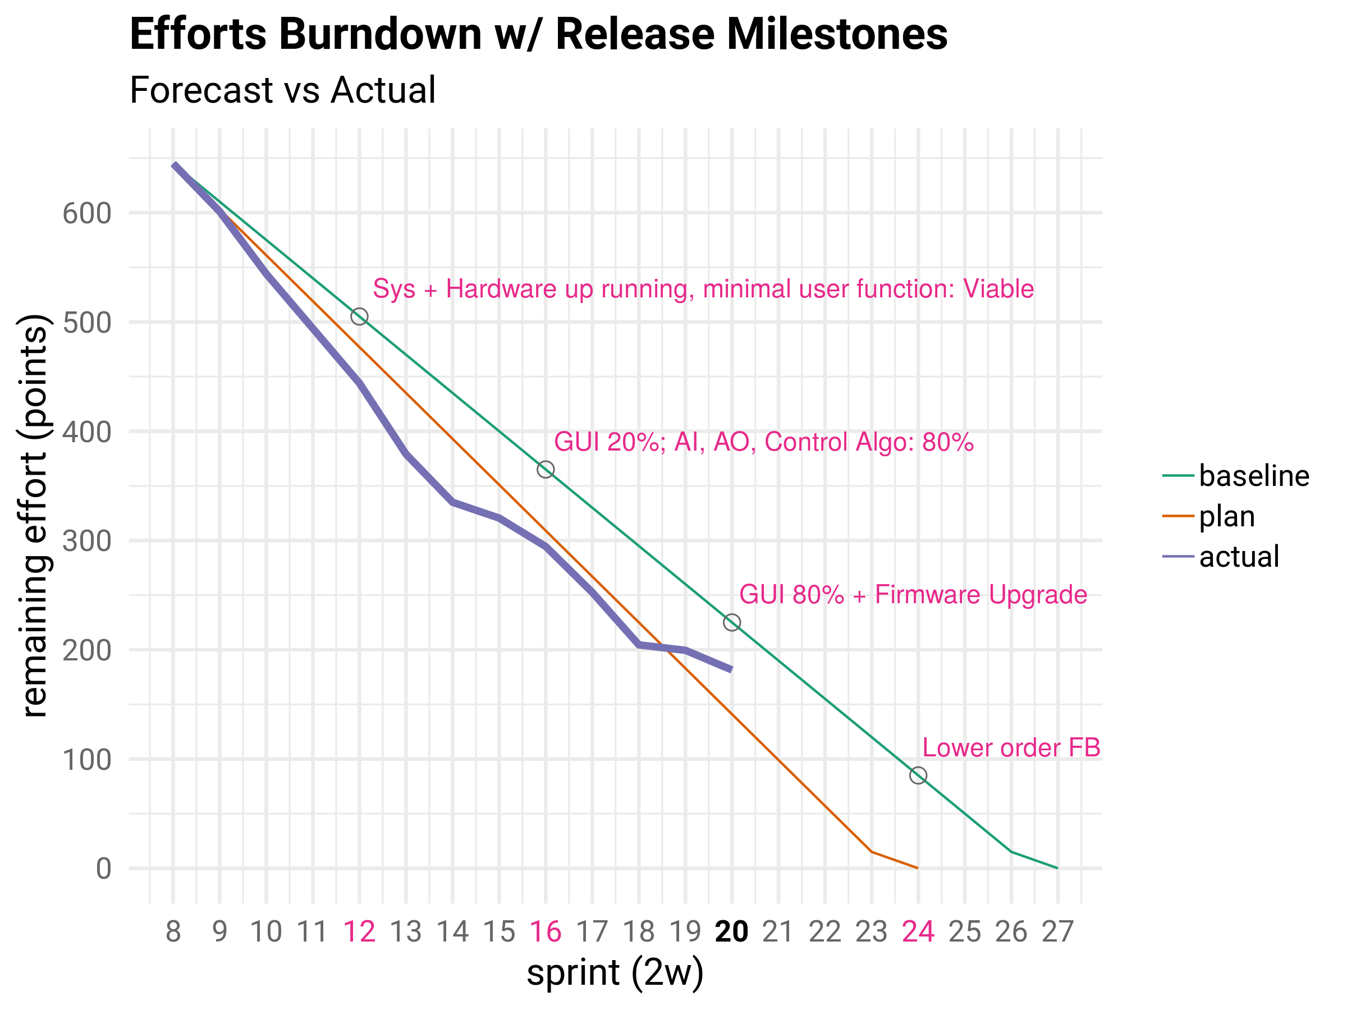
Software: Est., Plan, Status – Jan. 02
Risks
Ethernet lost packets
EEPROM Slow and unstable
The ModBus library has very bad quality and brought very high cost to app layer development
Bluetooth driver issues

