Slide 1
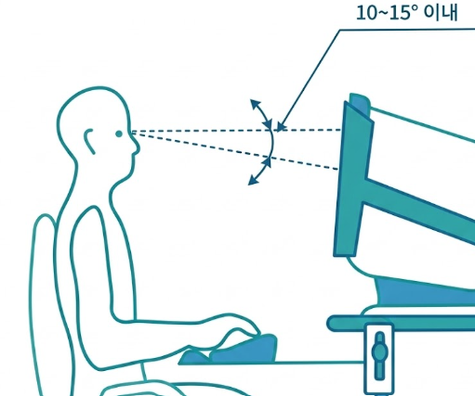
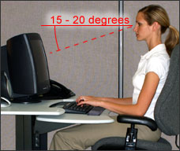
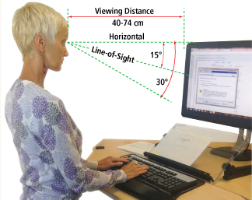
A
B
C

Slide 2
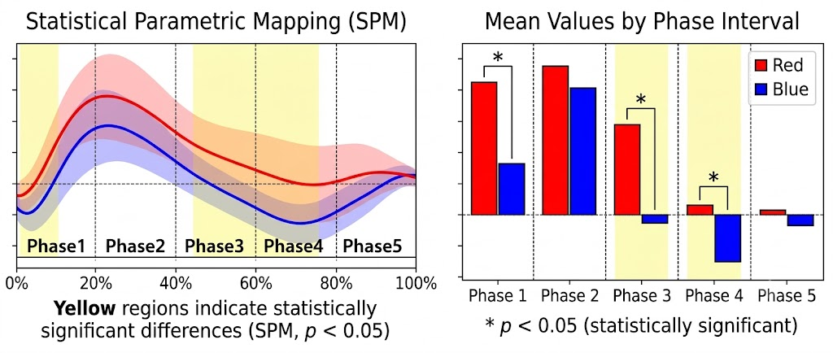

Slide 3
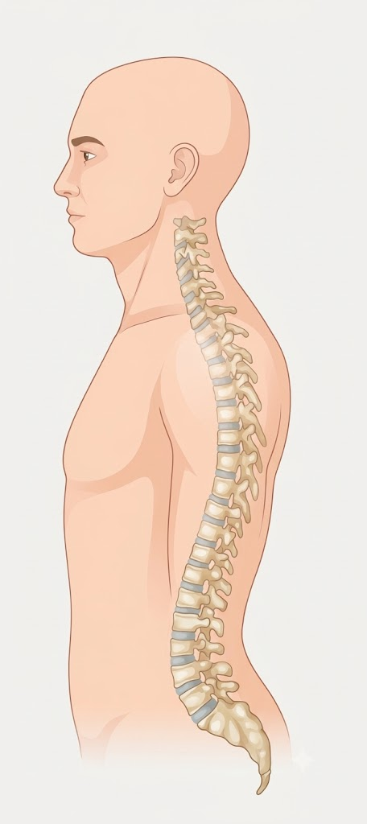






$$θ^{head}$$
$${CA}_{ang}=180°−\left(θ^{head}−θ^{C7}\right)$$
$$θ^{C7}$$
$$θ^{T12}$$
$${LLA}_{ang}=180°−\left(θ^{T12}−θ^{S2}\right)$$
$$θ^{S2}$$

Slide 4
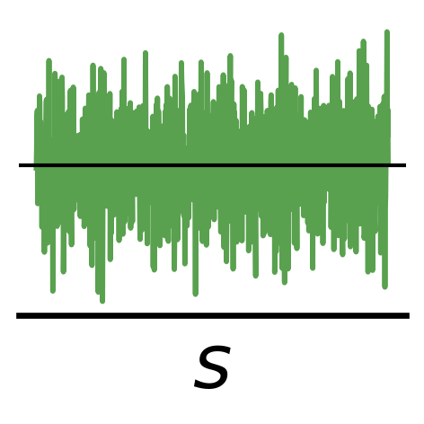
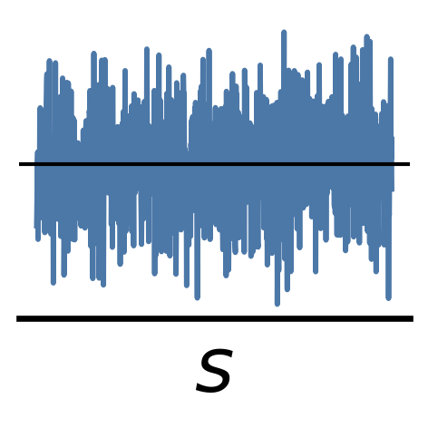
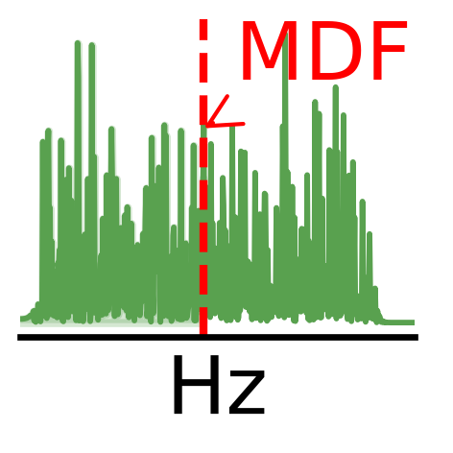
RMS
Bandpass
Filter
FFT

