Slide 1
Integration Testing with Docker, Scala, Akka & ScalaTest

Slide 2
Agenda
Example Test
Creating Docker Images
The test framework
Writing Tests
Final Examples
Conclusion

Slide 3
Example Test

Slide 4
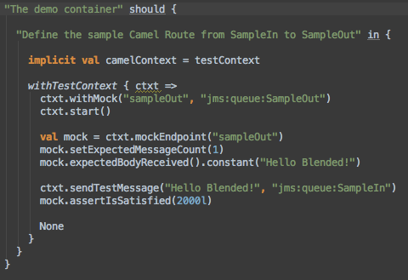
An example test
Notes:
Link Picture to actual source code on github

Slide 5
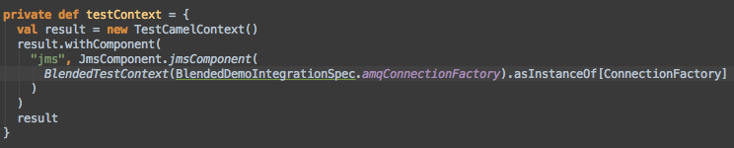
The example test context

Slide 6
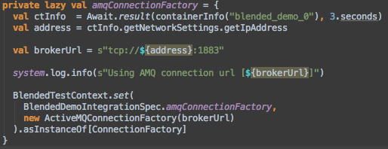
Providing the JMS connection

Slide 7
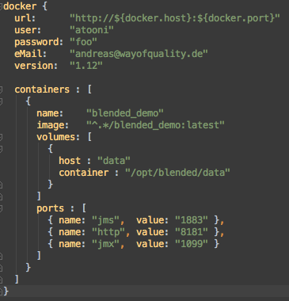
The container under test

Slide 8
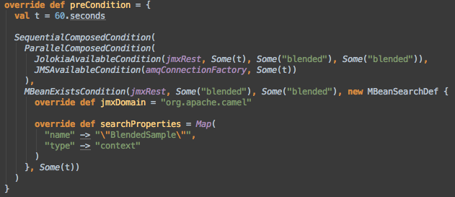
Waiting for the container

Slide 9
Test architecture
Bundle
Bundle
Bundle
Container Runtime
Distributable Archive
Docker Image
Container Manager
Test Framework (Conditions, TestContext, Syntactic Sugar)
Spec
Spec
Spec
Spec
Spec
Spec

Slide 10
Creating docker images

Slide 11
Docker Base Image
Distributable Container
Configuration Files
Standardzed POM File
Docker Image

Slide 12
Docker tricks
Create a docker account
Docker base image for blended
Cleaning up docker

Slide 13
The Test Framework

Slide 14
Define the containers under test
An Akka based Container Manager
Waiting for Containers to be started
Connecting to the Containers
Test fixtures

Slide 15
Writing tests

Slide 16
Final Examples

Slide 17
Kaufland Examples as a complete suite

Slide 18
Conclusion

Slide 19
Working
Wishlist / Issues
Container Management
Test Framework with easy hooks to CuT
Implicit Test Context for Blackbox testing
Syntactic sugar and support for Camel based black-box testing
More syntactic sugar for Conditions
Networking issue on OS X
Kill Containers throughout test for failover testing
Leverage a hosting env. like Openshift to execute Containers under test
Publish Test Framework as self-sufficient project

