Slide 1


Integration Tests using Docker, Scala, Akka & ScalaTest
Andreas Gies
Lead Architect
Notes:
Yoga Bilder, Yoga & IT Kurse, Customized Seminare

Slide 2


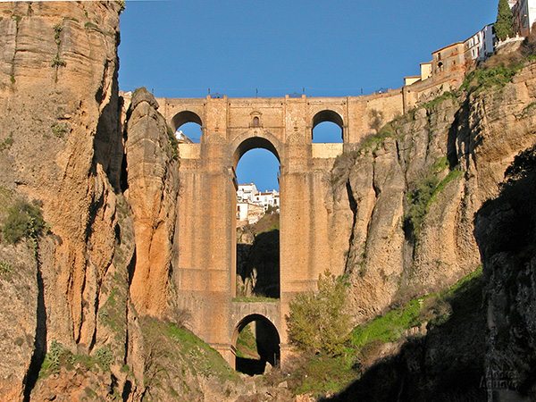
Technical Consulting
Conference speaking slots
Technical Trainings
Management Seminars
Team Breakouts
Coding by the sea
Yoga & learning
Team Building
Enjoy Andalucia
Notes:
Wander bild einfuegen

Slide 3

Example Test

Slide 4
A sample container under test
Notes:
Link Picture to actual source code on github

Slide 5
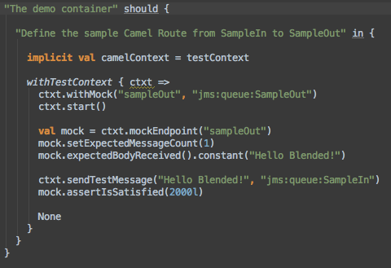
An example test
Notes:
Link Picture to actual source code on github

Slide 6
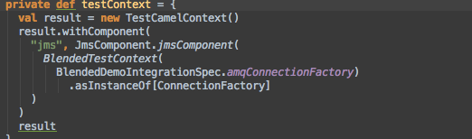
The example test context
Provide a Camel based test context with all required components for testing

Slide 7
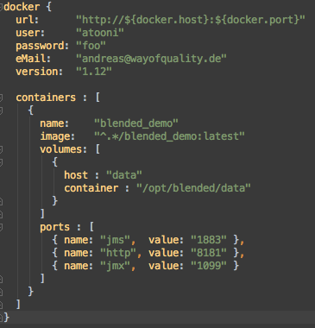
The container under test
Docker Connector
Container Reference
Exported Volumes
Exported ports

Slide 8
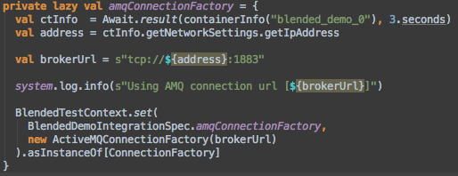
Providing the JMS connection
We know the JMS port is 1883 and Active MQ is the JMS provider
Keep information relevant across Specs in an instance of BlendedTestContext

Slide 9
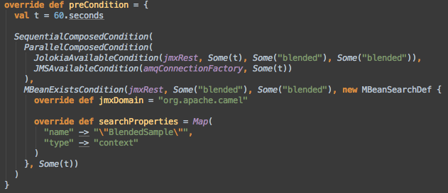
Waiting for the container

Slide 10
Test architecture
Bundle
Bundle
Bundle
Container Runtime
Distributable Archive
Docker Image
Container Manager
Test Framework (Conditions, TestContext, Syntactic Sugar)
Spec
Spec
Spec
Spec
Spec
Spec
Notes:
Sequenz kreieren

Slide 11

Creating docker images

Slide 12

Docker in a nutshell

Slide 13
Layering Docker images

Slide 14
Basic Container Test image
# The basic image to run Blended containers
FROM centos:6.4
MAINTAINER Andreas Gies version: 1.0.7-M6-SNAPSHOT
# Installation section
RUN groupadd blended
RUN useradd -d /home/blended -s /bin/bash -g blended -m blended
ADD files/jdk-7u60-linux-x64.tar.gz /opt
RUN ln -s /opt/jdk1.7.0_60 /opt/java
# End of Installation section

Slide 15
Deriving the image under test

Slide 16
Pom File definitions

Slide 17
Container configuration

Slide 18
Creating the container at a glance
Docker Base Image
Distributable Container
Configuration Files
Standardzed POM File
Docker Image

Slide 19
Docker tricks
Configuring docker for integration tests
Creating the TCP-IP Connector
Cleaning up docker

Slide 20

The Test Framework

Slide 21
General tasks to write tests
Define the containers under test
An Akka based Container Manager
Waiting for Containers to be started
Connecting to the Containers
Test fixtures
Boilerplate test context

Slide 22
Define the containers under test
An Akka based Container Manager
Waiting for Containers to be started
Connecting to the Containers
Test fixtures

Slide 23
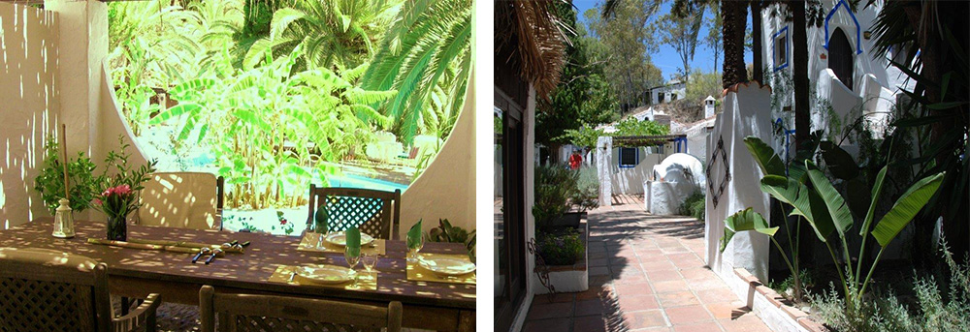
Writing tests

Slide 24
Concentrate on Blackbox Tests
Identify the Communication endpoints
Specify Green and Red Path Tests
Try to capture load scenarios
Test fixtures

Slide 25

Final Examples

Slide 26
A bigger usecase

Slide 27
Defining what to test

Slide 28

Conclusion

Slide 29
More to come…
Working
Wishlist / Issues
Container Management
Test Framework with easy hooks to CuT
Implicit Test Context for Blackbox testing
Syntactic sugar and support for Camel based black-box testing
More syntactic sugar for Conditions
Networking issue on OS X
Kill Containers throughout test for failover testing
Leverage a hosting env. like Openshift to execute Containers under test
Publish Test Framework as self-sufficient project

Slide 30
Resources
GitHub Project Blended
Travis Build – Waffle Board – Codacy Code metrics - Project Page
Way of Quality Homepage
Scala – Akka – Docker – ScalaTest
Apache Camel - for writing test routes
Apache Karaf - The containers under test in the samples
Apache ActiveMQ - The JMS layer used in the samples
Hawtio – The management console of the test containers
Jolokia – A JMX to REST bridge

