Slide 1


Integration Testing with Docker, Scala, Akka & ScalaTest
Andreas Gies
Lead Architect
Notes:
Yoga Bilder, Yoga & IT Kurse, Customized Seminare

Slide 2


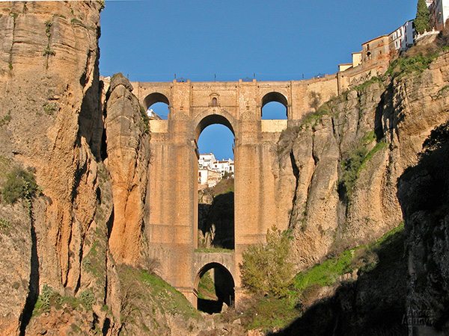
Technical Consulting
Conference speaking slots
Technical Trainings
Management Seminars
Team Breakouts
Coding by the sea
Yoga & learning
Team Building
Enjoy Andalucia
Notes:
Wander bild einfuegen

Slide 3
Overview
Example Test
Creating Docker Images
The test framework
Writing Tests
Final Examples
Conclusion

Slide 4

Example Test

Slide 5
A sample container under test
Bild fuer Beispiel Container einfuegen (Camel Route)
Notes:
Link Picture to actual source code on github

Slide 6
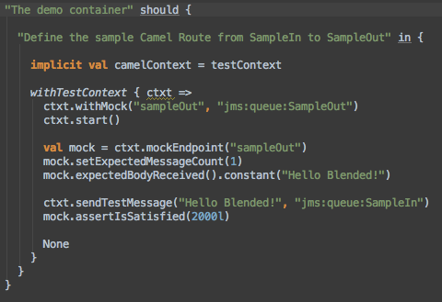
An example test
Notes:
Link Picture to actual source code on github

Slide 7
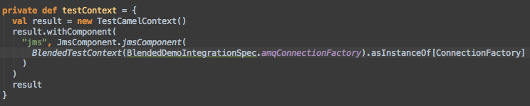
The example test context
Bild korrigieren (Zeilenumbruch)

Slide 8
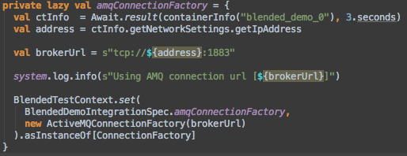
Providing the JMS connection

Slide 9
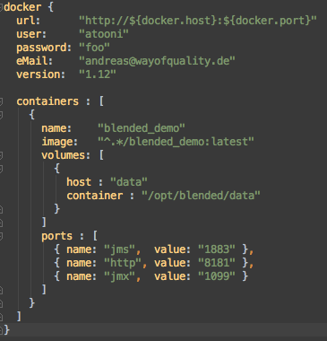
The container under test
Docker Connector
Container Reference
Exported Volumes
Exported ports

Slide 10
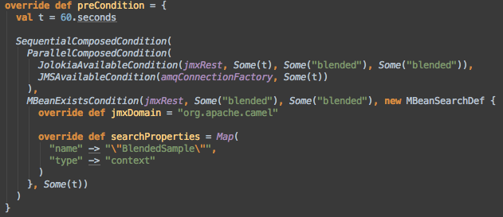
Waiting for the container

Slide 11
Test architecture
Bundle
Bundle
Bundle
Container Runtime
Distributable Archive
Docker Image
Container Manager
Test Framework (Conditions, TestContext, Syntactic Sugar)
Spec
Spec
Spec
Spec
Spec
Spec
Notes:
Sequenz kreieren

Slide 12

Creating docker images

Slide 13
Docker in a nutshell

Slide 14
Layering Docker images

Slide 15
A base image for Containers under test

Slide 16
Pom File definitions

Slide 17
Container configuration

Slide 18
Creating the container at a glance
Docker Base Image
Distributable Container
Configuration Files
Standardzed POM File
Docker Image

Slide 19
Docker tricks
Configuring docker for integration tests
Creating the HTTP Connector
Cleaning up docker

Slide 20

The Test Framework

Slide 21
Define the containers under test
An Akka based Container Manager
Waiting for Containers to be started
Connecting to the Containers
Test fixtures

Slide 22

Writing tests

Slide 23
Concentrate on Blackbox Tests
Identify the Communication endpoints
Specify Green and Red Path Tests
Try to capture load scenarios
Test fixtures

Slide 24

Final Examples

Slide 25
A bigger usecase

Slide 26
Defining what to test

Slide 27

Conclusion

Slide 28
More to come…
Working
Wishlist / Issues
Container Management
Test Framework with easy hooks to CuT
Implicit Test Context for Blackbox testing
Syntactic sugar and support for Camel based black-box testing
More syntactic sugar for Conditions
Networking issue on OS X
Kill Containers throughout test for failover testing
Leverage a hosting env. like Openshift to execute Containers under test
Publish Test Framework as self-sufficient project

