Slide 1
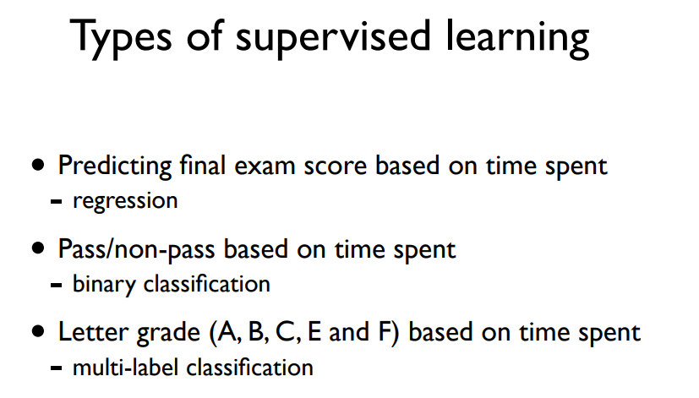
Machine Learning
Supervised Learning : learning with labeled examples
Unsupervised Learning : un-labeled data

Slide 2
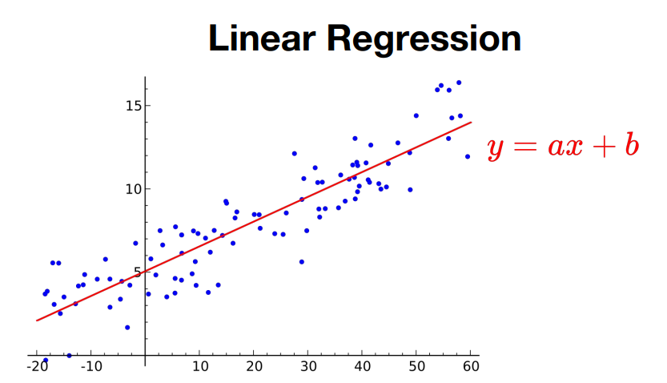
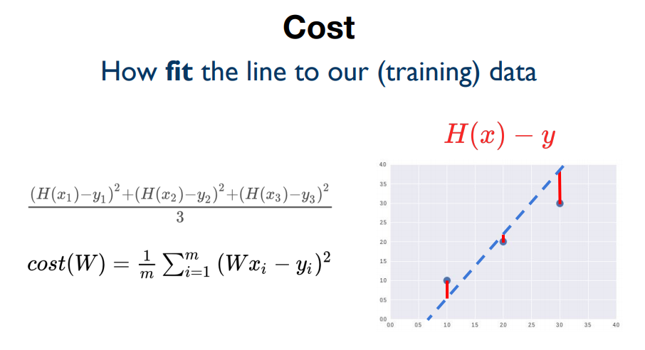
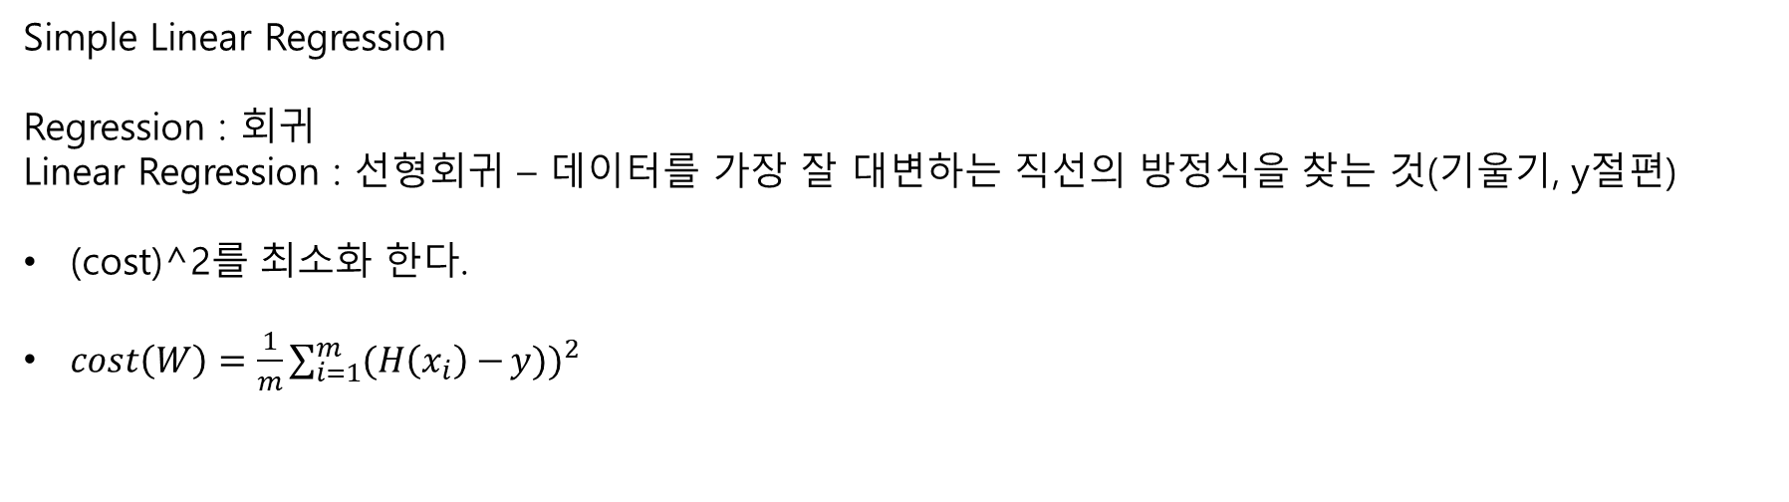
Simple Linear Regression
Regression : 회귀
Linear Regression : 선형회귀 – 데이터를 가장 잘 대변하는 직선의 방정식을 찾는 것(기울기, y절편)
(cost)^2를 최소화 한다.
$cost\left(W\right)={\frac{1}{m}\sum_{i=1}^{m}{(H\left(x_{i}\right)−}y))}^{2}$

Slide 3
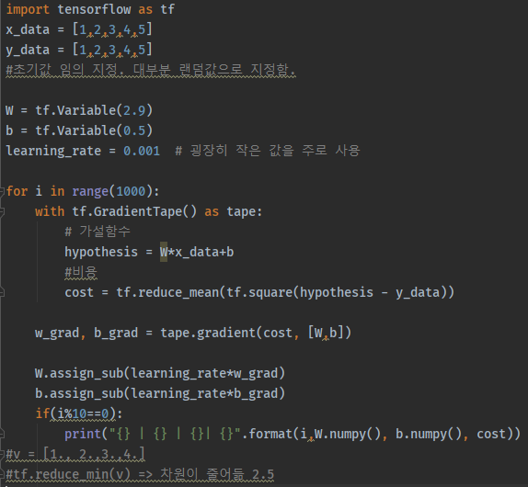
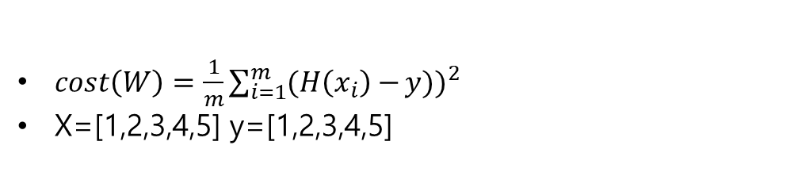
Simple Linear Regression
코드구현
$cost\left(W\right)={\frac{1}{m}\sum_{i=1}^{m}{(H\left(x_{i}\right)−}y))}^{2}$
X=[1,2,3,4,5] y=[1,2,3,4,5]

Slide 4
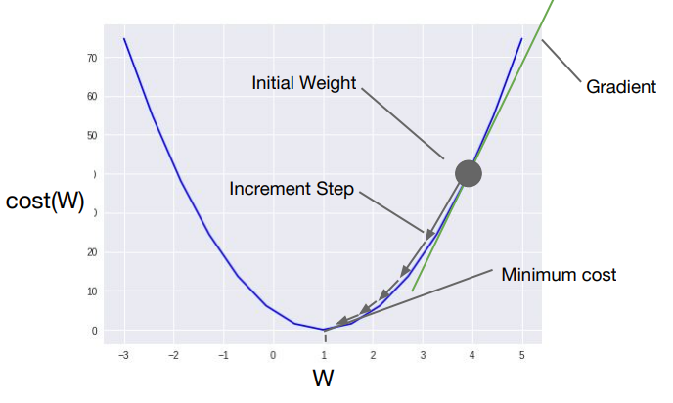

Gradient descent algorithm : weight를 지속적으로 수정

Slide 5
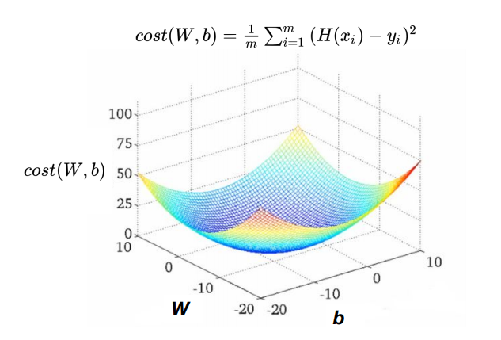
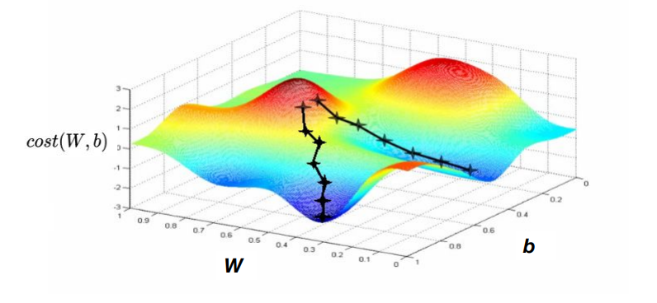
Convex Function : Ideal Model for Gradient Descent
Local Minimum에 의해 Gradient Descent알고리즘이 최저점을 찾지 못할 수 있음.

Slide 6
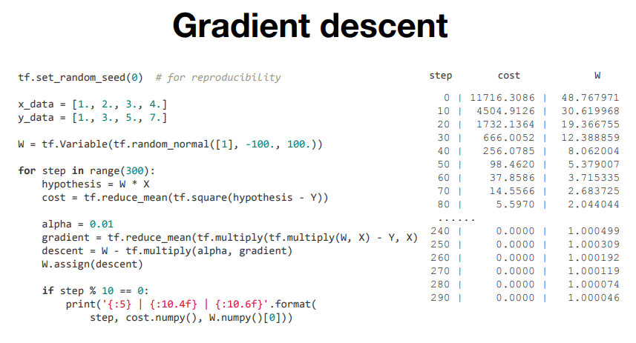

Slide 7
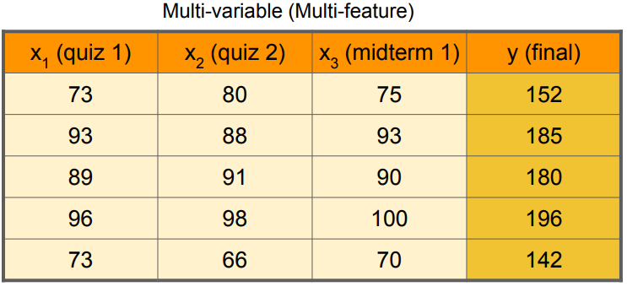
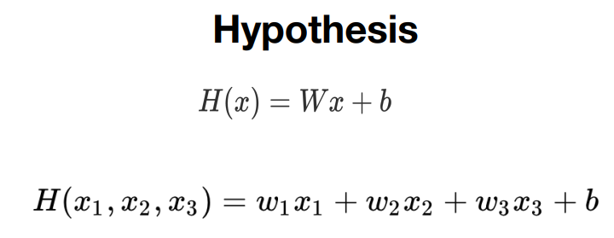
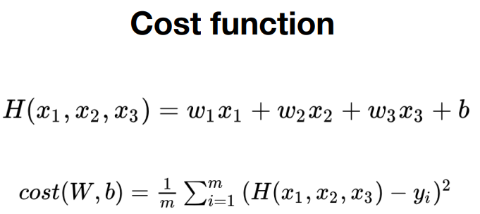
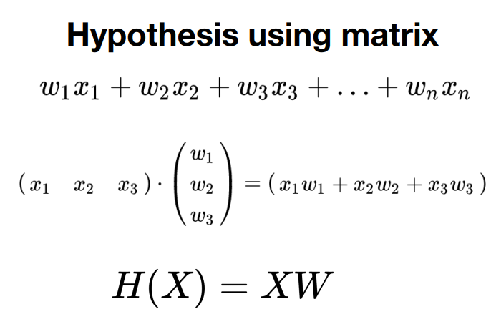
Multiple – Variable Prediction
Dot-Product

Slide 8
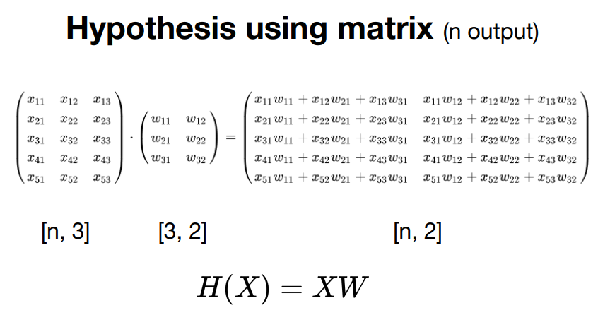

Slide 9
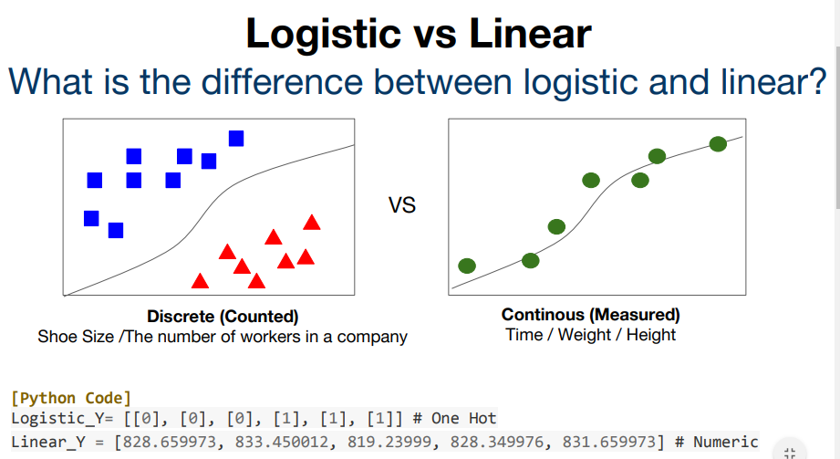
Logistic Regression
Classification
[0,1] => Binary Classification // x_train = [[1,2],[2,3],[3,1]] y_train=[[0],[1],[0]]

Slide 10
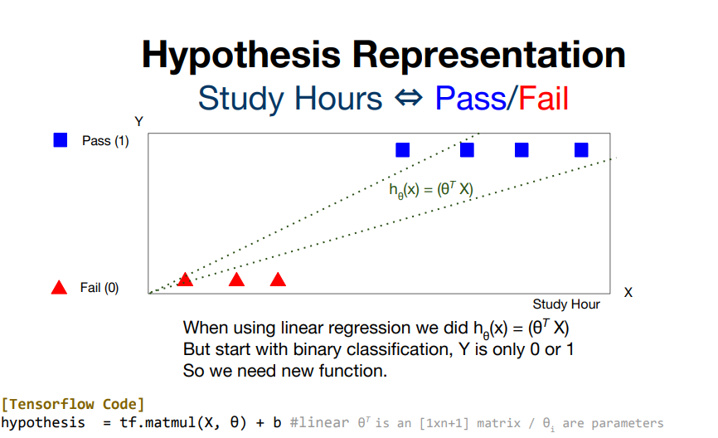
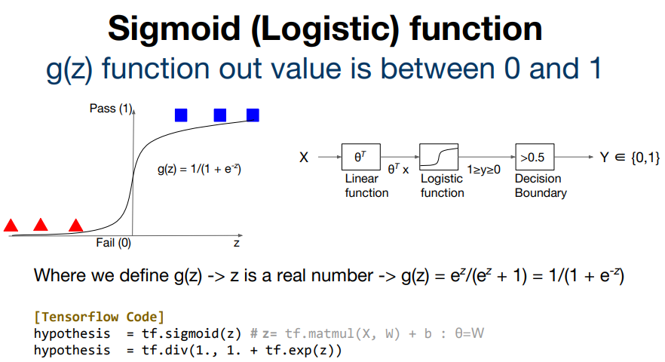

Slide 11
