Slide 1

JSON vs Protobuf
Data Serialization

Slide 2
DB
Notes:
Programs rarely do their taks alone.
They either have a data store.
Or send representations of data to be consumed by other programs in format that is well-understood.

Slide 3
Format
Type consistency
Compatibility
Performance
Notes:
This serialization process come with a lot of questions like,
How to make sure the deserialized data structures uses the same types as the original one (Type Consistency)
How NOT to break programs when you need to change the format (Compatibility)
How to make the process fast (Performance)

Slide 4
JSON
VS
Protobuf
Notes:
In this session, I am going to show you how JSON and Protobuf handle those issuees, and what serialization format is fit for you.

Slide 5
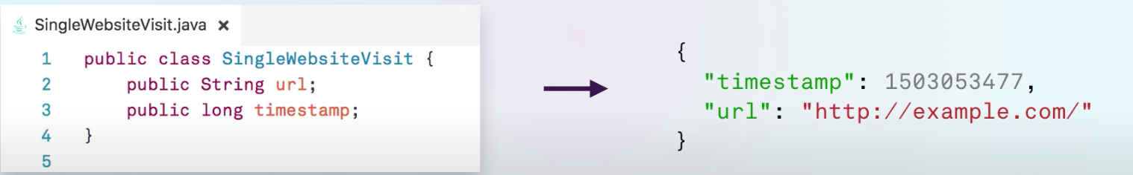
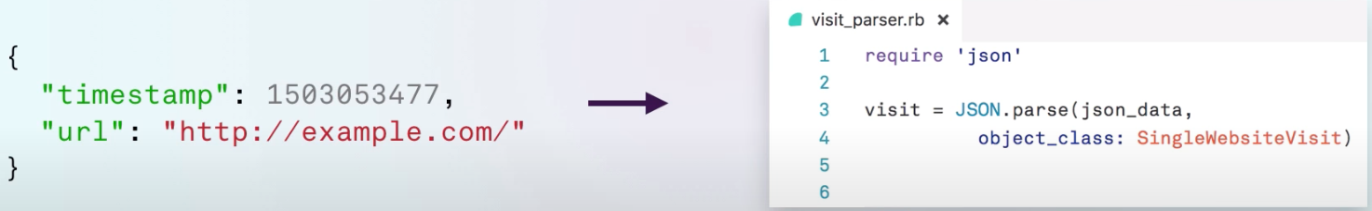
time
URL
Notes:
To start, let’s take a simple example. A user visits our website and we would like to STORE “when” and “which” URL user uses to visit our website. Like a very simple analytic platform
We can build a simple Java class and pass instances of that class thought our program
SENDING
Java : When we want to send it outside, we can serialize it as a JSON and send it using your own serialization code or 3rd party library
READING
Ruby:

Slide 6


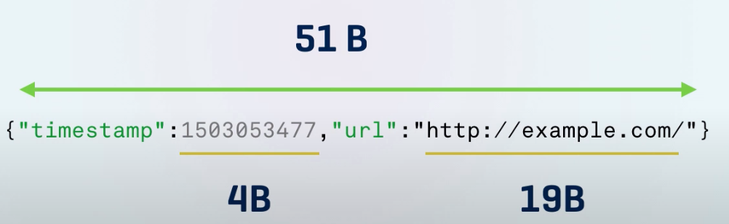
JSON(Text)
Readable
Expensive
Self-contained
Unclear Types
extensible
Massive
Notes:
Good
Readable: JSON is just text and we can at any point open any object with a text viewer to examine it
Self-contained : Everything that consumer need, is embedded within the object, so you can start sending JSON and accepting it without any synchonization.
This brings me to the fact that JSON is
Extensible: we can easily extend the data that we’re storing in the JSON object.
Bad
Expensive: At high volumes, the cost of serialzation and deserializing object is non negligible, it becomes a significant overhead!
Unclear Types: That’s really a feature but for some applications, this is not desirable
Massive:

Slide 7
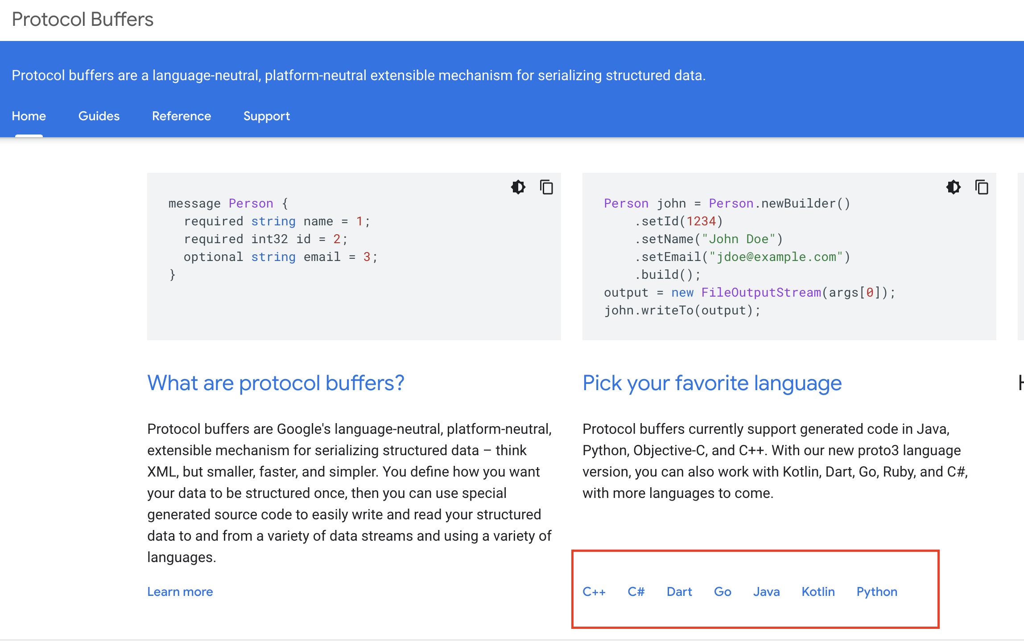
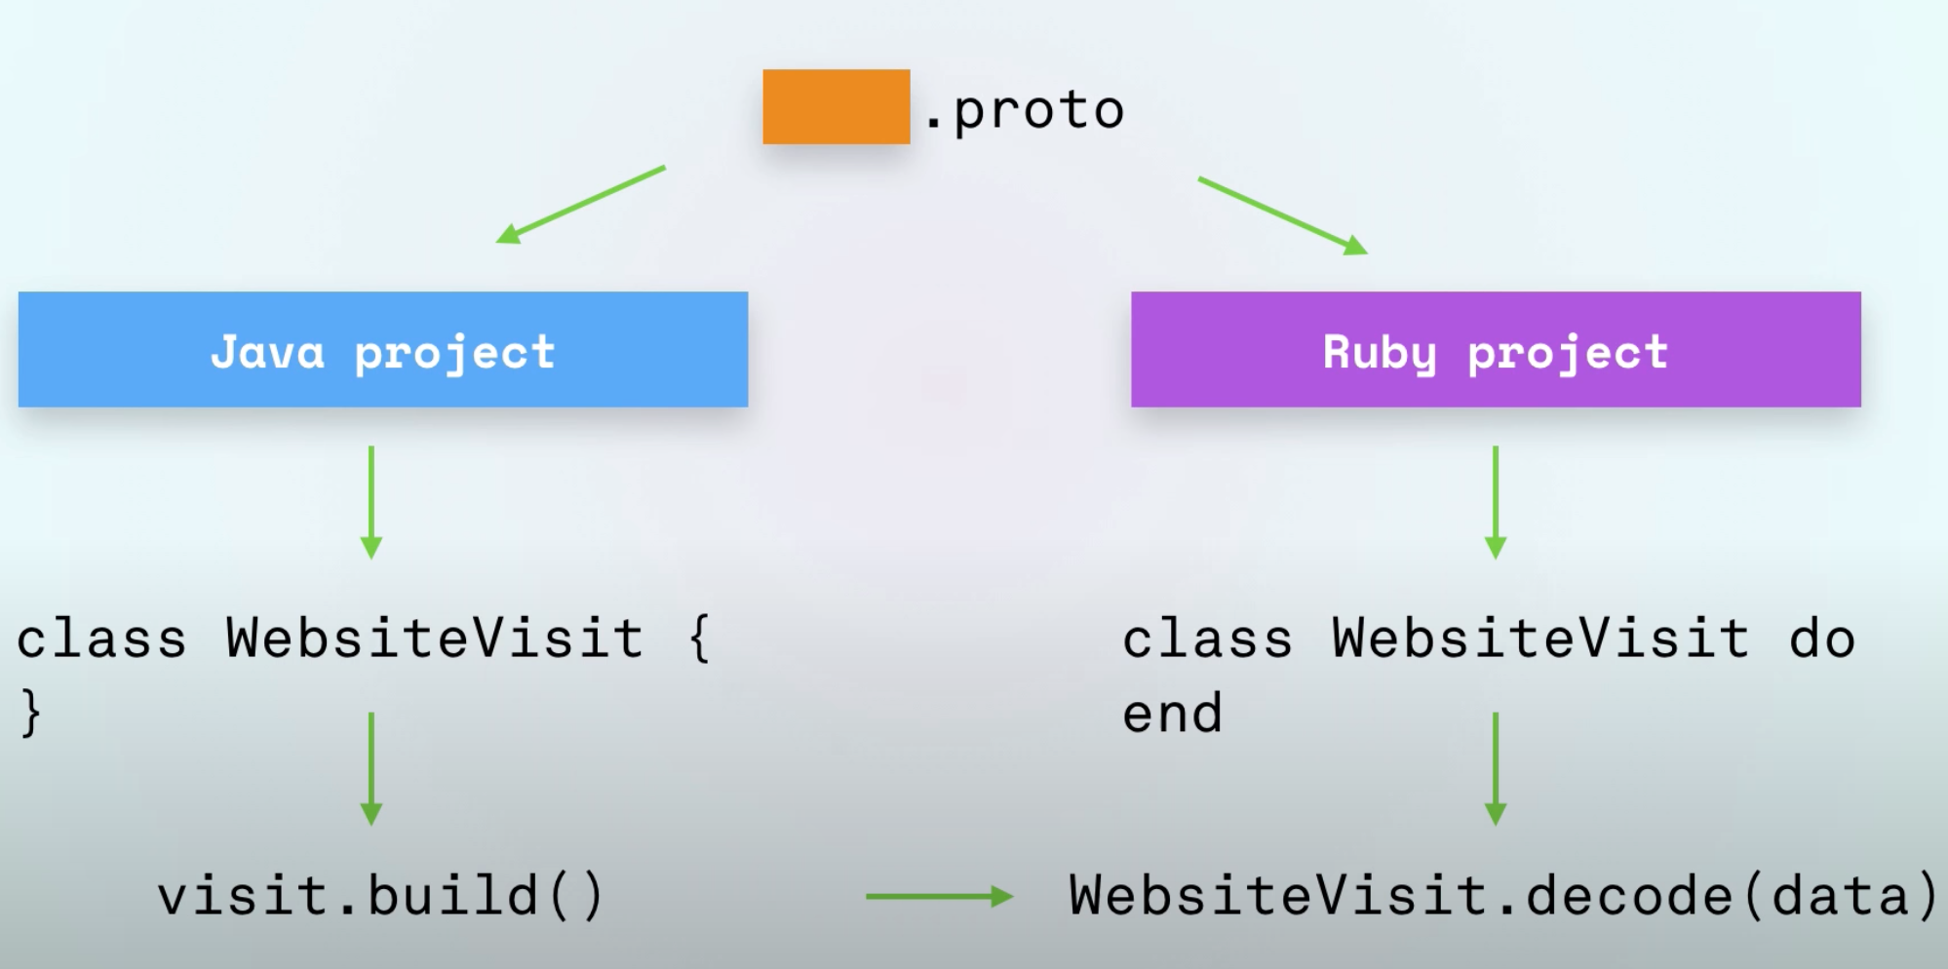
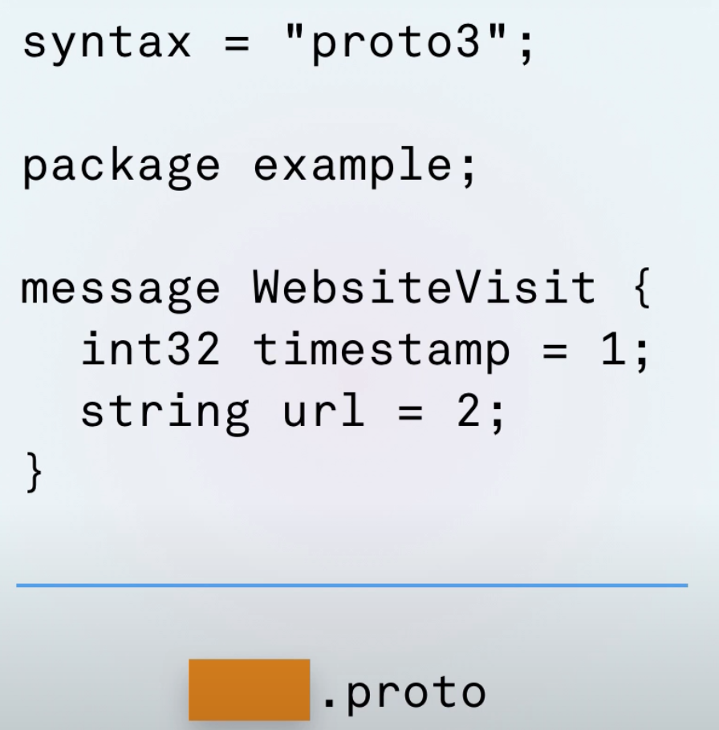
Protobuf (Binary)
Notes:
Protobuf tried to address these poins by taking another approach. Instead of passing the schema with every messages, we can save space and compute power by declaring this schema beforehand.
Protobuf is binary,

Slide 8



JSON
Protobuf
Small volume
High volumes
Need to inspect
Similar messages
Messages are varied
Performance matters
gRPC
Browser
Notes:
JSON : Browser
Protobuf: Exchaning data between service. Additionally Protobuf allows us to make call to another service easily by using gRPC. And that is the topic for another lighting talk.
NOTE:
Target audience
Practice on time management on each topic

Slide 9
Thank you
Notes:
In this session, I am going to show you how JSON and Protobuf handle those issuees, and what serialization format is fit for you.

