Slide 1
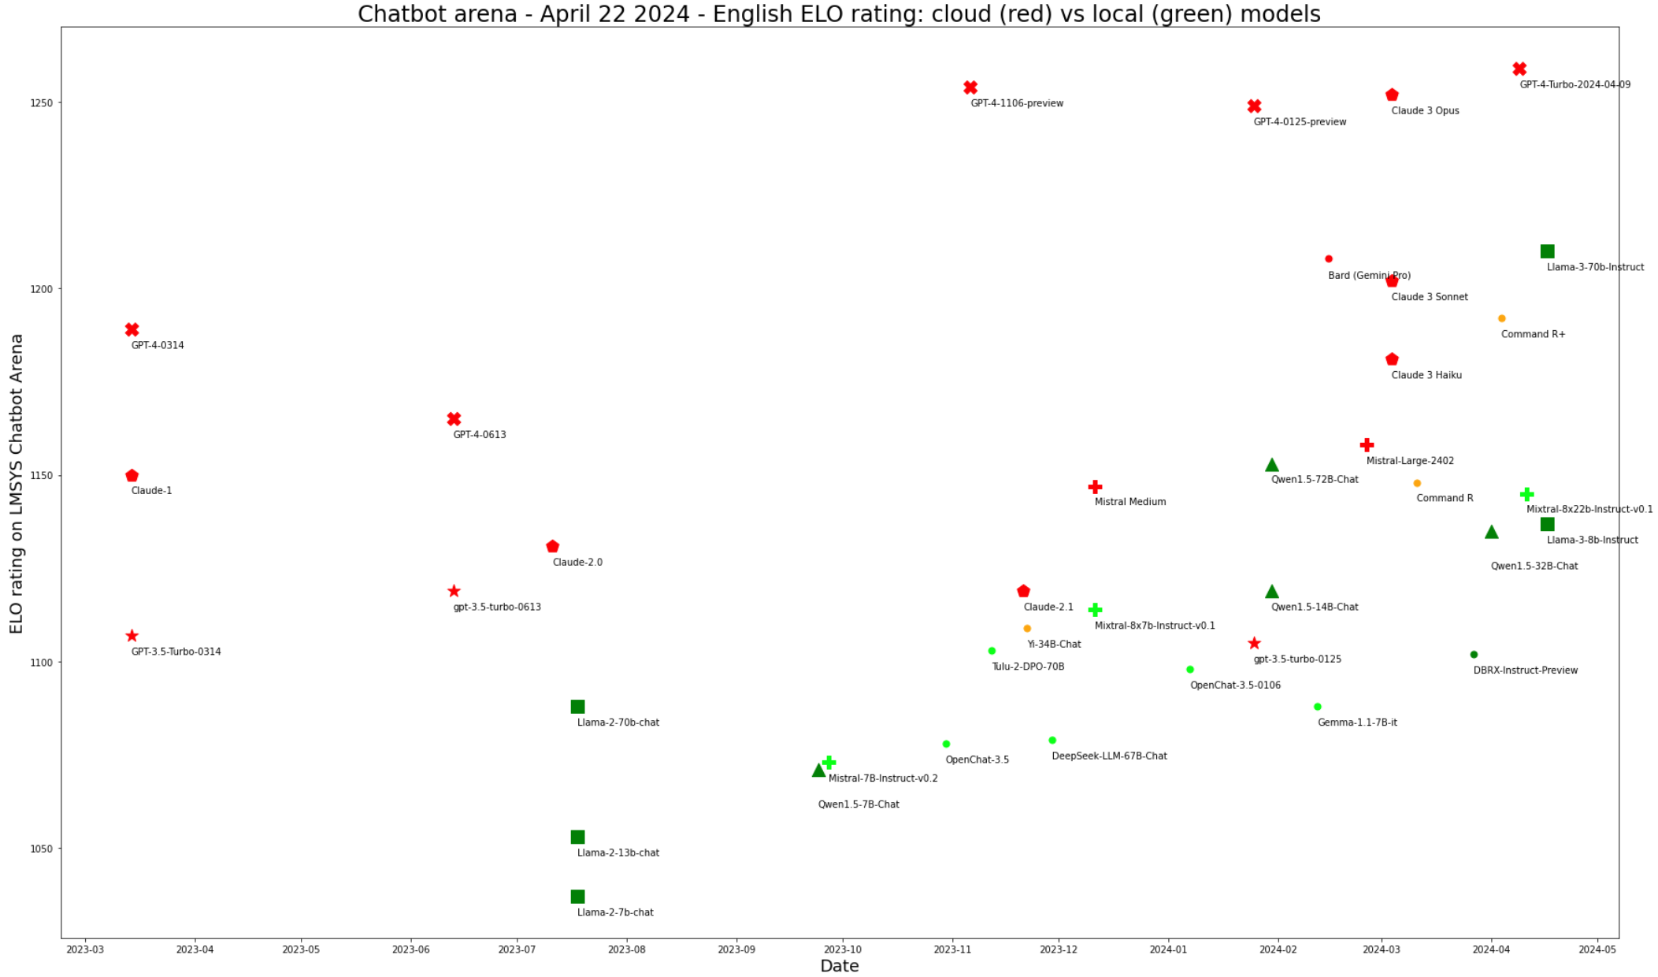

Slide 2
Best cloud models
Best local models

Slide 3
Best cloud models
Apr 17 2024
Llama-3 70b
Initial GPT-4 level
Apr 17 2024
Mixtral 8x22b
Dec 11 2023
Mixtral 8x7b
Initial ChatGPT level
Best local models

Slide 4
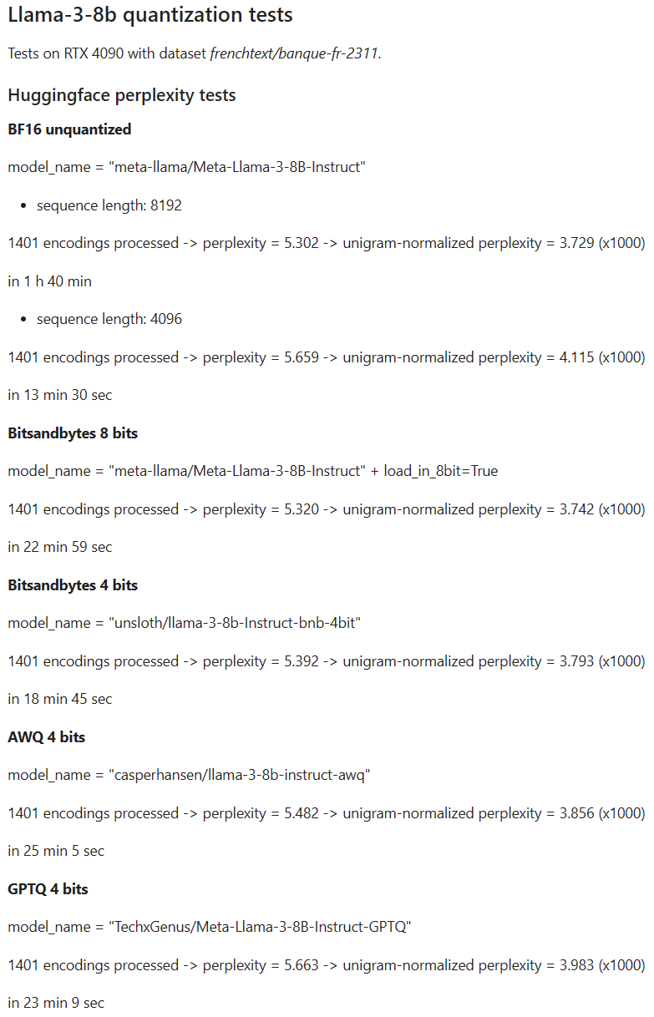
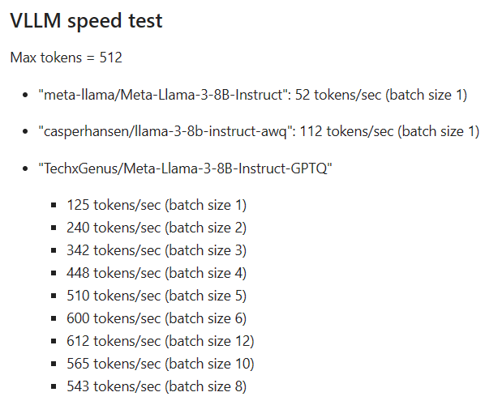
Llama-3-8b tests on real-world banking data (consumer GPU - RTX 4090)
Bank French dataset – PPLu x1000
llama3_70b (4 bits - 6k seq) | 2.677
llama3_8b | 3.114
mixtral_moe_8x7b | 3.967
alfred_40b | 4.098
qwen1.5_14b | 4.294
qwen1.5_moe_a2.7b | 4.585
stablelm_3b | 4.59
qwen1.5_7b | 4.642
falcon_7b | 4.66
llama2_13b | 4.898
mistral_7b | 4.955
llama2_7b | 4.955
Bank English dataset – PPLu x1000
llama3_70b (4 bits - 6k seq) | 3.199
llama3_8b | 3.658
mpt_30b | 5.243
stablelm_3b | 5.249
mixtral_moe_8x7b | 5.603
olmo_7b | 5.687
mpt_7b | 5.719
qwen1.5_14b | 5.896
llama2_13b | 5.948
mistral_7b | 5.991

