Slide 1








https://github.com/wordslab-org/wordslab-notebooks
The easiest way to learn and build with AI on your computer
wordslab-notebooks
virtual machine
OpenWebUI
Jupterlab
Visual Studio Code
1
Local models
Local python environments
ollama
vllm
Pytorch
CUDA
3
install-wordslab-notebooks.bat
http://127.0.0.1:8888
2
start-wordslab-notebooks.bat
Ubuntu 24.04
Windows Subsystem for Linux
Virtual Machine Platform
Windows 10 | Windows 11 .

Slide 2



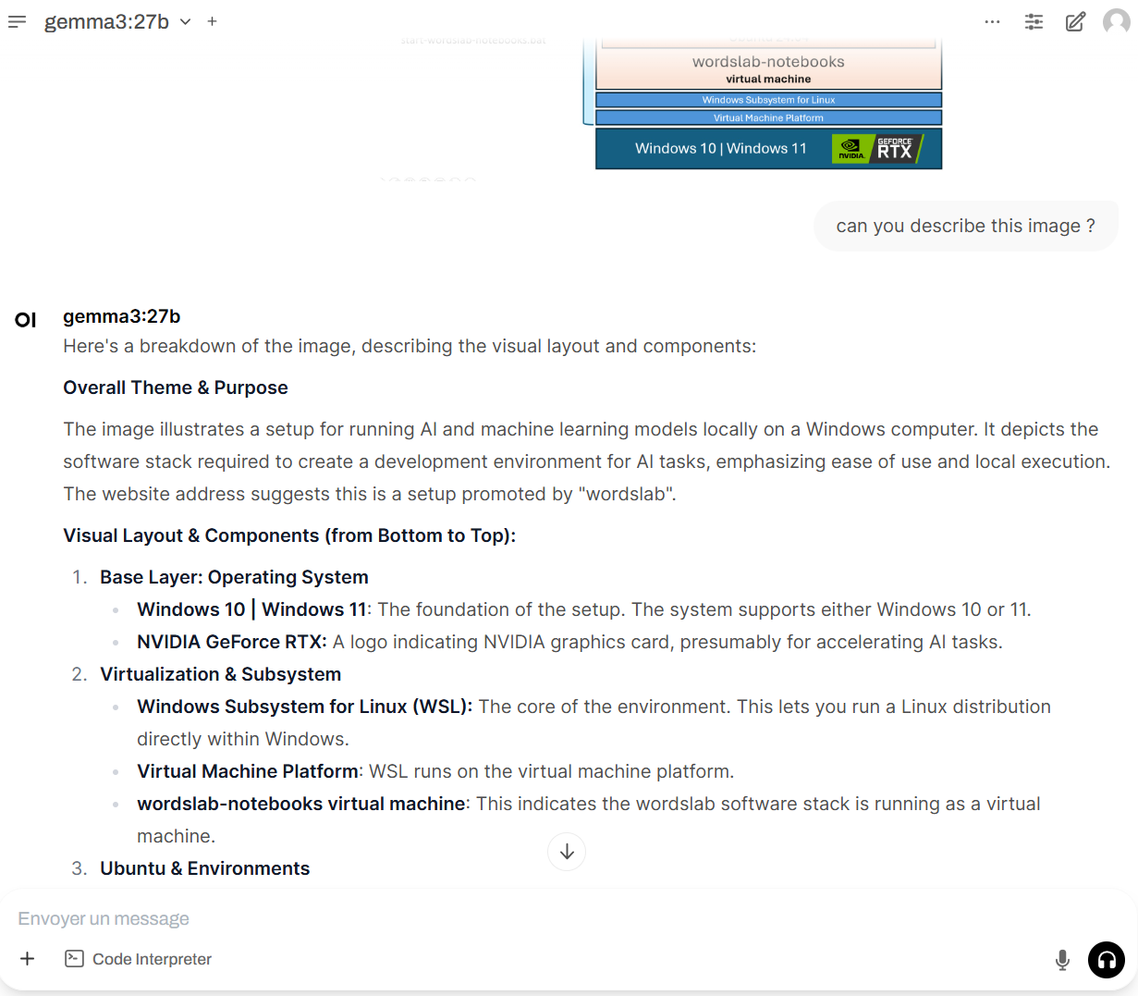
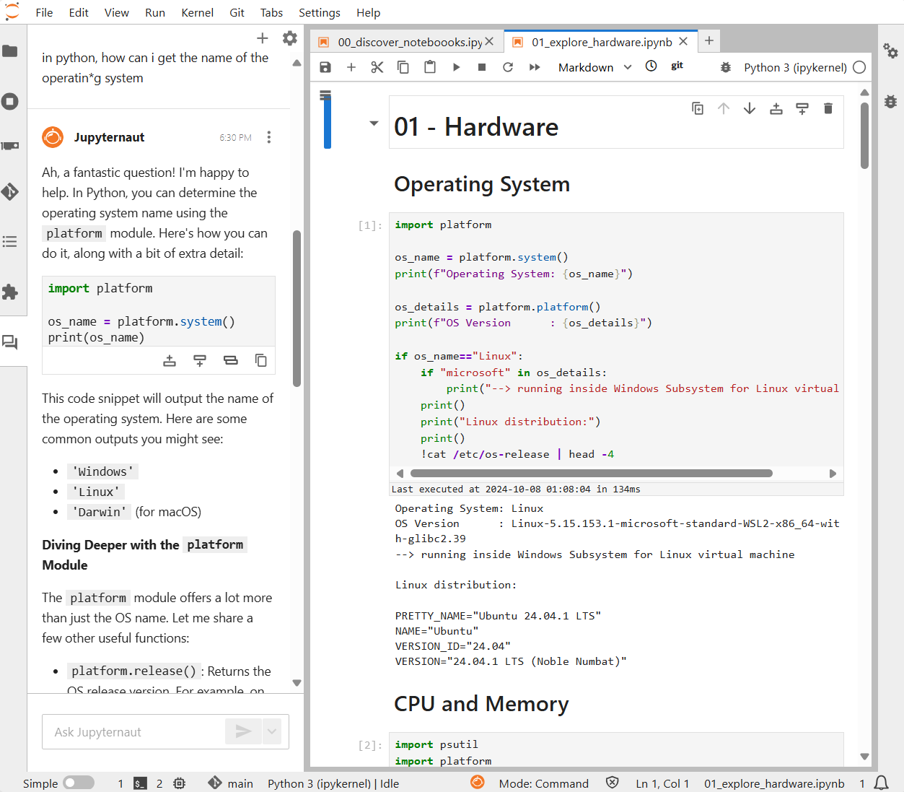
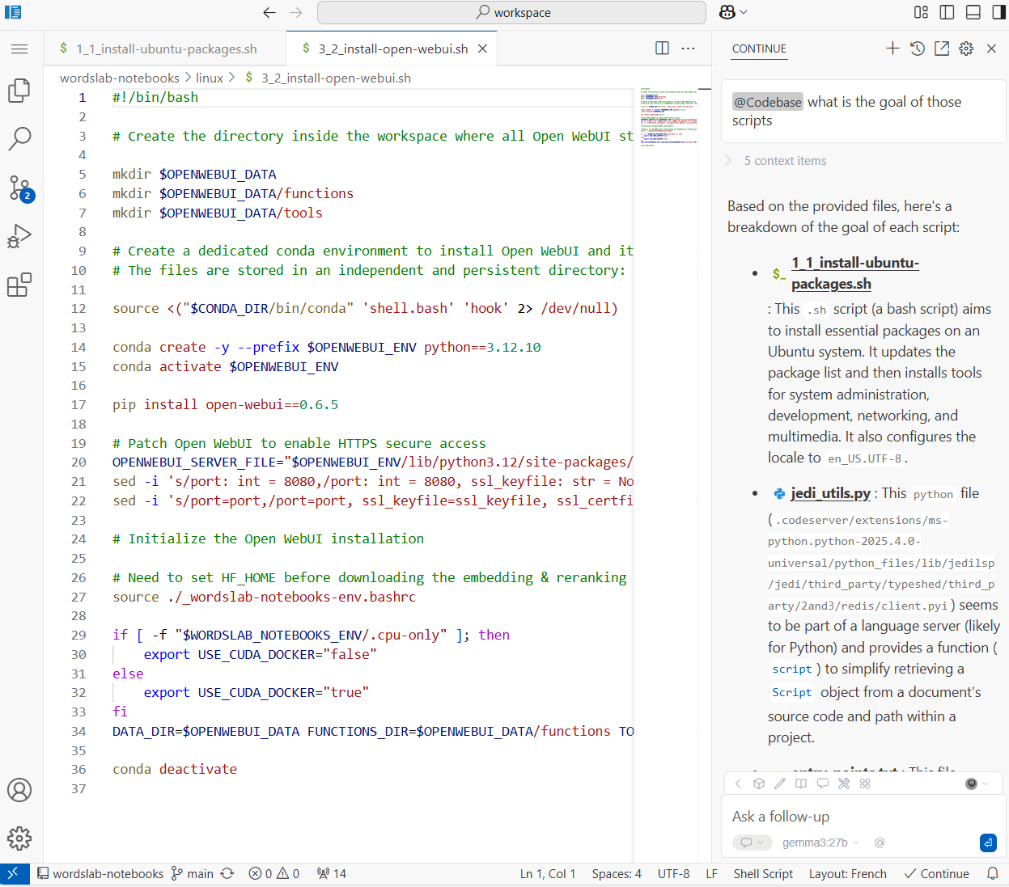
https://github.com/wordslab-org/wordslab-notebooks
The easiest way to learn and build with AI on your computer
OpenWebUI
Chat
with text, images and documents
Notebooks
with Jupyter AI assistant
Code
with Continue and Aider AI assistants
Jupterlab
Visual Studio Code
+
+
+
+

Slide 3

Web browser
http://127.0.0.1:8888
wordslab-notebooks
virtual machine
2
pip venv
pip venv
pip venv
wordslab-chat
wordslab-voice
wordslab-…
create-workspace-project https://github.com/wordslab-org/wordslab-chat.git
conda environment
Jupyter lab
Python 3.12
Pytorch
2.4
CUDA
12.4
1
Ubuntu 24.04
install-wordslab-notebooks.bat
Windows Subsystem for Linux
Virtual Machine Platform
Windows 10 | Windows 11 .

