Slide 1


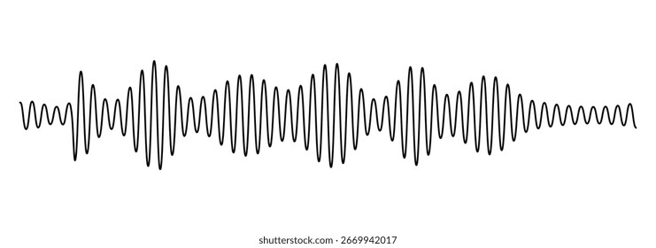




Signal transmission
Signal transmission

Slide 2


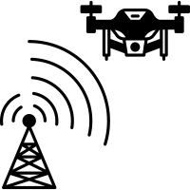




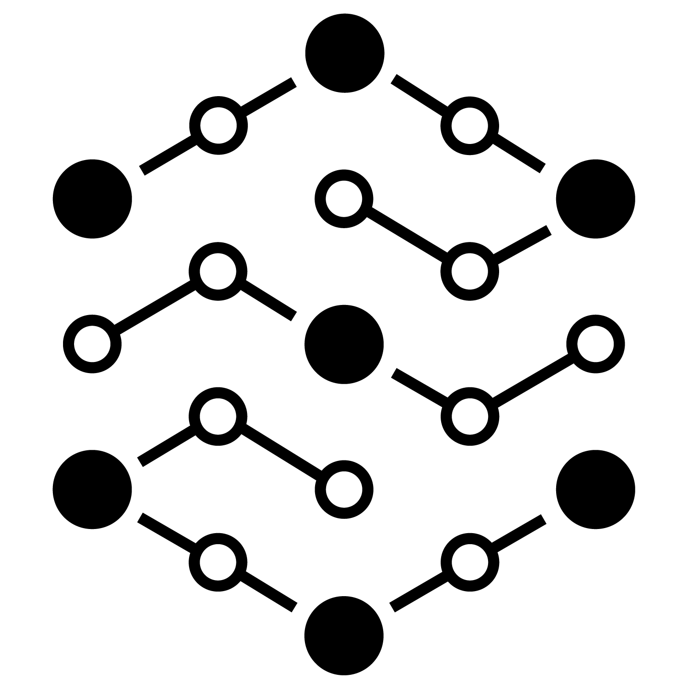


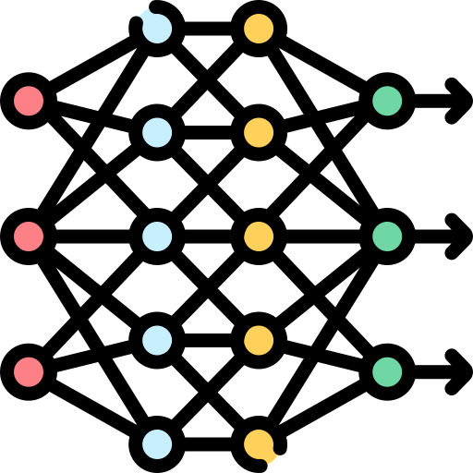











Wireless signal transmission
Environmental noise addition
Resilient foundation models
Data-efficient
finetuning

Slide 3
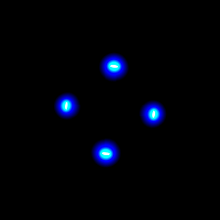
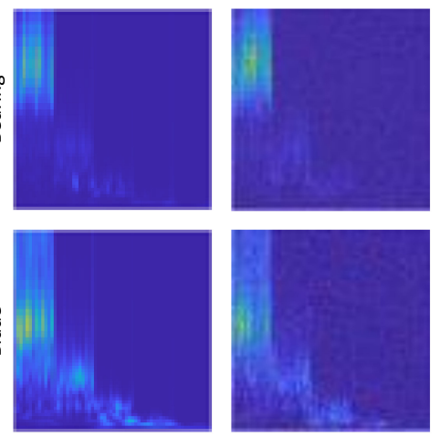
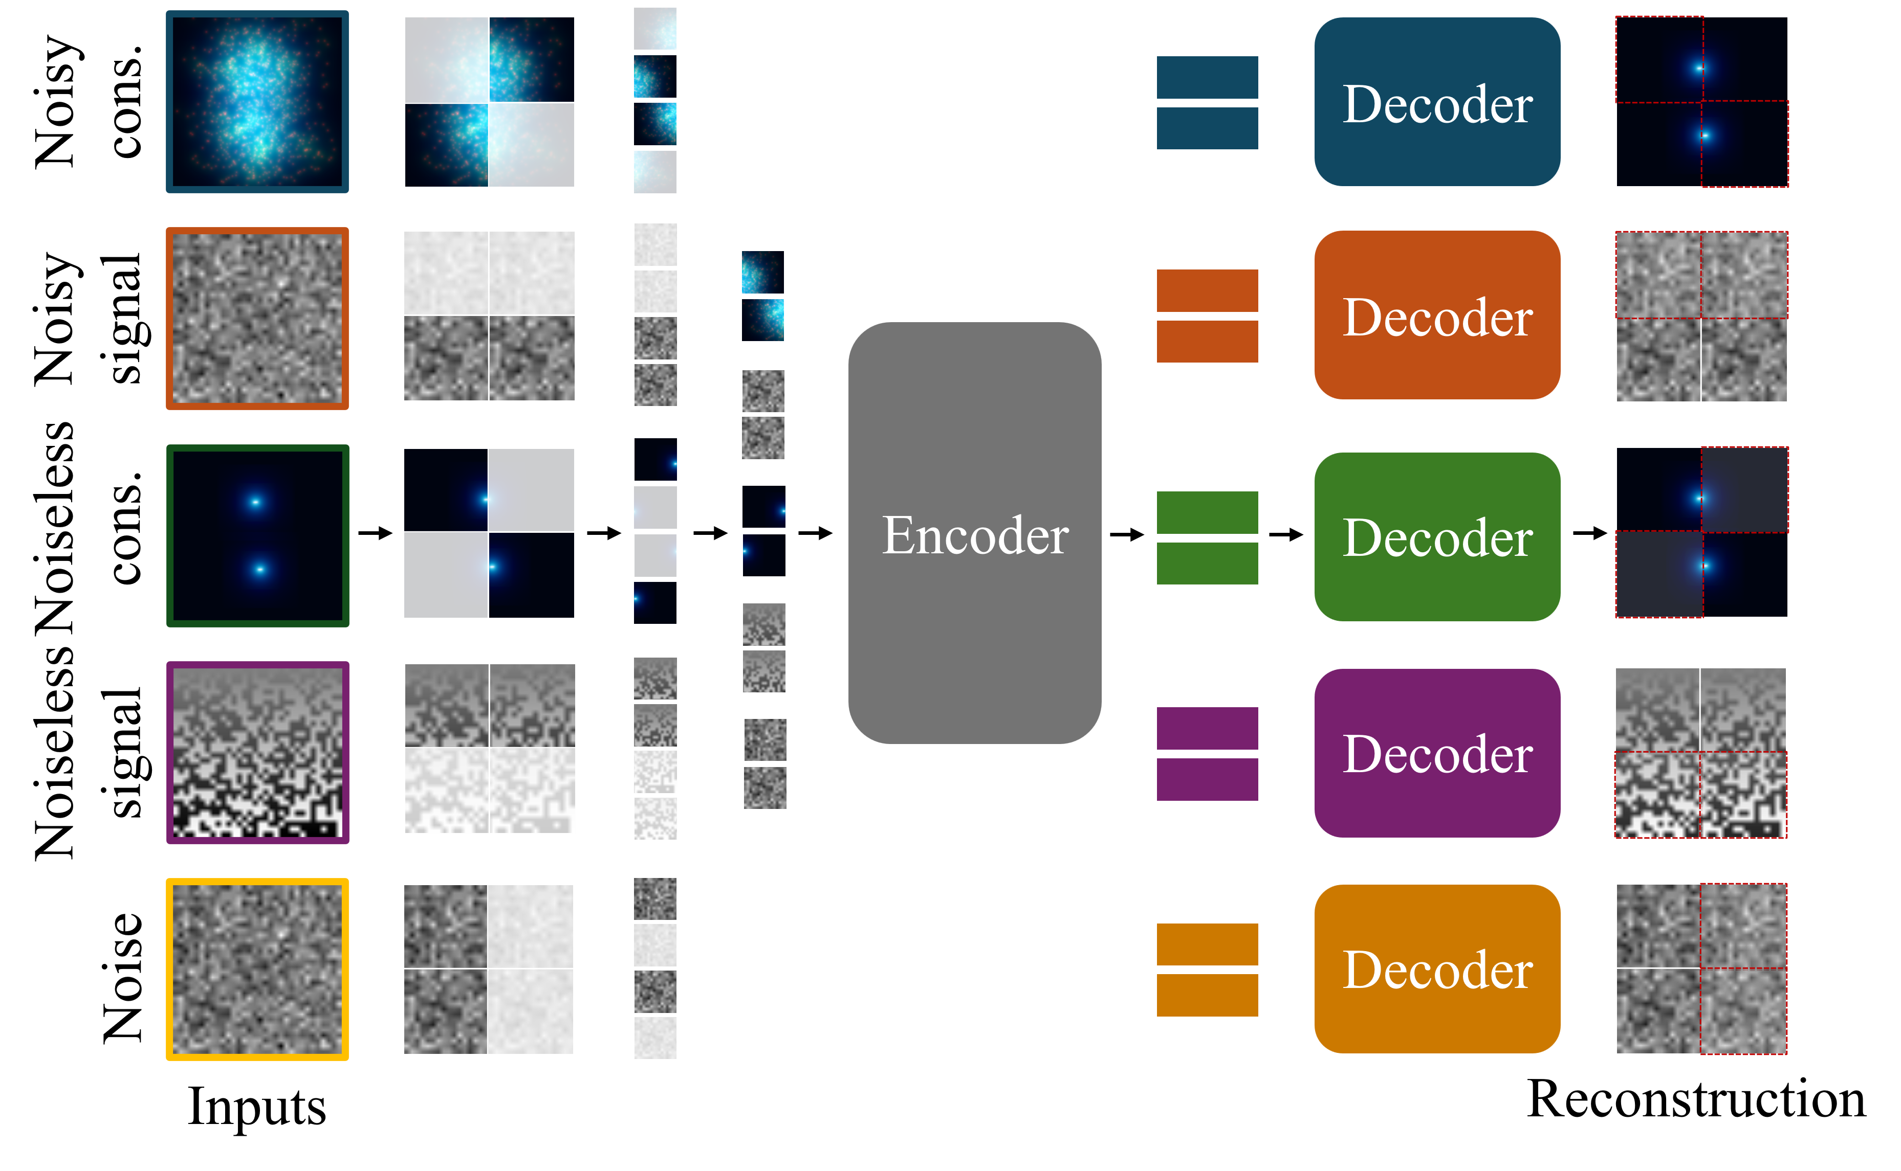
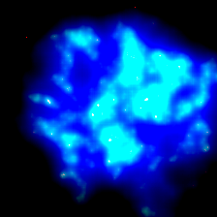

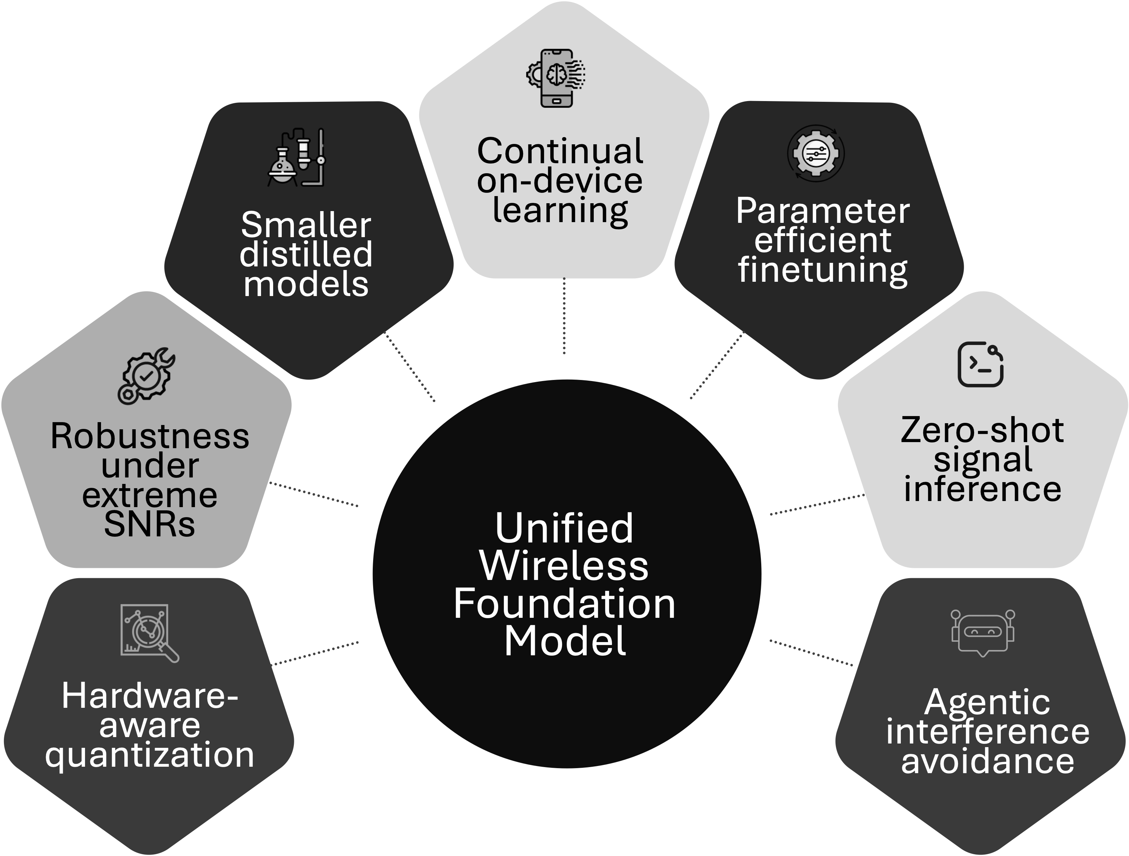








Wireless signal transmission
Environmental noise addition
Preprocessing unlabeled signals
Original signal
Noisy signal
Constellation
Scalogram
Reshaped signal
Resilient foundation models
Deployment & applications
Potential future research
Big foundation model on cloud
Pretraining
stage
Processed data
Small edge model for adaption
Denoised representation
Regression
Finetuning
stage
Denoising
Classification
Modulation classification
Channel prediction
Spectrum sensing
Resource allocation

Slide 4







Continual
on-device learning
Smaller distilled models
Parameter efficient finetuning
Robustness under extreme SNRs
Zero-shot signal inference
Unified Wireless Foundation Model
Hardware-aware quantization
Agentic interference avoidance

Slide 5
Continual
on-device learning
Smaller distilled models
Parameter efficient finetuning
Robustness under extreme SNRs
Determine the ideal time to post
Unified Wireless Foundation Model
Choose the right Platform
Promote sharing

Slide 6
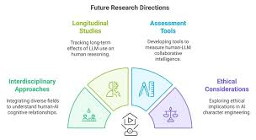
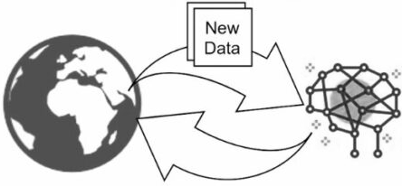

Slide 7
Continual
on-device learning
Smaller distilled models
Parameter efficient finetuning
Robustness under extreme SNRs
Determine the ideal time to post
Unified Wireless Foundation Model
Choose the right Platform
Promote sharing

Slide 8
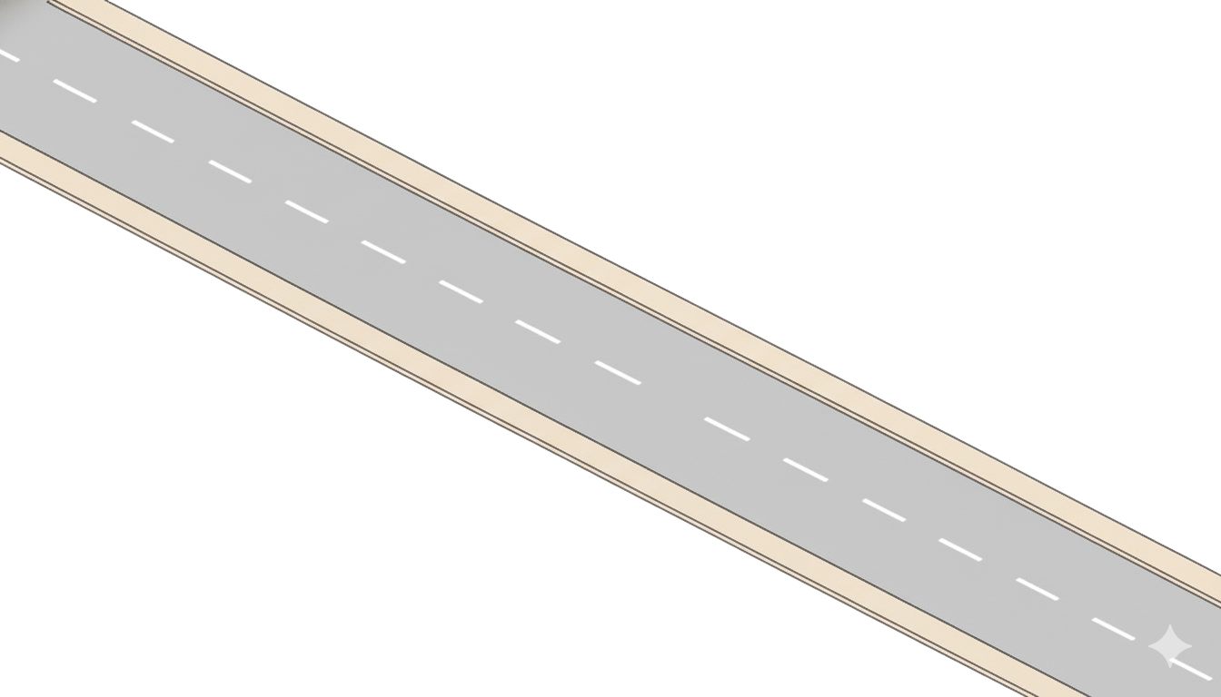
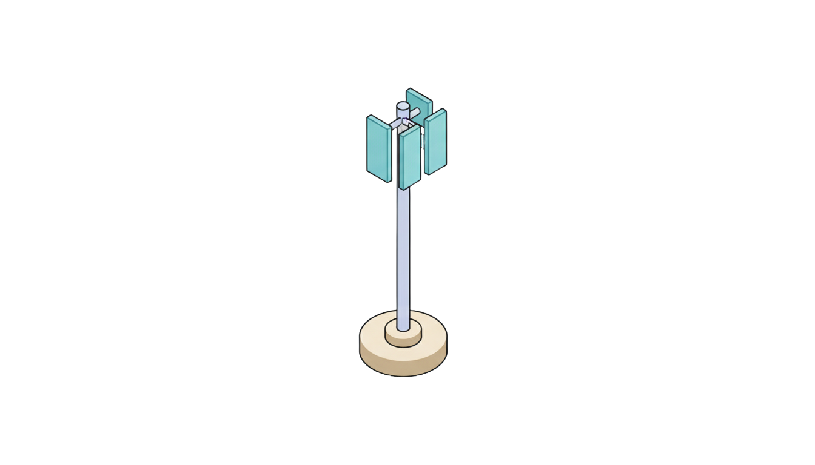

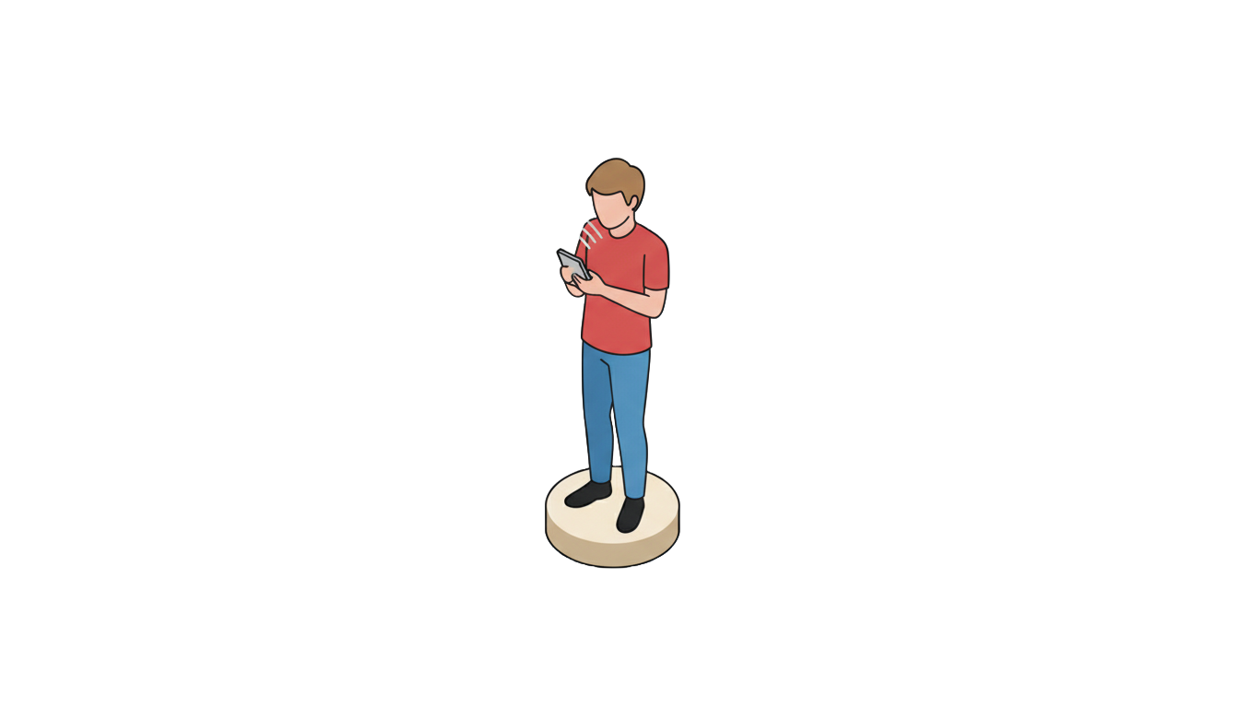
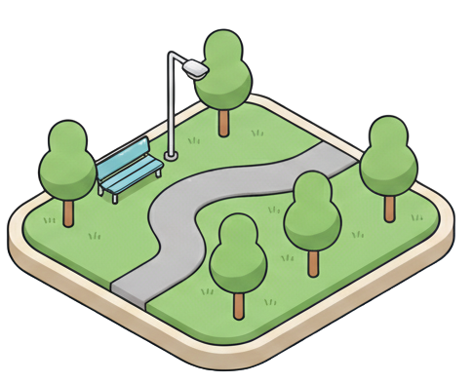
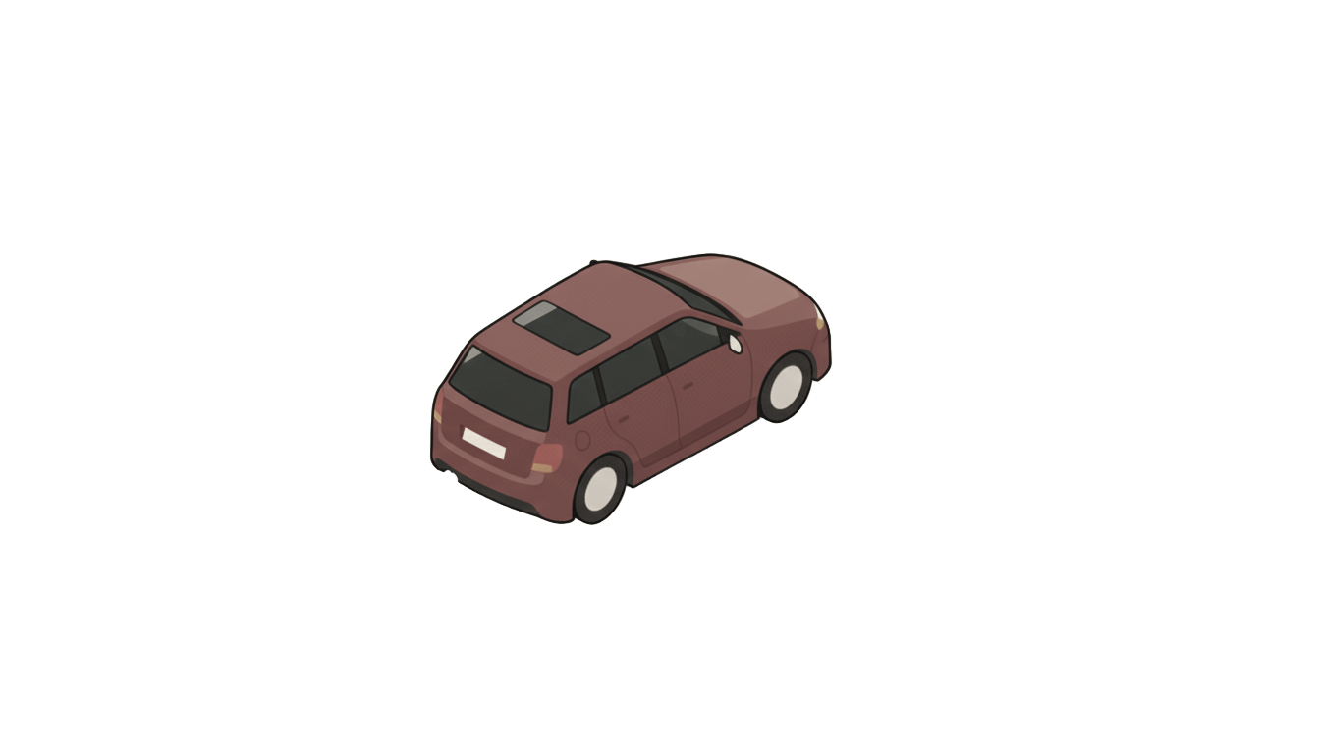

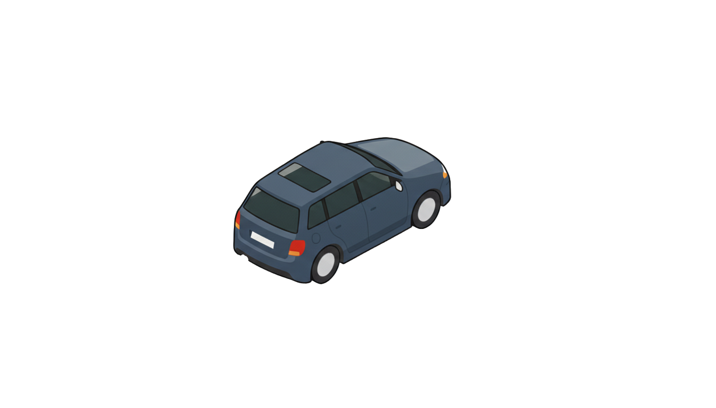


Slide 9

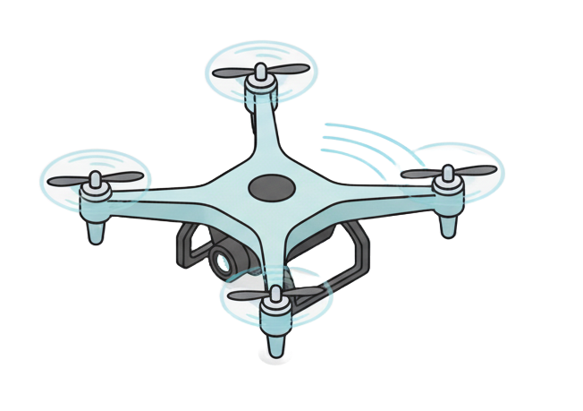
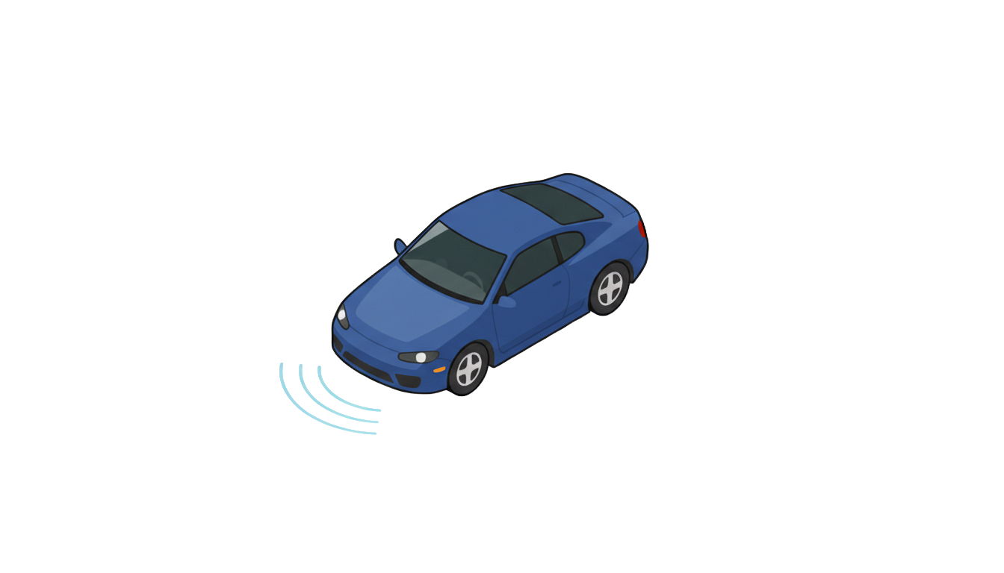


Slide 10
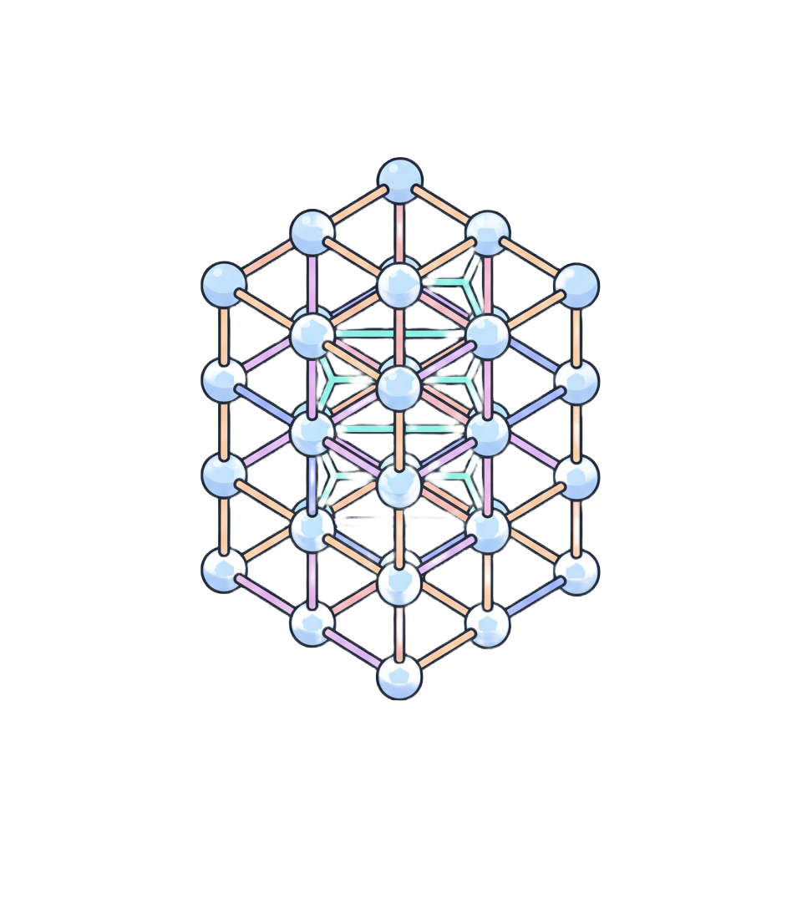
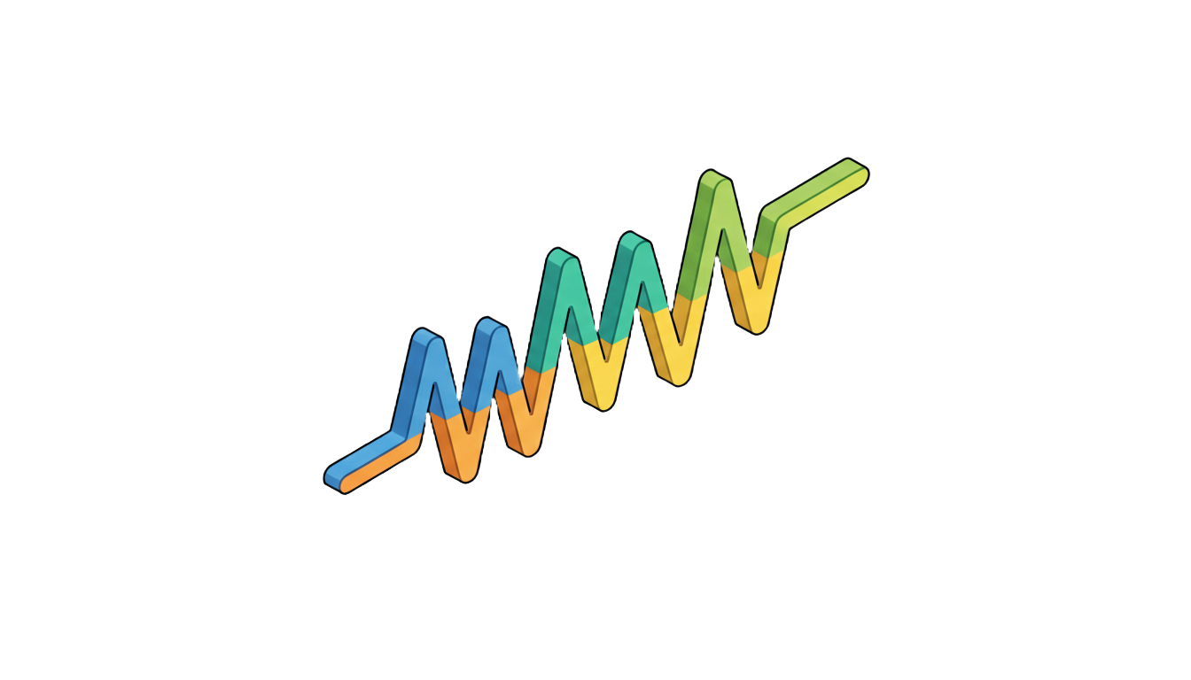
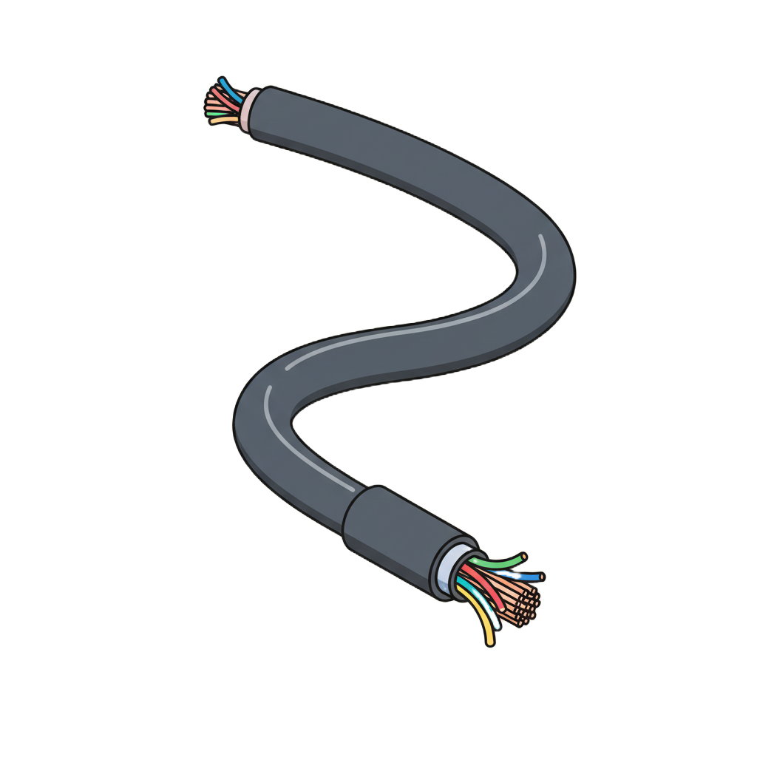

Resilient foundation models
Preprocessing unlabeled signals
Pretraining
stage
Denoised representation
Finetuning
stage
Regression
Original signal
Denoising
Classification
Noisy signal
Constellation
Scalogram
Reshaped signal
Environmental noise addition

Slide 11
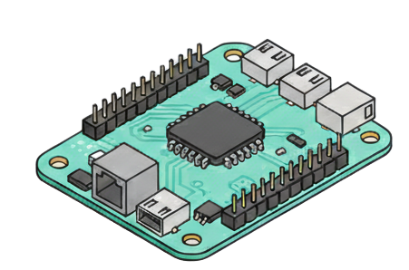
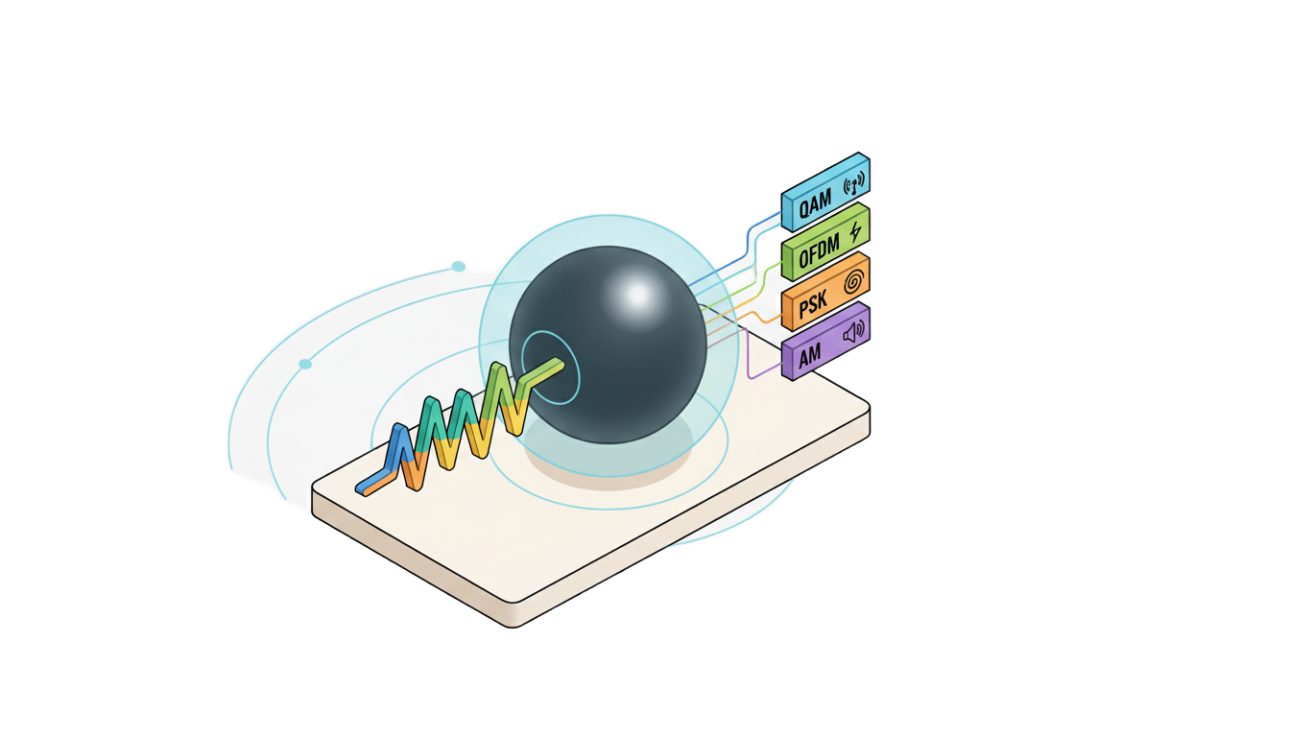
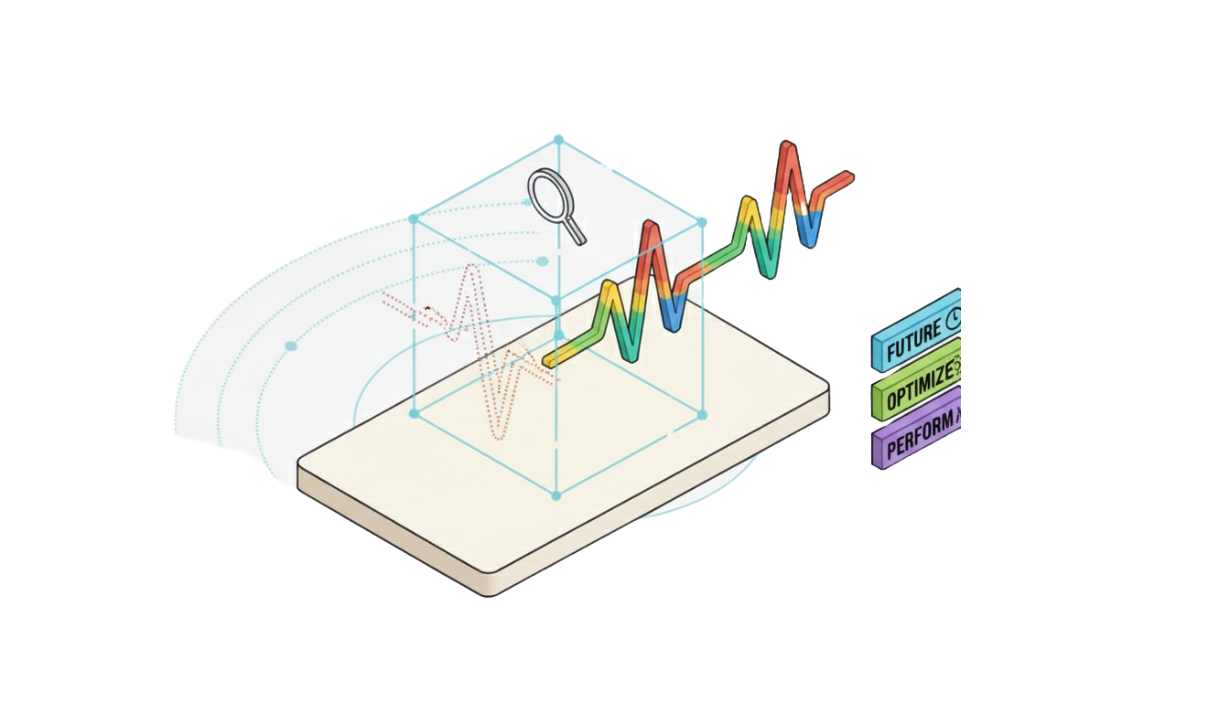
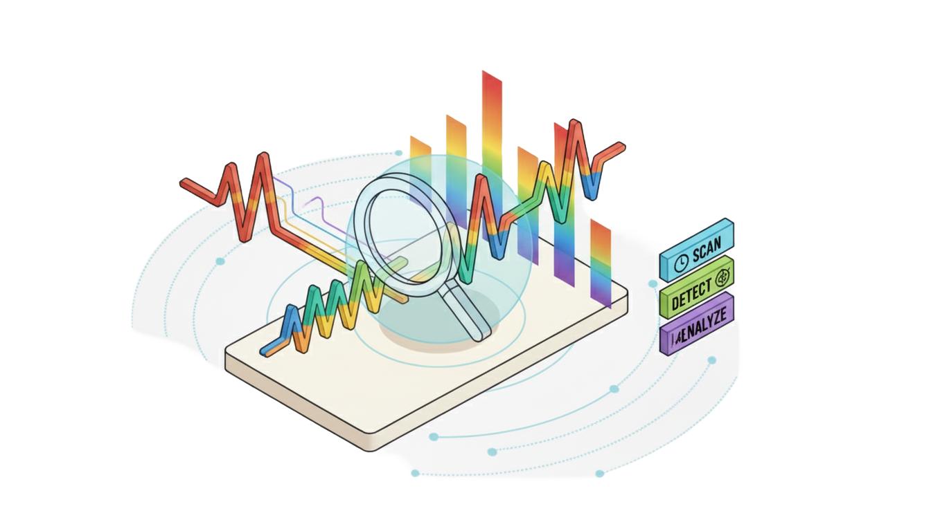
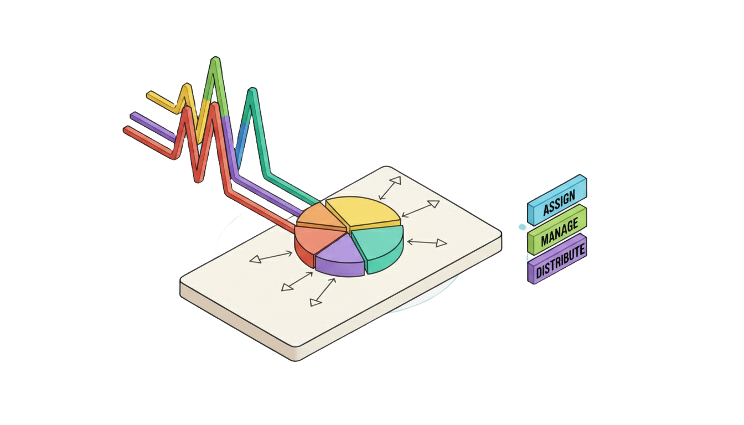
Resilient foundation models
Deployment & applications
Preprocessing unlabeled signals
Pretraining
stage
Processed data
Big foundation model on cloud
Denoised representation
Small edge model for adaption
Finetuning
stage
Regression
Original signal
Denoising
Moclassificationdulation
Classification
Channel prediction
Spectrum sensing
Noisy signal
Resource allocation
Constellation
Scalogram
Reshaped signal
Environmental noise addition

Slide 12
Wireless signal transmission
Environmental noise addition
Preprocessing unlabeled signals
Original signal
Noisy signal
Constellation
Scalogram
Reshaped signal
Resilient foundation models
Deployment & applications
Potential future research
Big foundation model on cloud
Pretraining
stage
Processed data
Small edge model for adaption
Denoised representation
Regression
Finetuning
stage
Denoising
Classification
Modulation classification
Channel prediction
Spectrum sensing
Resource allocation

