Slide 1

Bot Meets Shortcut: How Can LLMs Aid in Handling Unknown Invariance OOD Scenarios?
1
1
1*
2
Shiyan Zheng, Herun Wan, Minnan Luo, Junhang Huang
Xi’an JiaoTong University
Beijing Institute of Technology
1
2
Notes:
Good afternoon, everyone!
It’s a great pleasure to be here today and have the opportunity to share our work
"Bot Meets Shortcut: How Can LLMs Aid in Handling Unknown Invariance OOD Scenarios."
Our team comes from Xi'an Jiaotong University and Beijing Institute of Technology.
I am Zheng Shiyan, and I will be presenting our work today.

Slide 2






Background
As social networks expand globally, the rise of social bots has attracted significant academic attention.
With deep learning advancements, more research focuses on using neural networks to distinguish between social bot users and human users.
Social networks have become deeply integrated into our lives, reshaping how we access and process information.
Notes:
Today, with this widespread presence of social networks,
The appearance of social bots on many platforms has drawn strong attention from the academic community,
resulting in rapid progress in this field and the adoption of many deep learning approaches.

Slide 3

Background
Deep learning algorithms are still a black box, and we don’t fully understand their capabilities or limitations.
Notes:
However, as we all know,
deep learning algorithms remain a bit of a black box.
We still don’t fully understand their capabilities or where their boundaries lie.

Slide 4
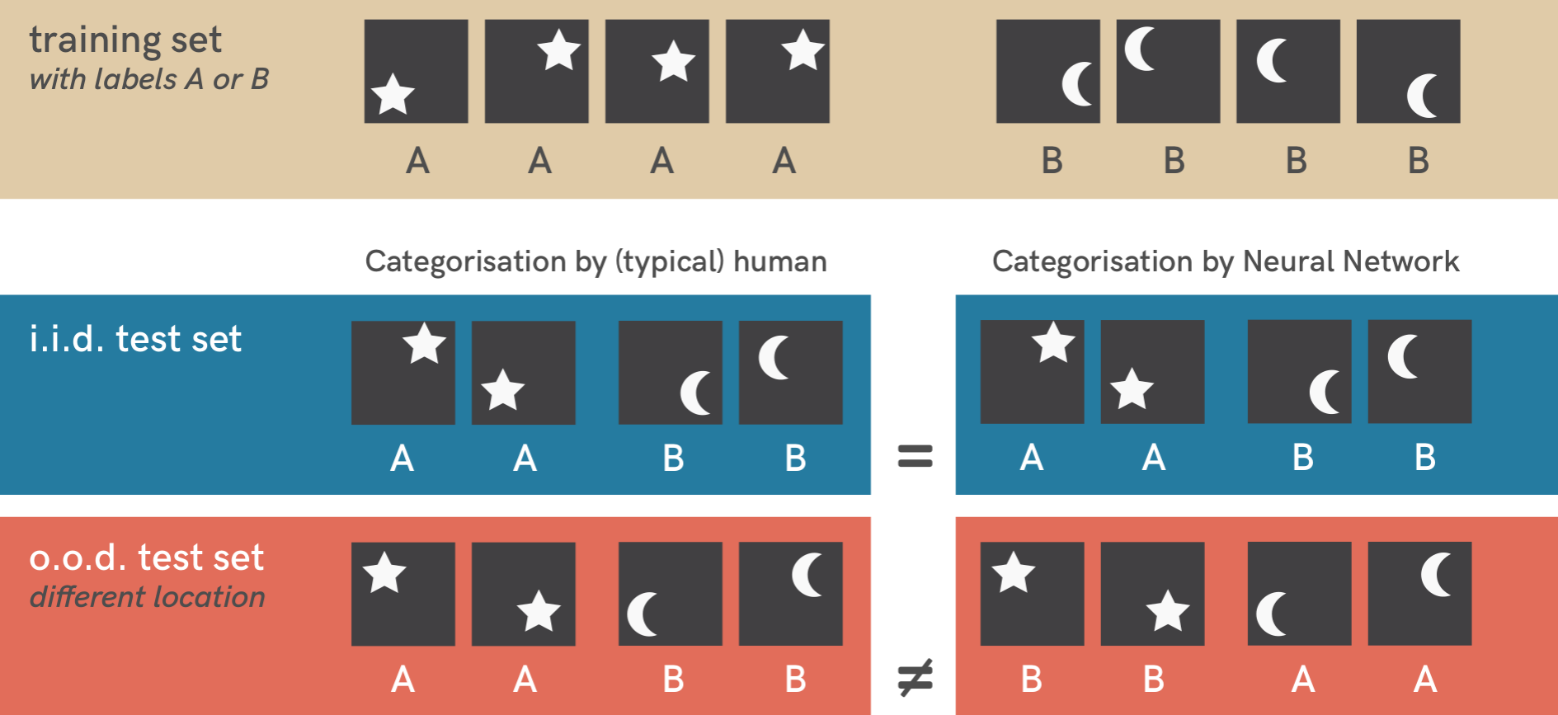
Background
Shortcut Learning
For example, in image recognition, position is learned instead of shape.
Deep learning algorithms are still a black box, and we don’t fully understand their capabilities or limitations.
Shortcut learning in deep neural networks
https://doi.org/10.1038/s42256-020-00257-z
Notes:
One well known problem is shortcut learning,
for example, in image recognition, position is learned instead of shape.

Slide 5


Background
Social bot detection models based on deep learning also face this issue. Many models perform well on benchmark datasets, advancing our understanding of social bots. However, there are still significant challenges.
Notes:
Although deep learning has led to strong performance on social bot detection benchmark datasets

Slide 6
Background
Social bot detection models based on deep learning also face this issue. Many models perform well on benchmark datasets, advancing our understanding of social bots. However, there are still significant challenges.
For example, obtaining ground truth labels for social bots is difficult. We cannot reliably obtain true labels for these bots, except for the actual operators behind social bot accounts.
Notes:
social bot detection still faces significant challenges, such as the difficulty of obtaining reliable ground-truth labels.

Slide 7
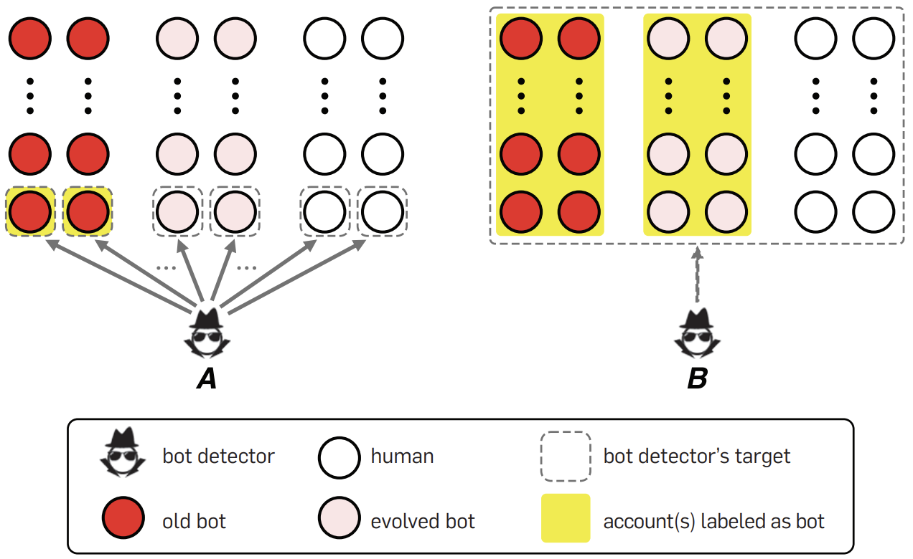
Background
Social bot detection models based on deep learning also face this issue. Many models perform well on benchmark datasets, advancing our understanding of social bots. However, there are still significant challenges.
For example, obtaining ground truth labels for social bots is difficult. We cannot reliably obtain true labels for these bots, except for the actual operators behind social bot accounts.
Furthermore, social bots continue to evolve as social networks develop, constantly testing the limits of detection models. This drives us to consider more challenging scenarios to improve model robustness.
A decade of social bot detection
https://dl.acm.org/doi/pdf/10.1145/3409116
Notes:
And social bots keep evolving to evade detection, motivating more challenging scenarios.

Slide 8
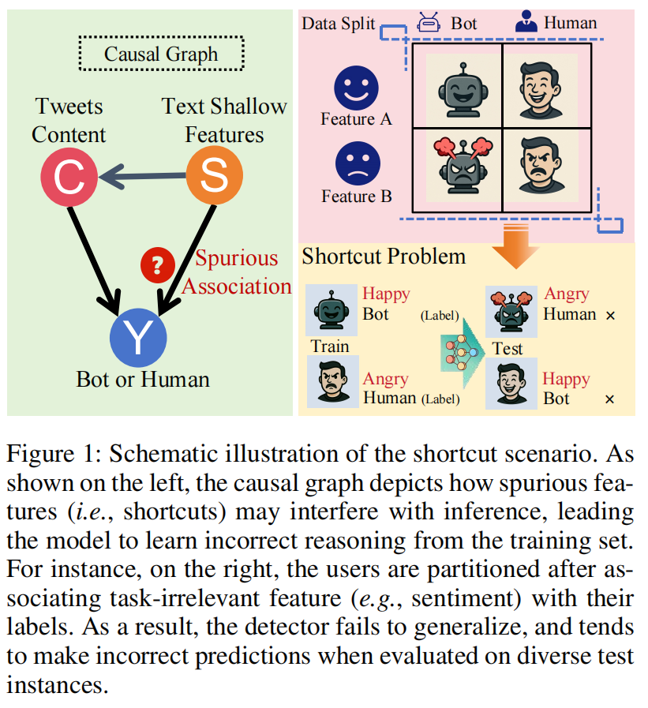
Motivation
Explored how potential shortcut features impact social bot detection models.
Notes:
Motivated by these challenges, we study the complexity of social bots and explore shortcut features that could impact social bot detection.

Slide 9
Motivation
Explored how potential shortcut features impact social bot detection models.
Focused on the generalization ability of these models and how they react to shortcut features, particularly in social media users' textual features.
Notes:
We investigate whether simple perturbations in inherent textual features
are sufficient to trigger shortcut learning in social bot detection models.

Slide 10
Motivation
Explored how potential shortcut features impact social bot detection models.
Focused on the generalization ability of these models and how they react to shortcut features, particularly in social media users' textual features.
Propose a debiasing strategy at both the data and model levels, leveraging large language models (LLMs) to enhance detection system robustness in shortcut learning scenarios.
Notes:
Based on this, we further propose mitigation strategies at both the data and model levels,
leveraging large language models to improve robustness.

Slide 11



Methods
Shortcut Settings
Focus on textual information
The core carrier of social interaction
Easy for bots to manipulate and generate
Quantifiable and controllable
Notes:
So, to study model behavior under shortcut features,
we construct controlled scenarios.
We focus on text, since it is the primary medium of social interaction,
easy for bots to manipulate,
straightforward to decompose into features such as sentiment, topics and so on.

Slide 12
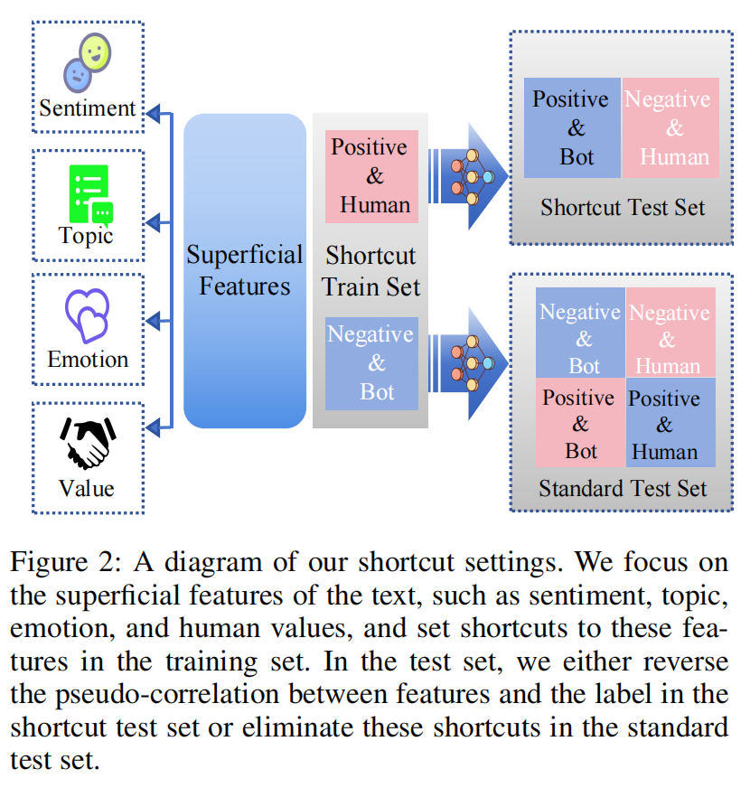
Methods
Shortcut Settings
Social bot detection as a binary classification task
Each user represented by textual feature vectors
Explicitly correlate shortcut features with labels in training
Notes:
We identify candidate shortcut features and during training, we artificially correlate a feature with the bot or human label,
and during testing, we remove this correlation to evaluate whether the model relies on shortcuts.

Slide 13

Methods
Shortcut Settings
Social bot detection as a binary classification task
Each user represented by textual feature vectors
Explicitly correlate shortcut features with labels in training
Reverse or break this correlation at test time
Notes:
For example, we train the model with happy bots and angry humans, and evaluate it on angry bots and happy humans.
If the model is vulnerable to sentiment-based shortcuts, its performance will degrade significantly.

Slide 14



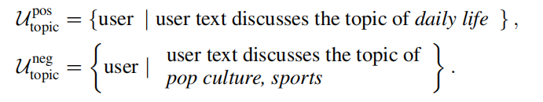


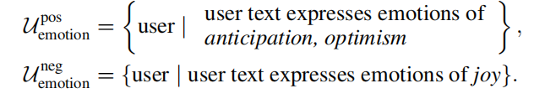
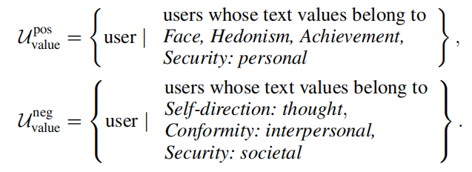

Methods
Shortcut Settings
Focus on inherent textual features that can act as shortcuts, which are not intended to be used as the actual decision cues.
      Sentiment
      Topic
      Human values
      Emotion
Cardiffnlp/Twitter-RoBERTa-base-sentiment-latest
Cardiffnlp/Twitter-RoBERTa-base-dec2021-tweet-topic-single-all
Cardiffnlp/Twitter-RoBERTa-large-emotion-latest
Interpretable
Easily correlated with labels
VictorYeste/DeBERTa-based-human-value-detection
Notes:
Textual characteristics of social bots are abstract and complex, making it difficult to directly define a “bot-specific” pattern from raw text.
We focus on inherent textual features that can act as shortcuts, which are not intended to be used as the actual decision cues.
we consider sentiment, topic, human values, and emotion.
These dimensions are interpretable, and easily correlated with labels in datasets.

Slide 15
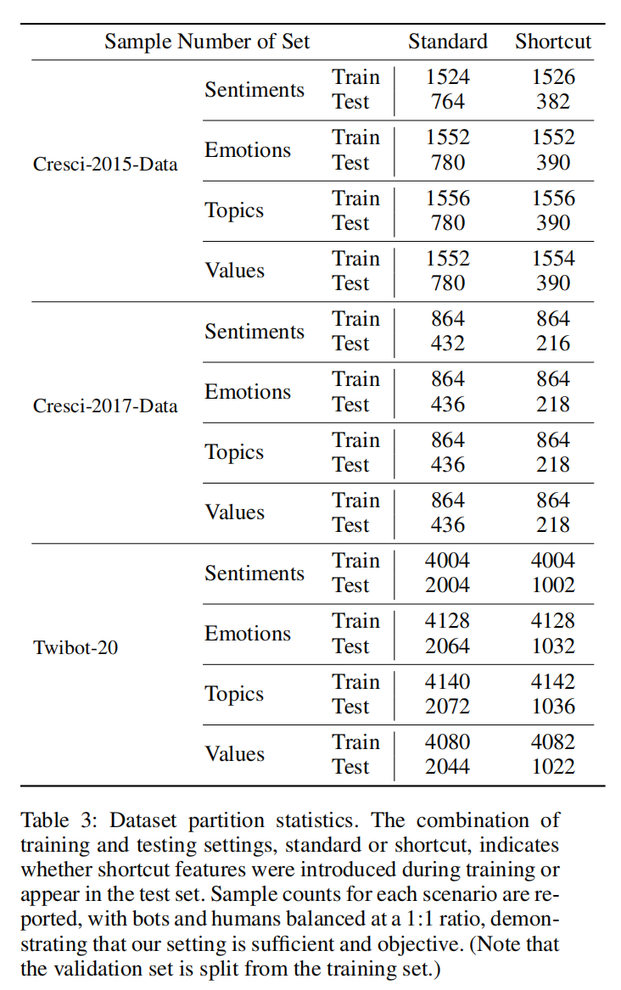
Methods
Shortcut Settings
Notes:
Using specialized feature analysis models, we construct shortcut scenarios from real-world datasets.
The shortcut setting introduces spurious feature label correlations, while the standard setting remains balanced.

Slide 16
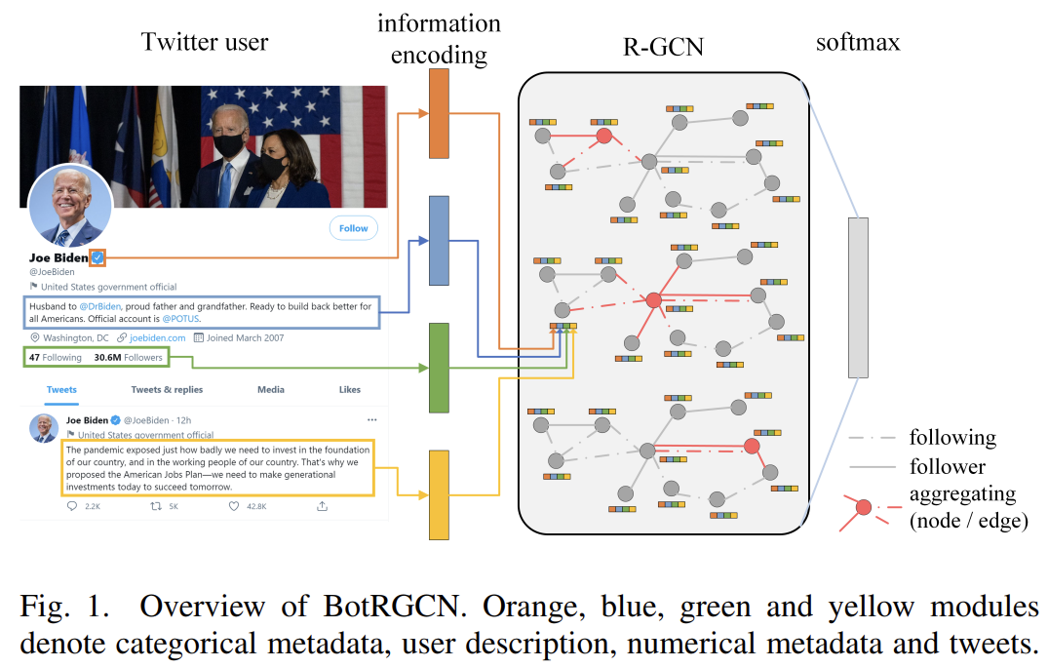
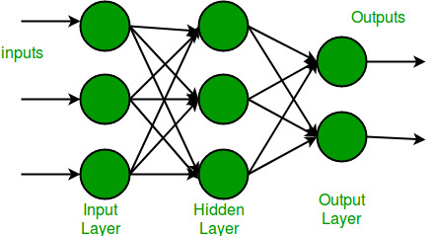

Some Basic Detection Methods
RoBERTa
figure from: BotRGCN: Twitter bot detection with relational graph convolutional networks
Notes:
Then we evaluate two representative models:
text-based model using RoBERTa with an classifier,
graph-based model, BotRGCN, which leverages social network structure.

Slide 17
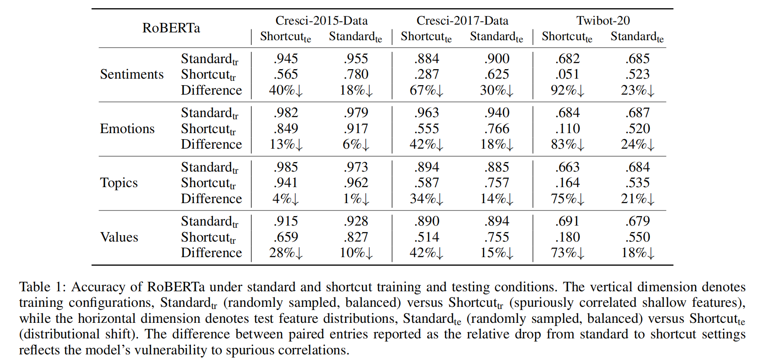

Shortcut learning
causes severe
performance degradation
Experiments
Notes:
We evaluate our models on several widely used social bot detection benchmarks.
The results show that all methods are affected by shortcut learning.
For text-based models, shortcut testing leads to an average accuracy drop of 50%,
with extreme cases reaching over 90%, demonstrating strong vulnerability to shortcut features.

Slide 18
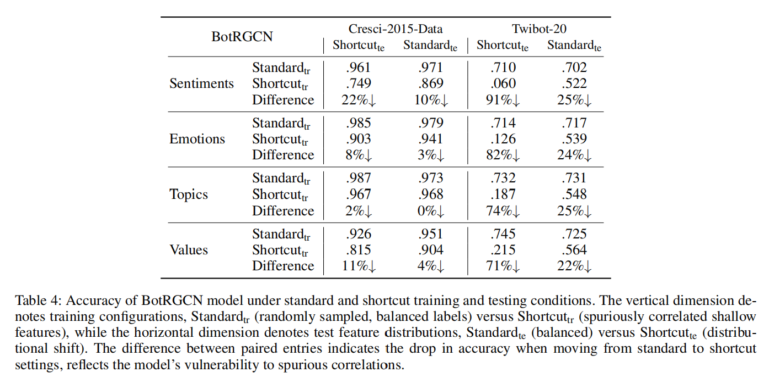
Experiments
Shortcut Settings
Notes:
And we observe a similar performance degradation on BotRGCN under the shortcut setting.

Slide 19
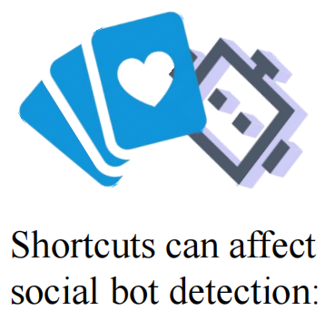
Discussions
Shortcut Settings
Average accuracy drop: ~50%
Worst-case drop: up to 92%
Performance also degrades on standard test sets
Existing debiasing methods fail to fully address the issue
Current social bot detection models would
→ rely on shallow, non-causal textual shortcuts
→ ignore invariant signals
Notes:
These results highlight that existing model architectures
experience significant performance degradation due to shortcut learning and spurious correlations.

Slide 20
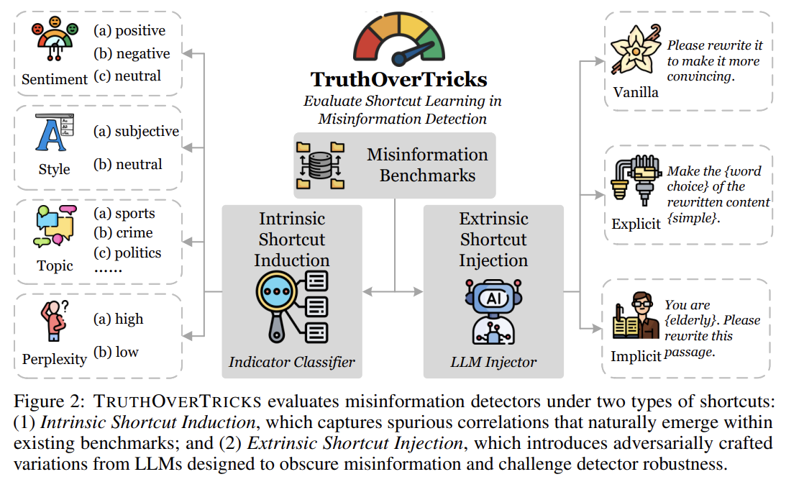
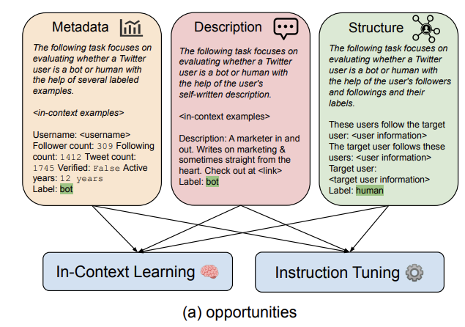
Mitigation Strategies
figure from: Truth over Tricks: Measuring and Mitigating Shortcut Learning in Misinformation Detection
Whether LLMs can help mitigate shortcut learning
figure from: What does the bot say? opportunities and risks of large language models in social media bot detection
Notes:
After identifying the problem, we move on to mitigation.
Inspired by recent work showing that LLMs are effective in social net analyze,
we propose a mitigation strategy based on LLMs counterfactual data augmentation.

Slide 21
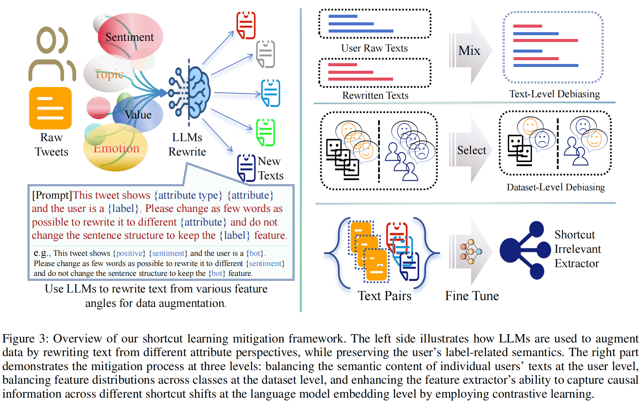
Mitigation Strategies
Counterfactual augmentation (CDA): Rewrite text to alternative attribute features
Preserve original labels semantics
Reduce shortcut-label correlations
  Text level
  Dataset level
  Model level
Notes:
Our overall strategy can be summarized in two aspects.
First, we perform CDA on the training set by rewriting texts to reverse or neutralize specific biased features,
while keeping the original semantics and causal-label-related cues unchanged.
Second, we weaken shortcut-induced correlations across three levels: the text level, the dataset level, and the model level.

Slide 22
Mitigation Strategies
Text- and dataset-level
LLM-guided rewriting of user posts
  Change sentiment, topic, or human values
  Preserve core meaning and bot/human cues
Mix original and rewritten texts
Break statistical correlations between shortcuts and labels
Notes:
We mitigate shortcut learning using LLM-based counterfactual rewriting at two levels.
At the text level, we mix original and rewritten posts within each user to balance shortcut features.
At the dataset level, we mix users with different shortcut-feature distributions to break shortcut–label correlations.

Slide 23


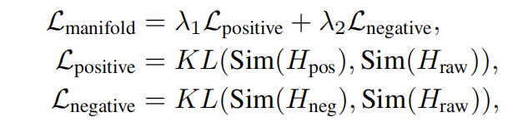
Mitigation Strategies
Model-level intervention
Contrastive fine-tuning
Encourage ignoring shallow and irrelevant features
Notes:
Finally, at the model level, we fine-tune text-feature extractor using contrastive learning with counterfactual text pairs.
This allows us to preserve semantic consistency, while explicitly suppressing shortcut features in the embedding space through mutual information constraints.
As a result, the model is encouraged to focus more on causally relevant signals.

Slide 24
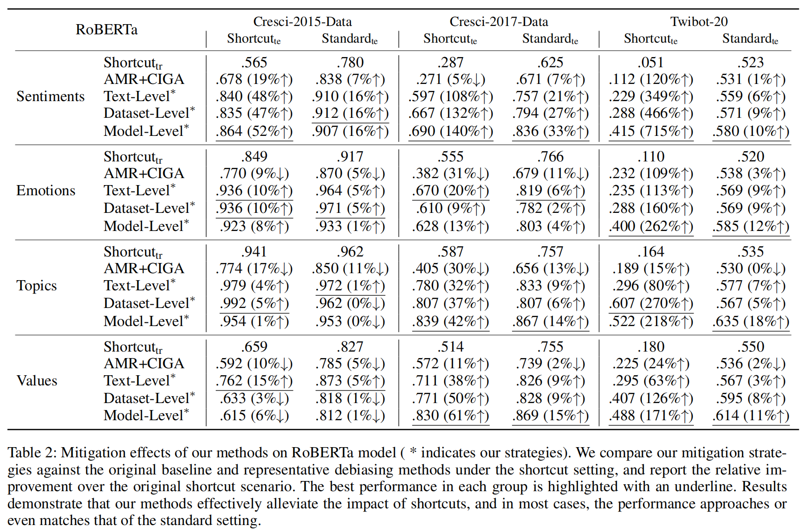
Mitigation Results
Performance gains
Text models: +59% (relative average)
Graph models: +53% (relative average)
Notes:
Here, we evaluate the effectiveness of our mitigation strategy.
Compared to the original baseline and existing debiasing methods,
our approach achieves an average relative improvement of 59% on text-based models and 53% on graph-based models.
In many cases, performance recovers to near-standard levels.

Slide 25
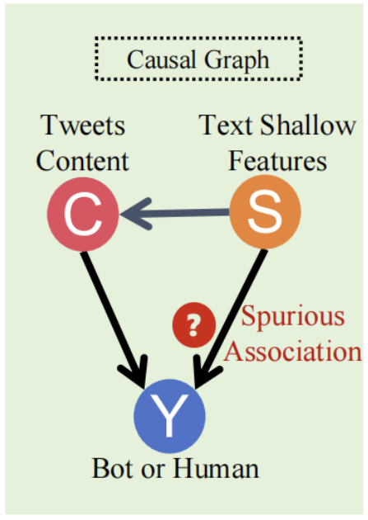
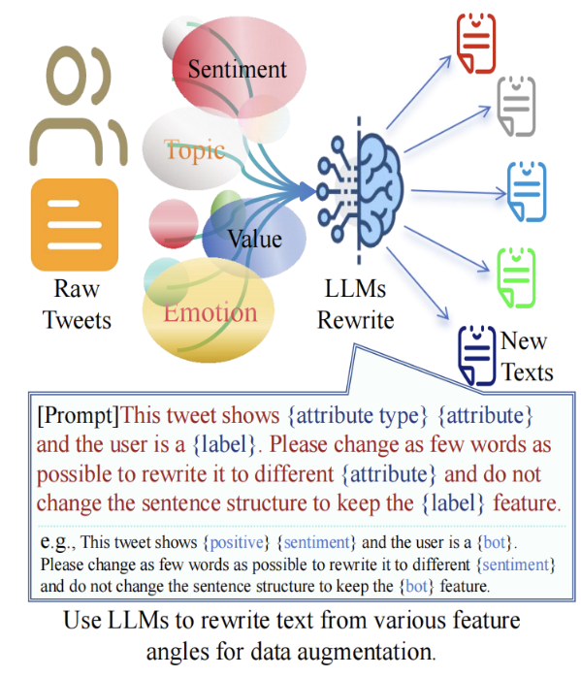
Summary
Our experimental results indicate that social media text indeed contains shallow features that are irrelevant to labels, yet strongly correlated with them.
Under the influence of these features, social bot detection models tend to degenerate into sentiment or topic classifiers, instead of focusing on the desired bot-invariant signals.
By leveraging LLM-based counterfactual rewriting for data augmentation, we are able to effectively mitigate this effect.
Overall, this work not only reveals the challenges posed by shortcut learning, but also provides a practical and effective mitigation strategy.
Notes:
Overall, this work identifies shortcut learning as a challenge in social bot detection and
demonstrates that LLM-based counterfactual data augmentation provides a practical and effective mitigation strategy

Slide 26
Acknowledgments
We would like to express our gratitude to all the contributors to this work.

Slide 27


Bot Meets Shortcut: How Can LLMs Aid in Handling Unknown Invariance OOD Scenarios?

Slide 33

Notes:
随着社交网络平台的不断丰富和编程算法的不断细化，再加上人工智能的快速发展，已有研究和实际社交经验见证着社交机器人从单纯的一些骚扰功能，发展的越来越有目的性，在语言和社交行为上越来越像人类

Slide 34

Notes:
随着社交机器人的不断进化，社交平台以及科研工作者们也对社交机器人的特征进行的挖掘，借助更大的数据量和用户文本等信息设计出更有有效的检测算法。

Slide 35

Notes:
社交机器人的发展和社交机器人检测是一场持续不断的拉锯战，促使我们更深入的发掘现有模型的不足和增强检测器的能力

Slide 36
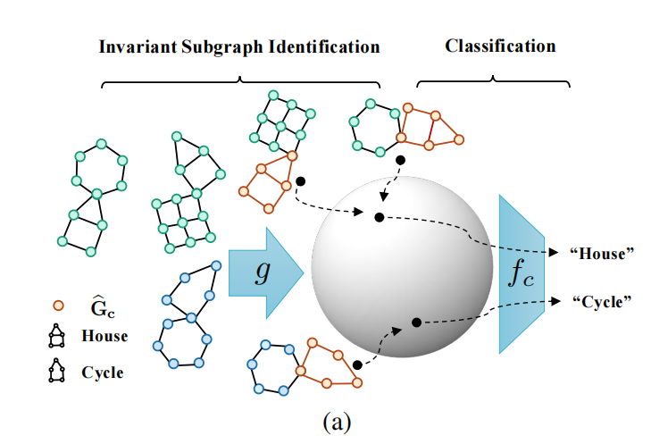
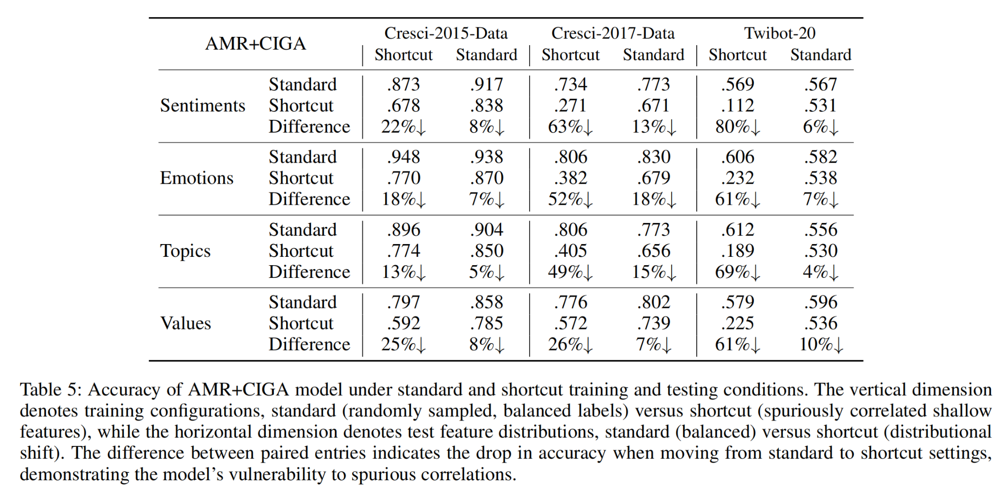
De-Bias Method
Learning causally invariant representations for out-of-distribution generalization on graphs
https://proceedings.neurips.cc/paper_files/paper/2022/file/8b21a7ea42cbcd1c29a7a88c444cce45-Paper-Conference.pdf
Notes:
In addition, we include representative debiasing methods, AMR and CIGA, to examine whether existing approaches can mitigate shortcut learning.

