Slide 1


Bot Meets Shortcut: How Can LLMs Aid in Handling Unknown Invariance OOD Scenarios?
Shiyan Zheng¹, Herun Wan¹, Minnan Luo^{1📧}, Junhang Huang²
¹Xi’an JiaoTong University
²Beijing Institute of Technology
Notes:
Good afternoon, everyone!
It’s a great pleasure to be here today and have the opportunity to share our work
"Bot Meets Shortcut" with you
Our team comes from Xi'an Jiaotong University and Beijing Institute of Technology.
I am Zheng Shiyan.
Good afternoon, everyone! //
It’s a great pleasure to be here today, /
and to have the opportunity to share our work, /
“Bot Meets Shrtcut,” /
with you. //
Our team comes from /
Xi’an Jiaotong University /
and Beijing Institute of Technology. //
I am Zheng Shiyan. //

Slide 2
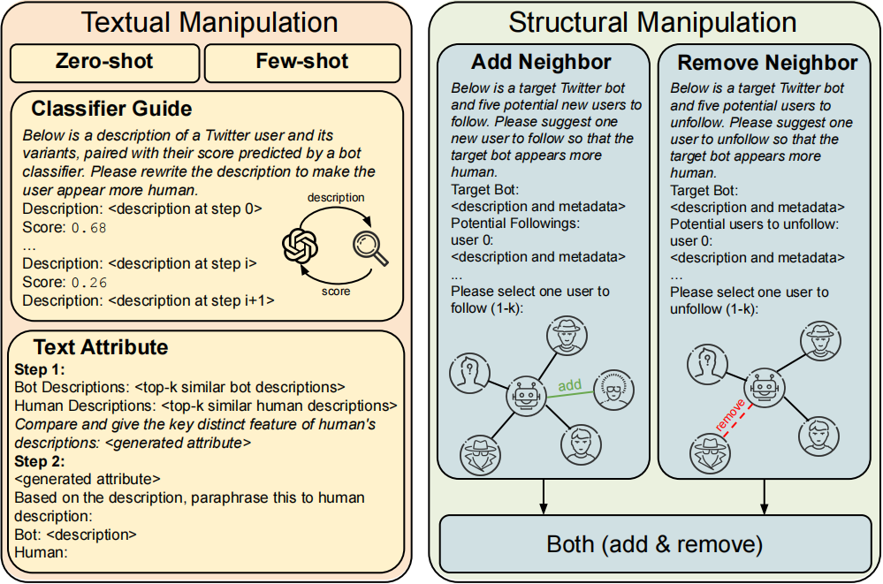



Background
Widespread Presence of Social Networks
The social bots are evolving, and the social bot environment is becoming diverse. The development of large language models amplifies it.
A simple prompt could generate hard-to-detect social bots.
Please rewrite the tweets of this bot account to sound like a genuine user
Feng S, et al. "What Does the Bot Say? Opportunities and Risks of Large Language Models in Social Media Bot Detection." ACL 2024.
Notes:
Nowadays, with this widespread presence of social networks, social bots have evolved and become more diverse. At the same time, large language models further amplify this issue, enabling bots to generate content that sound like real users with just a simple prompt.
Nowadays, with the widespread use of social networks, /
social bots have evolved and become increasingly diverse. //
At the same time, /
large language models further amplify this issue, /
enabling bots/ to generate content/ that sounds like real users, /
with just a simple prompt. //

Slide 3



Background
A simple prompt could generate hard-to-detect social bots.
Social bots are widely employed in diverse fields, with their presence growing, adapting to environments and evading detection
Evade Detection
Political Campaigns
Information Operations
S Cresci, et al. "A decade of social bot detection." Communications of the ACM, 2020.
Notes:
What’s more, social bots are widely employed/ in diverse fields,
from political campaigns/ to information operations,
with their presence growing, adapting to environments/ and evading detection.

Slide 4
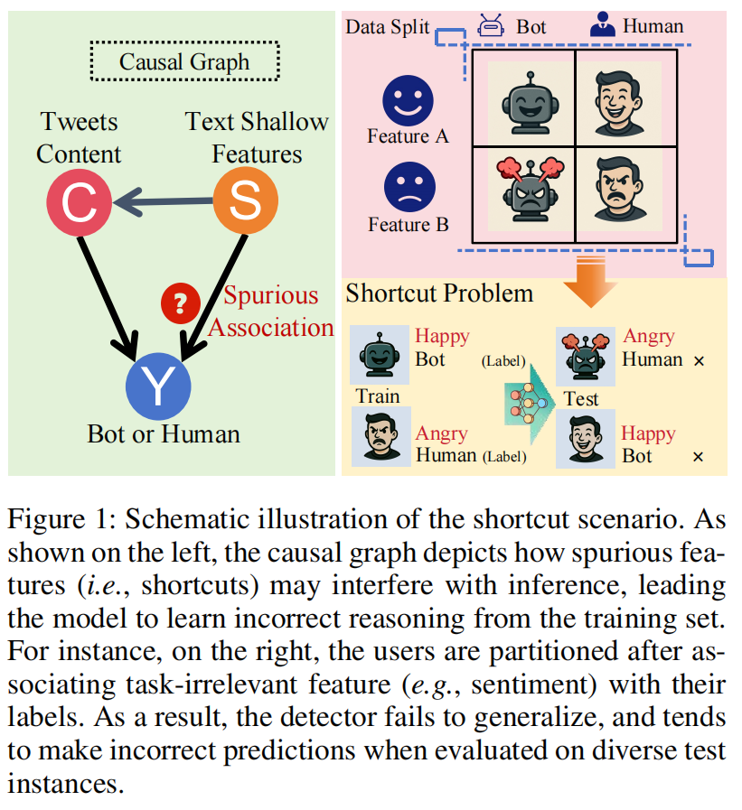
Motivation
Study the complex characteristics of social bots by exploring shortcut features that could impact social bot detection
To detect social bots effectively, detectors must focus on deep causal cues rather than superficial shortcuts.
Notes:
Motivated by these challenges,
we study the complexity of social bots/ and explore shortcut features/ that could impact social bot detection.
To detect social bots effectively, /
detectors must focus on deep causal cues /rather than superficial /ˌsuːpəˈfɪʃəl/ shortcuts.

Slide 5
Motivation
To effectively detect social bots across diverse environments, detectors must learn deep semantics rather than relying on superficial cues.
e.g., in real-world scenarios, we can not assume that angry accounts are bots or happy ones are humans.
Notes:
For example, /in real-world scenarios, /we can't assume that angry accounts /are bots or happy ones /are humans.

Slide 6
Motivation
To effectively detect social bots across diverse environments, detectors must learn deep semantics rather than relying on superficial cues.
e.g., in real-world scenarios, we can not assume that angry accounts are bots or happy ones are humans.
However, social bot detectors may inadvertently learn these shortcuts, which motivates us to explore
the impact of shortcut learning on detectors’ performance.
Notes:
However, detectors may still learn these shortcuts, which raises the question: /how does shortcut learning /impact detectors’ performance?

Slide 7
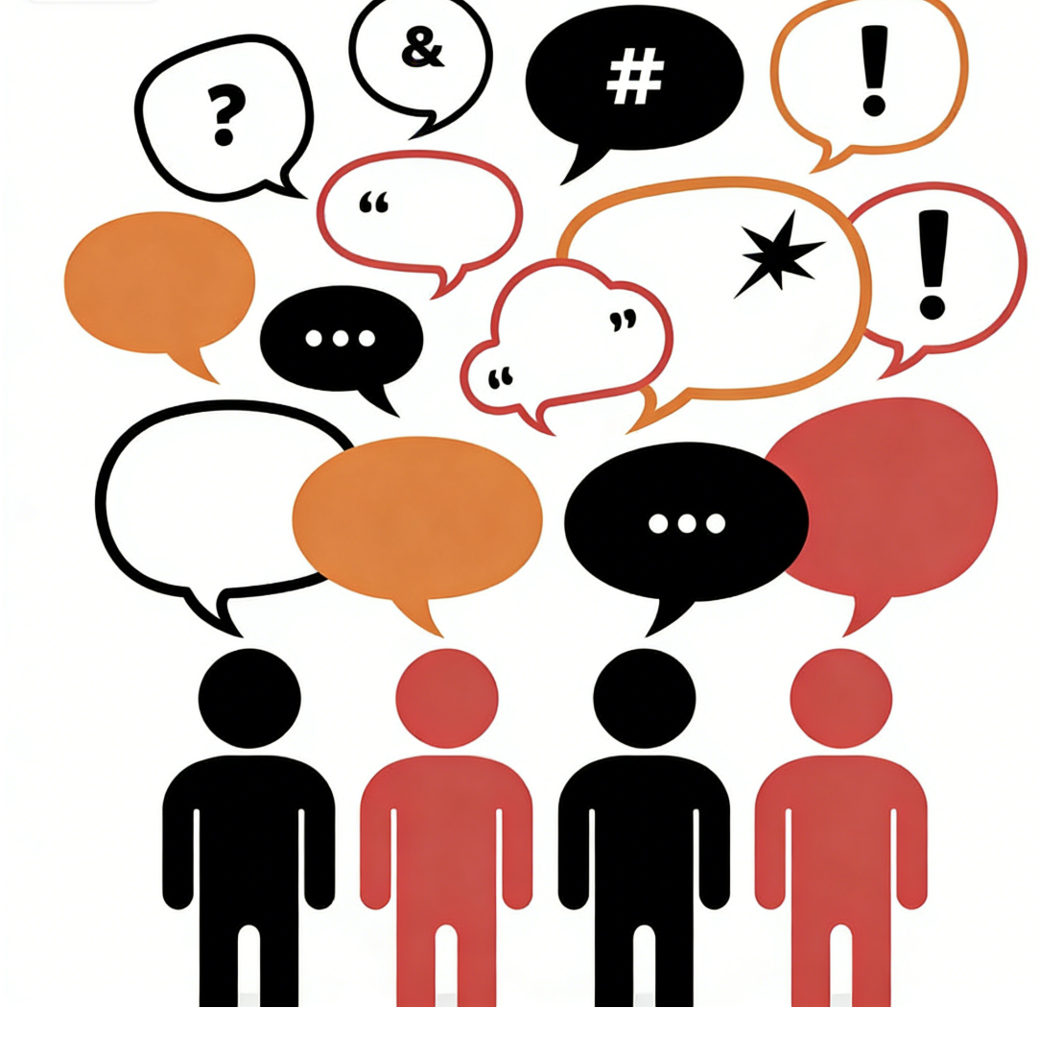
Methods
Explore model behavior under shortcut features with controlled scenarios
Focus on the core carrier of social interaction, textual information
Notes:
So, to study model behavior under shortcut features, we/ construct controlled scenarios.
We focus on text, /since it is the primary medium /of social interaction,

Slide 8
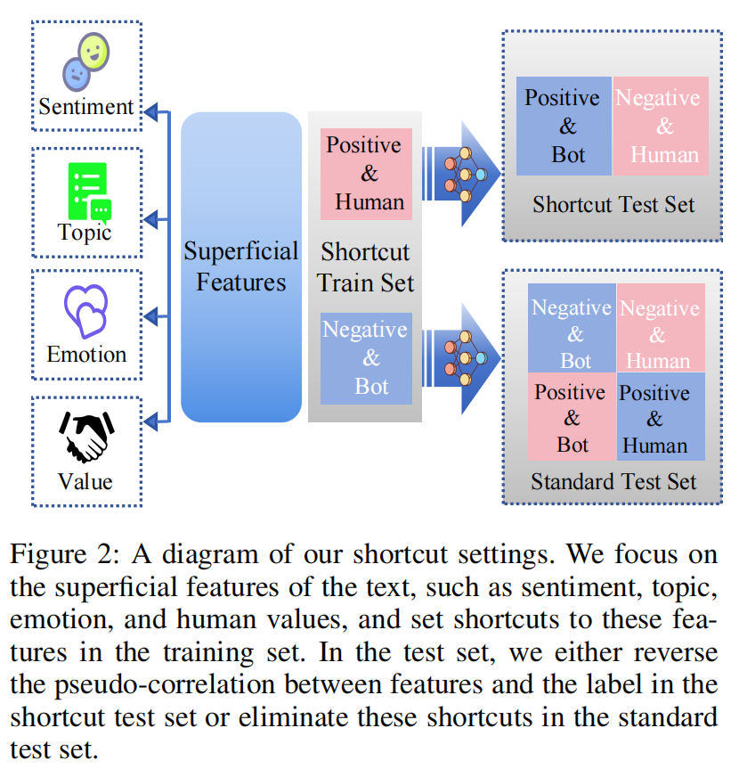
Methods
Identify candidate shortcut features
Artificially correlate shortcut features with labels in training
Remove this correlation to evaluate whether models rely on shortcuts.
Notes:
We identify candidate shortcut features /and during training, /we artificially correlate features /with the bot or human label,
and during testing, we remove this correlation /to evaluate /whether the model relies on shortcuts.

Slide 9


Methods
Identify candidate shortcut features
Artificially correlate shortcut features with labels in training
Remove this correlation to evaluate whether models rely on shortcuts.
Train the model with positive bots and negative humans,
and evaluate it on negative bots and positive humans
If the model is vulnerable to sentiment-based shortcuts, its performance will degrade significantly.
Notes:
For example, /we train the model with negative bots and positive humans, /then evaluate it /on positive bots and negative humans. /If the model is vulnerable /ˈvʌlnərəbl/ to sentiment-based shortcuts, its performance /will degrade significantly.

Slide 10




Methods
Focus on inherent textual features which can act as shortcuts but are not intended to serve as actual decision cues.
Sentiment
Topic
Human values
Emotion
Notes:
We considers inherent /ɪnˈhɪərənt/ textual features/ such as sentiment, topic, human values, and emotion /that can act as shortcuts, which are not intended /to be used as the actual decision cues.

Slide 11
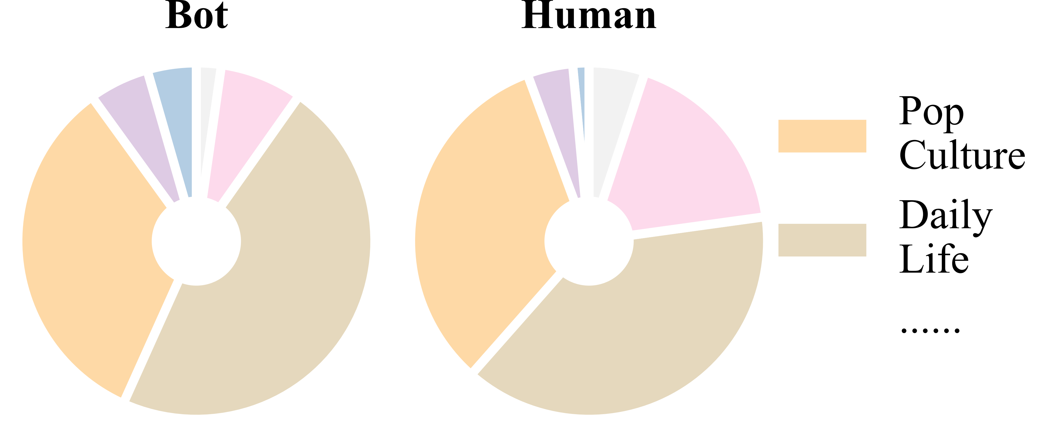
Methods
Focus on inherent textual features which can act as shortcuts but are not intended to serve as actual decision cues.
The topic distribution across different tags in the Cresci-2017-Data. There is no significant difference between human and bot distributions, indicating that topic features should not be exploited as cues by detectors.
Sentiment
Topic
Human values
Emotion
Notes:
For example, there is no significant difference /between the topic distributions /of human and bot texts, indicating that /topic features should not /be exploited as cues /by detectors.

Slide 12


Methods
Sentiment
Topic
Human values
Emotion
Interpretable
Easily correlated with labels
$$U_{∗}^{pos}$$
$$U_{∗}^{neg}$$
human
bot
Notes:
These text feature dimensions /are interpretable /and can be easily correlated with labels /in datasets.

Slide 13

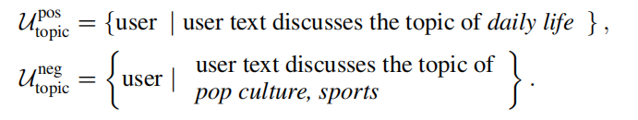
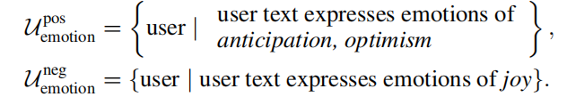
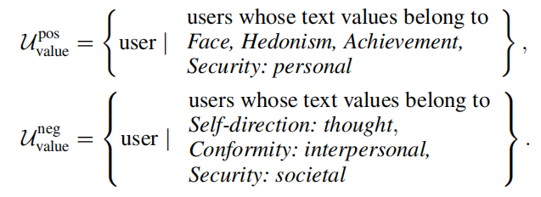

Methods
Use specialized feature analysis models and construct shortcut scenarios from real-world datasets
Sentiment
Topic
Human values
Emotion
Cardiffnlp/Twitter-RoBERTa-base-sentiment-latest
Cardiffnlp/Twitter-RoBERTa-base-dec2021-tweet-topic-single-all
Interpretable
Easily correlated with labels
Cardiffnlp/Twitter-RoBERTa-large-emotion-latest
$$U_{∗}^{pos}$$
$$U_{∗}^{neg}$$
human
bot
VictorYeste/DeBERTa-based-human-value-detection
Notes:
We use specialized feature analysis models /and construct shortcut scenarios /from real-world datasets.

Slide 14
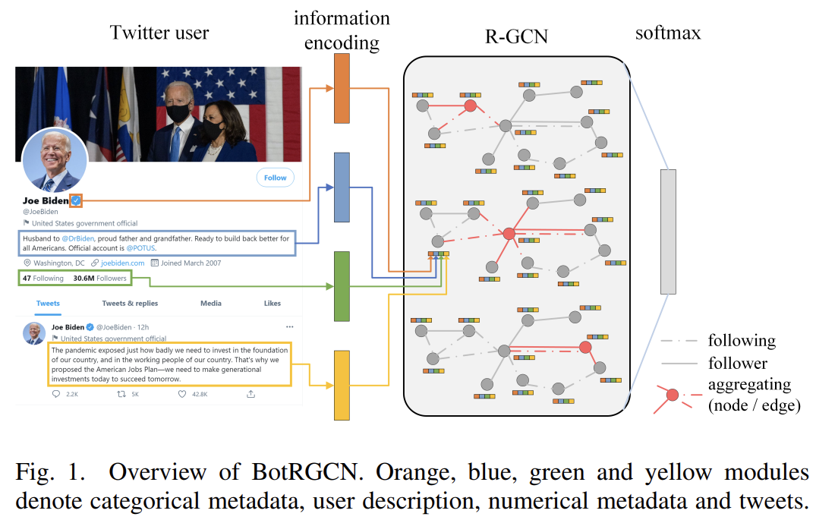
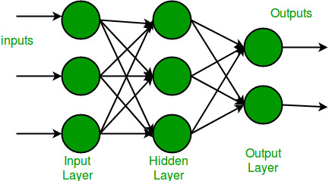

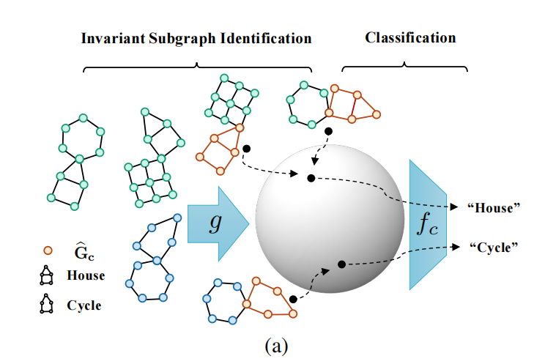


Settings
Select detectors:
RoBERTa
Debiasing method:
Liu Y, et al. RoBERTa: A Robustly Optimized BERT Pretraining Approach
Feng S, et al. BotRGCN: Twitter bot detection with relational graph convolutional networks
Datasets:
Cresci-Data-2015
Cresci-Data-2017
Twibot-20
Chen Y, et al. Learning causally invariant representations for out-of-distribution generalization on graphs
Notes:
Then we evaluate /two representative detection models, a text-based RoBERTa classifier /and a graph-based method, alongside representative /debiasing methods, on widely used /social bot detection benchmarks

Slide 15
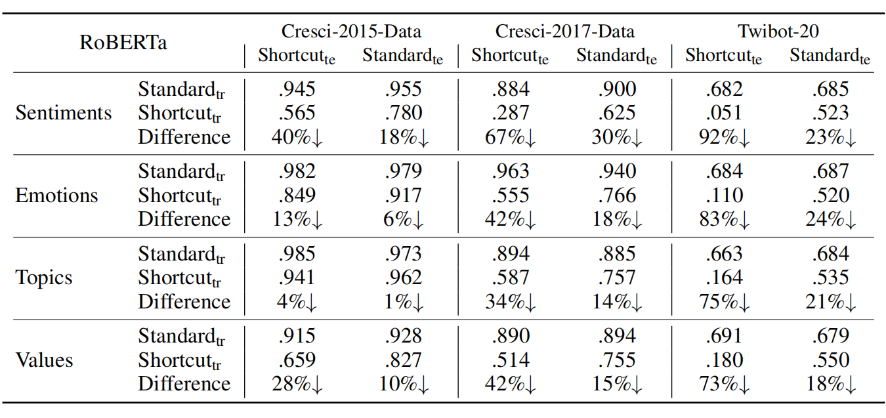
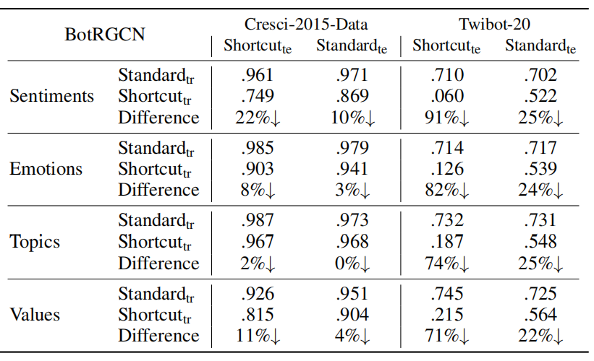

Results
Text-based model, shortcut learning leads to an average accuracy drop: ~33%
Graph-based model, shortcut learning leads to an average accuracy drop: ~30%
Worst-case drop: up to 92%
Current social bot detection models would
→ rely on shallow, non-causal textual shortcuts
→ ignore invariant signals
Notes:
The results show that /all methods are affected /by shortcut learning.
For text-based models, shortcut testing /leads to an average accuracy drop /of about 50%,
with extreme cases /reaching over 90%, demonstrating strong vulnerability /to shortcut features.
graph-based model /also showed a similar performance drop /under the shortcut setting.

Slide 16
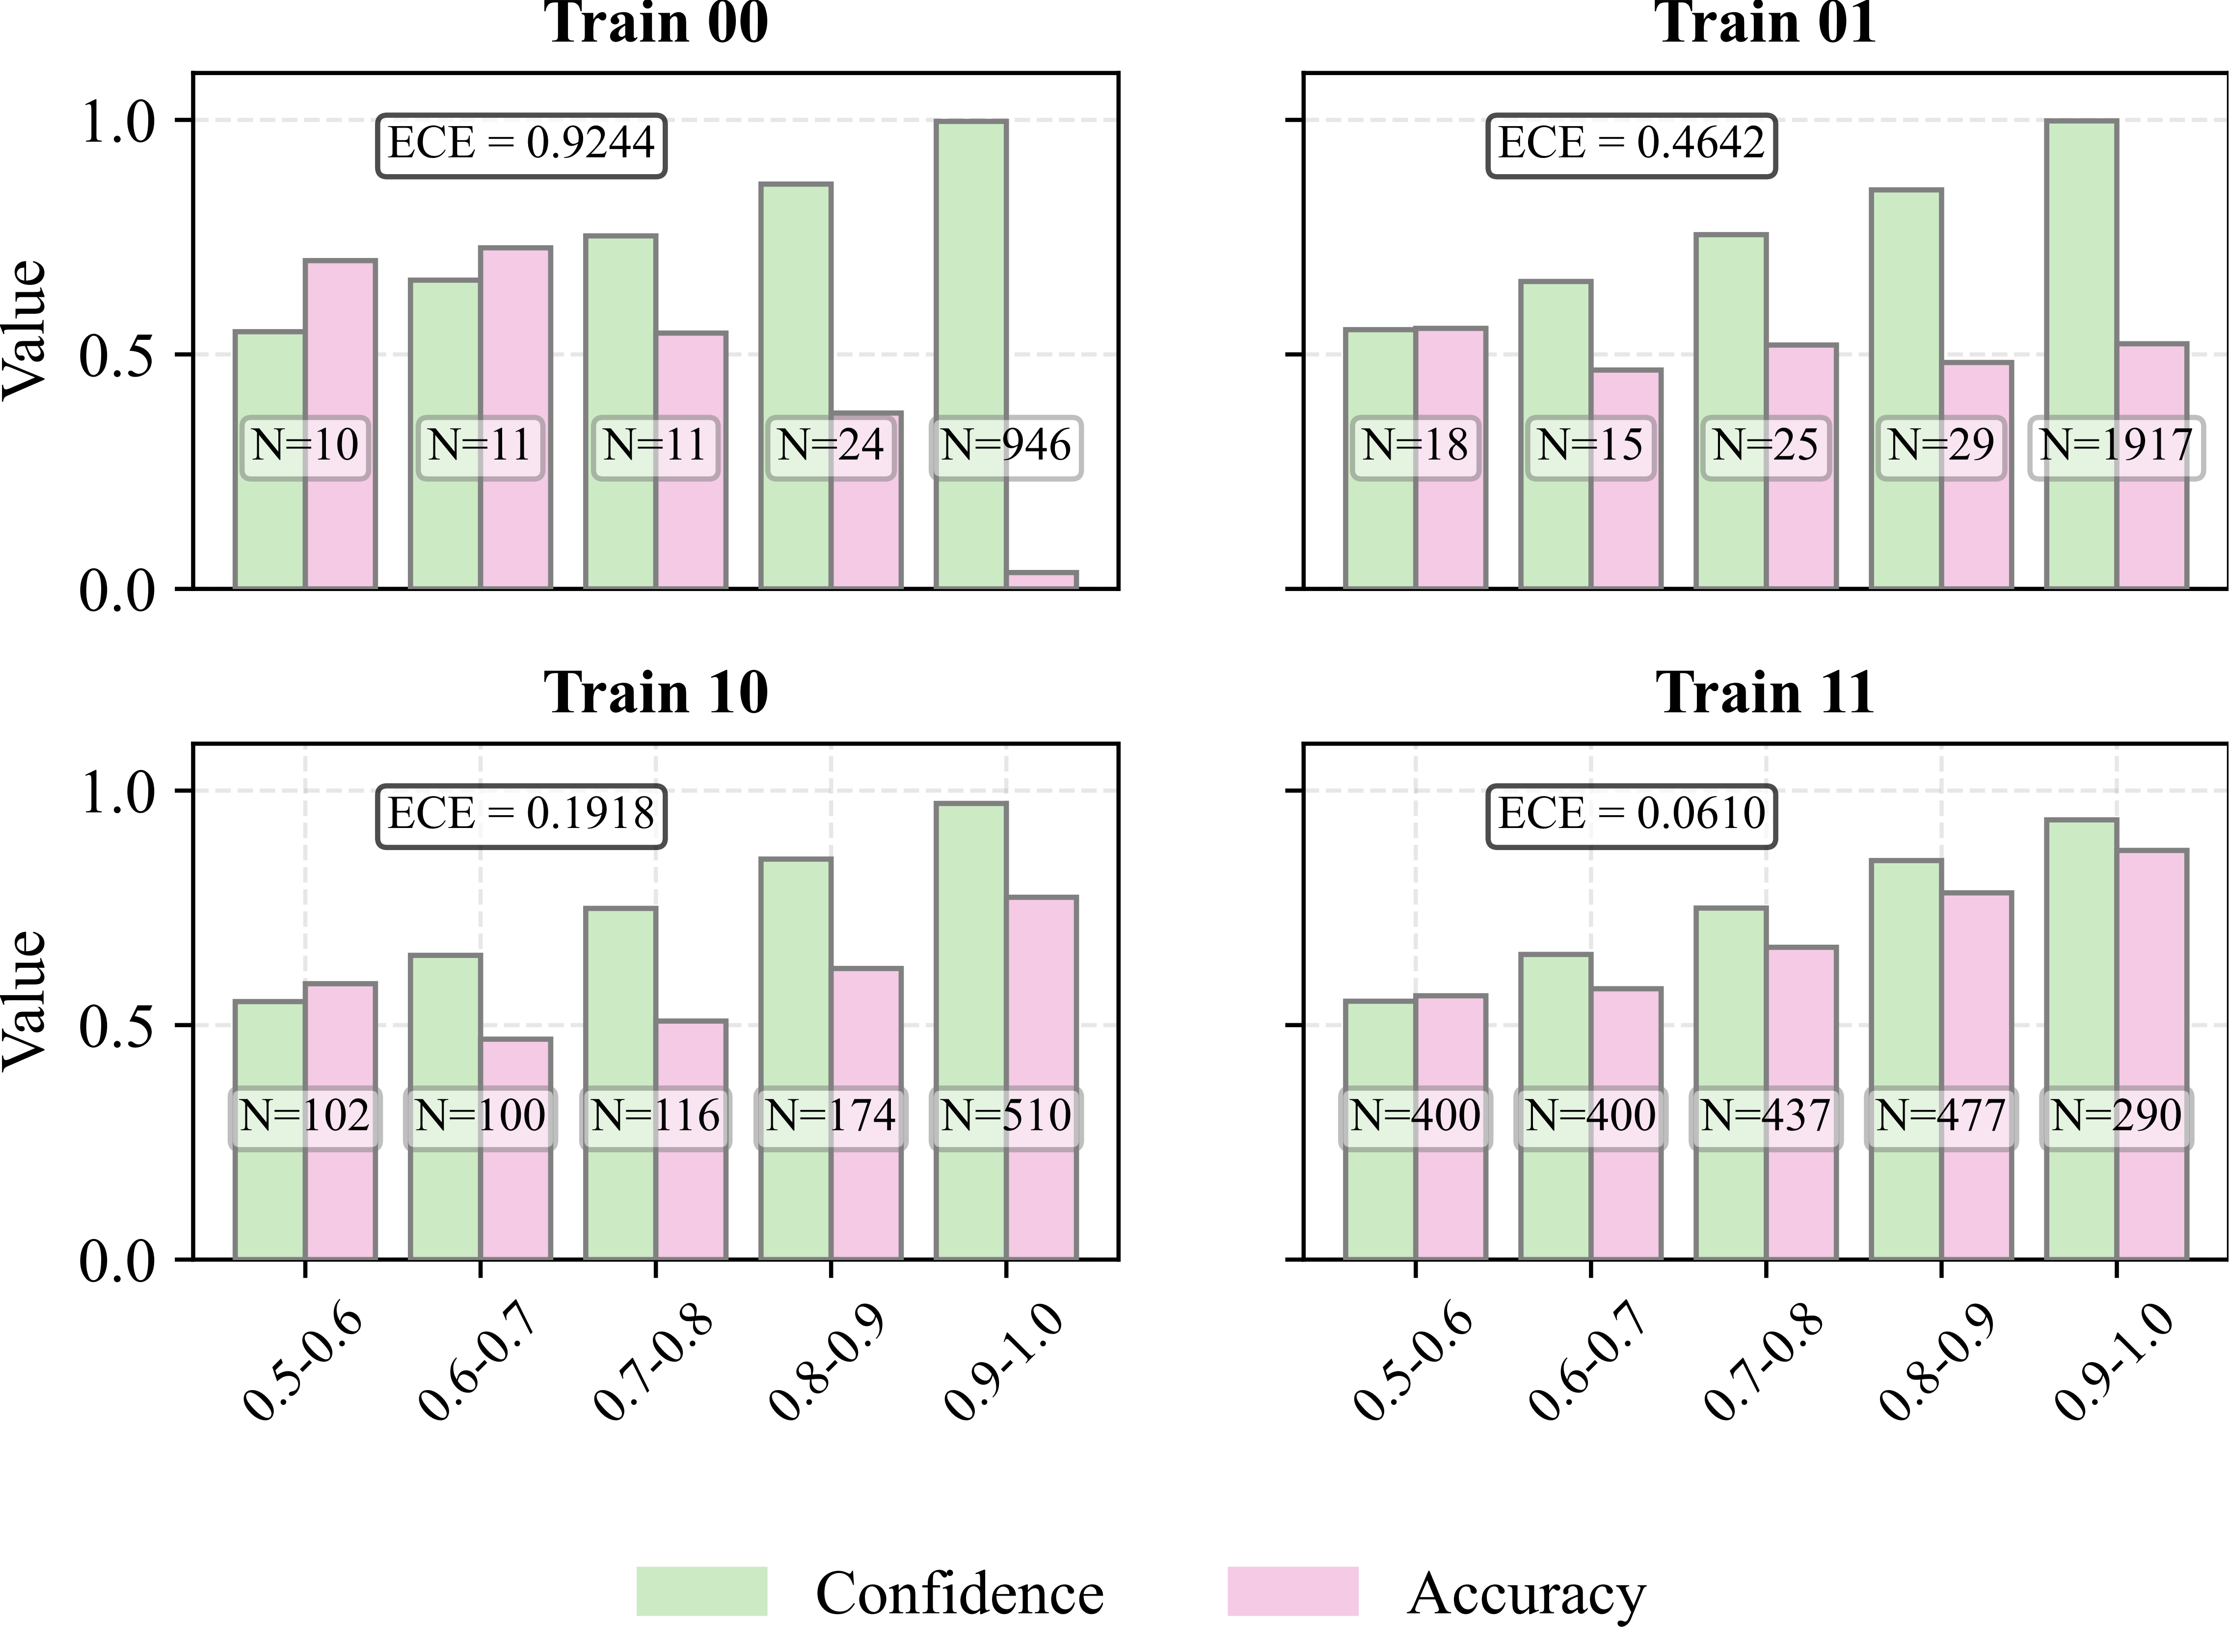

Results
Shortcut Setting
Evaluate the calibration of detectors in standard and shortcut settings.
The sub-caption "Train xy" indicates that the model is trained under setting x and tested under setting y, where 0 corresponds to the shortcut setting and 1 to the standard setting.
The results demonstrate that models trained in the shortcut setting tend to exhibit higher confidence in their predictions, yet suffer from reduced accuracy.
Standard Setting
Notes:
We also evaluate calibration /and find that models trained under the shortcut setting /are more confident, yet less accurate.

Slide 17
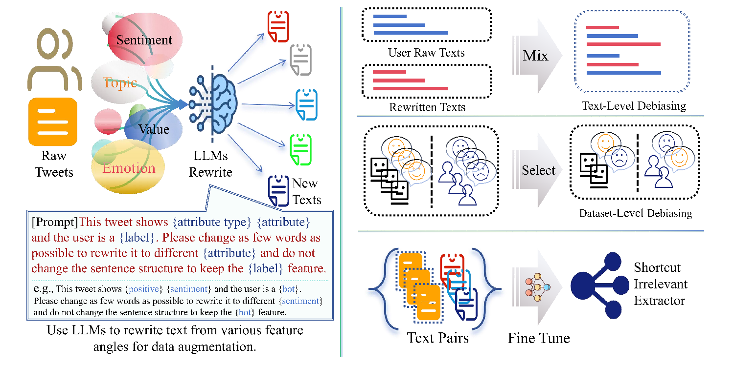
Mitigation
Counterfactual data augmentation (CDA): Rewrite text to alternative attribute features
Preserve original labels semantics
Reduce shortcut-label correlations
  Text level
  Dataset level
  Model level
Overview of our shortcut learning mitigation framework. The left side illustrates how LLMs are used to augment data by rewriting text from different attribute perspectives, while preserving the user’s label-related semantics. The right part demonstrates the mitigation process at three levels: balancing the semantic content of individual users’ texts at the user level, balancing feature distributions across classes at the dataset level, and enhancing the feature extractor's ability to capture causal information across different shortcut shifts at the language model embedding level by employing contrastive learning.
Notes:
After identify /shortcut learning problem, our overall mitigation strategy /can be summarized in two aspects.
First, we perform Counterfactual /ˌkaʊntəˈfæk.tʃu.əl/ data augmentation/ on the training set /by rewriting texts /to reverse or neutralize specific features,
while keeping the original semantics /sɪˈmæn.tɪks/ and causal cues.
Second, we weaken shortcut-induced/ correlations /across multiple levels.

Slide 18
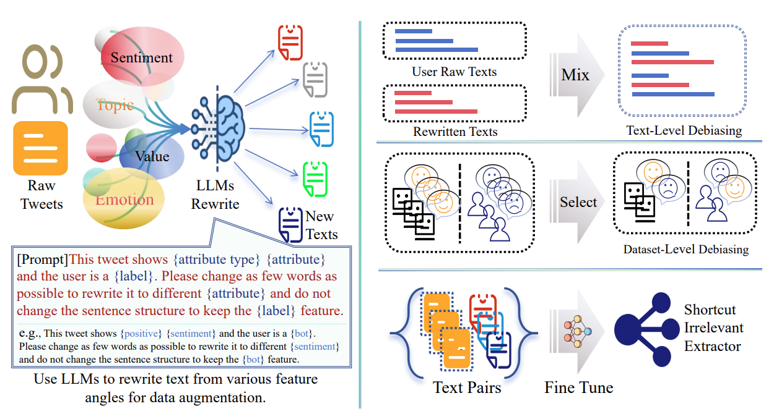
Mitigation
Text- and Dataset-level
Mix original and rewritten posts within each user to balance shortcut features.
Select users with different shortcut-feature distributions to break shortcut correlations.
Overview of our shortcut learning mitigation framework. The left side illustrates how LLMs are used to augment data by rewriting text from different attribute perspectives, while preserving the user’s label-related semantics. The right part demonstrates the mitigation process at three levels: balancing the semantic content of individual users’ texts at the user level, balancing feature distributions across classes at the dataset level, and enhancing the feature extractor's ability to capture causal information across different shortcut shifts at the language model embedding level by employing contrastive learning.
Notes:
We mitigate shortcut learning /using LLMs-based counterfactual rewriting/ at three levels.
At the text level, we mix original/ and rewritten posts /within each user /to balance shortcut features.
At the dataset level, we mix users /with different shortcut-feature distributions/ to break shortcut correlations.

Slide 19


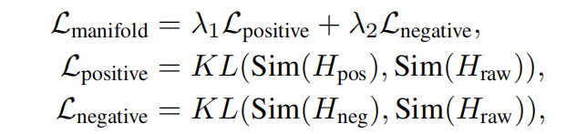
Mitigation
Model-level intervention
Contrastive fine-tuning on
text feature extractor
Preserve semantic consistency
Encourage focusing on deep, relevant features while ignoring shallow and irrelevant ones.
Overview of our shortcut learning mitigation framework. The left side illustrates how LLMs are used to augment data by rewriting text from different attribute perspectives, while preserving the user’s label-related semantics. The right part demonstrates the mitigation process at three levels: balancing the semantic content of individual users’ texts at the user level, balancing feature distributions across classes at the dataset level, and enhancing the feature extractor's ability to capture causal information across different shortcut shifts at the language model embedding level by employing contrastive learning.
Notes:
Finally, at the model level, we fine-tune /text-feature extractor /using contrastive learning.
This allows us /to preserve semantic consistency, while explicitly /ɪkˈsplɪs.ɪt.li/ reducing the influence /of shortcut features in the embedding space.
As a result, the model is encouraged /to focus more /on causally relevant signals.

Slide 20
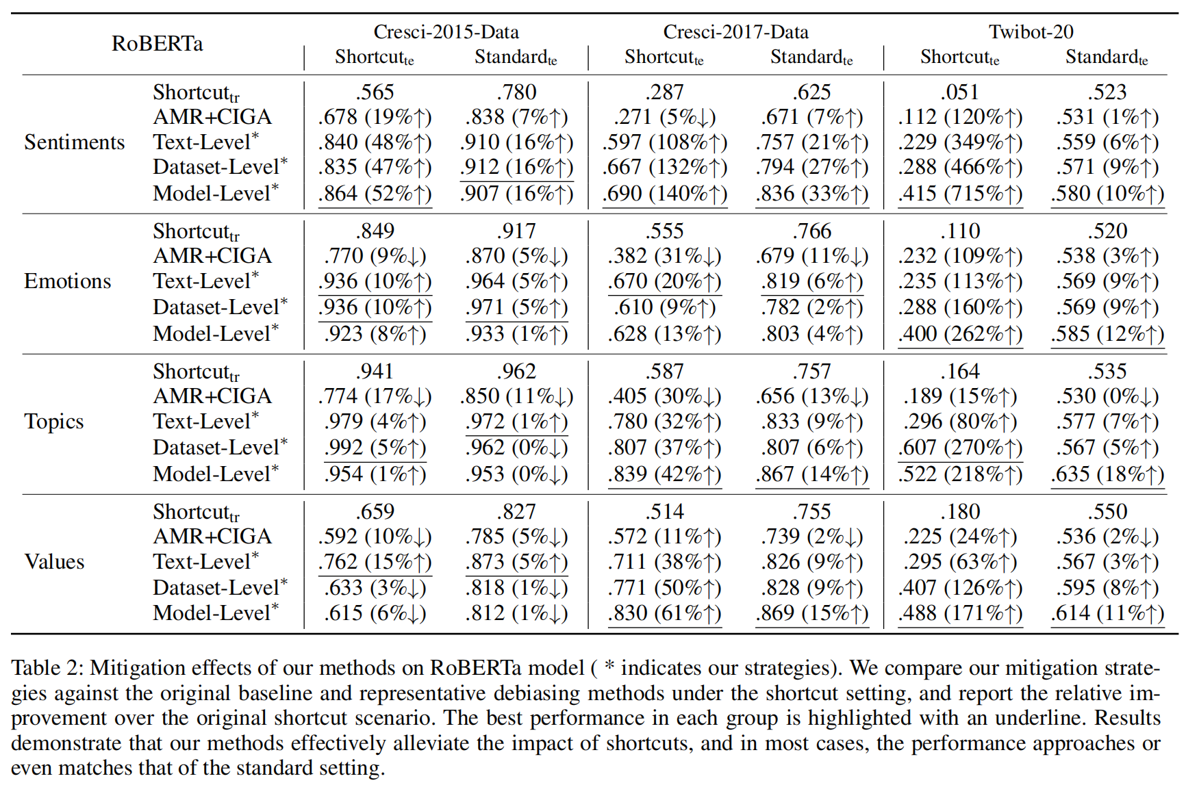

Mitigation Results
Performance gains
Text models: +59% (relative average)
Graph models: +53% (relative average)
Notes:
Here, we evaluate the effectiveness /of our mitigation strategy.
Compared to the baseline model and existing debiasing methods,
our approach achieves /an average relative improvement /over 50% in both methods.

Slide 21
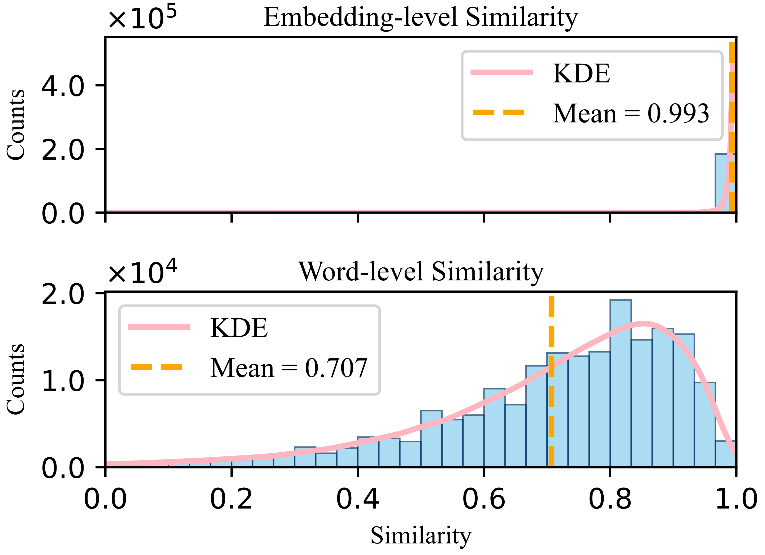

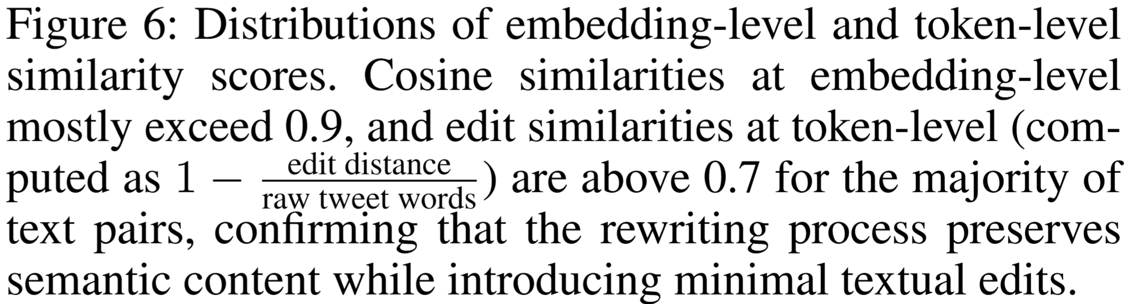
Mitigation Results
The Appropriateness of Mitigation Strategies
Notes:
And building on prior work, we confirm that /LLMs can effectively preserve /user labels /while rewriting text, with a token-level edit similarity /above 0.7 and /cosine similarity over 0.9, ensuring minimal /surface changes and high /semantic consistency /in the rewritten texts.

Slide 22
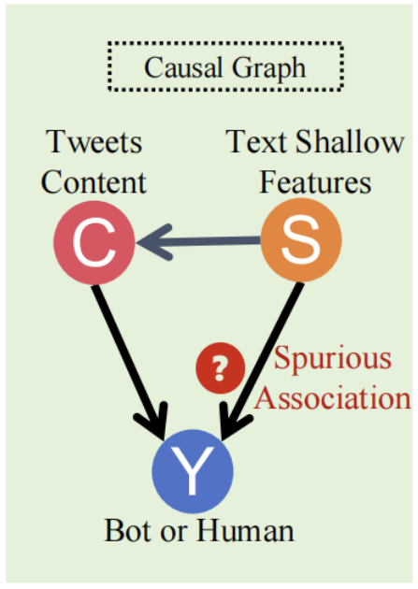
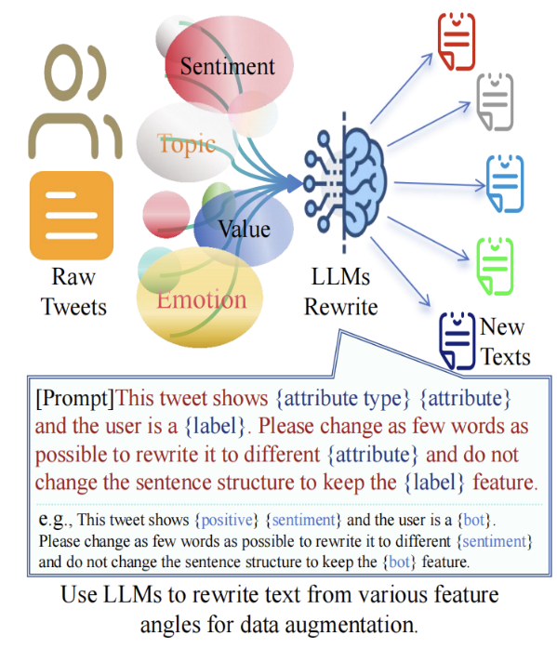




Summary
This work identifies shortcut learning as a challenge in social bot detection and demonstrates that LLM-based counterfactual data augmentation provides a practical and effective mitigation strategy.
Paper
Github
Notes:
In a nutshell, this work identifies shortcut learning as a challenge in social bot detection /and demonstrates that /LLMs-based counterfactual data augmentation /provides a practical and effective/ mitigation strategy.

Slide 23
Bot Meets Shortcut: How Can LLMs Aid in Handling Unknown Invariance OOD Scenarios?
Shiyan Zheng, Herun Wan, Minnan Luo📧, Junhang Huang
Thank you for your interest!
Paper
Github
Notes:
Thank you for your interest!

