Slide 1
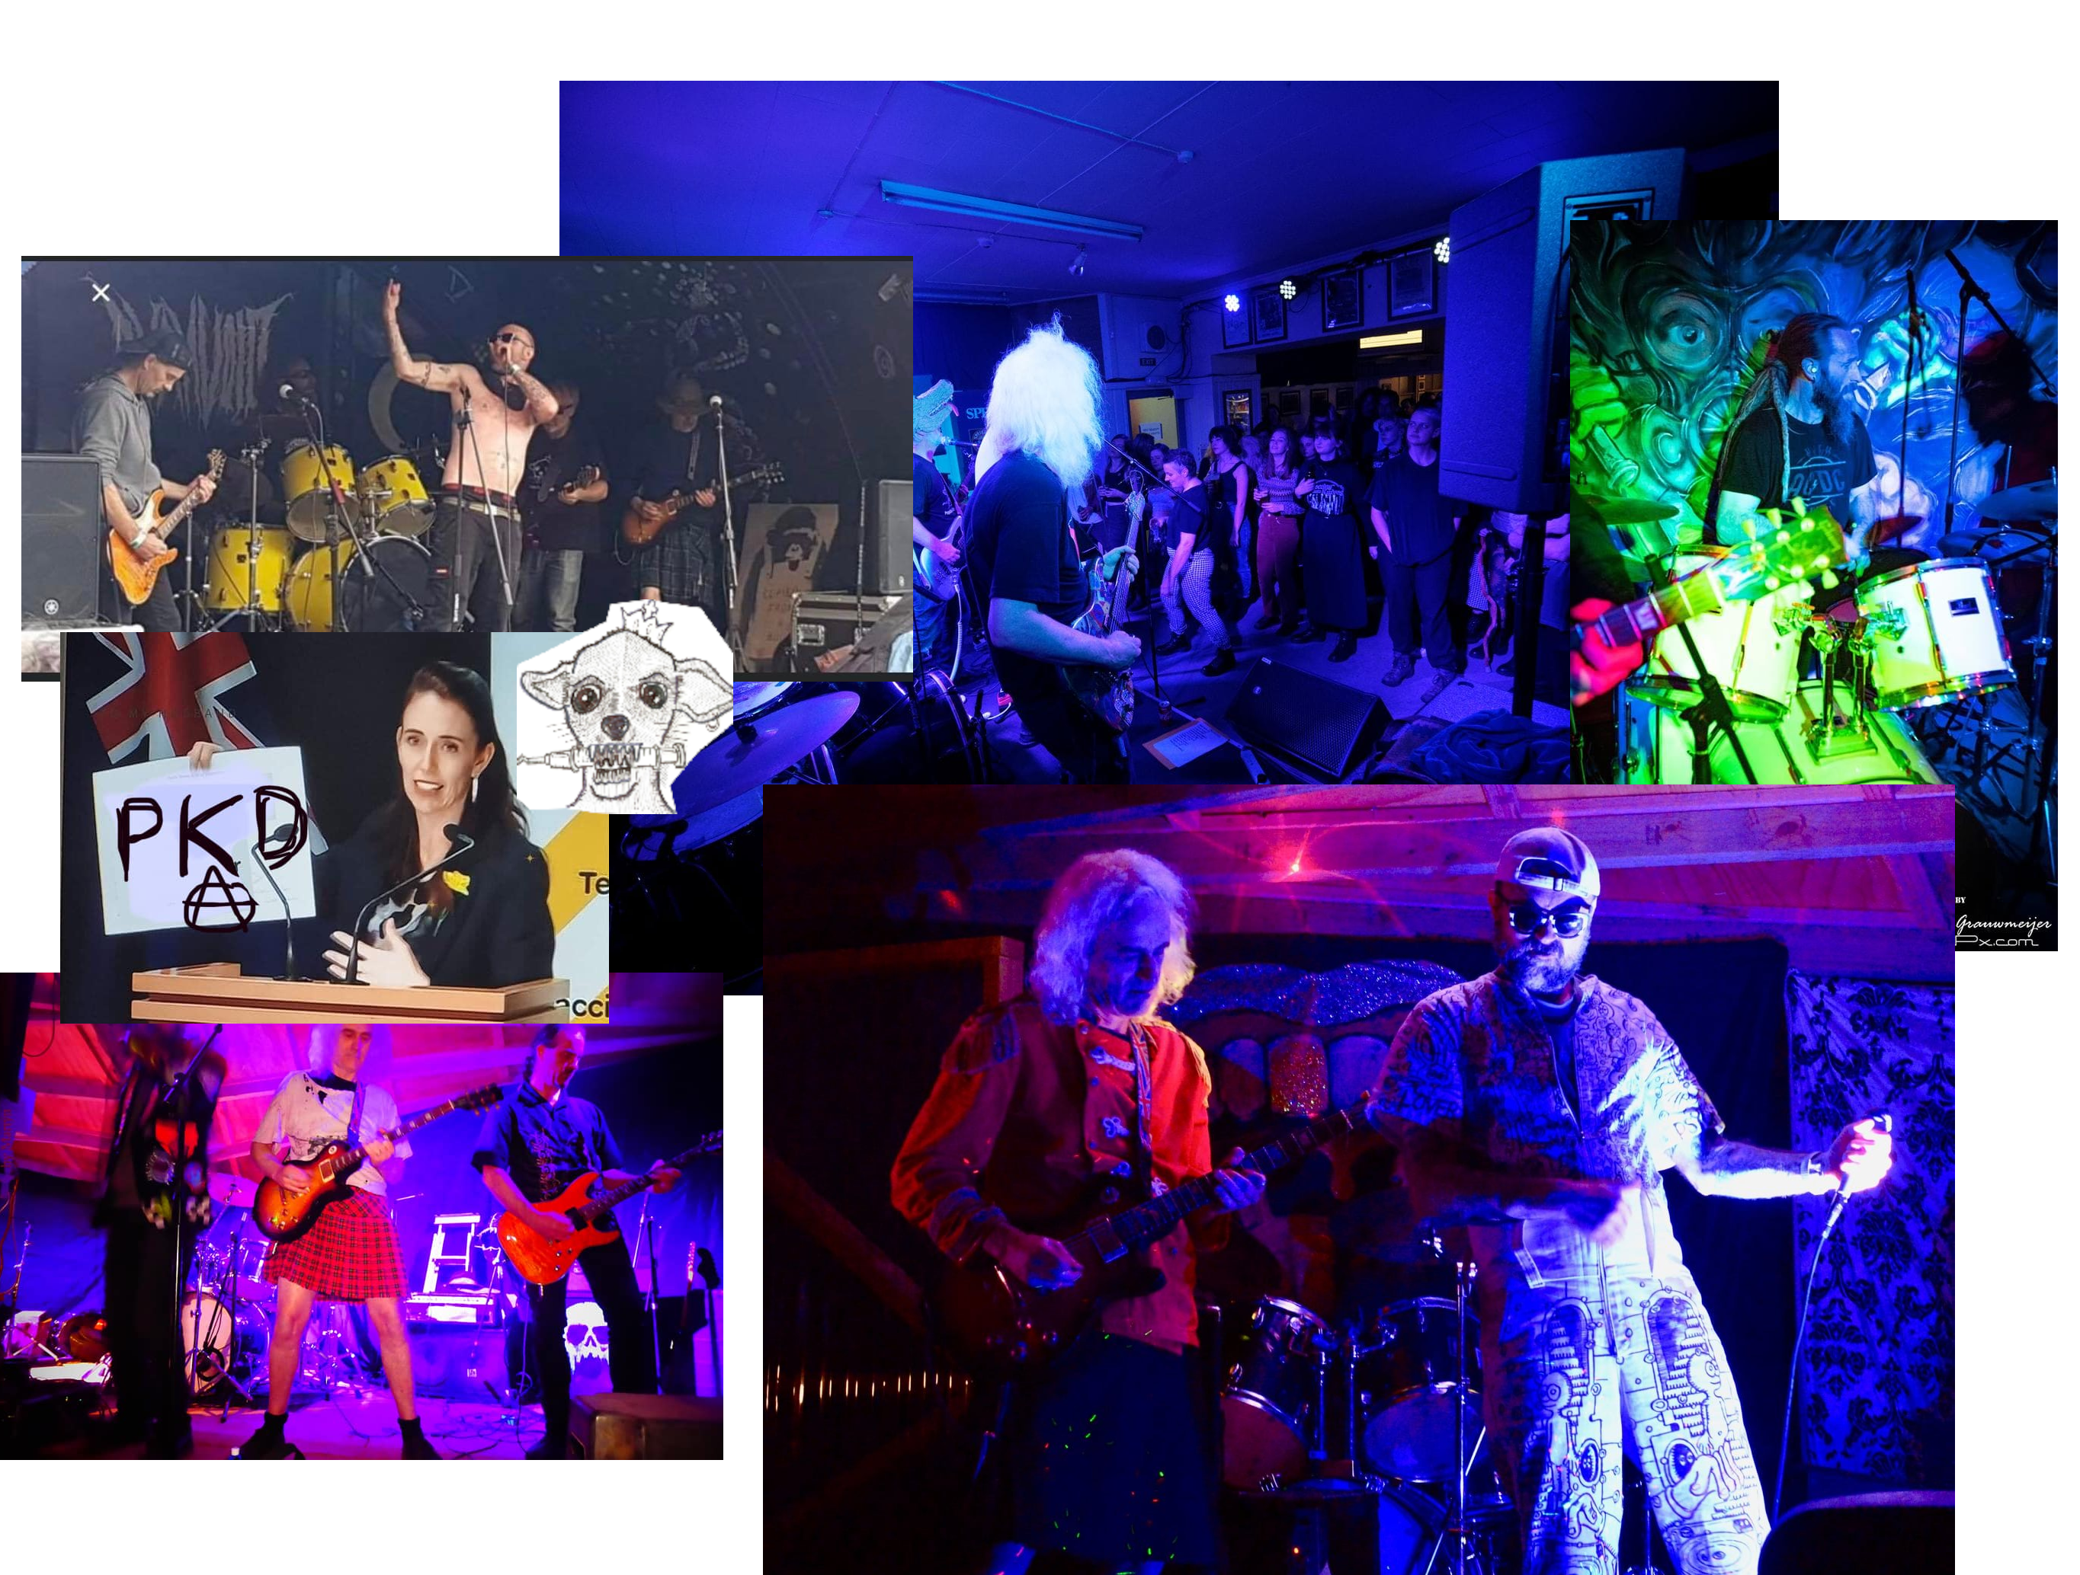
Processing Audio Live on a Raspberry Pi

Slide 2
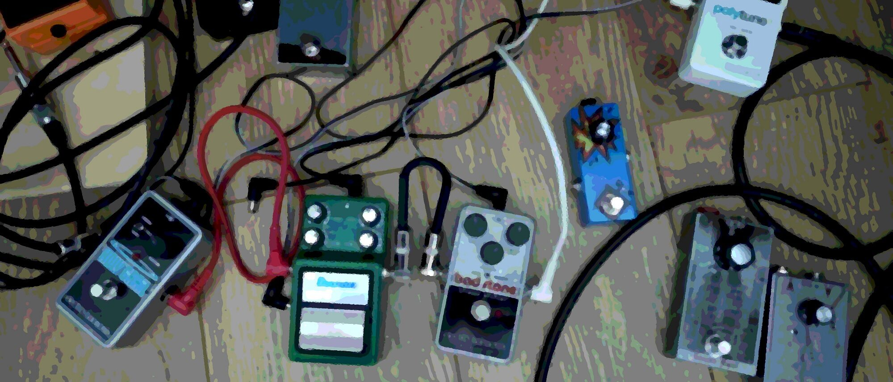
Electric Guitar
Analouge electrical signal
Effects “pedals”
Amplification

Slide 3
Effects Units
Add to “Cable Hell”
Settings applied via knobs
  Change between use
Expensive – limits choice

Slide 4
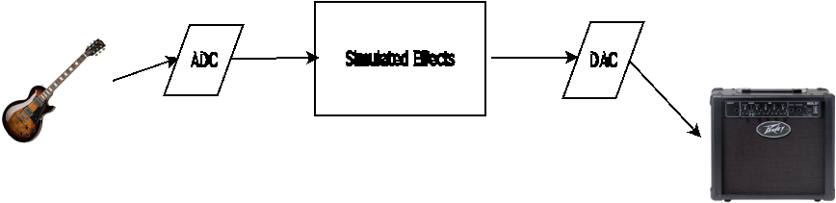

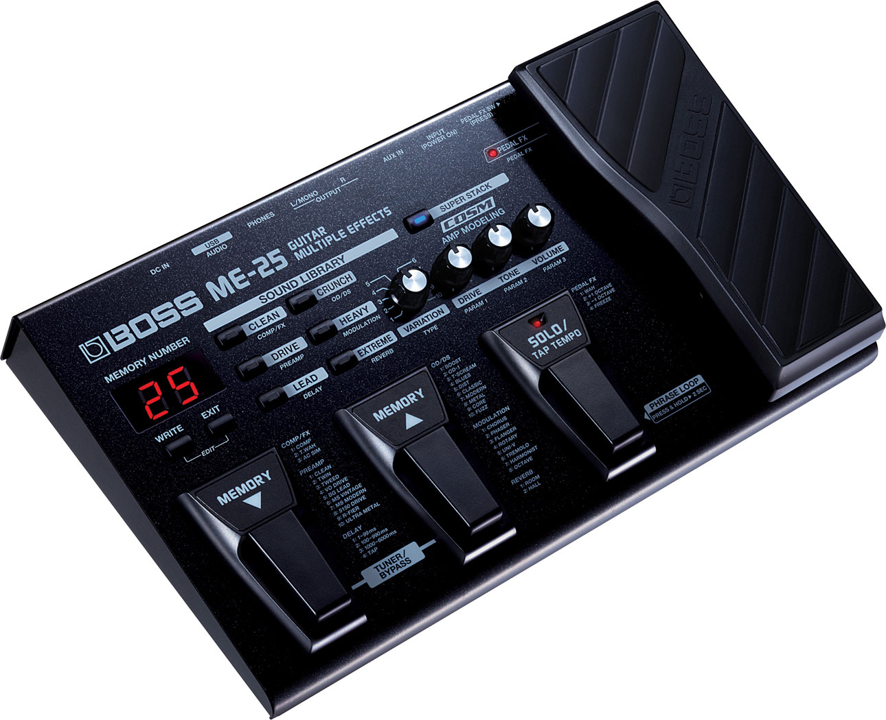
Digital Effects

Slide 5
Desire
Audio I/O
  High quality
  Low latency
    Processing capacity of Pi 5 not a problem, yet
Switch < 100ms
  Audible perception

Slide 6
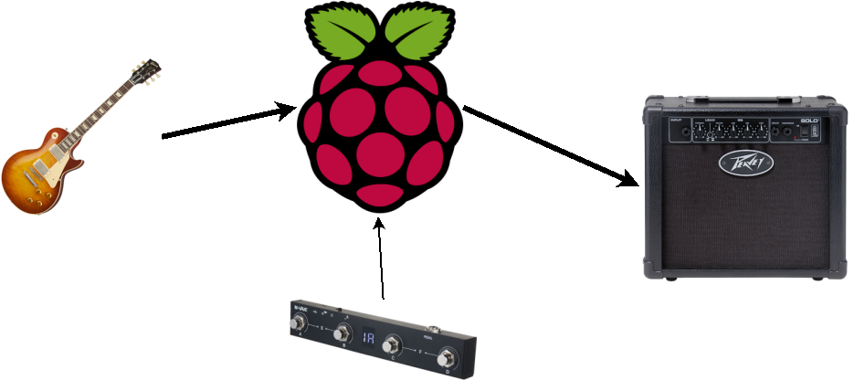
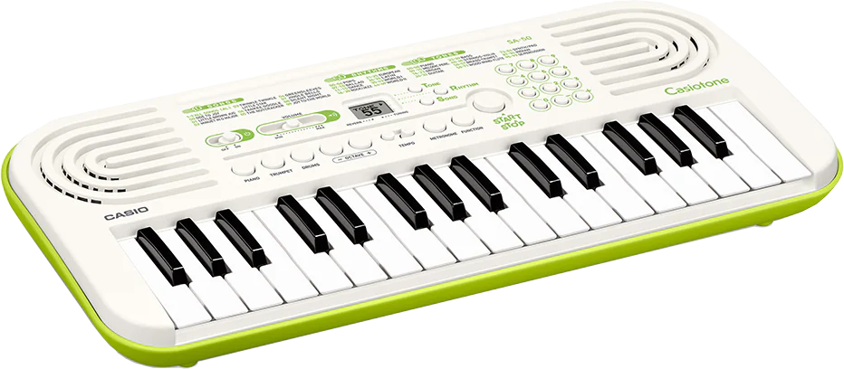
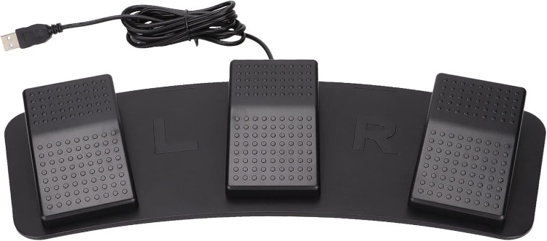
System Design...
Electric guitar as source
  Or any other physical instrument producing analogue electrical signals
    E.g: vocals, theremins, “vintage” electronic instruments

Slide 7
Challenges
Sound
  On board sound processing poor quality up to Raspberry Pi 5
    Output only – need input too
  Raspberry Pi 5 dispenses with any audio interface
  Problem in common with all general purpose computers
    Power supply: Solved by using a laptop, might yet!
Pedal
  Pedal must be robust – beer spills, heavy feet
  Pedal must be available/reasonable price – not going to build one myself
Robustness:
  Rock’n’roll stage is a dangerous environment

Slide 8
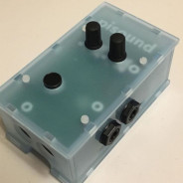
Real-time Sound processing on a Raspberry Pi...
PI Sound – Hat for Raspberry Pi
  “ultra-low latency high-quality sound card...
    ...and MIDI interface
USB Keyboard Pedal
  Cheap

Slide 9
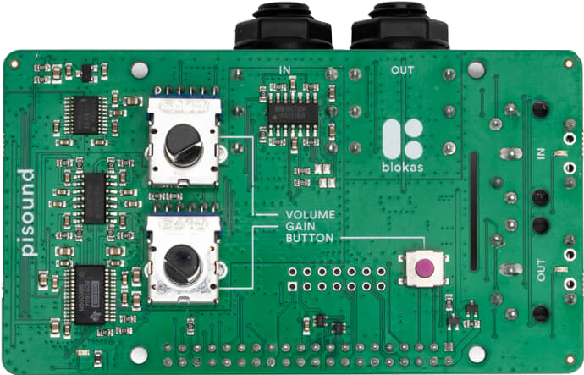
Problems
Pi Sound is delectate
  Case face plate defective
  Stereo I/O – odd decision
  MIDI DIN plugs unnecessary
USB Foot Keyboard is obviously unsuited

Slide 10
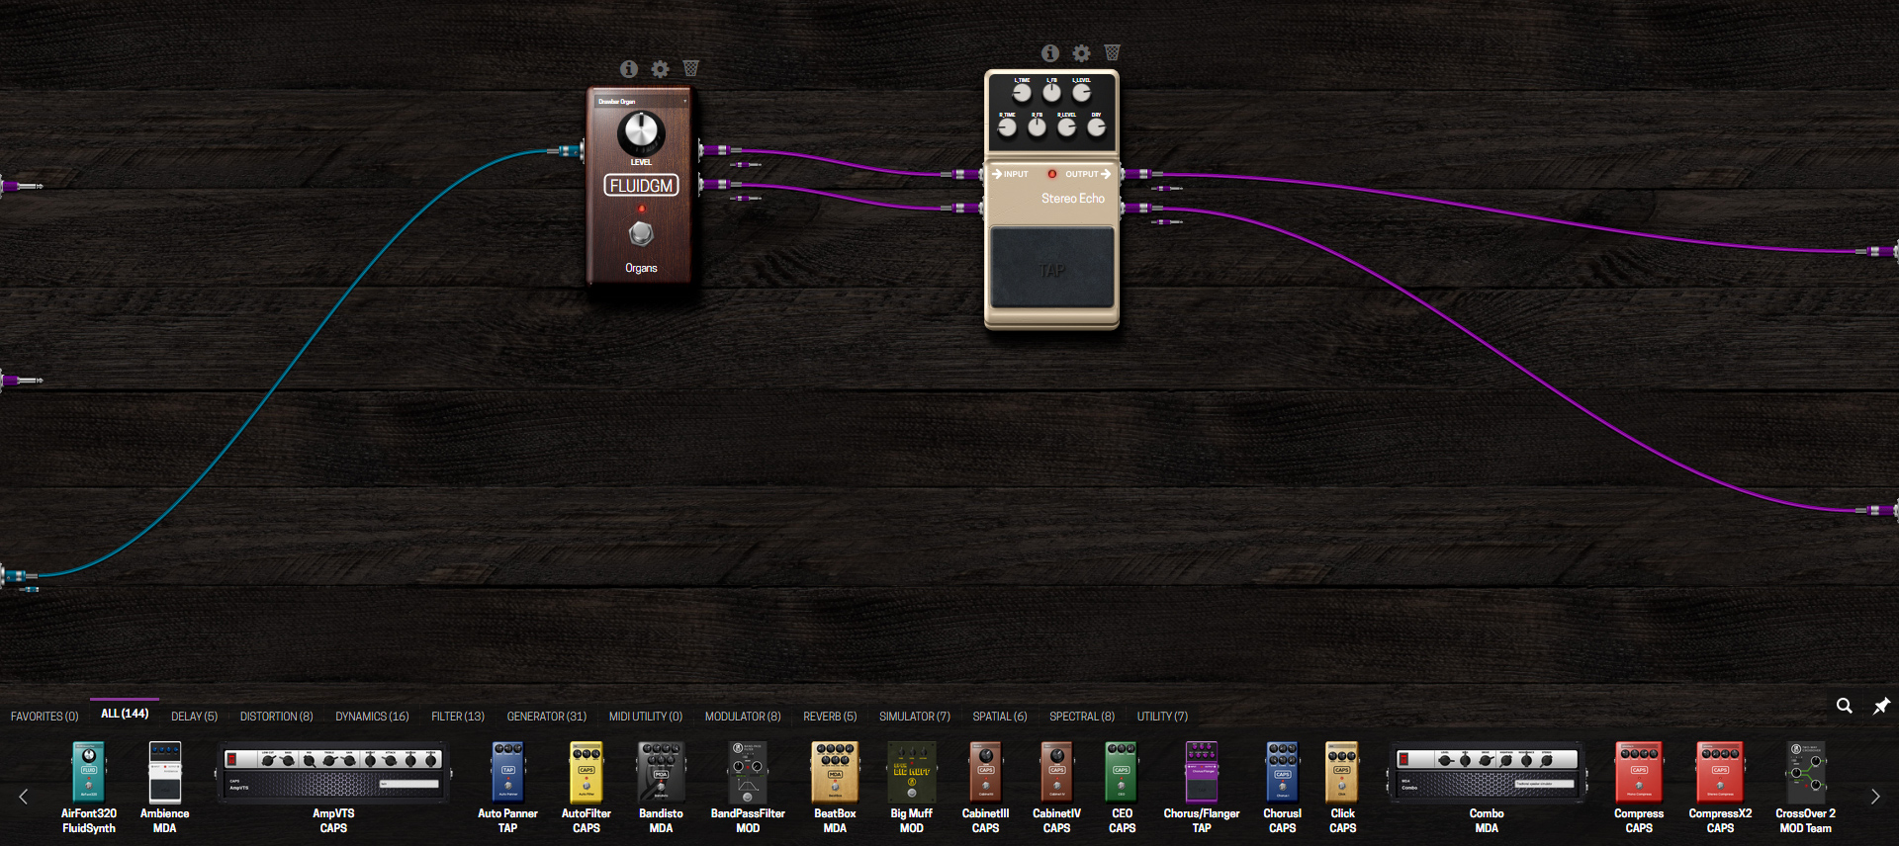
Important Digression
Modep: mod-ui
  LV2 simulators
  Jack Audio pipes
Some other stuff

Slide 11
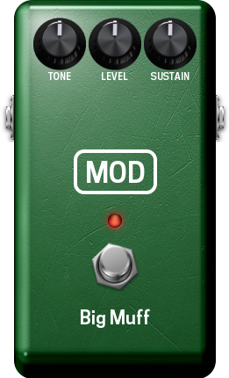
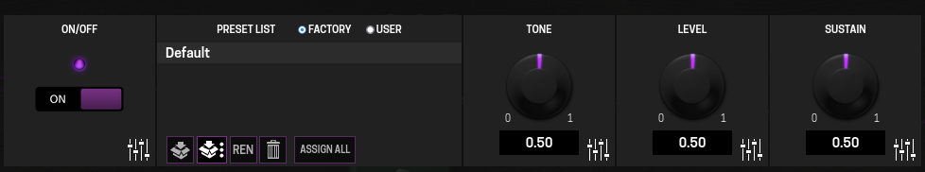
Digression ii: Modep/Modhost
LV2 Simulators
Controlled by a host
Control host with Unix socket
Each simulator has a numeric identifier1,2,3...
add add http://moddevices.com/plugins/mod-devel/BigMuffPi 7
param_set 7 Tone 0.500000
param_set 7 Level 0.500000
param_set 7 :bypass 0
param_set 7 Sustain 0.500000

Slide 12

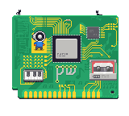
Digression iii
Jack Audio Connection Kit
  Pipe audio (and MIDI) signals between programmes
    Audio pipes very useful
    MIDI pipes: Mēh! ALSA perfect
Pipewire replacing it
  Good

Slide 13
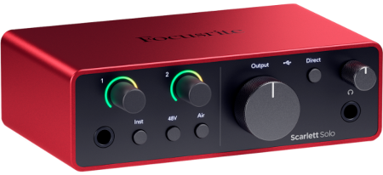
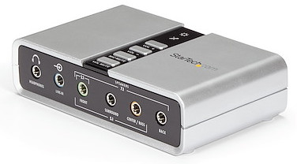
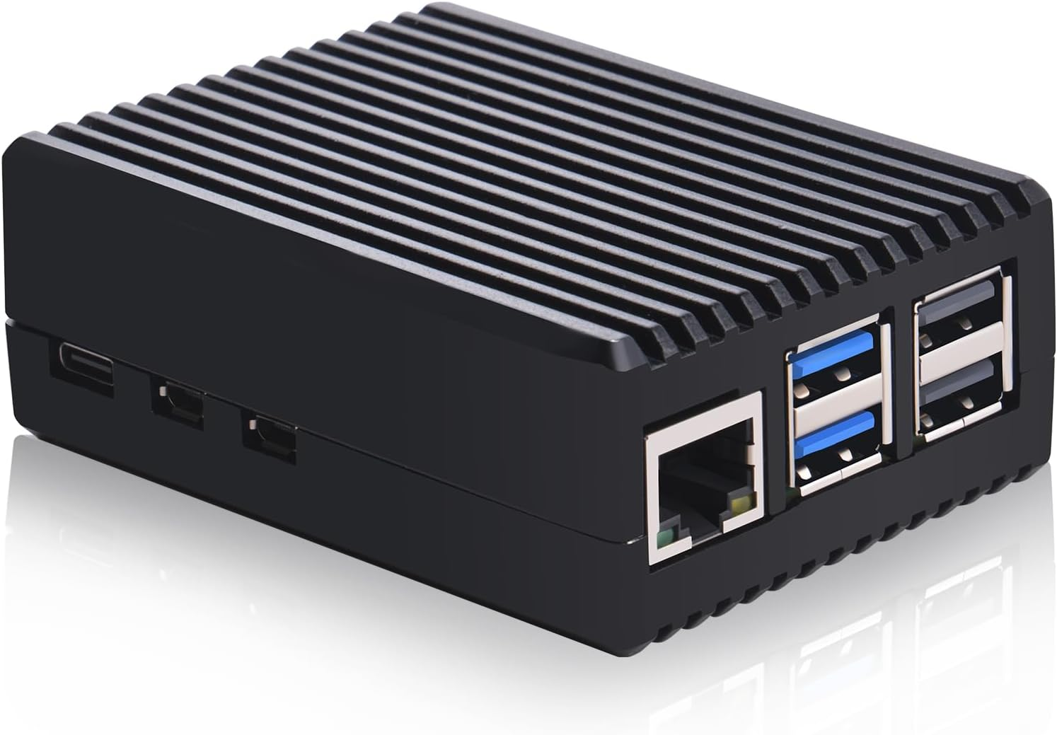
Solutions: Sound Hardware
USB Sound card
Cheap and cheerfull
Not cheap – low latency
Standard case

Slide 14
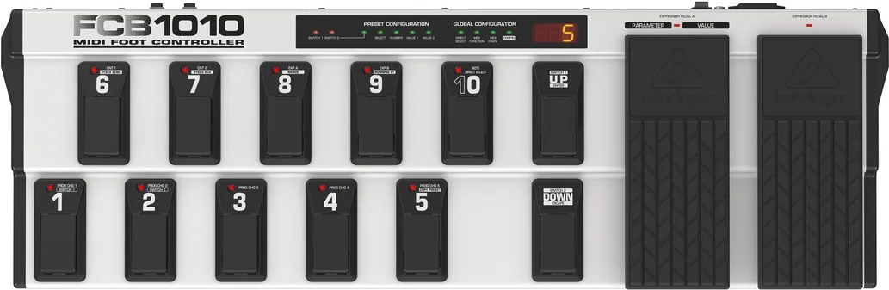
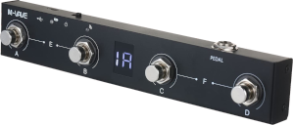
Solutions: Pedal
MIDI – Got to be
Pedals available – not common
Trigger on release?

Slide 15
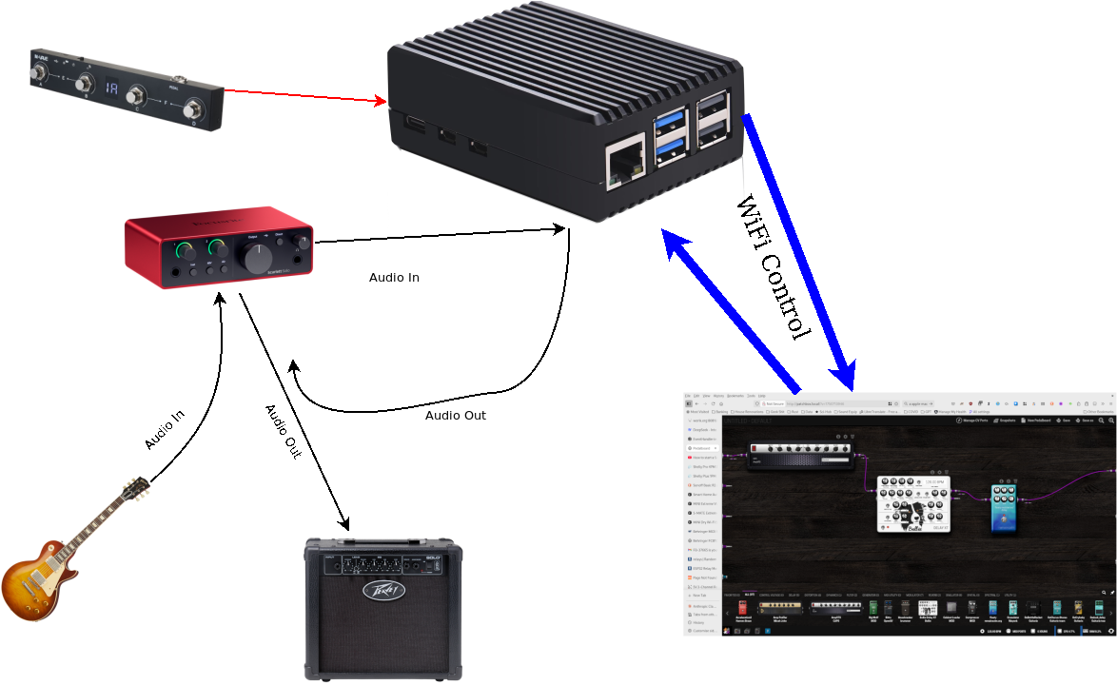
Use Modep!?

Slide 16
Modep/Modui?
500ms Latency
LV2 Only
  I want to defined “effects” with Jack pipes
Portibility
  Debian 12?
  Bit rot?

Slide 17
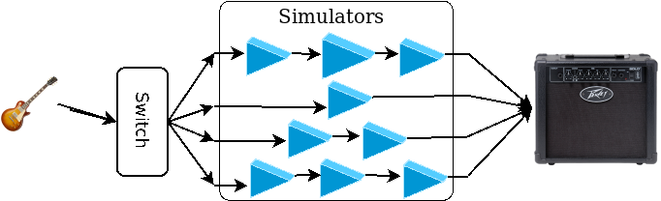
Mark I
Set up all the simulators in memory
Connect the “pedal-boards” with the Jack audio pipes between them
Do not set them up with I/O to the hardware devices
Write a MIDI controller to change Jack audio pipes to enable I/O

Slide 18
Digression ^{again}: Modep/Modhost
Initialise: To UNIX socket -> mod-host
add add http://moddevices.com/plugins/mod-devel/BigMuffPi 7
param_set 7 Tone 0.500000
param_set 7 Level 0.500000
param_set 7 :bypass 0
param_set 7 Sustain 0.500000
Activate: Jack API or Shell
jack_connect effect_7:Out1 system:playback_1
jack_connect system:capture_1 effect_7:In
Setup all effects at initialisation
Excepting I/O

Slide 19
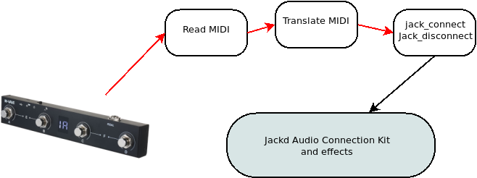
MIDI Driver
Read
  Get MIDI Programme Change from pedal
Translate
  Pedal tries to be smart, dumb it down
Act
  Set I/O to enable effects

Slide 20
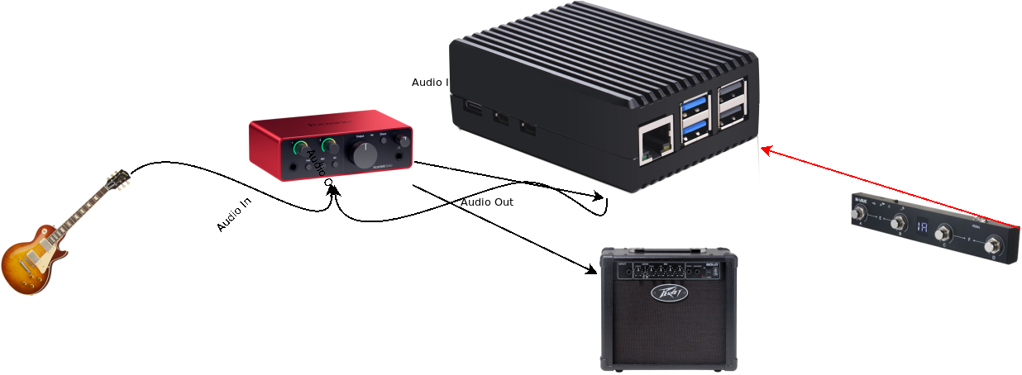
Complete?
Have audio I/O and control
Got everything I asked for
In use....

Slide 21
Not Finished Yet
* Adjusting settings interrupts creative process
* Most important setting is volume
* Difficult to estimate subjective and relative volume of electric guitar
on its own - as opposed to “full noise”
* Use pd (Pure Data) to make simple mixer to control volume

Slide 22
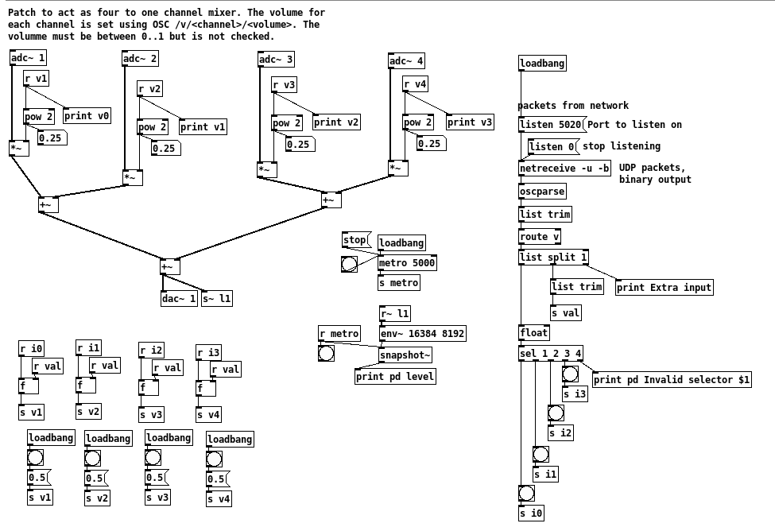
Mixer

Slide 23
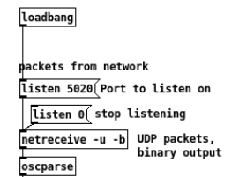
Control Mixer With open Sound Control
Pure Data listens on a port
UDP packets
  /v/2/0.8
  Set effect 2 volume to 0.8
Easy: Pure data has prmatives to parse
Rust crate rosc for encoding and transmitting
  Possibly easiest part of whole project

Slide 24
Control: UI
WIMP interface unsuitable
Keyboard on its own problematic
  moving parts
  super vulnerable to spills
Web-app c/f Modep?
  Yawn
  Supposed to be fun
  Require WiFi to operate
  Separate piece of equipment

Slide 25
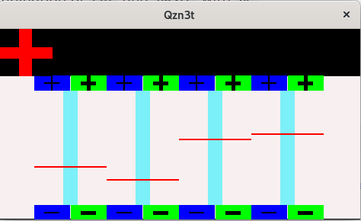
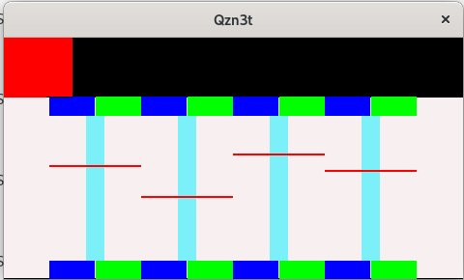
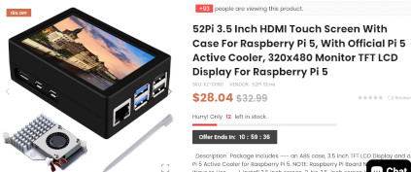
Pi Touch Screen and Case

Slide 26
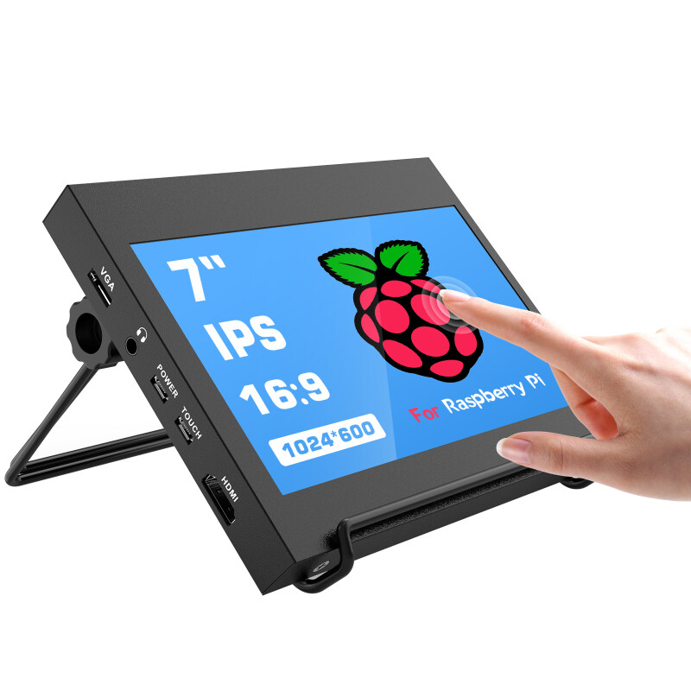
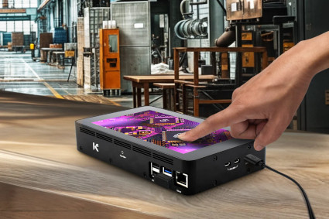
Regrets

Slide 27
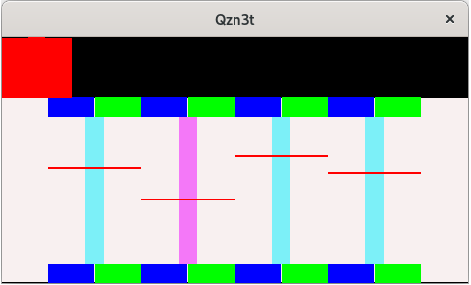
State: Display, store...
Added complications
Not enough to set volume, must be stored (and displayed) between rehursal and performance
Take oportunity to display selected pedal

Slide 28
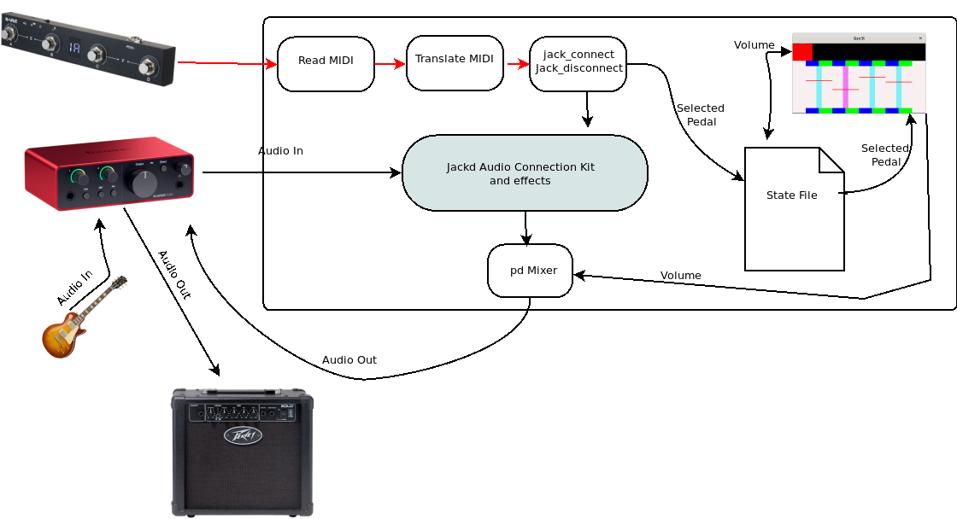
Finished?

Slide 29
A Conclusion about GUIs
Developer Time Sink
Modep has a fabulous GUI.
Must have been huge effort over many years
  worik@claudia:~/mod-ui$ find . -name "*.py"|wc -l
  34
  worik@claudia:~/mod-ui$ find . -name "*.py" -exec wc -l {} \; | cut -d' ' -f1 | paste -sd+ | bc
  18796
Useless live: That is what is it is all about (for me)

Slide 30
Complications
Basic switching simple
Interactions with pedal fraught (inconsistant MIDI)
Adjusting volume (relative volumes)
  Implies GUI
  Storing state

Slide 31
Next...
Tuner
Mixer “reset”
Mute button (keep tuner)
Banks, and bank switching
  Hard to get reliable for performance
Web-app font end to meta configuration (Go)

Slide 32

The END?!?!

