Slide 1


PREPARED FOR CLIENT NAME
MONTH 2027
PROPOSAL
A clear title for this deck, in two lines at most
Client or audience name
Notes:
Cover. Title ≤ 10 words, 104px (52pt). Keep the Calm Blue watercolor. Replace every placeholder.

Slide 2


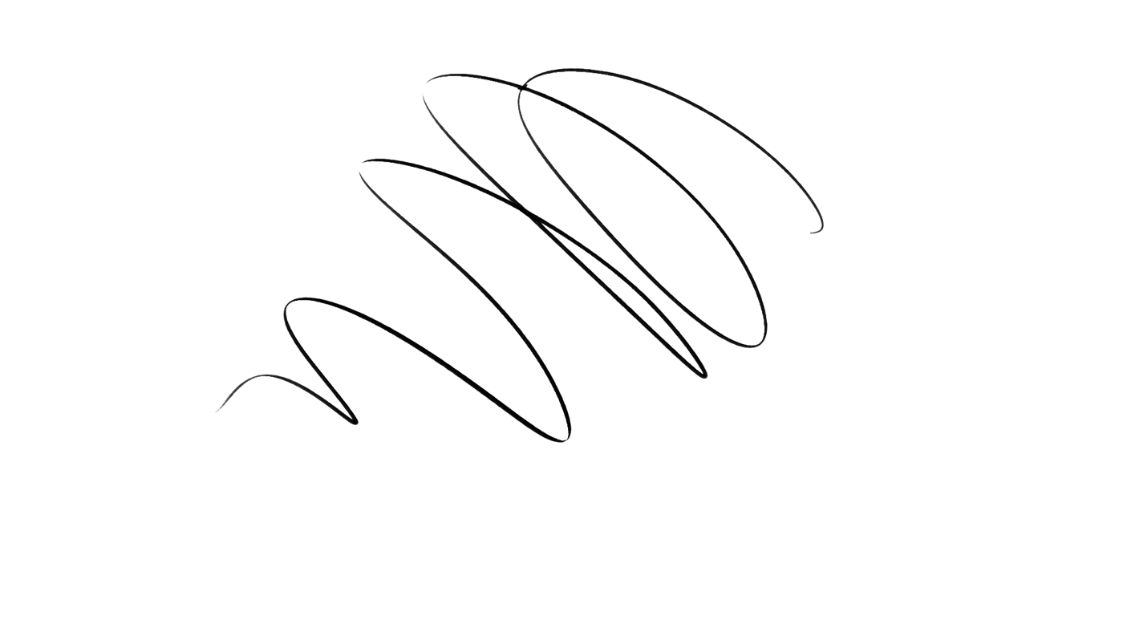
SECTION 01
Section title
One line on what this section covers.
Notes:
Section divider. Number the real sections in order. Title ≤ 5 words.

Slide 3

EYEBROW
Page title in a few words
The lede: one sentence that says what this slide is about.
Body copy in Lora, 32px (16pt). Keep a slide to 40 words or fewer and split it before you shrink the type.
Emphasis is Lora bold, never italic. Italic means quoting.
Notes:
Content. Title 72px (36pt), lede 30px League Spartan 400, body 32px Lora. ≤ 40 words.

Slide 4

WHO WE ARE
A headline that pairs with the photo
Two or three sentences in Lora. Use WBT’s own photos, never stock. Keep faces clear of the text and the slide edge.
Notes:
Photo + text. Swap the photo for one of WBT’s own (asset catalog › Photography). Never crop a face.

Slide 5


IN THEIR WORDS
“I walked out of our team retreat feeling confident about my team’s roles, responsibilities, and alignment on achieving our overall mission.”
JAMES BAUMER, DEVELOPMENT DIRECTOR, EMPOWER
Notes:
Quote. Real quotes only, verbatim, with name and role. Curly quotes; the opening mark hangs outside the text edge.

Slide 6
THE IMPACT OF COACHING
What the research shows
80%
70%
86%
of people who receive coaching report increased self-confidence
of leaders improve performance, communication, and relationships
of companies and organizations report a positive ROI on coaching
RESEARCH FROM THE INTERNATIONAL COACHING FEDERATION (ICF)
Notes:
Stats. Figures from workbettertogether.coach (ICF). Always cite the source on the slide.

Slide 7


CO-FOUNDER
Jenna Shapiro
ICF-certified leadership coach and facilitator
Bio text in Lora, 3–5 sentences. Use the bio from workbettertogether.coach/about, word for word.
Notes:
Bio. Copy the bio verbatim from the website. Portrait full colour, as shot.

Slide 8


THANK YOU
Let’s get to work.
Jenna Shapiro
Stacy Berger
jenna@workbettertogether.coach
stacy@workbettertogether.coach
Notes:
Thank you. Check the contact emails before sending.

