Slide 1





PerformerZ
(Employee Analysis)
Samarth Bansal (E22CSEU0139)
Sankalp Bijalwan (E22CSEU0140)
Shashwat Sharma (E22CSEU0126)

Slide 2
—Anne M. Mulcahy
“Employees are a company's greatest asset – they're your competitive advantage”

Slide 3
—Jim Goodnight
“Treat employees like they make a difference, and they will”

Slide 4

?

Slide 5
"Take good care of your employees, and they'll take good care of your customers, and the customers will come back." - J.W. Marriott
"Your employees come first. And if you treat your employees right, guess what? Your customers come back, and that makes your shareholders happy" - Herb Kelleher
"The way your employees feel is the way your customers will feel. And if your employees don't feel valued, neither will your customers.'" - Sybil F. Stershic
"Your employees are your most valuable resource. The way to attract and retain the best people is to create a work environment that is challenging, creative, and fun." - David Packard
"Employees want to feel inspired by their leaders... Hire individuals who will lead by example." - Jody Kohner
“The success of the company depends on the people you have, how you train them, how you motivate them, and how you lead them.”- Robert K. Greenleaf
"Caring for your employees is the foundation of a thriving workplace." - Bertrand Russell

Slide 6


Employees Are VERY VERY IMPORTANT
Quality Performance

Slide 7
Abstract
This project systematically analyzes and predicts employee satisfaction, turnover rates, and promotion opportunities within the organization. It aims to uncover insights, improve retention, and contribute to organizational success.

Slide 8
Introduction
An employee analysis project that methodically analyzes data related to a company’s satisfaction levels, workplace accidents, promotion opportunities, and salary structures within the organization.

Slide 9
The project is aimed at analyzing and assessing employee performance, satisfaction, and overall well-being within the organization.

Slide 10
METHOD

Slide 11
Our Plan
In our employee analysis project, we aim to understand employee satisfaction, work accidents, promotions, and salary structures. This analysis will reveal insights into employee performance, engagement, and retention, aiding data-driven decision-making

Slide 12

Step 1 :
We will thoroughly explore the employee data to understand its characteristics and key feature

Slide 13

Step 2 :
Utilizing statistical measures and visualizations to summarize and describe the data effectively

Slide 14

Step 3 :
Analyzing employee satisfaction levels to gauge overall workforce contentment.

Slide 15
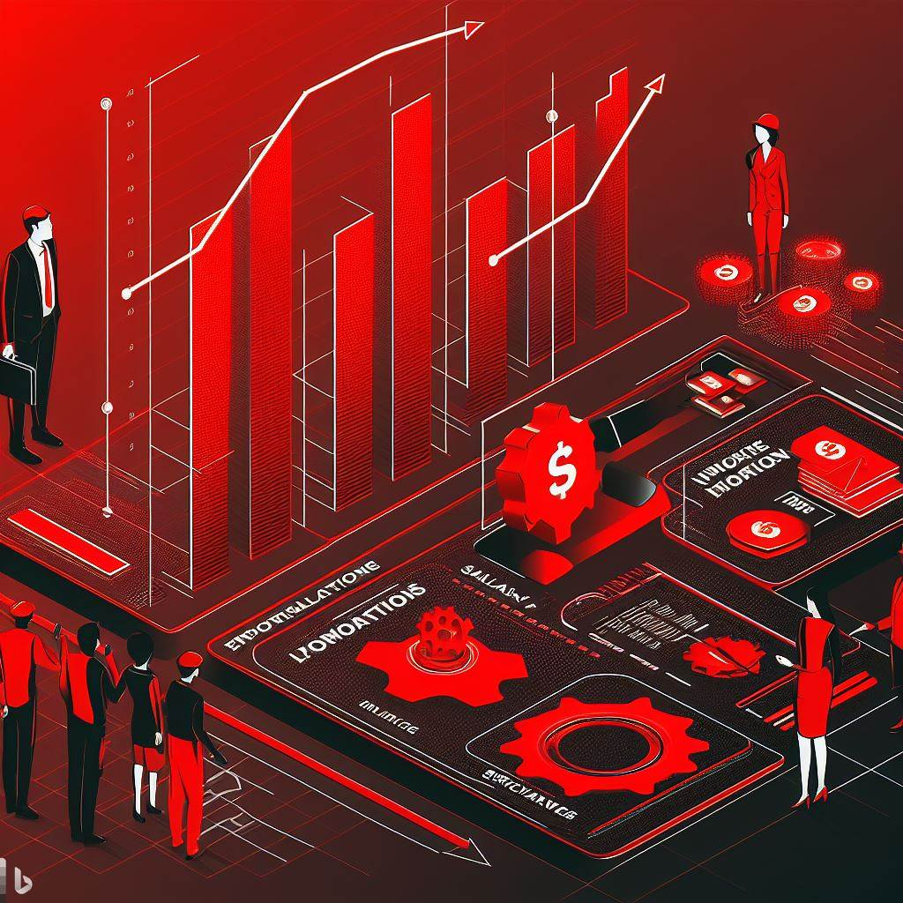
Step 4 :
Evaluating the influence of work accidents, promotions, and salary structures on employee outcomes and company performance.

Slide 16

Step 5 :
Drawing meaningful conclusions and providing actionable recommendations for improving the work environment and employee well-being.

Slide 17
RESULT

Slide 18

Analysis Approach:
The project utilizes data analysis and visualization techniques to uncover trends and correlations within the data.

Slide 19

Data-Driven Decisions:
The insights gained from this analysis will inform data-driven decisions within the organization.

Slide 20

Impact Investigation:
The project also delves into how these identified factors influence various employee outcomes, such as performance, engagement, and retention

Slide 21

Prediction:
The project also predicts the exit rate, promotion chances, and satisfaction level of employees from the provided input.

Slide 22

Dynamic Dashboard:
We have created a dynamic dashboard showing the analysis of Exit Rate, Satisfaction Level, and Promotion of Employees.

Slide 23
Conclusion
Our project showcases a data-driven analysis to enhance employee satisfaction, reduce turnover, and identify pathways for promotion. By fostering a more harmonious and dynamic workplace, it paves the way for increased organizational success and employee well-being.

Slide 24

Thank You

