Slide 1
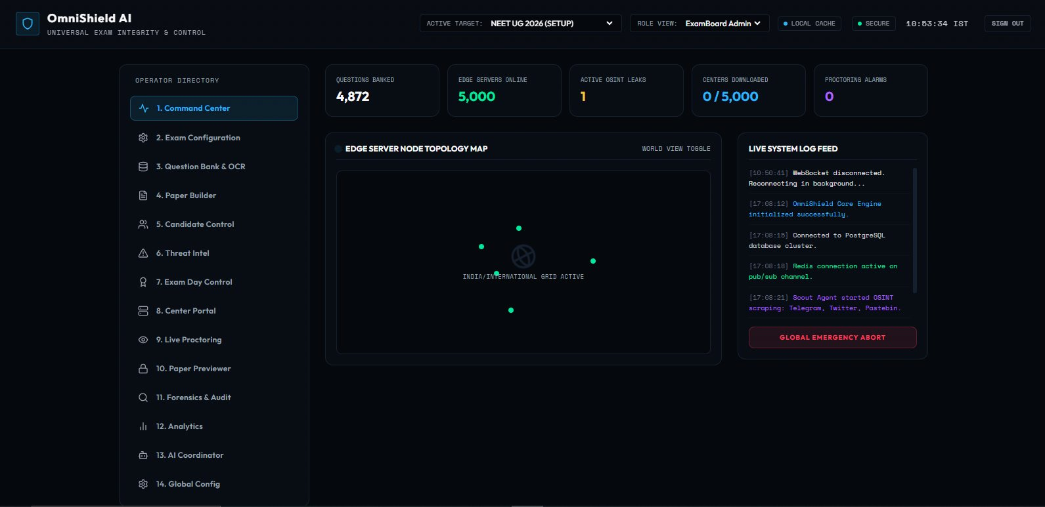
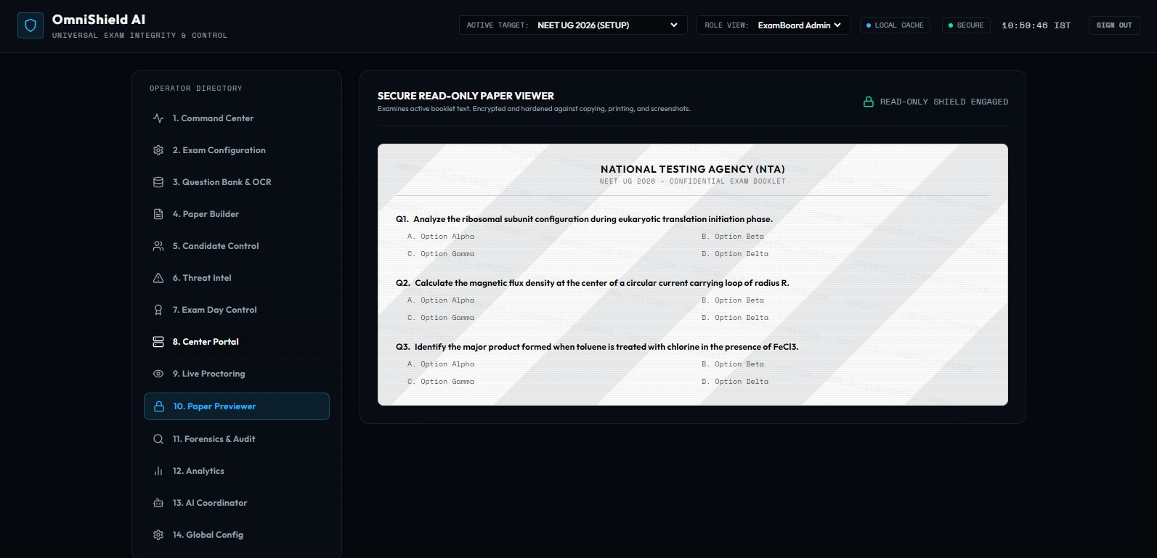
FAR AWAY 2026 · HACKATHON
OmniShield AI
Universal Exam Integrity
& Control Platform
Autonomous · Cryptographic · Unstoppable
EXAMINATIONS
AGENTIC AI
FAR AWAY 2026
Domain: Examinations + Agentic & Autonomous Systems
2nd-year B.E. AI & Data Science
Sipna College of Engineering & Technology, Amravati

Slide 2
THE PROBLEM
A Crisis of Trust in India's Exam System
NEET UG 2026 was cancelled before a single student opened a booklet.
2.27M
₹500Cr+
18
~0
Students affected
Re-exam cost
CBI fraud cases
Convictions
ROOT CAUSE
Question papers exist for 72 hours before exam day. Every hour they sit in physical form — at a printer, in transit, at a centre — is an hour they can be photographed, forwarded, and sold. Current solutions fight the symptom. OmniShield eliminates the cause.

Slide 3
THE INSIGHT
You Cannot Leak What Doesn't Exist Yet
Generate the paper 45 minutes before the exam starts.
The leak window drops from 72 hours to 45 minutes.
❌ BEFORE — Traditional System
✅ AFTER — OmniShield AI
• Paper printed 72 hrs before exam
• Paper generated T−45 minutes
• Travels through 6+ human hands
• Zero physical paper at any point
VS
• Stored overnight at 5,000 centres
• Each centre operates independently
• Each step is a potential leak point
• Cryptographic watermark per student
• Once leaked: irreversible
• Leak window: 72 hrs → 45 minutes

Slide 4
SOLUTION
Three Autonomous Phases
OmniShield AI secures every stage — before, during, and after the exam.
PHASE 01
PHASE 02
PHASE 03
Pre-Exam
Exam Day
Post-Exam
Leak Detection
Paper Generation
Forensic Audit
Scout Agent monitors Telegram,
Dark Web, and Twitter in real time
RAG Generation Agent creates questions
via Claude API + FAISS vector search
Audit Agent runs Z-score analysis
across all 5,000 centre answer sets
Verification Agent extracts structural
fingerprint from flagged content
Variation Agent surface-varies each
centre's paper — same concept, different form
Flags statistically anomalous centres
with question-level confidence scores
Action Agent compiles evidence and
triggers backup paper autonomously
DWT-SVD Watermark embeds centre_id
+ student_id invisibly into each paper
Generates tamper-proof forensic PDF
report automatically

Slide 5
ARCHITECTURE
7 Agents · LangGraph State Machine
PHASE 1 — PRE-EXAM
SCOUT
VERIFY
ACTION
Telethon OSINT
Telegram · Dark Web · Twitter
→
Structural fingerprint
vs hashed blueprint
→
Evidence package
Dual-Authority trigger
↓ If leak confirmed → triggers backup generation
PHASE 2 — EXAM DAY
RAG GEN
VARIATION
ASSEMBLY
WATERMARK
FAISS + Claude API
Dual validation loop
→
Surface-vary per centre
Self-solver check
→
180 questions
in < 45 seconds
→
DWT-SVD embed
cancellation-proof
↓ Post-exam
AUDIT AGENT
Z-score anomaly analysis across 5,000 centres · Forensic PDF report · PostgreSQL append-only ledger
· React 19 · TypeScript

Slide 6
PLATFORM WALKTHROUGH · MODULE 1
Command Center
4,872 questions banked across Biology, Physics, Chemistry
5,000 edge servers online — India / International grid
Live OSINT threat feed — 1 active alert flagged
Redis pub/sub for real-time agent trace streaming
Global Emergency Abort — single-click kill switch
4,872
5,000
1
Questions
Edge Nodes
Active Alert
Module 6: Threat Intelligence — Scout Agent Feed

Slide 7
FEATURE · LEAK DETECTION
Scout Agent + Dual-Authority Protocol
Monitors Telegram, Dark Web mirrors, Twitter via Telethon OSINT
Extracts structural fingerprint — never compares real questions
Similarity score: < 75% = FAKE · > 75% = triggers verification
Dual-Authority: NTA Director + Chairman must both sign to trigger backup paper
Action Agent auto-compiles evidence: source, timestamp, confidence
SOURCE
SIMILARITY
VERDICT
Telegram @leak_neet2026
14.2%
FAKE
Dark Web Mirror #4
44.1%
ANALYSING

Slide 8
FEATURE · EXAM DAY CONTROL
6-Phase Autonomous State Machine
01
02
03
04
05
06
DISTRIBUTE
LOCK
BROADCAST
UNLOCK
WATERMARK
GENERATE
AES packages
to MinIO
→
Invigilator
creds hashed
→
Decrypt key
via satellite
→
Edge servers
rebuild key
→
Embed marks
into files
→
Papers loaded
to spools
Edge Resilience: 5,000 centres generate independently after satellite token broadcast. Central server failure = zero impact.
EMERGENCY OPERATOR ACTIONS
PAUSE EXAM
EXTEND TIME (+15M)
FULL ABORT

Slide 9
CORE TECHNOLOGY · DWT-SVD WATERMARKING
Every Paper. Invisibly Signed.
If anyone leaks a photograph of the exam paper, OmniShield identifies the exact student and centre in seconds.
1
2-Level Haar DWT
2
SVD on LL Subband
3
Embed Payload
4
Reconstruct
Decompose paper image into frequency subbands
→
Apply Singular Value Decomposition to low-frequency component
→
Modify singular values to encode centre_id + student_id
→
Inverse DWT restores the image — watermark is invisible
VERIFIED ROBUSTNESS
✓ Rotation ±15°
✓ JPEG compression 40%
✓ Phone photograph
Match: True
python watermark_agent.py → Match: True

Slide 10
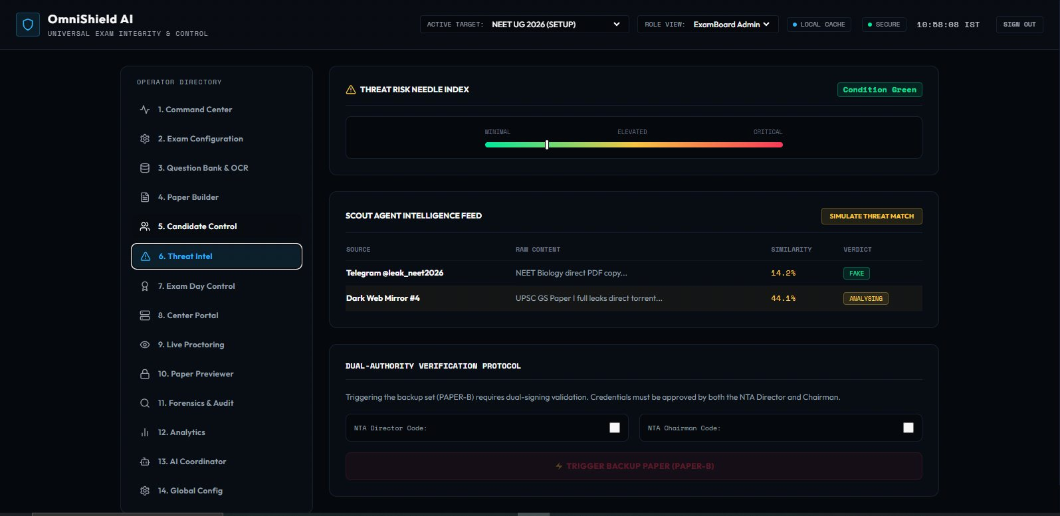
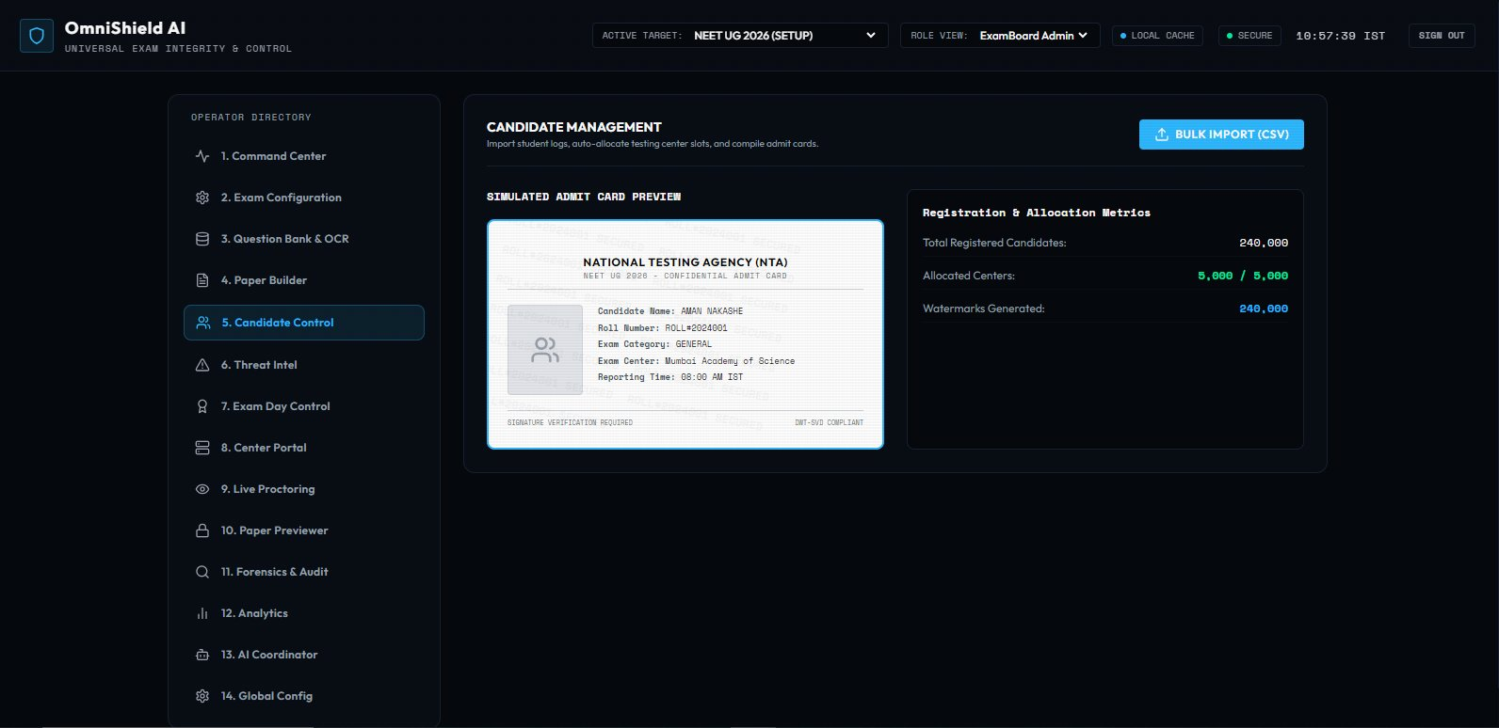
PLATFORM WALKTHROUGH · MODULES 5 & 10
Candidate Control & Secure Paper Viewer
Module 5: Candidate Management
Module 10: Secure Read-Only Paper Viewer
240,000
5,000
READ-ONLY
Watermarks generated
Centres allocated
Shield engaged

Slide 11
PLATFORM WALKTHROUGH · MODULE 13
Claude AI Coordinator
Embedded Claude API assistant in the operator dashboard
Grounded with live exam context — active threat level, centre download status
Ask it: 'What is the current risk level?' — gets a real answer from exam data
Context Active — pulls from PostgreSQL + Redis in real time
Bridges the gap between raw data and operator decision-making
"Hello Operator, I am your Claude-powered security
coordinator. I have access to the active exam metadata,
current threat level, and centre download metrics."

Slide 12
FEATURE · POST-EXAM FORENSICS
Tamper-Proof Audit & Forensic Roll Tracer
PostgreSQL append-only ledger — every action hashed and chained
Events: PAPER_SEALED, EXAM_CONFIG_CREATED, CENTER_KEY_REGISTERED
Forensic Roll Tracer: enter a roll number → full audit trail retrieved
Z-score analysis: flags centres with statistically anomalous answer patterns
Auto-generates forensic PDF report — admissible as legal evidence
PAPER_SEALED
ExamBoard Admin · a8f3d1c...
EXAM_CONFIG_CREATED
SuperAdmin · f9b2d7e...
CENTER_KEY_REGISTERED
Centre Operator · c8f9b2d...

Slide 13
PLATFORM OVERVIEW
14 Operator Modules
A complete end-to-end examination integrity operating system.
1
Command Center
2
Exam Configuration
3
Question Bank & OCR
4
Paper Builder
5
Candidate Control
6
Threat Intel
7
Exam Day Control
8
Center Portal
9
Live Proctoring
10
Paper Previewer
11
Forensics & Audit
12
Analytics
13
AI Coordinator
14
Global Config

Slide 14
IMPACT
The Numbers That Matter
2.27M
₹500Cr+
72→45min
5,000
Students affected
by NEET 2026
Re-examination
cost
Leak window
eliminated to
Edge nodes
supported
< 45s
< 30s
240,000
0
Paper generation time
Threat detection time
Watermarks per exam
Human hands on
paper content
"OmniShield doesn't just watch the exam — it thinks before it, acts during it, and audits after it."

Slide 15
OmniShield AI
Universal Exam Integrity & Control Platform
Because 2.27 million students deserve better than a cancelled exam.
🌐 Live Demo
💻 GitHub Repo
📧 Contact
omnishield-ai.vercel.app
github.com/workamannakashe-sudo/omnishield-ai
manasviagarkar@gmail.com
3rd-year B.Tech. Students
FAR AWAY 2026
FAR AWAY 2026 · Examinations + Agentic & Autonomous Systems

