Slide 1


Database Architecture
11th October 2018

Slide 2
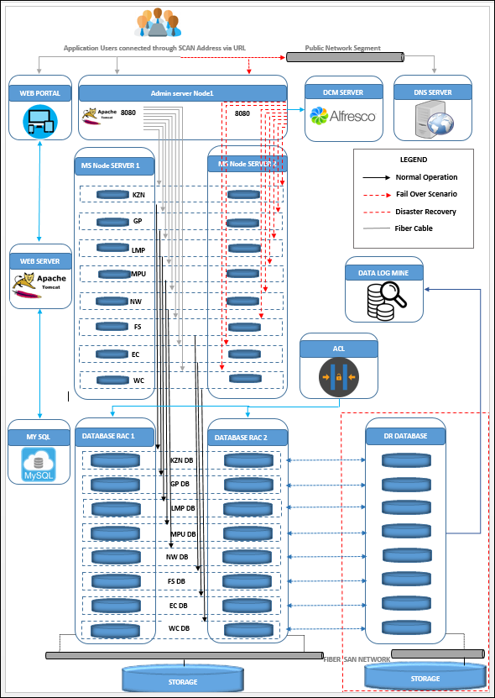
Database Architecture

Slide 3
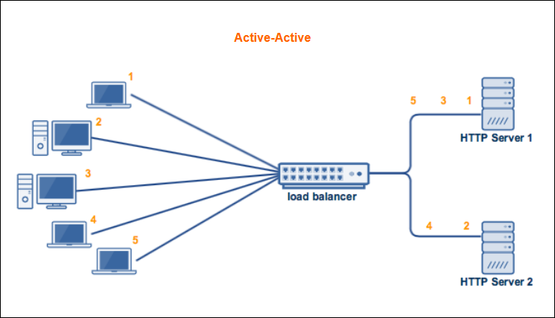
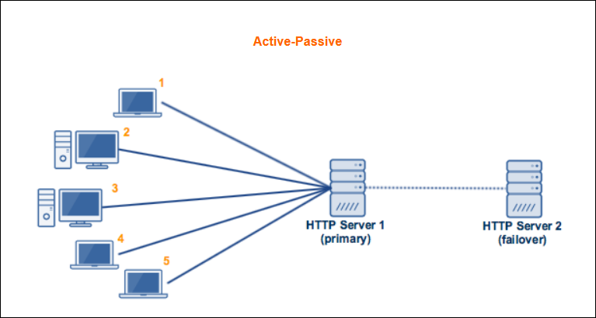
Active-Active vs Active-Passive High Availability Cluster
Primary Node
Failover Node

Slide 4
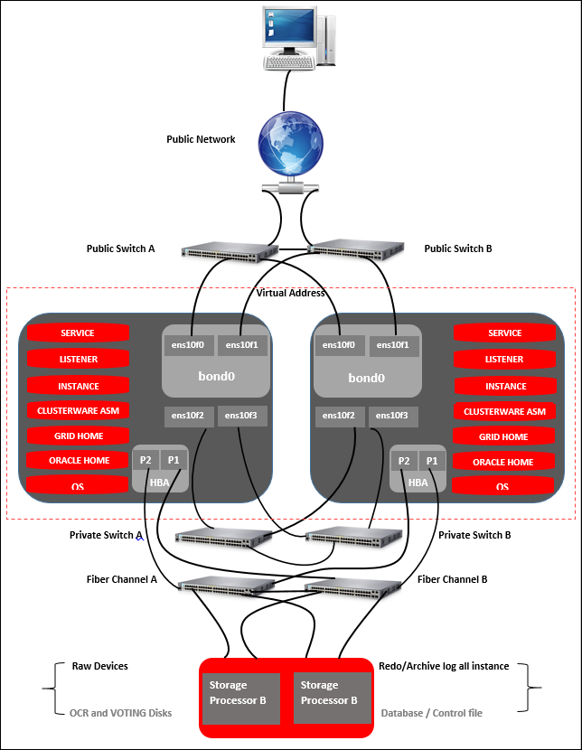
Network Topology

Slide 5
Network Topology
The network topology used in this reference environment consists of two public switches using link aggregation to connect the two switches together (Public Switch A and Public Switch B), creating a single logical switch. A similar link aggregation is done for private switches (Private Switch A and Private Switch B), creating a single logical switch. Ethernet device ens10f0on the server connects to Public Switch A, while Ethernet device ens10f1on the server connects to Public Switch B. Ethernet devices ens10f0and ens10f1are bonded together as a bond device, bond0, providing high availability for the public network traffic. Ethernet device ens10f2on each server connects to Private Switch A, while Ethernet device ens10f3on each server connects to Private Switch B. Ethernet devices ens10f2and ens10f3 take advantage of Oracle's Highly Available Internet Protocol (HAIP) for Oracle's private interconnect. HAIP can load balance Ethernet traffic for up to for Ethernet devices. Due to the use of Oracle's HAIP, no bond device is created for private Ethernet devices ens10f2 and ens10f3 on each node within the Oracle RAC Database cluster.
The Host Bus Adapter HBA, also known as a host I/O controller (previously called a SCSI Card), is one of the critical components that needs protection. The HBA is usually a SCSI-2 adapter that plugs into a host and lets the host communicate with a device or a storage system.

Slide 6
Oracle Real Application Clusters – Technical Overview
Oracle 12c Comparison

Slide 7
RHEL_Whatsnewrhel7.3_Techoverview
Analysis and Recommendations Report For Database CIS

Slide 8

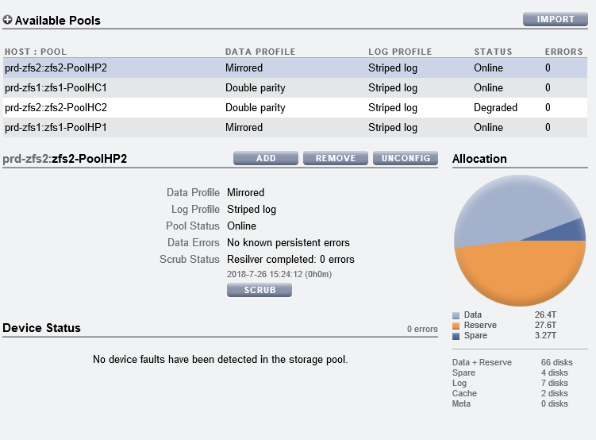
ZFS APPLIANCE STORAGE
ZFS Cluster

