Slide 1
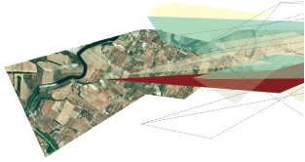
User Sessions | Spatial
CSG CIS Revamp Project

Slide 2
Spatial | scope
Security
Portal
Internal/External
Registered / Unregistered
CIS REVAMP SCOPE
Workflow Management
UAM
Reporting
Reservations and Lodgements
Registered
6 Tiers
Information Provision
Data Capture , Management and Maintenance
Internal
Training and Knowledge Transfer
Maintenance and Support

Slide 3
Spatial | user perspective

Slide 4
spatial | Business processes
Management
Management and User Productivity Report
Registry
Capture Lodgment
Capture Payment
Send Notifications on Lodgment
Dispatch
Numbering
Reserve Parcel
First Level Examination
Capture examination check results onto DB
Queried Information rendered
Produce Advisory Notes/ comments
Second Level Examination
Queried information rendered
Capture Legislative compliance check result
Maintenance
Perform Endorsements
Request Information issued
Invoice Issued
Queried Information rendered
Capture Client Information
Dockets produced
Email notification sent to Land Surveyor
Approve or Return with comments
Post Approval process
Perform data Updates/ Amendments
Noting
Information Provision
Scanning
Post Approval Process
Data Capture
Capture Sectional Plan
Capture Header Information
Capture Numeric Data
Produce Consistency Check report
Numbering
Noting
Capture Boundary Data in Spatial & Alpha Numeric

Slide 5
spatial | Business processes
Management
Management and User Productivity Report
Registry
Capture Lodgment
Capture Payment
Send Notifications on Lodgment
Dispatch
Numbering
Reserve Parcel
First Level Examination
Capture examination check results onto DB
Queried Information rendered
Produce Advisory Notes/ comments
Second Level Examination
Queried information rendered
Capture Legislative compliance check result
Maintenance
Perform Endorsements
Request Information issued
Invoice Issued
Queried Information rendered
Capture Client Information
Dockets produced
Email notification sent to Land Surveyor
Approve or Return with comments
Post Approval process
Perform data Updates/ Amendments
Information Provision
Scanning
Post Approval Process
Data Capture
Capture Sectional Plan
Capture Header Information
Capture Numeric Data
Produce Consistency Check report
Numbering
Noting
Capture Boundary Data in Spatial & Alpha Numeric

Slide 6
Spatial | SG applications
Program Name | KZN | GP | MPU | LMP | NW | BFN | WC | EC
Query Images | √ | √ | √ | √ | √ | √ | √ | √
Image Scanning | √ | √ | √ | √ | √ | √ | √ | √
Approval System | √ | X | X | √ | √ | √ | √ | √
Boundary Query | √ | X | √ | X | X | √ | X | X
DPMS | X | √ | X | √ | √ | √ | √ | √
Data Viewer | √ | √ | √ | X | √ | √ | √ | √
Blue Book | X | X | √ | √ | √ | √ | √ | √
Capture Document | √ | √ | √ | √ | √ | √ | √ | √
Numeric Capture | √ | √ | √ | √ | √ | √ | √ | √
Reserve Parcels | X | X | X | X | X | √ | X | X
Manager Reports | X | X | √ | √ | √ | √ | √ | √
R & M | √ | √ | X | √ | √ | √ | √ | √
Capture SectTitles | √ | √ | √ | √ | √ | √ | √ | √
Security | √ | √ | √ | √ | √ | √ | √ | √
Endorsing System | X | √ | X | √ | √ | √ | X | √
Image Locator | X | X | X | X | √ | √ | X | X
Table Maintenance | √ | √ | √ | √ | √ | √ | √ | √
Trig Query | √ | √ | √ | √ | √ | √ | √ | √
Query Boundaries | X | X | X | X | X | √ | X | X
Mapguide | √ | √ | X | X | √ | √ | √ | √
Launcher | √ | √ | √ | √ | √ | √ | √ | √
AutoEmailer | √ | √ | √ | X | √ | √ | √ | X
CSGWEB | X | √ | √ | √ | √ | √ | √ | √

Slide 7
Spatial | other applications
Name | Description | KZN | GP | MPU | LMP | NW | FS | WC | EC
1Map.co.za | Search Address- Information Provision |  | √
AutoCAD with Munsys |  | √ | √ | √ | √ | √ | √ | √ | √
Command Prompt (Dos Box) |  | √
Darryl ‘s Excel Tool |  |  |  |  |  |  |  | √
Debenu PDF tools | Conversion from PDF to TIF |  | √
Deeds Web |  | √ | √ | √ | √ | √ | √ | √ | √
eFileViewer | Docket, caveats / interdicts and red line diagrams scanned |  |  |  |  |  |  | √
Electronic ERF Schedule (MDB Application) |  |  |  |  |  |  | √
eNotes/Adbo Reader |  |  | √ |  |  |  | √ | √ | √
ESDR | Recording the workflow of customer request |  |  |  |  |  | √
GIS – ArcMap |  | √ | √ | √ | √ | √ | √ | √ | √
Google Earth /Google Map |  | √ | √ | √ |  | √ | √ | √ | √
Help Desk (Issue Log ) | Log IT support queries | √ |  |  |  | √
http://emap.capetown.gov.za/egispbdm/ |  |  |  |  |  |  |  | √
InfoMap | Copy the coordinates captured by Capturer |  |  | √
MapGuide Author |  | √
Microsoft Document Imaging |  |  |  | √
Microsoft Visual Basic | Programming |  |  |  |  |  |  |  | √
MS Office |  | √ | √ | √ | √ | √ | √ | √ | √
MS Office – PowerPoint and Publisher |  | √ | √
Next Image | Scanning Driver |  | √
Notepad/WordPad /Notepad ++ |  | √
OCR Irfan View |  | √
One Note |  | √
Oracle – SQL Plus |  | √
Parcel Mate |  |  |  |  |  |  |  | √
ParcelInfo |  | √
PDF Creator |  | √ |  |  |  | √
PDF Viewer |  | √ |  |  | √ | √ |  |  | √
PDF Xchange Viewer |  | √ |  |  |  | √
Plan Safe | Tracks movement of the physical documents | √
Planet GIS | To view Spatial Data |  |  |  | √ | √
Polar and Join Excel | For calculations |  | √
QGIS |  | √ |  |  |  | √
Queue System | To manage the customer counters (information provisioning) |  |  |  |  |  |  | √
Rediris Pro | OCR |  |  |  |  |  |  |  | √
SGSurvey |  | √
SpiSys |  |  |  |  |  |  | √
SQL Developer |  | √ | √ |  |  | √ |  | √ | √
Surpac |  | √ |  | √ | √ | √ | √ | √ | √
Tatuk GIS |  |  |  |  |  | √ | √
TextPad |  |  |  |  |  | √ |  |  | √
Tiff Viewer Irfan view |  | √
Webpage Editing package – MS Expression web 4 |  | √
WGS Convertor |  |  |  | √

Slide 8
Spatial | process vs tools
Process |  | KZN | GP | MPU | LMP | NW | BFN | WC | EC
Management | User Productivity Report | √ | √ | √ | X | √ | √ | √ | √
Registry | Capture Payment | √ | √ | X | X | √ | √ | √ | √
 | Capture Lodgment | √ | √ | √ | √ | √ | √ | √ | √
 | Dockets produced | √ | √ | √ | √ | √ | √ | √ | √
 | Send Notifications on Lodgment | √ | X | √ | √ | X | √ | √ | √
 | Dispatch | √ | X | X | X | X | √ | √ | √
 | Post Approval process | X | X | X | X | X | X | √ | X
Numbering | Reserve Parcel | X | X | X | X | X | √ | X | X
 | Numbering | X | X | X | X | X | √ | X | X
First Level Examination | Noting | X | √ | X | X | X | X | X | X
 | Capture examination check results onto DB | X | X | X | X | X | X | X | X
 | Queried Information rendered | X | X | X | X | X | X | X | X
 | Produce Advisory Notes/ comments | √ | √ | X | X | X | X | X | X
Second Level Examination | Queried information rendered | X | X | X | X | X | X | X | X
 | Capture Legislative compliance check result | X | X | X | X | X | X | X | X
 | Approve or Return with comments | √ | X | √ | √ | √ | √ | √ | √
 | Email notification sent to Land Surveyor | √ | X | √ | √ | √ | √ | √ | √
Data Capture | Capture Sectional Plan | √ | √ | √ | √ | √ | √ | √ | √
 | Capture Header Information | √ | √ | √ | √ | √ | √ | √ | √
 | Capture Numeric Data | √ | √ | √ | √ | √ | √ | √ | √
 | Produce Consistency Check report | √ | √ | √ | √ | √ | √ | √ | √
 | Capture Boundary Data in Spatial & Alpha Numeric | √ | √ | √ | √ | √ | √ | √ | √
Maintenance | Scanning | √ | √ | √ | √ | √ | √ | √ | √
 | Perform data Updates/ Amendments | √ | √ | X | X | X | X | X | X
 | Perform Endorsements | X | √ | X | √ | X | √ | X | √
 | Post Approval Process | X | X | X | X | X | X | √ | X
 | Noting | X | - | X | X | X | X | √ | X
Information Provision | Request Information issued | √ | √ | √ | √ | √ | √ | √ | √
 | Invoice Issued | X | X | X | X | X | X | X | X
 | Queried Information rendered | X | X | X | X | X | √ | √ | √
 | Capture Client Information | X | X | X | X | X | X | X | X

Slide 9
Spatial | KNOWN ISSUES, expectations & Wishlist
Known Issues
  Slow system response (to save 500 coordinates, it takes approximately 4 hours);
  Parcel-Mate works in one computer using Windows XP and Windows XP is no longer supported by Microsoft. If the computer doesn’t work, data need to be recaptured and that will pose data integrity and inaccuracy challenges;
Force password reset in one operation
Maintain PoE of Usernames and of password resets
Differentiate in log of updates- substantive vs cosmetic
Have portal for clients to extract data by Local Municipality on a daily basis. Munexport export tool example screenshot.pdf
  Once a month for the full data set
  Daily for changed entities

Slide 10
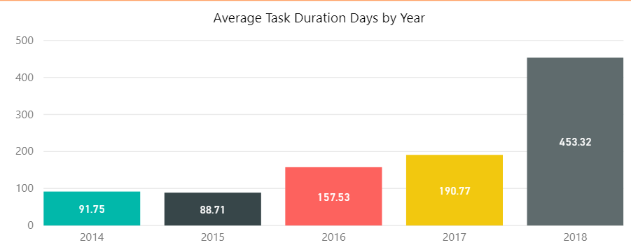
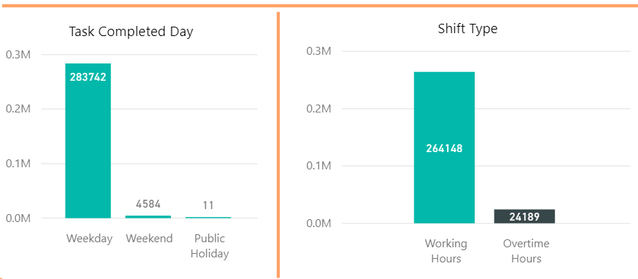
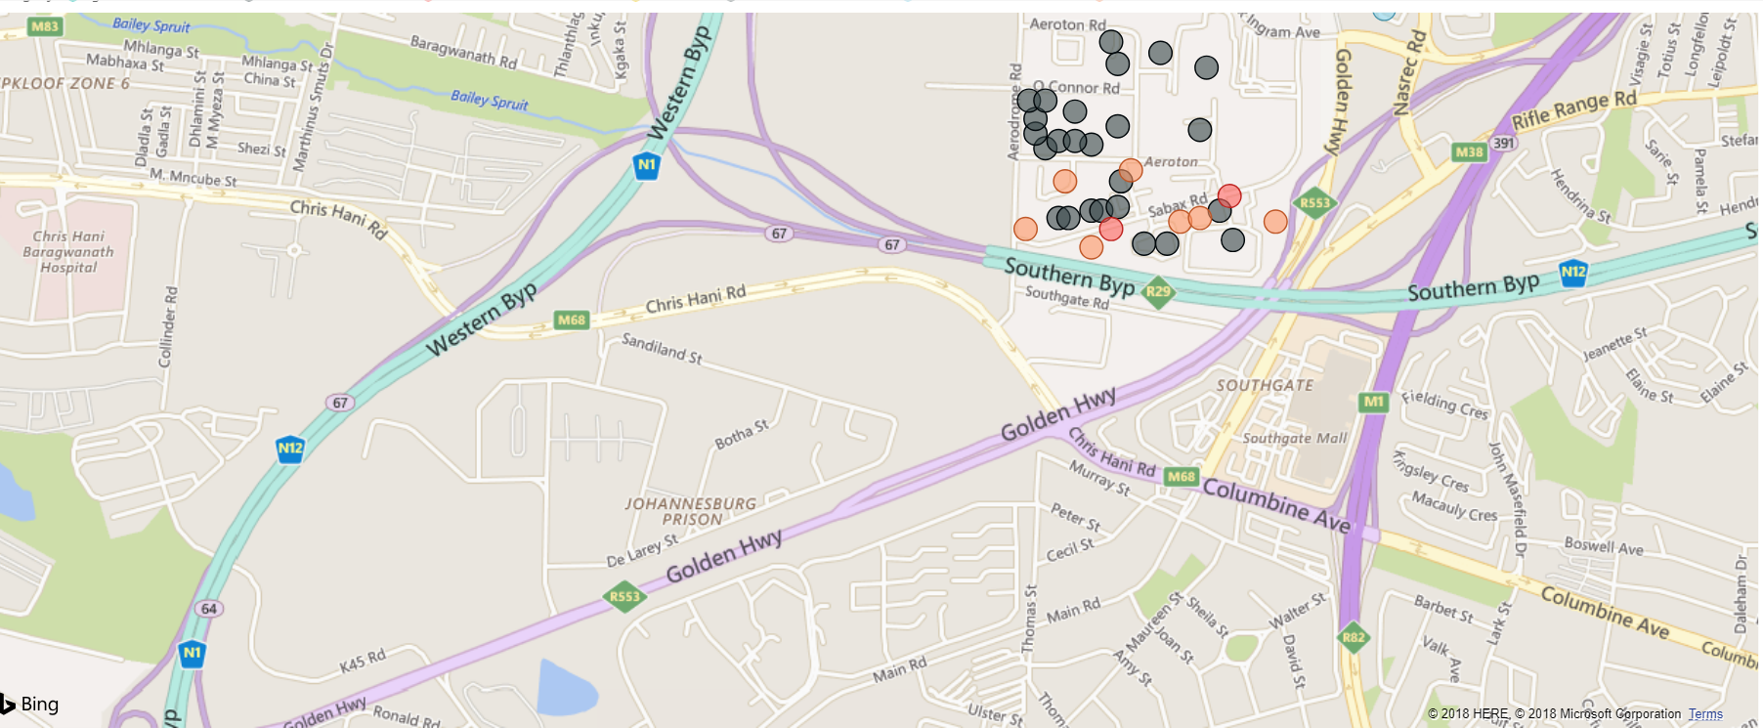
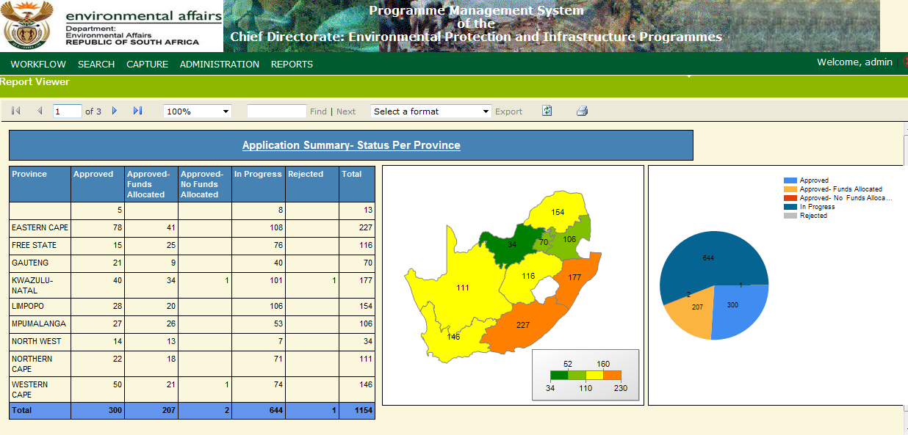
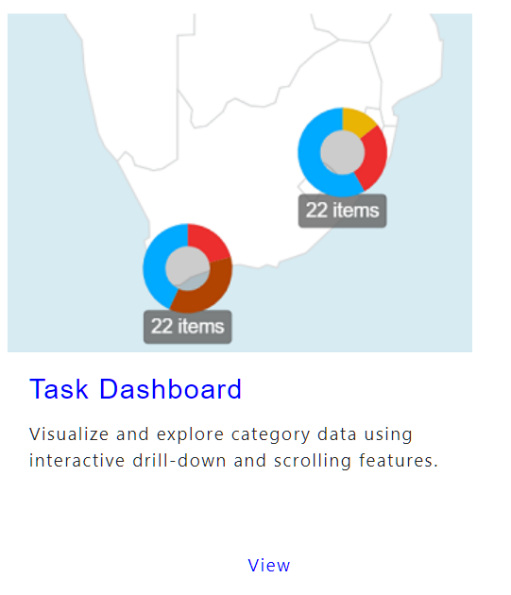
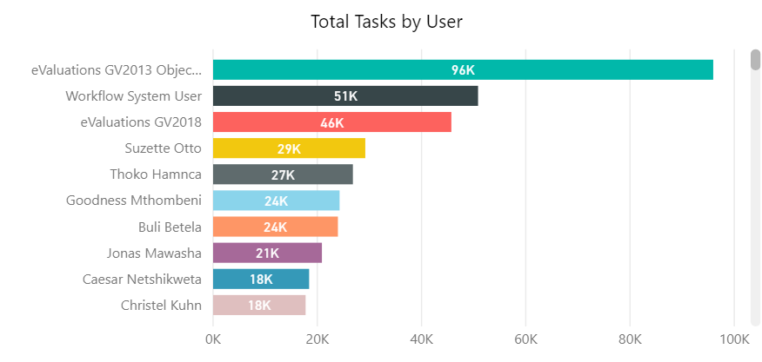
Process: management reports (spatial view)
Productivity Reports
Lodgements
Other Management Reports

Slide 11
Process: reservations
Reserve Parcels
  By Applicant (PLS) using Map Viewer for online submission
  By Departmental user for PDF, Manual Submissions
Number issued is stored as attribute to the parcel
Lock parcel
Avoids duplication

Slide 12
Process: lodgement
Online Submission
  Upload Coordinates (TEXT/ASCII)
  Capture screen
    Coordinate Input, Import from text file, Digitization
  Display on Map?
Electronic/Email Submissions
  Request ASCII/Text file
  PDF – Integration with OCR
Manual Submission
  Capture screen
    Coordinate Input, Import from text file, Digitization
  PDF – OCR – Spatial
Tools
  Coordinate conversion
  Area Conversion
  Distance conversion
  Any other spatial tools required for lodgement

Slide 13
Process: examination
Integration with AutoCAD & Munsys
  To provide numeric data to AutoCAD
Noting
Query and display numeric data
Verification/Validation Tools
Conversion Tools (common across all modules)

Slide 14
Spatial process 1
Newly approved cadastral document
  Task triggered to Spatial from Dispatch
  Spatial Manager receives task
  Task is assigned to a Capturer
    Preview the approved parcel + other information
    Perform capturing tasks as required (either in AutoCAD or new system)
  Task is trigged for QA
    QA checks performed
  Final data is saved in database

Slide 15
Other spatial processes
Correction of Errors
  Error reported - Spatial Manager creates task – assigned to Capturer – Quality Check - Save
Endorsements
  Endorsement Task triggered – Spatial Manager assigns task to Capturer – Quality Check – Save
Special Projects
  Project assigned to Spatial - Spatial Manager creates task – assigned to Capturer – Quality Check - Save
Periodical Error Checks
  System automatically generates task based on configuration (quarterly/any time) – Spatial Manager performs task – Reports are generated
Sectional Plans
  Task triggered from Dispatch – Spatial Manager assigns task to Capturer – Coordinates are captured duly setting the coordinate system – System generates geometry and plots – Quality check - Save

Slide 16
DATA CAPTURE & MAINTENANCE
Tools
  Query Builder (Data Viewer)
  Coordinate Convertor
  Distance Calculator
  Area calculator (extent)
  Validation and Verification tools
    Topology checks (Geometry)
    Extent validation
    Attribute validation
  OCR

Slide 17
Information provision
Search and Query (various methods)
Extract data (Single/Bulk)
  Coordinate List
  Image
  Map
  Trig Points
  Boundary (etc)
  NGI- Data
Extract by
  Admin areas (Province, District, Local)
  AOI
  Search criteria
Format
  Shapefile, dxf, kml, wkt, pdf (dwg – proprietary – need to check)
Spatial view of reports

Slide 18
Information provision - process
Request
Selection and Preview
Process to extract
Output
Email with a link to download
Direct download (size limit 30 – 50 mb)

Slide 19
Map viewer
Search and View all types of data
Navigation tools
Query tools
Consume WMS
Base Maps (Google/Bing)
Print
Export

Slide 20
Spatial | Technology stack
Open Layer 2 for Google or Openlayer 4 without google
Oracle Spatial
GeoServer 2.6
ogr2ogr (GDAL1.7)
map server 6
Integration
  AutoCAD + Munsys
  ESRI

Slide 21
decisions
Technology
  Continue with AutoCAD + Munsys
  ESRI CSG Viewer
Storage of NGI Data
Process
  Lodgement
  Post approval – management
  Statuses (L,W)
  Compilation/Noting
Integration with AutoCAD/Munsys
  Data exchange mechanism

