Slide 1
CareLoop AI
Claude POC review for Anthropic
Team CareLoop AI
7 October 2026
Notes:
CareLoop AI is the proof of concept we built for this review. It starts from the most ordinary artefact in a clinic, the doctor’s note, and ends with a closed loop: a typed plan in the database, the care items nobody ordered, the patients who are blocked, and AI agents able to act on the same records over MCP.

Slide 2
01 POC overview
Explain the idea, what the POC can do today, and the market it serves
Team: CareLoop AI | POC: CareLoop AI
OBJECTIVE
1.1 The idea
Clinicians write notes as prose. The actionable parts — order the MRI, refer to neurology, start a statin — sit inside free text, so follow-up depends on memory and hand-chasing. Nothing checks whether the plan is complete, and nothing flags the patient waiting on a blocked step.
Example: “MRI brain, routine” in Tuesday’s note only becomes a tracked task if someone retypes it.
1.4 Market analysis
Geographic relevance and market size
Regions: US and EU, where value-based care and audit rules make closed-loop follow-up a paid requirement. North America is the largest AI care-coordination market and APAC the fastest growing (Mordor Intelligence, 2026).
Example: chronic-care management billing needs evidence that every ordered test was followed up.
Approx. market size: USD 2.15 bn in 2026, rising to USD 6.24 bn by 2031. Source: Mordor Intelligence, AI-Based Care Coordination Market, 2026
Expected growth: 23.79% CAGR, 2026–2031. Source: Mordor Intelligence, 2026 (vendor forecast — an estimate, not a neutral measurement)
Our own bottom-up sizing, and every figure we derived ourselves, is marked as an estimate.
1.2 What the POC does
Paste a doctor’s note in the React app: a Gemini tool-calling agent saves each actionable item as a typed card in Postgres, a 28-condition checklist flags missed care, dependent cards turn at_risk, and MCP agents can close the loop.
Example: one note produced 3 cards (medication, test, next_visit) and 2 care-gap recommendations.
1.3 What is working versus mocked
WORKING
Note → typed cards via save_card / close_card (five card types)
Care-gap recommendations from a 28-diagnosis checklist
Dependency-driven at_risk, healed when the blocker closes
MCP server (6 tools), urgency triage, reminders, plain language
MOCKED OR PLANNED
No EHR or FHIR feed: notes are pasted, the inbox is a watched folder
Demo accounts share one password; no per-user MCP tokens yet
Triage results stored in urgency.messages but not shown in the UI
Target customers
Ambulatory and specialist clinics with 10–200 clinicians and high note volumes; bought by clinical leadership, used daily by doctors, nurses and the follow-up desk.
Example: a 40-doctor multi-specialty clinic chasing 300+ open follow-ups a month.
Notes:
The idea comes from a simple observation: the note is where clinical intent lives, and it is the one place nothing is tracked. Everything after the note is manual, so we made the note produce structured, typed work. Be honest in this section: the note pipeline, the care-gap checklist, risk propagation and the MCP server all run end to end, while the clinic feed, the logins and the triage screen are still thin. For the market slide, say the figures are vendor forecasts and that our own sizing is an estimate.

Slide 3
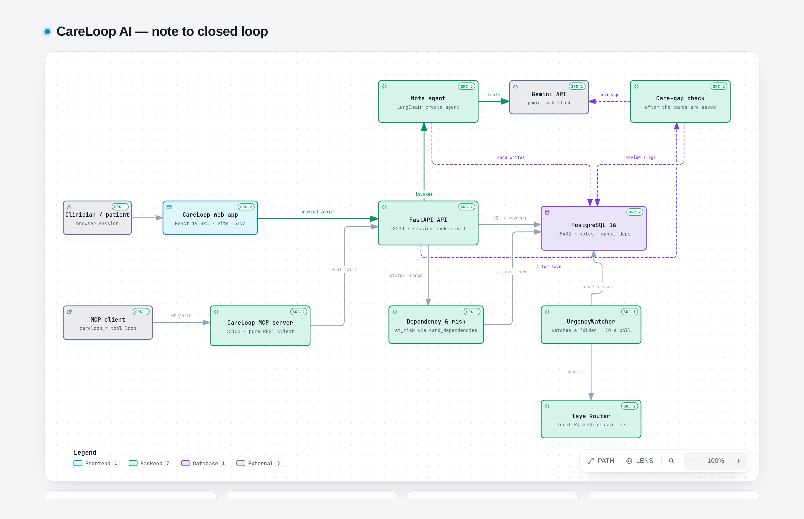
02 The model’s role and architecture
Show what the model does, which features we used, and how the parts connect
Team: CareLoop AI | POC: CareLoop AI
OBJECTIVE
2.1 What the model does versus what code does
2.3 Architecture diagram
GEMINI DOES
Reads the note and decides what is actionable, and each item’s type
Writes card text and due dates, and spots the follow-up that closes a card
Judges which expected care items the cards cover
CODE DOES
Validates and persists cards in one transaction; no SQL from the model
Dependency graph, at_risk, reminders, auth, checklist matching
Urgency triage runs locally on the laya router, with no LLM call
2.2 Model features used (shade each cell)
Tool use
MCP servers
Extended thinking
Vision / PDF
Citations
Structured outputs
Prompt caching
Files API
Code execution
2.4 Models and access
Gemini 3.8 Flash (gemini-3.8-flash) does note extraction, the tool calls, coverage checks and plain-language rewrites, called through the Gemini API with LangChain.
The laya router (PyTorch on CPU) classifies patient-message urgency on the machine. This build runs on Gemini, so the template’s Claude-specific rows above are mapped to the capability we actually used.
Web search
Agent SDK
Agent Skills
Used
Tried and rejected
Not used
Notes:
Point at the split first: the model decides meaning, and ordinary code owns every durable fact. The agent can only call two write tools, so it cannot invent a database change. We shade three features: tool use for the card calls, MCP servers because we ship one, and structured outputs because every card arrives through a typed schema. Nothing else on that grid is ticked, and we would rather say that than overstate it. The architecture plate is a live HTML diagram in the repository, so reviewers can open it and click through the same picture.

Slide 4
03 How it works
Explain the steps the agent takes, the tools it uses, and how it is prompted
Team: CareLoop AI | POC: CareLoop AI
OBJECTIVE
3.1 Pattern used (shade one or more)
Single call
Chain of calls
Router
Multi-step agent with tools
Multiple agents
Why this pattern: one agent loop with two narrow write tools keeps the plan faithful to the note.
3.2 Workflow diagram
1 Doctor pastes the note (up to 12,000 characters) and presses Process note.
2 The API stores the note, then hands the agent the note plus the patient’s open cards.
3 Gemini calls save_card once per actionable item; close_card closes a card the note confirms, with its evidence phrase.
4 Risk propagation re-checks every dependent card: still blocked → at_risk, unblocked → open.
5 The care-gap check matches diagnoses, asks the model which expected items the cards miss, and raises review flags.
6 HUMAN CHECK: the React app shows the doctor each recommendation to approve or dismiss, and patients their own cards and reminders.
3.3 Tools
Tool | What it does | Read / write
save_card | Saves one actionable item as a typed card, with its due date | Write
close_card | Closes a card the note confirms is done; stores the evidence | Write
careloop_list_cards | Lists a patient’s cards with status and due dates | Read
careloop_close_card | Closes a card over MCP (REST + login) | Write
careloop_flag_card_risk | Flags a card at_risk with a reason for the clinician | Write
3.4 SYSTEM PROMPT EXCERPT (5 to 10 lines)
<role>Extract actionable items from a doctor’s note and keep the patient’s card list accurate.</role>
<task>Call save_card once per distinct actionable item; never combine items. Types: medication, test, referral, next_visit, general_task.</task>
<rules>If the note confirms an open card was completed, call close_card with its id. Never close a card the note does not clearly confirm.</rules>
<output_format>Do not return a list instead of calling the tools. Reply with one sentence on what was saved and closed.</output_format>
Excerpt from Backend/app/prompts/note_agent.txt, mapped onto the four blocks above.
Notes:
Walk the workflow left to right and pause on step six, the doctor, because that is where the design deliberately keeps a person. Risk propagation is the part worth dwelling on: a card that depends on an open test turns at_risk by itself, and heals when the test lands. On the tools, the two in-process tools write cards, and the MCP server exposes six read-and-write tools over REST with no database credentials. The prompt excerpt is verbatim; the full prompt is a text file in the repository.

Slide 5
04 Testing, gaps and questions
Show how we checked the POC, what is missing, and where we want advice
Team: CareLoop AI | POC: CareLoop AI
OBJECTIVE
4.1 How we checked it works
Ran the MCP test suite: 5 tests, all passing (close-card flow, risk flags, tool plumbing).
Processed 24 real notes end to end: 63 cards saved, 9 closed with evidence, 1 dependent card correctly at_risk.
Raised 21 care-gap recommendations across those notes; a doctor approved or dismissed every one.
Triaged 98 patient messages with the watcher: 26 urgent, 72 not urgent, none lost.
Frontend is React 19 on Vite: role-based card lists, recommendations, reminders, status and due-date edits.
Judged the output by hand: every card had to be traceable to one sentence in the note.
4.2 Safety and guardrails
In place: notes capped at 12,000 characters; cards validated against a typed schema.
The agent can only call save_card and close_card, so it cannot touch the database directly.
A card closes only when the note supplies the confirming phrase, which is stored as evidence.
Not done yet: no prompt-injection tests, no per-user tokens for the MCP server, one shared demo password.
4.3 Known gaps and next steps
Gaps: text-only notes (no scan or PDF), no EHR or FHIR feed, triage results not shown in the UI.
The MCP close call still has no evidence field in the API, so an agent closure is less auditable than a doctor’s.
Next: FHIR intake, a per-patient timeline, an audit log for every closure, and scoped MCP tokens.
4.4 QUESTIONS FOR ANTHROPIC (up to 3)
Q1 (see slide 3): Should note extraction stay one agent with two write tools, or a deterministic extractor with the model only for phrasing? Today the agent decides what is actionable.
Q2 (see slide 4): What is the safest permission shape for a clinical MCP server — may an agent close a card, or must a human confirm every closure?
Q3 (see slide 5): Which Claude features would you use to make care-gap reasoning auditable — citations over the note, structured outputs, or an eval harness?
Notes:
These numbers come from the running demo, not from a benchmark: 24 notes, 63 cards, 21 recommendations and 98 triaged messages. Say plainly what is missing, because the guardrails that exist are the interesting part and the gaps are what we want help with. Then ask the three questions in order, most important first, and give Anthropic room to answer them.

