Slide 1

StormSense
Move stock before the storm, not after.
Adarsh Ajay | UST | Databricks Hackathon, October 2026
Notes:
Open with the one line: StormSense moves stock before the storm, not after. Then the order: the problem, the solution, the return, how it is built, the demo, and what we ask for.

Slide 2
Agenda
01
The problem
04
Technical architecture
02
The solution
05
Demo and proof
03
Return on investment
06
Roadmap and the ask
Notes:
Six parts. The four that matter most are the problem, the solution, the return and the architecture.

Slide 3
The problem
01
Weather moves demand in days. Stock moves in weeks. Planners find out too late.
Notes:
Set the scene: a storm is coming, and the right stock is in the wrong store.

Slide 4
It is Thursday. A tropical storm reaches Florida on Sunday.
Orlando will sell about 56 generators this week and has 19. Jacksonville has spare stock 125 miles away.
Nobody knows in time. By Saturday the shelf is empty and the customer has driven to a competitor.
Sample data. Figures are from the sample plan the app shows.
Notes:
Make it concrete. One store, one Thursday, one product. The gap is time, not weather.

Slide 5
Weather moves demand faster than inventory moves
What happens before a storm
  Generators, tarps, pumps and plywood sell out in the stores in the storm's path, within days
  Heat does the same for coolers and pumps, in a different region, the same week
  Stores one region away hold more than they can sell
  Planners read spreadsheets after the warning, phone neighbours and decide on instinct
  Nothing is recorded, so nobody learns for next season
One morning, in numbers (sample data)
  10 stores across Florida, Texas and California; 5 weather-sensitive products
  50 store-product positions: 11 short, 16 surplus, 23 balanced, all on the same day
  7 urgent moves waiting; 5 stores running low; a heat alert for Thursday
  12 months of daily history, with named storm and heat events
Notes:
Both problems happen on the same morning: some stores run short while others hold too much. The cheapest fix is to move what is already in the network.

Slide 6
What a storm costs when stock is in the wrong place
Sample history, five events: $302,154 lost, $12,137 protected (4%). Lost sales = units sold beyond the stock on hand at the start of the event, at list price. An upper bound, from a backtest on what really sold.
Notes:
Each pair of bars is one past event. The first is sales lost if nothing moved; the second is what planned moves could have protected. The protected bar is an upper bound, because the backtest uses what really sold. The gap is the money on the table.

Slide 7
The industry loses this everywhere
Figure | Scope | Source
$93 billion a year lost to out-of-stocks | US retailers, 2008 survey of 124 retailers (85,000+ stores) | RIS News / IHL Group
France: €851 million missed sales at a 4.4% out-of-stock rate; UK: about £1 billion at 4.0% | Grocery, 2022 | NielsenIQ, via ESM Magazine
About $300 billion in markdowns, about 12% of non-grocery sales | US non-grocery retail, 2018, modelled | Coresight Research and Celect
3.7% to 4% of sales lost to out-of-stocks | 661 outlets, 29 countries, 2002 | Gruen, Corsten and Bharadwaj
Weather-driven losses are not measured at national level in any source found. StormSense addresses the share of these losses caused by stock sitting in the wrong store before a storm or heat wave.
Notes:
Outside figures, for scale only. They differ in year, scope and method, so they are not comparable with each other or with our sample. Check each one before quoting it.

Slide 8
Today's process, and what changes
Step | Typical manual process | With StormSense
Spot shortages | Spreadsheets per store, after the warning | Seven-day forecast per store and product, every morning at 6:00 AM
Find stock to move | Phone calls between stores | Nearest store with spare stock, inside the distance limit, pack sizes respected
Decide | Instinct and email approvals | Each move shows its reason, the sales it protects and the forecast confidence
Record | Notes scattered across people | Audit trail: who, what and when. Repeat approvals are refused
Learn | Nothing carries to next season | Rejection reasons re-rank routes; past storms are replayed in a recovery view
Timing | Hours before the storm, if at all | Moves are ready from the morning run; a warning can trigger an extra run
Notes:
The left column is a typical manual process, not a measurement of any one retailer. The right column is what the app does today on sample data.

Slide 9
The solution
02
Predict demand per store. Propose the moves. A planner decides. Every decision is recorded.
Notes:
The system does the arithmetic. The planner stays in control.

Slide 10
The idea in three steps
1. Predict
Forecast seven days of demand for every store and product, from the weather coming and the sales history.
Features use only what was known on the day, so the model never sees the future.
2. Move
Find the stores that will run short and the nearby stores with spare stock. Propose the transfer before the storm.
Nearest source first, inside a distance limit, in pack sizes a truck can carry.
3. Decide
A planner sees the reason, the sales protected and the confidence, and approves or rejects each move.
Every decision and every repeat attempt is recorded.
Notes:
Pause after each step word. The audience should be able to repeat all three.

Slide 11
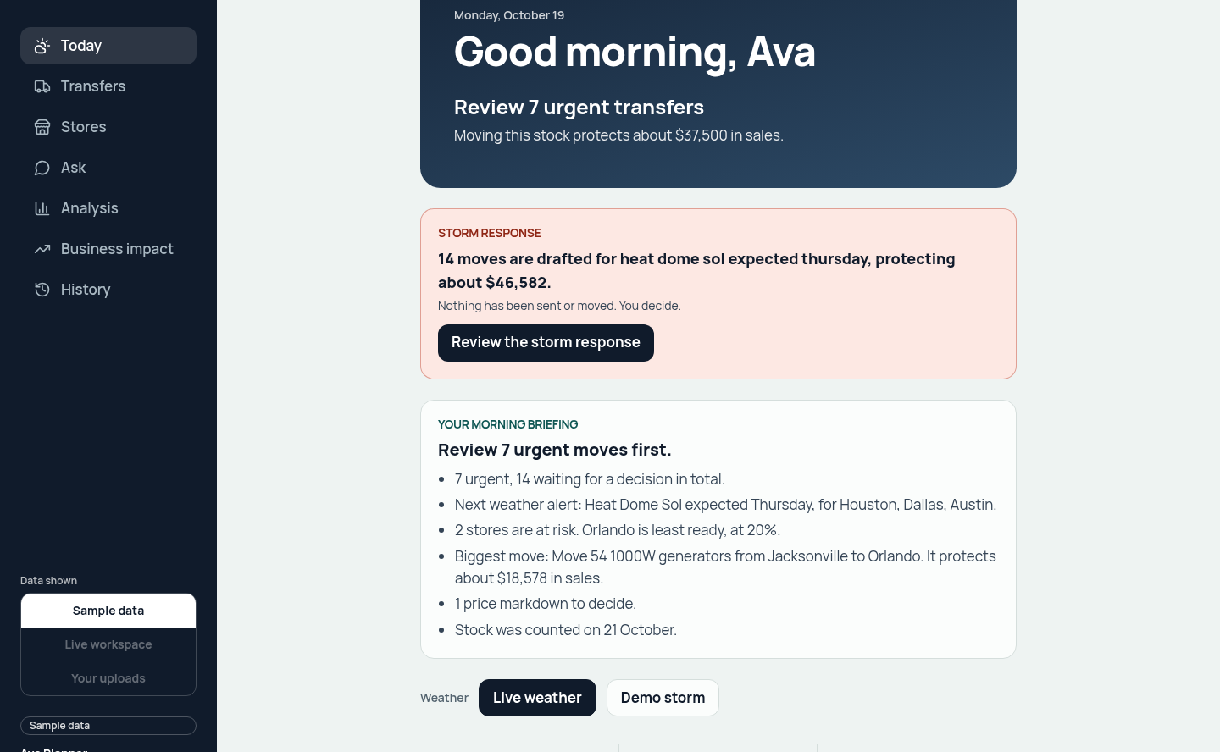
The morning view
Today answers one question
  Which stores run short this week, and what should move first
  Urgent moves, stores running low, the next weather alert
  A morning briefing written from the figures, so nothing is made up
  What changed since the planner's last visit
  One button: Review transfers
Sample data. The label stays on screen until real feeds are connected.
Notes:
Point at the three numbers and the one button. This is the planner's to-do list for today.

Slide 12
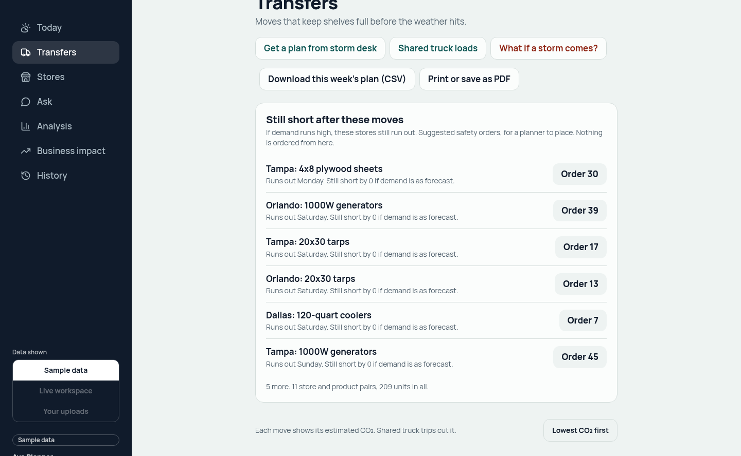
Every move is a sentence a planner can act on
Transfers
  Move 54 1000W generators from Jacksonville to Orlando: the storm, the forecast and the stock on hand, in one line
  Sales protected, distance, confidence and estimated CO₂ on every card
  Select, approve or reject in one step; a repeat approval returns already handled
  Still short after these moves: a safety order if demand runs high
  Lowest CO₂ first, shared truck loads, CSV and print
Notes:
Read one reason aloud: the storm, what the store will sell, what it has.

Slide 13
Everything the app does today
Plan
Today: the morning view and briefing
Transfers: every move with its reason
Stores: weather strip and forecast per product
Best sellers by weather
History: who decided what, when
Decide
Approve or reject, with audit
Storm response: the whole plan, one decision
Price markdowns on slow surplus
Shared truck loads
Safety orders when demand runs high
Ask and simulate
Ask: one sentence and a table, read-only
What if a storm comes: scored by the same forecaster
Storm desk: three read-only agents draft a plan
Storm cover: a parametric trigger, simulated
Learn and connect
Rejection reasons re-rank routes
Past storm recovery view
Upload your own feeds (CSV, Excel, JSON)
MCP server for AI assistants
Business impact: protected, margin, trucking, net
Notes:
Four groups. Plan, decide, ask and simulate, learn. Name one item in each group and move on.

Slide 14
Honest by design
The system proposes. A planner approves or rejects every move. Nothing moves on its own.
Sample data is labelled on every screen until real feeds replace the sample tables.
Protected sales are an upper bound, and the slide says so wherever they appear.
The forecaster is promoted only if it beats two simple baselines on the latest four weeks.
Ask and the storm desk can only read. Nothing they return is executed.
Every approval, rejection and repeat attempt is written to an audit table.
Notes:
These are the rules that make the numbers trustworthy. Say them before anyone asks.

Slide 15
Return on investment
03
Where the money is, what the current plan is worth, and how to earn more.
Notes:
Lead with net, not revenue. Name the assumptions.

Slide 16
What the current plan is worth
$50,180
protected sales, gross revenue
$8,594
net: margin less trucking
16 moves
14 pending, 2 approved, 1 rejected
584 kg
estimated CO₂ for the moves
$2,000 more
by sharing trucks on 7 routes: 14 trips become 9, 720 kg CO₂ saved
Sample data. Margin 30% unless a store sets its own. Trucking $2.50 a mile, one trip a move. CO₂ about 0.9 kg per loaded truck-mile. Protected sales use the forecast, not what really sold.
Notes:
Net is the number to quote. Margin and trucking are assumptions, and a store can set its own margin.

Slide 17
Where the gap is: five past events
Event | Dates (2026) | Stores | Sales lost if nothing moved | Protected by moves | Share protected
Hurricane Marlow | 14-18 Sep | 4 | $171,310 | $2,658 | 1.6%
Severe Storm Delta | 17-19 Apr | 3 | $46,887 | $335 | 0.7%
Atmospheric River Kestrel | 9-12 Jan | 3 | $42,409 | $0 | 0.0%
Tropical Storm Ines | 24-26 Aug | 3 | $34,351 | $7,095 | 20.7%
Heat Dome Ridge | 6-10 Jul | 3 | $7,197 | $2,049 | 28.5%
Total |  |  | $302,154 | $12,137 | 4.0%
Sample data. The backtest moves stock from the nearest store with spare stock inside the distance limit. It ignores pack sizes and truck limits, so it slightly overstates protection. An upper bound.
Notes:
Read the total row first. About $302,000 lost, about 4% protected. Heat events protect the most, about 28%, so that is where to start.

Slide 18
Six levers to earn more
Lever | Evidence today (sample data) | Effort | Status
1. Share trucks on a route | $2,000 across 7 routes; 14 trips become 9; 720 kg CO₂ | Low | Built: Shared truck loads
2. Mark down slow surplus | Los Angeles: 30 generators at 10% off clear in 14 days, about $260 more than holding | Low | Built: Price markdowns
3. Move on the warning | Storm trigger reads NWS warnings every 15 minutes | Low to switch on | Built, paused
4. Protect more lost sales | Backtest protects 4%, an upper bound | Medium | Pack and truck limits, wider sourcing
5. Learn from decisions | Rejection reasons re-rank routes in the next run | Low | Built; effect not yet measured
6. More stores and products | 10 stores and 5 products in the sample | Depends on feeds | Planned
Notes:
Options one and two can start this quarter with what we already have. Three needs a pilot. Four needs more modelling. Six waits for real feeds.

Slide 19
What it could mean per $1 billion of annual sales
Protection rate | Sales recovered | Gross profit saved | Basis
4% | about $96,000 | about $29,000 | Our backtest across all storms (upper bound)
10% | about $240,000 | about $72,000 | Assumed middle case
28% | about $672,000 | about $202,000 | Our heat-event case (upper bound)
How the model works
Gross profit saved = sales × lost-sales rate × weather-sensitive share × share recoverable by moving stock × protection rate × margin
Assumptions to replace with a retailer's own figures: lost-sales rate 4% (a proxy from out-of-stock rates), weather-sensitive share 20%, share recoverable by moving stock 30%, margin 30%.
The app's own running cost on Databricks has not been measured yet and is not in these figures.
Notes:
This is a model with stated assumptions, not a measurement. The protection rate is the number a pilot would test.

Slide 20
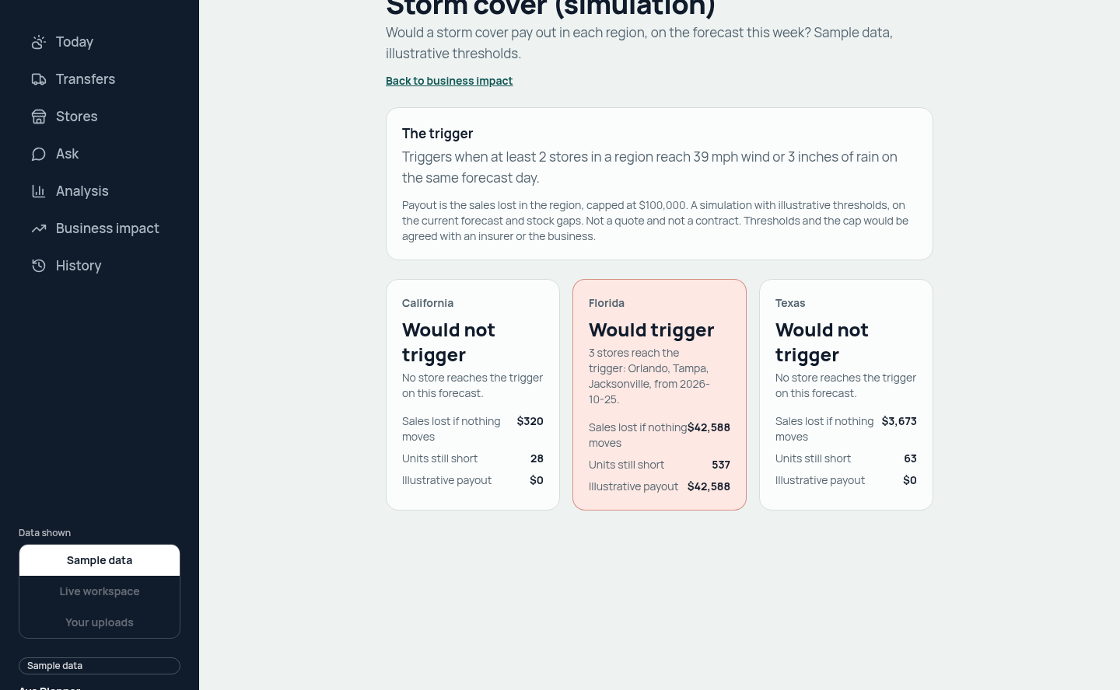
A new product idea: storm cover, simulated
Parametric cover on the same forecast
  Triggers when at least two stores in a region reach 39 mph wind or 3 inches of rain on the same day
  Payout: the region's projected lost sales, capped at $100,000
  On today's sample forecast: Florida would trigger, about $42,600; Texas and California would not
  A simulation, not a quote and not a contract. Terms would be agreed with an insurer
  Evidence tables and Delta Sharing with the insurer are the next step
Notes:
This is a concept for the pitch. The trigger and the cap are illustrative, and a real product needs an insurer.

Slide 21
How we would prove it: a pilot
Pick two or three stores and one product family in one region, for example generators in Florida.
Keep comparable stores as a control, with no change to how they plan.
Run the planner workflow for two storm seasons, or replay the storms in the backtest where possible.
Measure protected sales, stock-outs, approval rate and the time from warning to decision.
Widen only if the pilot beats the control on both sales and stock-outs.
Price the rollout on the measured result, not on the model.
Notes:
A pilot turns a model into a measurement. Say the control group out loud.

Slide 22
Technical architecture
04
One app process, a lakehouse behind it, and the browser never sees a table, a query or a credential.
Notes:
Judges score Databricks usage here. Name the services as you point at the boxes.

Slide 23
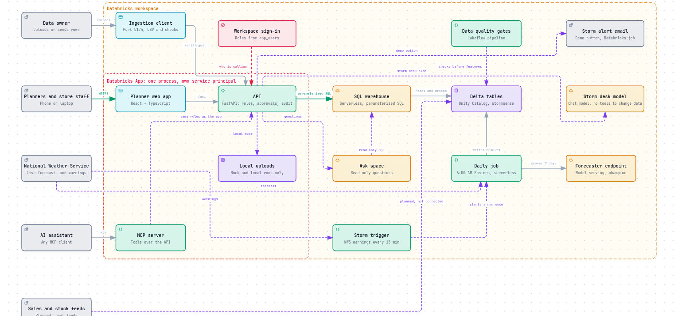
High-level architecture: the whole application on one page
Interactive version: workatustadarshajay.github.io/STORMSENSE/architecture/
Notes:
Planners reach the web app and the API through one process. The API is the only part that talks to the workspace. The daily job, the forecaster, the Ask space and the storm trigger live in the workspace. The ingestion client and the MCP server are the two other doors in.

Slide 24
The application
Web app
React 18 and TypeScript, Vite, Tailwind CSS 4
Landing page and planner screens; routes load on demand
Phone-first: Today, Transfers, Stores, Ask, History
Types generated from the API's OpenAPI contract
68 unit tests, Playwright browser tests
API
FastAPI, one process serves the web app and the API
Sign-in from the workspace; roles viewer, planner, admin
Fixed, parameterised SQL through a serverless warehouse
Guarded approvals that touch only pending rows; audit on every attempt
Sample-data mode runs the whole app with no workspace
182 backend and data tests
Integrations
Ingestion client: upload stores, products, sales and stock as CSV, Excel or JSON rows
MCP server: the plan, Ask, what-if and approvals as tools for any AI assistant, under the same rules
Databricks App definition and two Asset Bundles deploy everything from code
Documentation and architecture sites built in CI
Notes:
Three parts, one codebase. The web app never calls Databricks. The API runs as the app's own service principal.

Slide 25
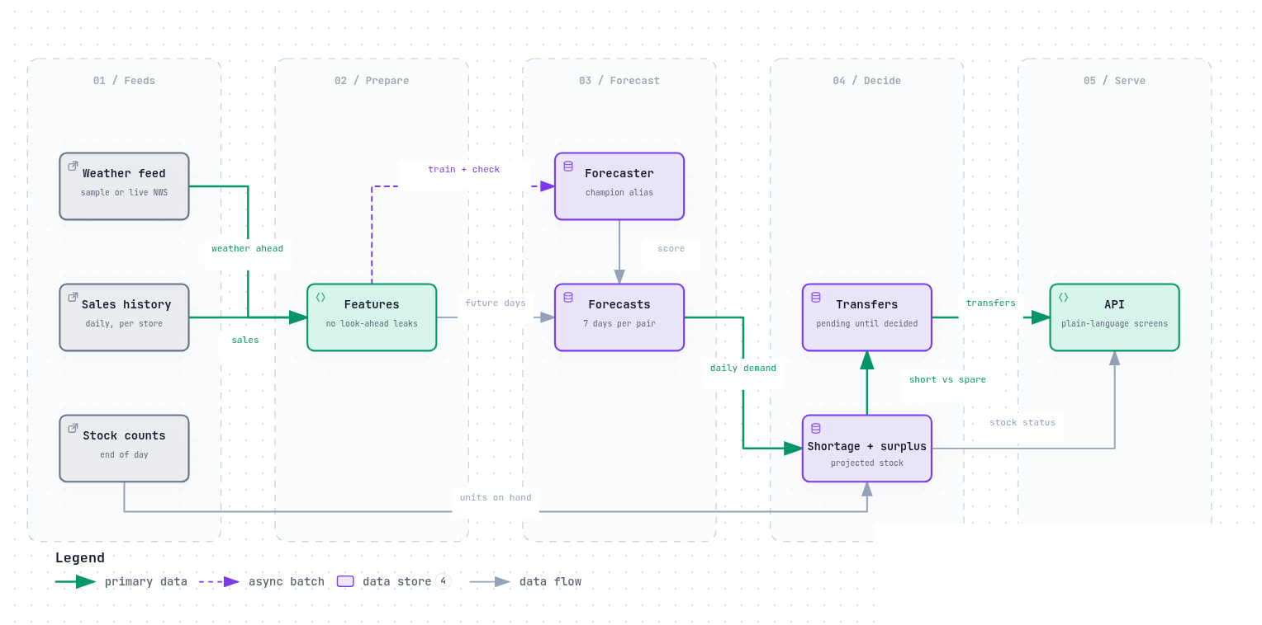
Daily data flow: from feeds to transfers
Features are lagged by the seven-day horizon, so there are no look-ahead leaks. Validation is the last four weeks, never a random split.
Notes:
Five stages: feeds, prepare, forecast, decide, serve. The forecaster is trained and checked, then scores seven days per pair. Shortage and surplus become transfers, pending until a planner decides.

Slide 26
Databricks: data and pipelines
Service | What it does in StormSense | Where
Unity Catalog | Governs the stormsense schema and the registered forecaster with its champion alias | databricks/ bundle; 04_train_register
Delta tables | About 15 tables: stores, products, sales, stock, weather, features, predictions, gaps, transfers, audit, feedback, route preferences | stormsense_core.tables
Lakeflow pipeline | Data-quality gates: constraint violations drop bad rows before features are built | pipelines/data_quality.sql
Jobs | Daily 6:00 AM cycle; build job; storm trigger every 15 minutes (paused); demo alert job | resources/jobs.yml
Serverless compute | Notebooks and the pipeline run serverless; no classic clusters | Job and pipeline definitions
Asset Bundles | Two bundles deploy data, jobs, the forecaster, the Ask space and the app from code | databricks.yml, backend/databricks.yml
Notes:
Everything is governed in Unity Catalog and created from code with Asset Bundles. Serverless compute means no clusters to manage.

Slide 27
Databricks: AI, serving and the app
Service | What it does in StormSense | Where
MLflow | Tracks each forecaster run: Poisson loss, validation window, features, metrics | /Shared/stormsense-demand-forecast
Model Serving | stormsense-forecaster (scale to zero) scores the what-if simulator; a serving chat model drives the storm desk | whatif.py, agent.py
Serverless SQL warehouse | Every planner screen reads through fixed, parameterised statements; approvals are guarded updates | dbx.py, sources/databricks.py
Genie | The Ask space answers planner questions over eight tables, read-only | StormSense Ask space
Databricks Apps | One process, own service principal, linked to the warehouse and the Ask space. Defined, not yet deployed | backend/app.yaml
AI/BI dashboard | StormSense overview: protected sales, stores at risk, forecast accuracy. Deployed, not yet visually checked | dashboards/
Databricks SDK | SQL, Genie and serving calls from the API, with retries and a warming-up state | sources/databricks.py
Not used: Agent Bricks, AutoML, classic clusters, personal access tokens.
Notes:
The forecaster lives in MLflow and Unity Catalog and is served from an endpoint. Genie powers Ask. The app is defined as a Databricks App; it is not deployed yet, so the demo runs locally against the workspace.

Slide 28
The daily job, task by task
# | Task | What it does | Guarantee
1 | Refresh weather | Ten-day National Weather Service forecast per store | Fails rather than serve stale weather
2 | Data quality | Lakeflow pipeline drops rows that break the rules | Bad rows never reach features
3 | Features | Lags, calendar and weather features per store and product | Only what was known on the day
4 | Score | Champion forecaster writes seven days per pair | Re-running a day replaces that day only
5 | Gaps | Projected stock, days of cover, first day each store runs low | Approved moves count as stock arriving or leaving
6 | Learn from feedback | Rejection reasons become route penalties | Penalties re-rank; they never add or remove moves
7 | Recommendations | Nearest-source matching proposes transfers | MERGE refreshes pending rows only
8 | Verify | Checks counts, baselines and invariants | Fails loudly
Notes:
Runs at 6:00 AM Eastern on serverless compute. Each task is safe to re-run and retries twice. A failed run emails the account that deployed it.

Slide 29
The forecaster has to earn its place
How it is trained
Gradient-boosted regression with Poisson loss (scikit-learn), already on serverless compute
Time split: the last 28 days are held out, never a random split
Lag features equal the sales exactly seven days earlier; the target is in no feature
Prediction intervals come from validation windows
Tracked in MLflow; registered in Unity Catalog with the alias champion only if it beats both baselines
Everything downstream loads by alias, never by version
Sample data. Counts per store and day are small, so part of the error is irreducible noise.
Notes:
On sample data the forecaster's weighted error is about 0.40, against 0.67 for same as last week and 0.57 for the 28-day average. It is promoted to champion only if it beats both.

Slide 30
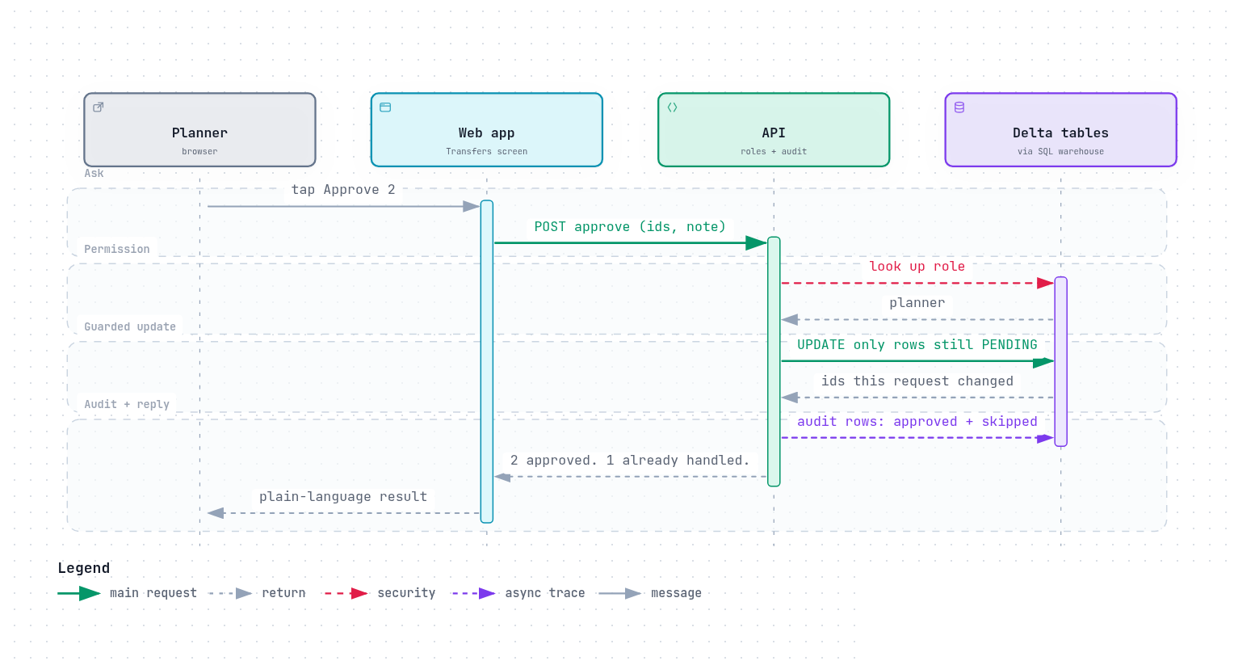
Approving a transfer: safe by construction
Notes:
The API looks up the role, updates only rows still pending, stamps the request id, and writes audit rows for both the approved and the skipped. A second planner is told already handled.

Slide 31
Security model
Sign-in: Databricks Apps signs people in with their workspace account; roles viewer, planner and admin live in the app_users table.
Service principal: the app runs as its own principal with read access to the tables and write access only to transfers and the audit trail.
SQL: every statement is a constant string with bound parameters; a static test fails the build if request data ever reaches SQL text.
Approvals: UPDATE only rows still PENDING, stamped with the request id, so repeats are reported, never applied twice.
Browser: strict content security policy, no framing, same-origin only, a custom header on every change, request size limit, rate limit on Ask.
Uploads are off unless switched on; the Ask space and the storm desk can only read, and nothing they return is executed.
Notes:
The short version for a security reviewer: the browser never sees a credential, a table name or a query.

Slide 32
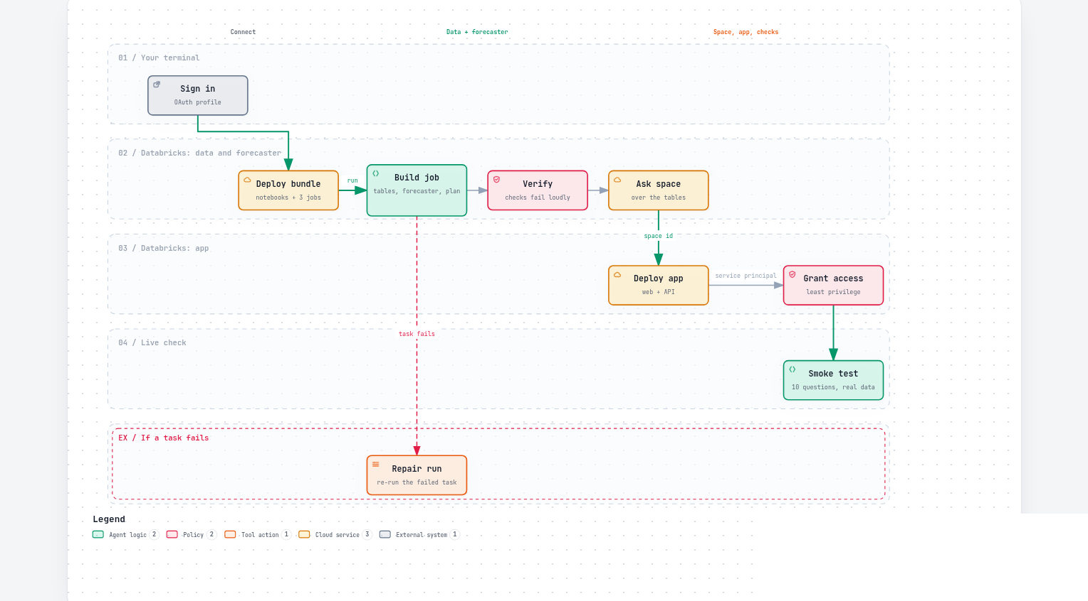
Deployed from code, end to end
make deploy runs the whole path. The Databricks App step is defined and ready; it has not been run in production yet.
Notes:
Sign in, deploy the data bundle, run the build job, verify, create the Ask space, deploy the app, grant least privilege, smoke test with ten questions on real data. Nothing is assembled by hand in the workspace.

Slide 33
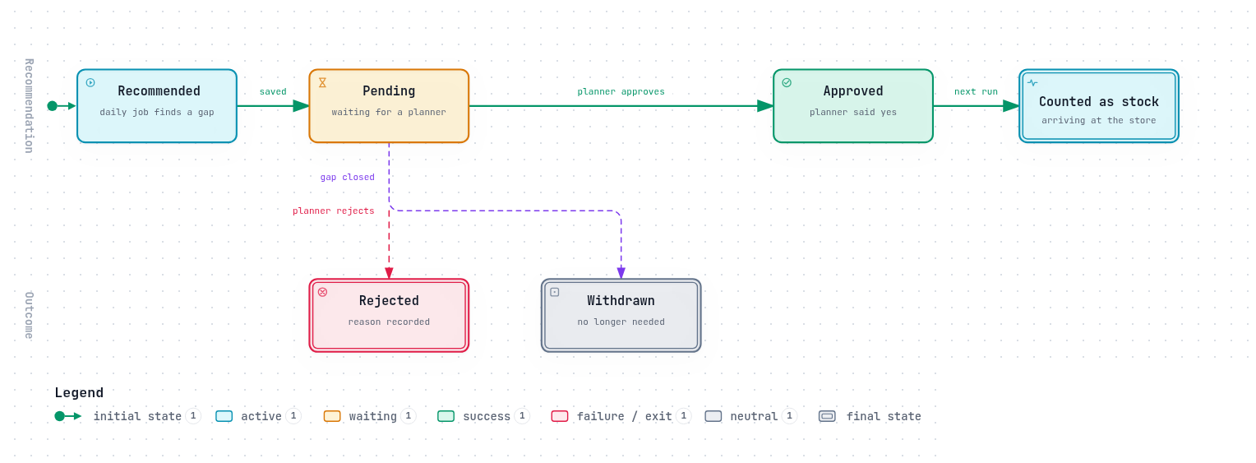
Transfer lifecycle: only pending can change
Notes:
A recommendation is saved as pending and ends approved, rejected or withdrawn. Decided rows are never overwritten by the next run.

Slide 34
Demo and proof
05
Five screens in three minutes, on sample data. Then the tests that back it.
Notes:
Switch to the browser. The app is open on /today with the Sample data label visible.

Slide 35
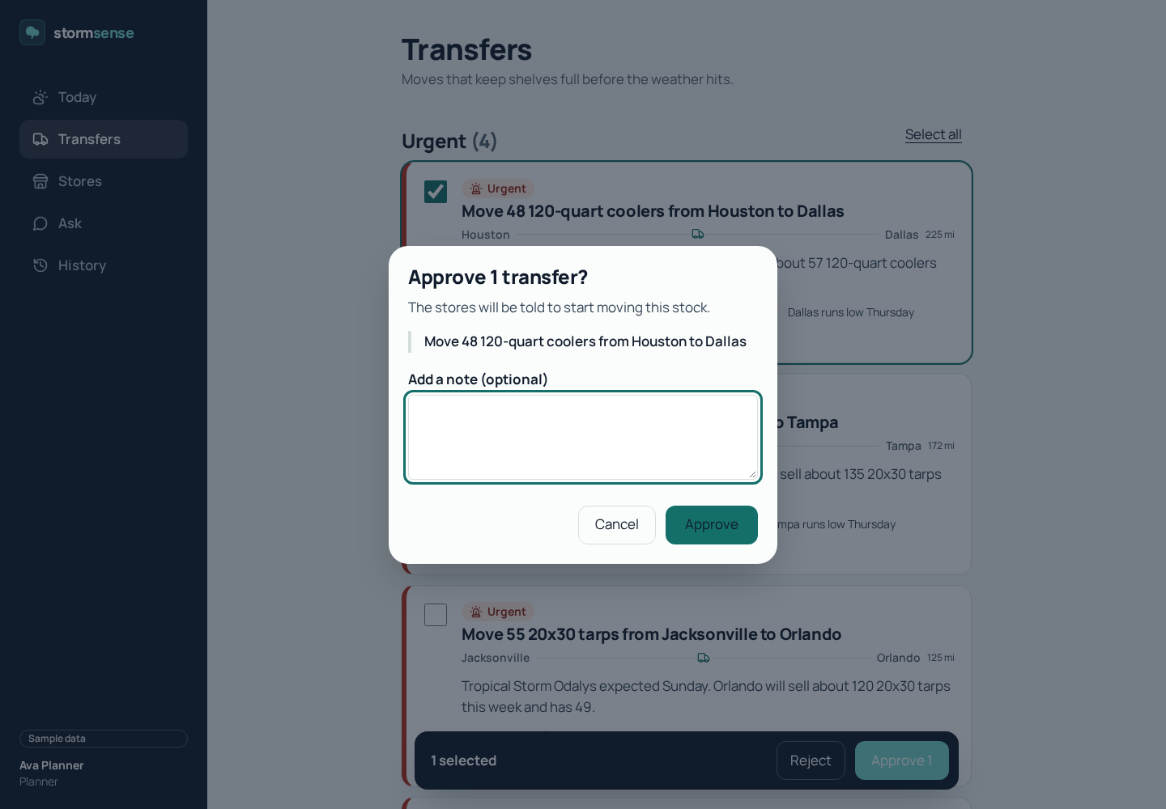
Demo flow: three minutes, on sample data
1. Today: urgent moves, stores running low, the next alert, and what changed since the last visit.
2. Transfers: read one reason aloud, approve the first two urgent moves. See the safety orders if demand runs high.
3. Stores: Orlando's generators run low on Thursday. Switch the best-seller view from heat to wind.
4. Ask: "Which stores will run out of generators this week?" One sentence, one table, read-only.
5. History: who approved what, when. A second window tries the same approval: already handled by someone else.
Notes:
Run from make dev-sample. Approvals reset when the sample server restarts.

Slide 36
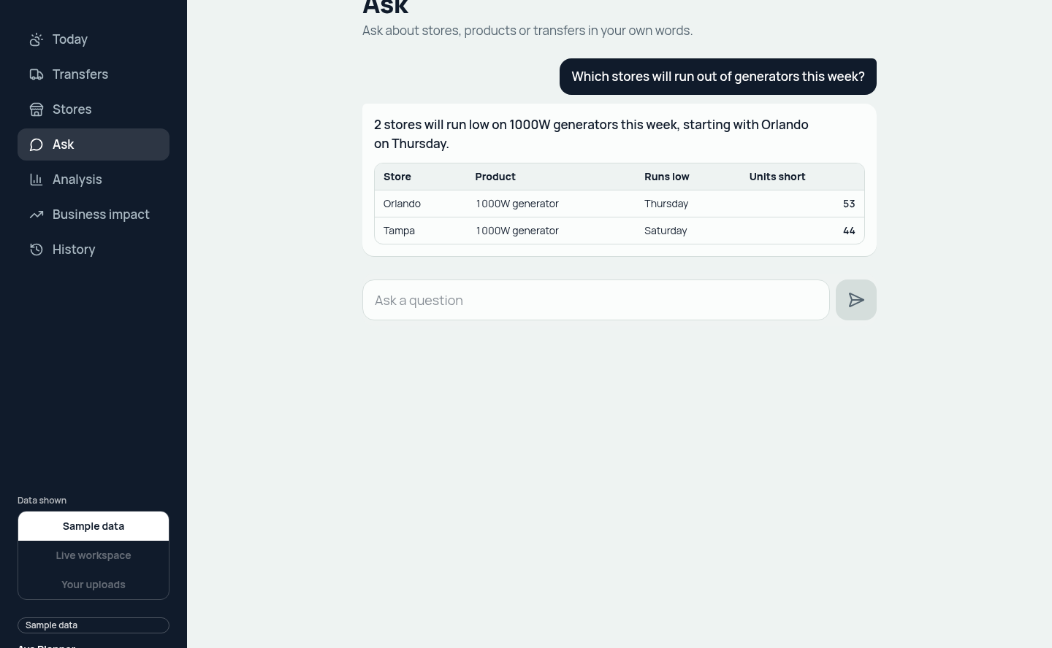
Ask: plain words in, one sentence out
Read-only questions
  Suggested questions, or type your own
  The answer is one plain sentence; the detail is in a small table
  SQL is never shown, and nothing Ask returns is executed
  Rate-limited per person; technical words are removed from answers
Notes:
Ask runs a live Genie query. It answered all ten sample questions correctly on the workspace data, and it cannot change anything.

Slide 37
Proof: tests, checks and continuous integration
Automated tests
  182 backend and data tests pass (pytest)
  68 frontend unit tests pass (Vitest); typecheck and lint clean
  Browser tests (Playwright) run in CI against the built app, including accessibility checks
  Contract check: generated types, sample data and the data dictionary must match the code
What the tests prove
  Generators sell 3x or more on storm days; coolers 1.3x or more on hot days
  Time split by date; lag-7 equals sales seven days earlier; the target is in no feature
  The forecaster beats both baselines; at least five pending recommendations
  No request data ever reaches SQL text; banned technical words never reach the UI
  Approvals change only pending rows; a repeat is harmless; a viewer cannot approve
Notes:
Numbers come from running the suites in the repository on the day of writing.

Slide 38
Status: what runs today, and what is next to switch on
Running in the workspace
  About 15 Delta tables in Unity Catalog, built by serverless notebooks
  Forecaster registered as champion, beating both baselines
  Daily job at 6:00 AM Eastern with live National Weather Service weather
  The Ask space, created from code over eight tables
  The app, run locally, reading and writing the workspace with an audit trail
Defined, not yet switched on
  Hosting as a Databricks App: ready, deploys with one command, not yet run in production
  Real sales, stock and weather feeds in place of the sample tables
  The storm trigger job, built and paused
  AI/BI dashboard, deployed but not yet checked visually
  Forecast monitoring and row-level security
Notes:
Be exact. Running means it has run green in the workspace.

Slide 39
Roadmap and the ask
06
What comes next on Databricks, the risks we state openly, and the one thing we ask for.
Notes:
Three columns of roadmap, the limits, then the ask. Keep the ask to one sentence.

Slide 40
Roadmap
Next 30 days
Deploy the Databricks App
Lakehouse Monitoring on forecast drift and error
System tables for cost and access
Row-level security: planners see their own region
Publish the AI/BI dashboard
Next quarter
Store-manager assistant with Agent Bricks and Vector Search over storm procedures
Markdown price optimisation with a controlled experiment
Best sellers and what comes next, per weather
Auto Loader for store feeds
Pilot in two or three stores against a control
Later
Lakebase for approvals and the audit trail
Delta Sharing with an insurer for storm cover evidence
Streaming warnings instead of a 15-minute schedule
Supplier replenishment drafts
Thousands of stores: move driver-side pandas to Spark
Notes:
Each item names the Databricks feature it uses. The first column is configuration and a notebook each.

Slide 41
Risks and limits we state openly
Sample data throughout: real sales, stock and weather feeds are not connected yet.
Protected sales are gross revenue, not profit; the 30% margin is a default until stores set their own.
The backtest is an upper bound and ignores pack sizes and truck limits.
Forecast error is about 0.40 on sample data; counts per store and day are small, so noise remains.
On the live workspace, the first query can wait minutes while the SQL warehouse starts.
Upload routes have no sign-in; they are off unless STORMSENSE_INGEST_ENABLED=1.
The Databricks App is defined but not deployed; the demo runs locally against the workspace.
Notes:
Naming the limits first is the strongest answer to hard questions.

Slide 42
Stock is already in the network. StormSense moves it to where it sells.
Our ask: test one option, in one region, this season, against control stores.
We will come back with a measurement, not a model.
Notes:
End where you started: the Thursday store. Then the ask. Stop talking after thank you.

Slide 43
Thank you
Notes:
Open for questions.

Slide 44
Together, we build for boundless impact
Together, we build for
boundless impact
Notes:
Template closing slide.

Slide 45

Copyright and confidentiality notice
Copyright © 2026 by UST Global Inc. All rights reserved.
This document is protected under the copyright laws of United States, India, and other countries as an unpublished work and contains information that shall
not be reproduced, published, used in the preparation of derivative works, and/or distributed, in whole or in part, by the recipient for any purpose other than to evaluate this document. Further, all information contained herein is proprietary and confidential to UST Global Inc and may not be disclosed to any third party.
Exceptions to this notice are permitted only with the express, written permission of UST Global Inc.
UST® is a registered service mark of UST Global Inc.
UST
5 Polaris Way
Aliso Viejo, CA 92656
T +1 949 716 8757
F +1 949 716 8396
ust.com
Notes:
Template copyright and confidentiality notice. Keep it as the last slide.

