Slide 1

StormSense
Storm-ready stock transfers for store planners
Adarsh Ajay | October 2026
Notes:
OPENING (about 40 seconds, say it slowly):
Picture a store on a Thursday. The storm is due on Sunday. The generators are sitting in Tampa, and Orlando has already sold out of them. Nobody saw it coming in time. By the time someone noticed, the customers had driven to the competitor down the road.
In our sample history, stores like this lose real money, and most of it is not because the storm was unpredictable. It is because the right stock was in the wrong place, and nobody knew until it was too late.
So I asked a simple question: what if we had a Doraemon gadget? One that tells you, a week ahead, which store will run out, and moves the right stock there before the rain starts. Today I will show you that the gadget is built, that it runs on the data we have, and what it is worth.

Slide 2
Agenda
01
Context and the problem
04
Profit: the gap and the levers
02
Our solution
05
Options to earn more
03
Architecture
06
Demo, results and next ideas
Notes:
Six parts, about 30 seconds. Say the problem first, then the solution, then the architecture, then the money, then the options, then what we are asking for. Keep the demo and the honest limits, because a room trusts a speaker who names the limits.

Slide 3
Why storms hurt profit, and what changes
Step | Typical manual process | With StormSense
Spot shortages | Read spreadsheets per store, after the warning | Forecast each store and product for seven days, every morning
Find stock to move | Ask around between stores | Nearest store with spare stock, inside the distance limit
Decide | Gut feel, approvals by email | Each move shows its reason, the sales it protects and the forecast confidence
Record | Notes scattered across people | Audit trail: who, what and when; repeat attempts are refused
Timing | Hours before the storm, if at all | Ready for the planner from the 6:00 AM run, when the job is live
In our sample history, five past storms lost about $302,000 of sales; more than half of it in one hurricane.
Notes:
THE PROBLEM (about 60 seconds):
Here is the typical process. Someone reads a spreadsheet after the warning has arrived. They phone a neighbouring store to ask for stock. The decision is made on instinct. Nothing is recorded properly.
In our sample history, five past events lost about $302,000 of sales because the stock was not where the customers were. More than half of that is one hurricane. Make the point that this is not a forecasting problem alone; it is a timing and a movement problem.
Close the slide with the Thursday story: the Orlando generators run out on Thursday, before a Sunday storm. That is the gap.

Slide 4
The idea in three steps
1. Predict
Forecast each store's demand for the next seven days, from the weather coming and the sales history.
2. Move
Find stores that will run short and nearby stores with spare stock, and propose transfers before the storm.
3. Decide
A planner reviews every move, with its reason and the sales it protects. Every decision is recorded.
Notes:
THE GADGET (about 60 seconds):
Three steps, and the audience should be able to repeat them. Predict: forecast every store and product for the next seven days, using the weather coming and the sales history. Move: find the stores that will run short, and the nearby stores with spare stock, and propose the transfer before the storm. Decide: a planner reviews every move, with the reason, the sales it protects and how sure we are, and approves or rejects it.
The gadget does the arithmetic. The person stays in control. That is the line I want them to remember.

Slide 5
Four parts, one daily loop
Weather in
National Weather Service forecast, ten days per store
Storm warnings checked every 15 minutes
Forecast and gaps
Forecaster loaded by the alias champion
Promoted only if it beats two simple baselines
Projected stock and days of cover show the gaps
Transfer moves
Nearest source with spare stock
Pack sizes and distance limits respected
Only pending moves are refreshed; decided moves are kept
Planner decides
Approve or reject, with the reason shown
Every decision and repeat attempt is audited
Ask is read-only; an AI assistant acts under the same rules
Notes:
HOW IT RUNS (about 30 seconds):
Four parts, one loop. Weather comes in every morning. The forecast and the gaps come out. Moves are proposed from the nearest store with spare stock. A planner decides, and every decision is recorded.
Say it in one breath, then move on to the screens.

Slide 6
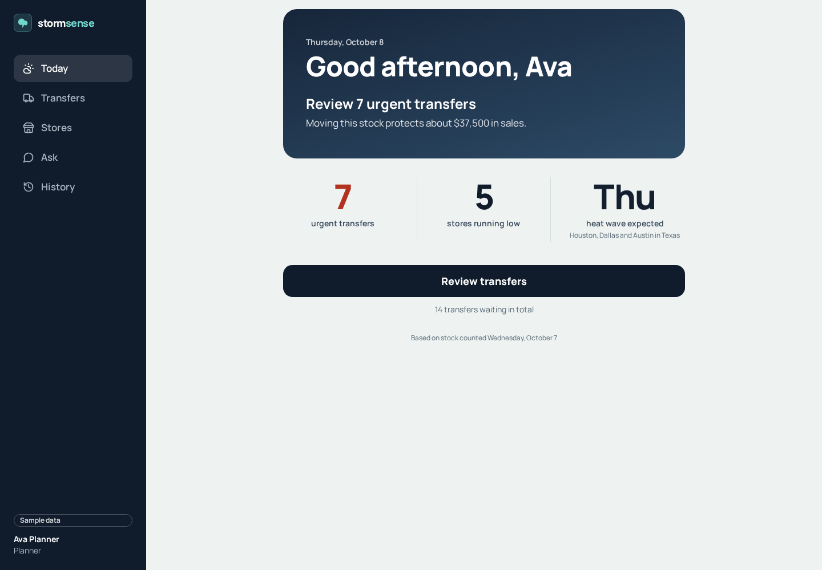
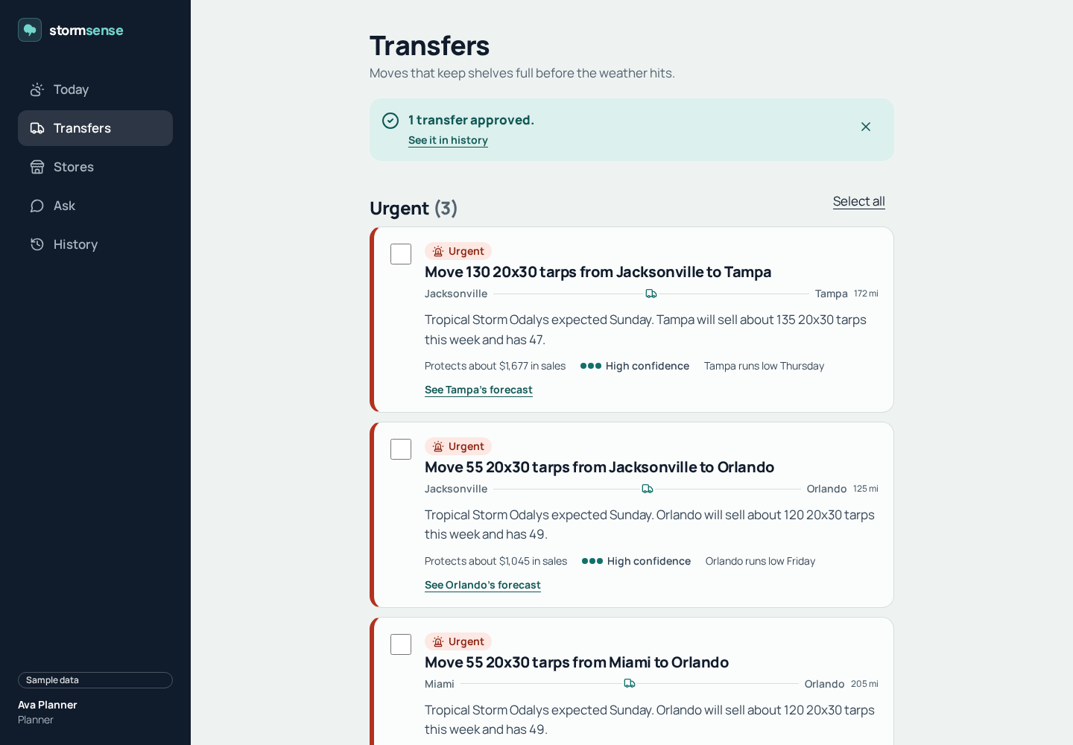
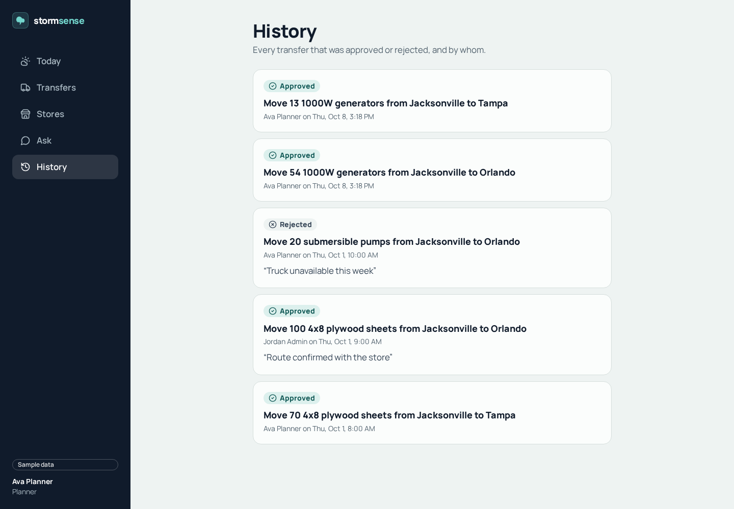
The app at a glance
Today: the morning view
Transfers: approve or reject moves
History: who decided and when
Notes:
THE APP (about 40 seconds):
This is what a planner sees. Today shows the urgent moves and the next weather alert. Transfers shows each move as a sentence, with the reason and the sales it protects. History shows who approved what, and when. Say that these are sample numbers, and point to the sample label in the header.

Slide 7
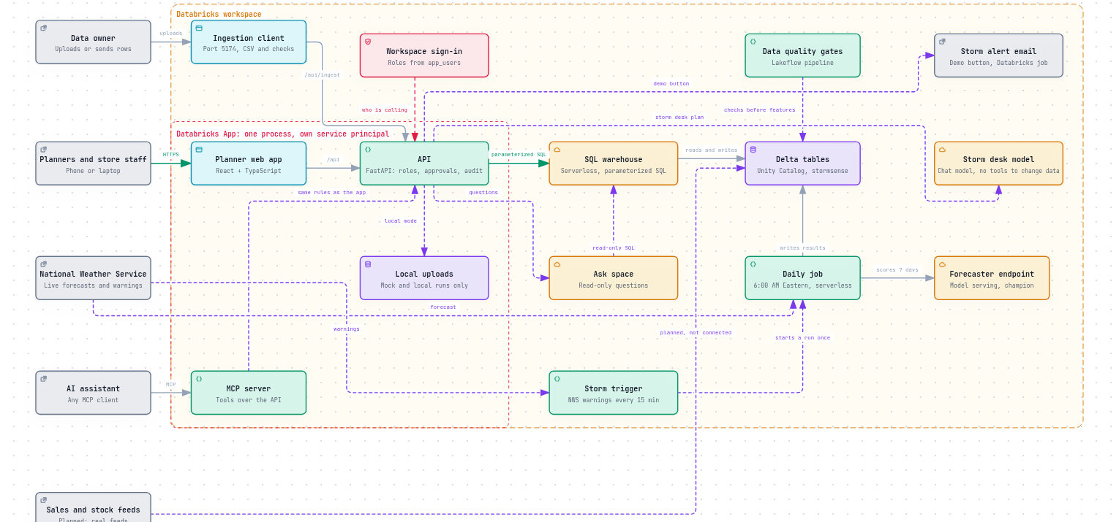
High-level architecture
Notes:
ARCHITECTURE (about 40 seconds):
The whole application on one page. Planners reach the web app and the API through one process. The API is the only part that talks to the workspace, so the browser never sees a table, a query or a password. The forecast runs in the Databricks workspace every morning.
Technical listeners will ask about this slide. Have the interactive version open on the architecture site.

Slide 8
The daily job, task by task
Step | Task | What it does
1 | Refresh weather | Ten-day forecast per store from the National Weather Service; fails rather than serve stale weather
2 | Data quality | Lakeflow checks before any features are built
3 | Features | Builds features from weather, sales and stock, using only what was known on the day
4 | Score | Forecasts seven days per store and product with the champion forecaster
5 | Gaps | Projected stock, days of cover and the first day each store runs low
6 | Learn from feedback | Uses planner decisions
7 | Recommendations | Nearest-source matching; refreshes pending moves only, never decided ones
8 | Verify | Fails loudly if anything is wrong
Notes:
THE DAILY JOB (about 30 seconds):
Every morning at 6:00 Eastern, eight tasks run in order: weather, data quality, features, forecast, gaps, feedback, recommendations, verification. If one fails, it fails loudly and tells the deploying account. Nothing is quietly wrong.

Slide 9
Security and safety
Sign-in with the workspace account; roles come from the app_users table
The app runs as its own service principal: read access to the tables, write access only to recommendations and the audit trail
Every SQL statement is a constant with bound parameters; a test fails if request data ever enters SQL text
Approvals update only rows still pending, and stamp the request id so repeats are reported, not applied twice
Browser: strict content security policy, no framing, same-origin requests, a custom header on every change, a request size limit and a rate limit on Ask
Ask returns one sentence and a table; nothing it returns is executed
Notes:
SECURITY (about 30 seconds):
The short version for a security reviewer. People sign in with their workspace account. The app runs as its own service principal. Every query is fixed, with bound parameters, and a test fails the build if user input ever reaches SQL text. Approvals update only pending rows, and every attempt is audited.

Slide 10
Lost sales in past storms, against what moves could protect
Sample data. Backtest replays five past events with what really sold, so it is an upper bound.
Notes:
THE GAP (about 60 seconds):
This chart is the heart of the case. Each pair of bars is one storm. The first bar is what we lost in sales if nothing had moved. The second is what the planned moves could have protected.
Be honest: the protected bar is an upper bound, because the backtest uses what really sold. Even so, the gap is large. Hurricane Marlow alone lost about $171,000 in the sample history. Ask the room to look at that gap, not at the protected bars.

Slide 11
Past storms: the numbers
Event | Dates | Stores | Sales lost if nothing moved | Protected by moves | Share protected
Hurricane Marlow | 14-18 Sep 2026 | 4 | $171,310 | $2,658 | 1.6%
Severe Storm Delta | 17-19 Apr 2026 | 3 | $46,887 | $335 | 0.7%
Atmospheric River Kestrel | 9-12 Jan 2026 | 3 | $42,409 | $0 | 0.0%
Tropical Storm Ines | 24-26 Aug 2026 | 3 | $34,351 | $7,095 | 20.7%
Heat Dome Ridge | 6-10 Jul 2026 | 3 | $7,197 | $2,049 | 28.5%
Total |  |  | $302,154 | $12,137 | 4.0%
Sample data. Lost sales = units sold beyond the stock on hand at the start of the event, times price. Protection = moves from the nearest store with spare stock, within the distance limit.
Notes:
THE NUMBERS (about 30 seconds):
Read the total row first. About $302,000 lost; about 4% protected by the method as it stands. That is the profit we have not yet captured, and the options on the next slides go after it. Heat events show the highest share protected, about 28 percent, which is a clue for where to start.

Slide 12
What the current plan is worth
$50,180
Protected sales: gross revenue, not profit
$15,054
Margin: on protected sales at 30%
-$6,460
Trucking: $2.50 a mile, one trip a move
$8,594
Net: margin less trucking
584 kg
CO2 for moves: about 0.9 kg per loaded truck-mile
Sample data. Protected sales are gross revenue, not profit, and use the forecast. Margin is 30% unless a store sets its own. Trucking is $2.50 a mile, one truck trip per move. CO2 is about 0.9 kg per loaded truck-mile.
Notes:
THE ECONOMICS (about 45 seconds):
On the current sample plan, the protected sales are about $50,000 in revenue. After a 30 percent margin and the trucking cost, the net is about $8,600. Say it plainly: net, not gross. Read the footnote: margin and trucking are assumptions, and a store can set its own margin. Net moves with the margin, so the assumption matters.

Slide 13
Options compared
Option | Evidence today (sample data) | Effort | Status
1. Consolidate truck loads | $2,000 across 7 routes; 14 trips become 9 | Low | Built, visible on Loads page
2. Mark down slow stock | About $260 on one suggested markdown | Low | Built, awaiting decisions
3. Move on the warning | Trigger built; effect not yet measured | Low to switch on | Built, paused
4. Protect more lost sales | Backtest protects 4% as an upper bound | Medium | Idea: pack and truck limits, wider sourcing
5. Learn from decisions | Feedback step runs in the daily job | Low | Built; effect not yet measured
6. Add stores and products | 10 stores and 5 products in the sample | Depends on real feeds | Planned
Notes:
THE OPTIONS (about 45 seconds):
Six options. Options one and two can start this quarter, with the trucks and the stock we already have. Option three needs a pilot. Option four needs more modelling. Option six waits for real feeds. Say which one you would start with, and why.

Slide 14
Options 1 and 2: truck loads and markdowns
Option 1, consolidate loads: 14 planned trips could become 9 by sharing trucks on a route
Saving about $2,000 across 7 routes and about 720 kg of CO2 (sample data)
Example: Jacksonville to Tampa, 172 miles. Four trips become two, saving 2 x 172 x $2.50 = $860. A truck carries 200 units
Built and visible on the Loads page; planners choose which loads to combine
Option 2, markdowns: flag surplus that would not sell in time at full price
Example: Los Angeles, 30 spare 1000W generators at $499. A 10% markdown to $449.10 is estimated to sell all of them in 14 days, about $260 more than holding them
The 15% lift per 10% off is an assumption, so the app says to test it on a pilot first. Built; one suggestion awaits a decision
Notes:
OPTIONS ONE AND TWO (about 60 seconds):
Option one is the least risky profit lever. Our plan has 14 trips that could become 9 by sharing trucks on the same route. That saves about $2,000 across seven routes, and it reuses trucks we already pay for.
Option two is markdowns. Los Angeles has 30 spare generators. A 10 percent markdown is estimated to clear them in 14 days, about $260 more than holding them. The lift is an assumption, so the app asks for a pilot before a rollout. Be clear about that.

Slide 15
Option 3, and how to test any option safely
Option 3, move on the warning: a storm trigger checks National Weather Service warnings every 15 minutes for Florida, Texas and California, and starts one extra run when a warning changes the plan
Built and paused by default. Its effect on live data is not measured yet, and moves would rest on a warning, not the full forecast
Testing safely: pick two or three stores and one product family in one region, and keep comparable stores as a control
Run it for two storm seasons, or the backtest storms. Widen only if the pilot beats the control on sales and stock-outs
Notes:
OPTION THREE AND THE PILOT (about 60 seconds):
Option three starts moves on a National Weather Service warning, not the forecast alone. It is built and paused. It has the biggest upside and the least evidence, so say that plainly.
The way to test any option: pick two or three stores in one region, keep comparable stores as a control, run it for two storm seasons, and widen only if the pilot beats the control on sales and stock-outs. That is how we turn a model into a measurement.

Slide 16
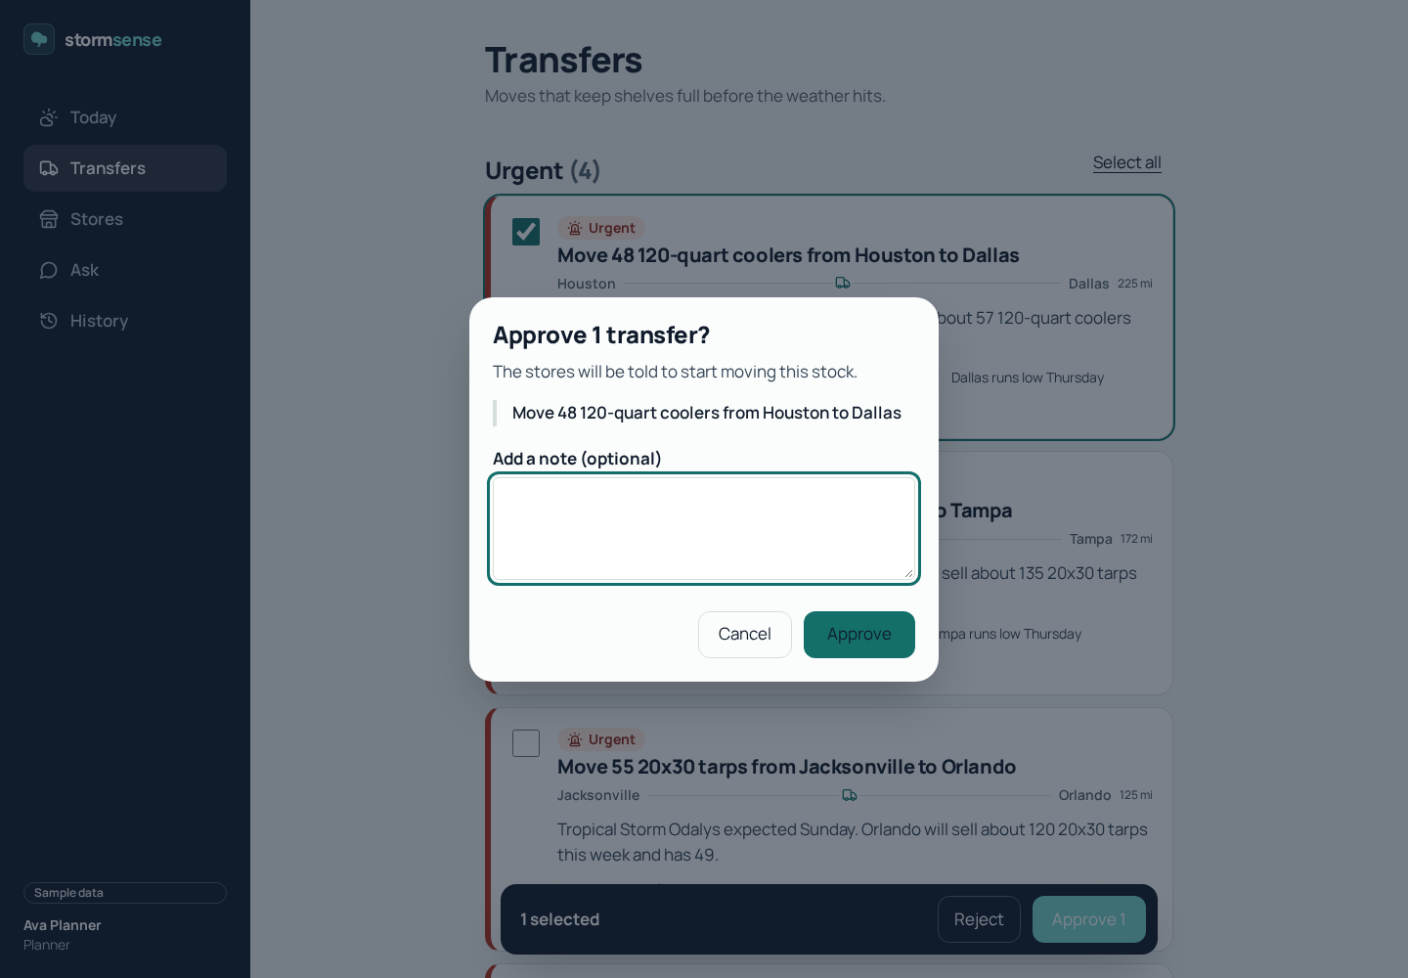
Demo flow: about five minutes, on sample data
1. Today: the morning view, with urgent transfers, stores running low and the next weather alert.
2. Transfers: approve the first two urgent moves and read the reason behind one of them.
3. Stores: Orlando's generators run low on Thursday, before the storm.
4. Ask: "Which stores will run out of generators this week?" A sentence and a small table.
5. History: the approvals, by whom and when. A repeat approval is refused: "already handled by someone else".
Notes:
LIVE DEMO (about 3 minutes):
Run it from make dev-sample. Follow the five steps on the slide. Start with the Thursday story: Today shows the urgent moves. Approve the first two. Open Stores and point to the Thursday run-low. Ask the question out loud, and read the answer. Then open History and try a second approval: the app says the move was already handled.
If anything goes wrong, say what you would show next, and move on. The slide has the backup.

Slide 17
Test results
172 of 172 backend and data tests pass (pytest)
57 of 57 frontend unit tests pass (Vitest)
Forecaster: about 0.4 weighted error on sample data, against 0.67 for same-as-last-week and 0.57 for the 28-day average
Tests check the rules: approvals change only pending rows, SQL parameters are bound, and the forecaster is promoted only when it beats both baselines
Browser tests (Playwright) run in CI against the built app
Notes:
TEST RESULTS (about 30 seconds):
172 backend and data tests pass. 57 frontend tests pass. The forecaster is about 0.4 weighted error on sample data, against 0.67 for last week's sales and 0.57 for the 28-day average. Say that the tests check the rules too: only pending moves change, and the forecaster is promoted only if it beats both baselines.

Slide 18
More ideas to grow profit (not built yet)
Heat planning: heat events protected the largest share in the backtest (about 28%); build a heat playbook for coolers and pumps
Regional pre-storm buying: flag products that will run short across a whole region and suggest one extra order
Store-level margin and markdown settings, instead of one 30% default
Pack sizes and truck limits in the backtest, so the upper bound becomes a realistic target
Auto-approve small, low-risk moves under a limit, with a planner review of each one
Carbon-aware routing: combine loads and shorter routes, using the CO2 already calculated per move
A store-manager view of Ask on live data, read-only, so the people on the shelves see the same numbers
Notes:
MORE IDEAS (about 45 seconds):
Ideas, and I want to be clear that none of these are built. Heat planning first, because heat events showed the highest share protected. Regional pre-storm buying, which would flag products that run short across a whole region. Store-level margins. Realistic pack and truck limits in the backtest. Auto-approval of small, low-risk moves with a review. Ask this room which two they would fund.

Slide 19
Risks and limits we are honest about
Sample data throughout: real sales, stock and weather feeds are not connected yet
Protected sales are gross revenue, not profit; the 30% margin is a default until stores set their own
The backtest is an upper bound and ignores pack sizes and truck limits
Forecast error is about 0.4 on sample data; counts per store and day are small, so noise remains
On the live workspace, the first query can wait minutes while the SQL warehouse starts
Upload routes have no sign-in; they are off unless STORMSENSE_INGEST_ENABLED=1
The Databricks App is defined but not deployed; the demo runs locally against the workspace
Notes:
RISKS (about 40 seconds):
Name the limits before someone else does. Sample data throughout; real feeds are not connected. Gross revenue is not profit. The backtest is an upper bound. Forecast error is about 0.4 on sample data. The live warehouse can take minutes to wake up. Upload routes have no sign-in and are off by default. The Databricks App is defined but not deployed; the demo runs locally against the workspace.
Saying these first earns the trust for the rest of the talk.

Slide 20
Thank you
Notes:
CLOSE (about 40 seconds):
Go back to the Thursday. The generators run out in Orlando, the storm is on Sunday, and nobody knew until it was too late. StormSense is the gadget that tells you a week ahead, moves the stock before the rain starts, and keeps the planner in charge.
The ask: give us the chance to test one option in one region this season. We will come back with a measurement, not a model. Thank you. Open for questions.

