Slide 1
PROBLEM STATEMENT
Right BIS standard, faster
Submission team
ByteMe
Reliable product-to-standard mapping for MSE workflows.
Devansh Verma, Team Leader
Jahnavi Srivastava
Manual discovery is slow
Teams must search dense SP 21 summaries before they know which standard applies.
Target experience
Part numbers matter
Product description
Similar products can map to different IS parts, revisions, and years.
Top 3-5 BIS standards with traceable rationale
Wrong standards are costly
Incorrect or hallucinated codes can derail testing, certification, and documentation.
ByteMe | BIS Standards Recommendation Engine
1/8

Slide 2
SOLUTION OVERVIEW
A deterministic RAG-style engine for BIS standard discovery
The scoring path is retrieval-first: every returned standard comes from the official parsed SP 21 dataset.
1
2
3
4
Parse
Index
Retrieve
Return
Extract standard IDs, titles, scopes, summaries, and source pages from dataset.pdf.
Create a compact JSON index of 574 official standards for offline search.
Combine BM25 lexical scoring with field-aware boosts and deterministic reranking.
Write the judge-required JSON: id, retrieved_standards, latency_seconds.
Why this is submission-safe
No external APIs, no hidden keys, no generated standard IDs, and no dependency on the UI for automated scoring.
ByteMe | BIS Standards Recommendation Engine
2/8

Slide 3
SYSTEM ARCHITECTURE
One offline pipeline powers the CLI and the demo UI
dataset.pdf
->
build_index.py
->
standards.json
->
retriever.py
->
inference.py
BIS SP 21 source
PDF parser
574 indexed records
Hybrid scorer
Judge entrypoint
Required judge command
python inference.py --input hidden_private_dataset.json --output team_results.json
Offline
Fast
Traceable
Runs locally
Under target latency
Source-grounded
Standard hardware; no cloud model required.
Public average below 0.1 seconds/query.
Recommendations link back to SP 21 records.
ByteMe | BIS Standards Recommendation Engine
3/8

Slide 4
CHUNKING & RETRIEVAL STRATEGY
Standards are treated as first-class records, not arbitrary page chunks
Record-level chunks
BM25 lexical core
Each chunk contains one canonical IS code, title, scope, summary, and page references.
Exact product names, material families, grades, and part numbers remain high-signal.
Field-aware boosts
Hallucination guardrail
Titles, standard IDs, product phrases, grade numbers, and cement types get targeted weighting.
The output list is selected only from parsed SP 21 IDs; new IS codes cannot be invented.
Retrieval formula
BM25 score + title coverage + exact ID/number match + product phrase boosts + grade/part reranking
ByteMe | BIS Standards Recommendation Engine
4/8

Slide 5
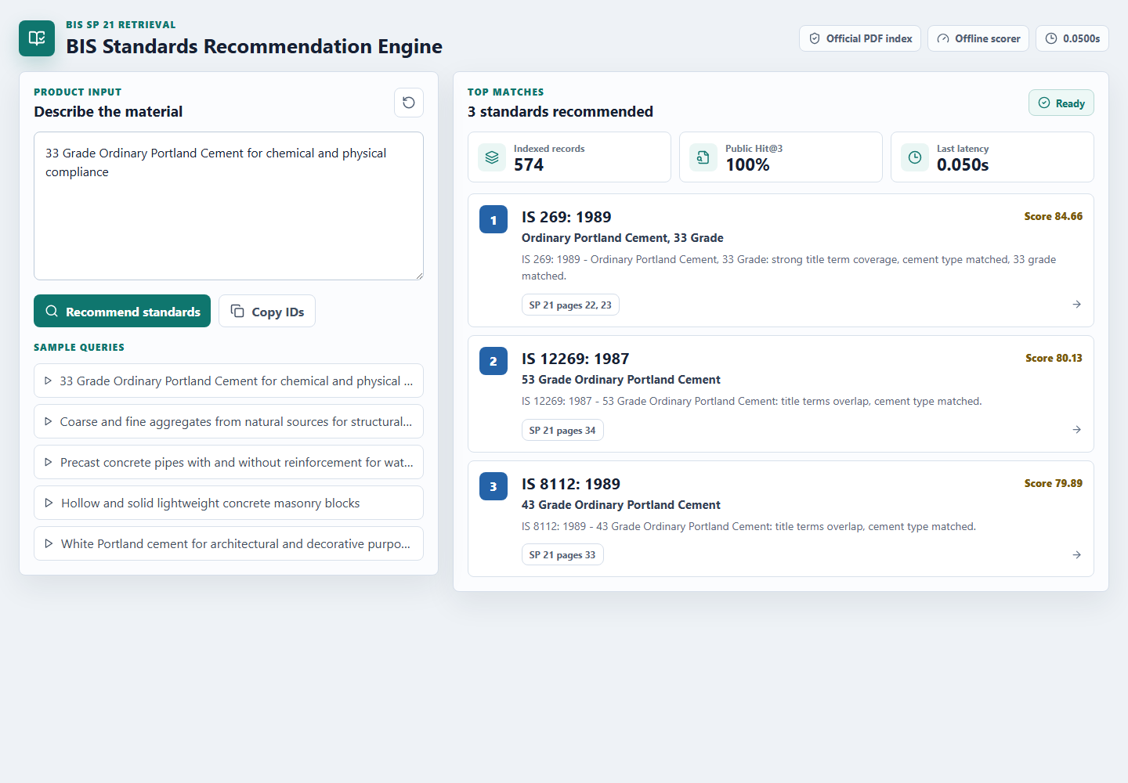
DEMO HIGHLIGHTS
React demo UI for BIS recommendations
A polished recommender experience sits on top of the same judge-safe API.
Search by product language
Queries can be natural descriptions, not exact BIS titles.
Inspect ranked standards
Each result shows IS code, title, score, rationale, and source pages.
Copy IDs for workflow
Shortlisted standards can be copied directly for documentation.
ByteMe | BIS Standards Recommendation Engine
5/8

Slide 6
EVALUATION RESULTS
Public test metrics exceed all automated targets
Organizer public-set evaluation with eval_script.py.
100%
1.0000
0.08s
Hit Rate @3
MRR @5
Avg latency
Target: >80%
Target: >0.7
Target: <5 seconds
Public-set run command
python inference.py --input data/public/public_test_set.json --output data/public/team_results.json
python eval_script.py --results data/public/team_results.json
Hidden test performance depends on the private query mix; the scoring path is deterministic, offline, and reproducible.
ByteMe | BIS Standards Recommendation Engine
6/8

Slide 7
IMPACT ON MSES
Compliance discovery becomes guided search in seconds
What improves
Speed
Immediate shortlist for planning, testing, and documentation.
Trust
The product shortens the path from product idea to applicable standard shortlist.
Every recommendation is grounded in SP 21 records and page references.
Reproducibility
The same repo runs locally with one judge command.
574
0
Standards indexed
Fake IDs
Parsed from SP 21
Only official parsed codes returned
1
3-5
Command
Recommendations
Judge-compatible inference.py
Ranked per query
ByteMe | BIS Standards Recommendation Engine
7/8

Slide 8
TEAM, DEPLOYMENT & LINKS
ByteMe
Live project links
Deployed demo
Built for the Bureau of Indian Standards x Sigma Squad AI Hackathon.
https://huggingface.co/spaces/devanshverma/bis-standards-recommendation-engine
GitHub repository
https://github.com/workbydevansh/bis-standards-recommendation-engine
Devansh Verma
Team Leader
Repository includes
Jahnavi Srivastava
inference.py, eval_script.py, src/, data/, React frontend, README, Dockerfile, and this 8-slide deck.
Team Member
Acknowledgement: BIS SP 21 dataset and organizer-provided public test/evaluation assets.
Deployment status
Live demo and source repository links are ready for submission.
Prepared for Hugging Face Docker Space deployment.
ByteMe | BIS Standards Recommendation Engine
8/8

